Slide 1
Class 20: Introduction to the Protozoa and Protozoa 1

Slide 2
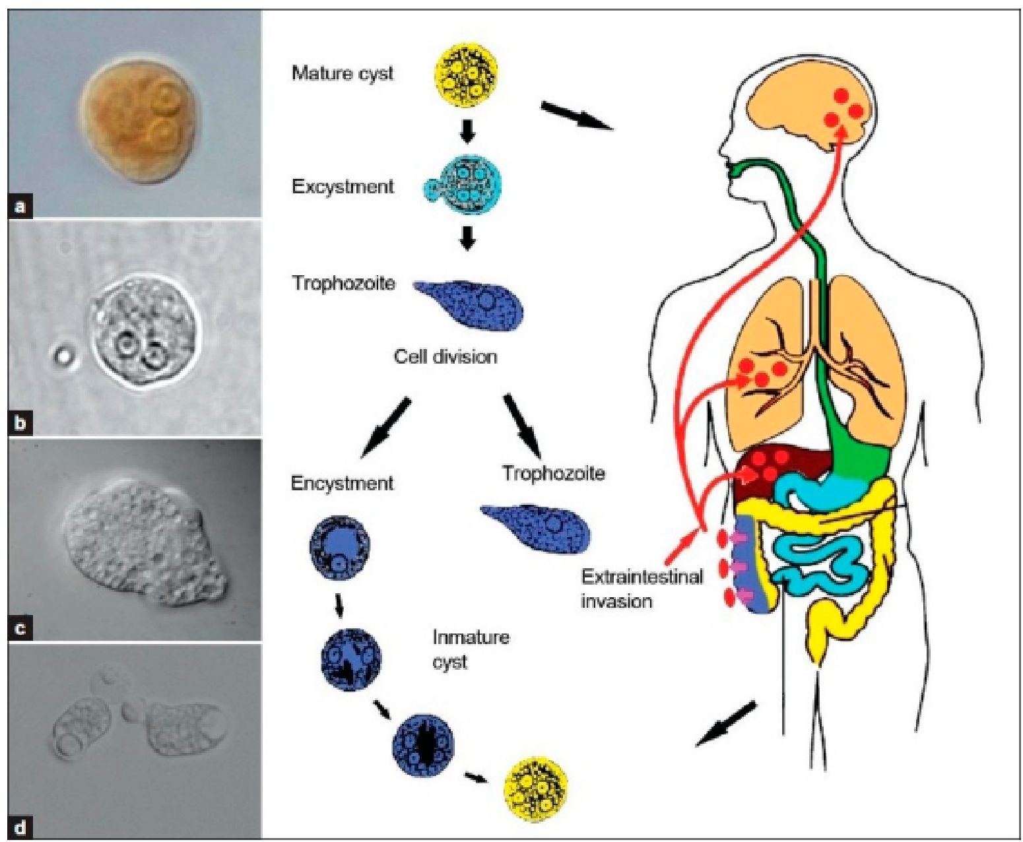

Q1. trophs and cysts
Many amoebae life cycles are split into two life stages: troph and cyst. What does each stage do and why do amoebae bother to differentiate into these two stages?
Ponder on your own (2 m), discuss with your group
(3 m), then share with the class (5 m).

Slide 3
Q2. There are three forms of African sleeping sickness. Which do you think would be the most EASIEST/MOST DIFFICULT to control?

Slide 4
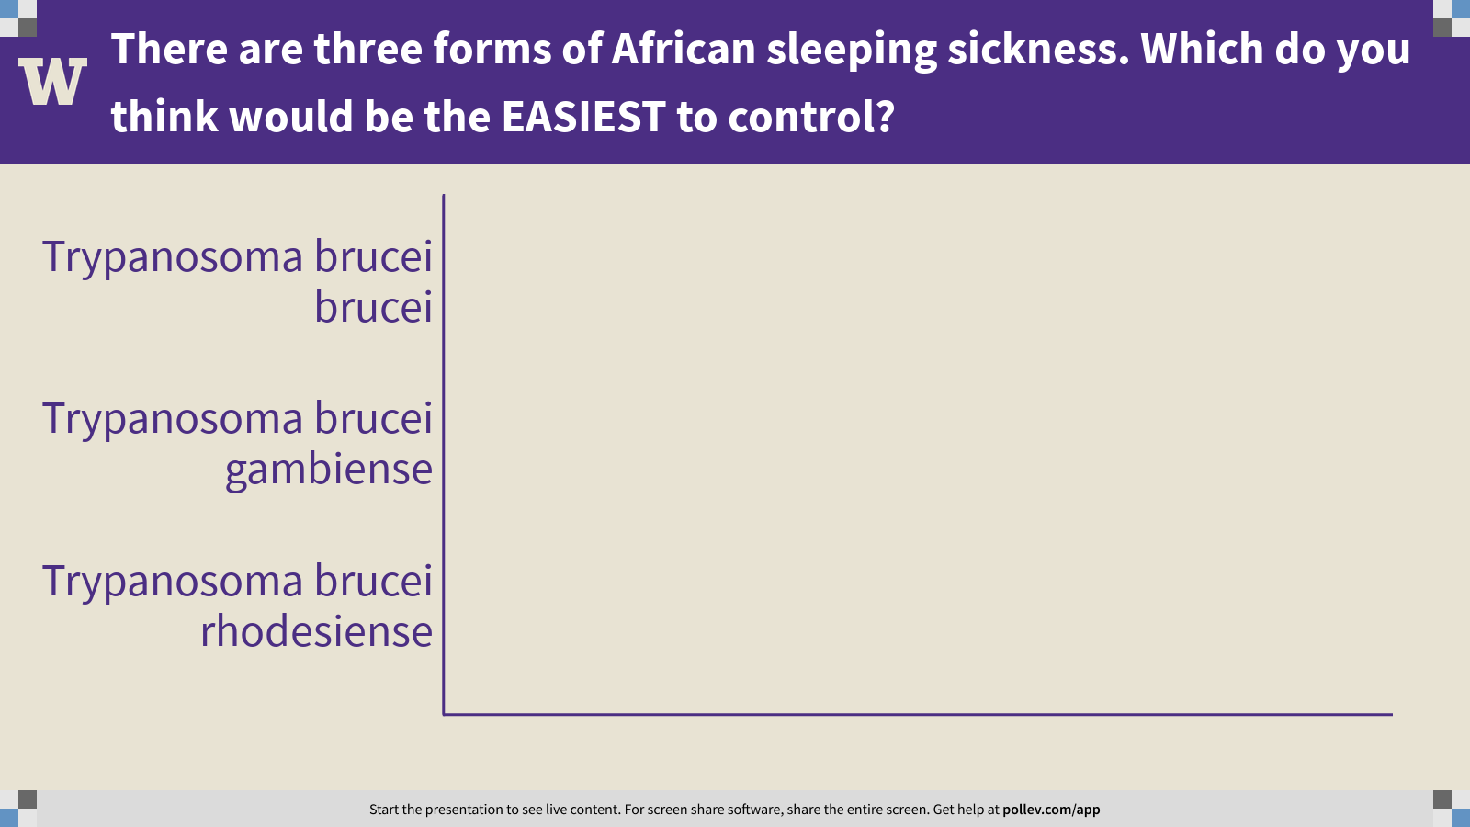
Notes:
There are three forms of African sleeping sickness. Which do you think would be the EASIEST to control?
https://www.polleverywhere.com/multiple_choice_polls/Dt6RIWtlQrleiczdoI5yP?flow=Default&onscreen=persist

Slide 5
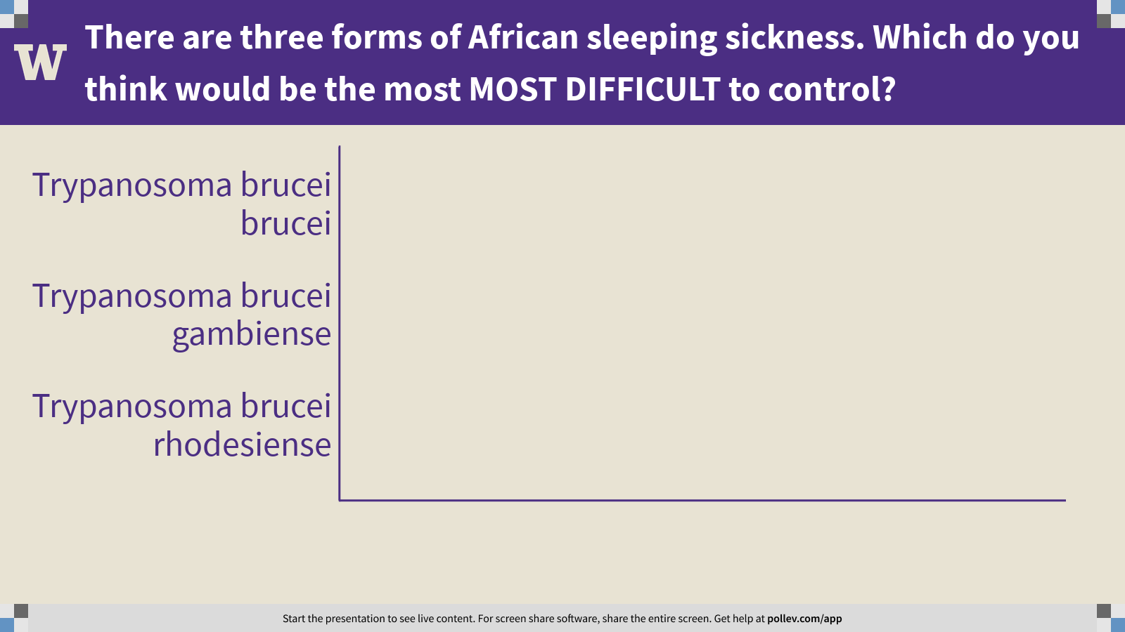
Notes:
There are three forms of African sleeping sickness. Which do you think would be the most MOST DIFFICULT to control?
https://www.polleverywhere.com/multiple_choice_polls/69EoUkLjVA4LYkhBHxI8Y?flow=Default&onscreen=persist

Slide 6
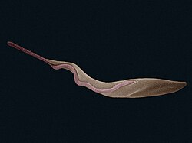
Q3. trypanosomiasis control
Imagine that you live in west Africa, in the presence of T. b. rhodesiense. What could you and your fellow villagers do to reduce the burden of sleeping sickness in your village?
Ponder on your own (3 m), discuss with your group
(5 m), then share with the class (5 m).

Slide 7
Q4. In what kind of habitats would you expect to find the greatest burden of leishmaniasis?

Slide 8

Notes:
In what kind of habitats would you expect to find the greatest burden of leishmaniasis?
https://www.polleverywhere.com/free_text_polls/K7ttNAL6NCk55tvf0BzKW

Slide 9
Class 20: Introduction to the Protozoa and Protozoa 1

