Slide 1
Class 5: Schistosomes 2

Slide 2
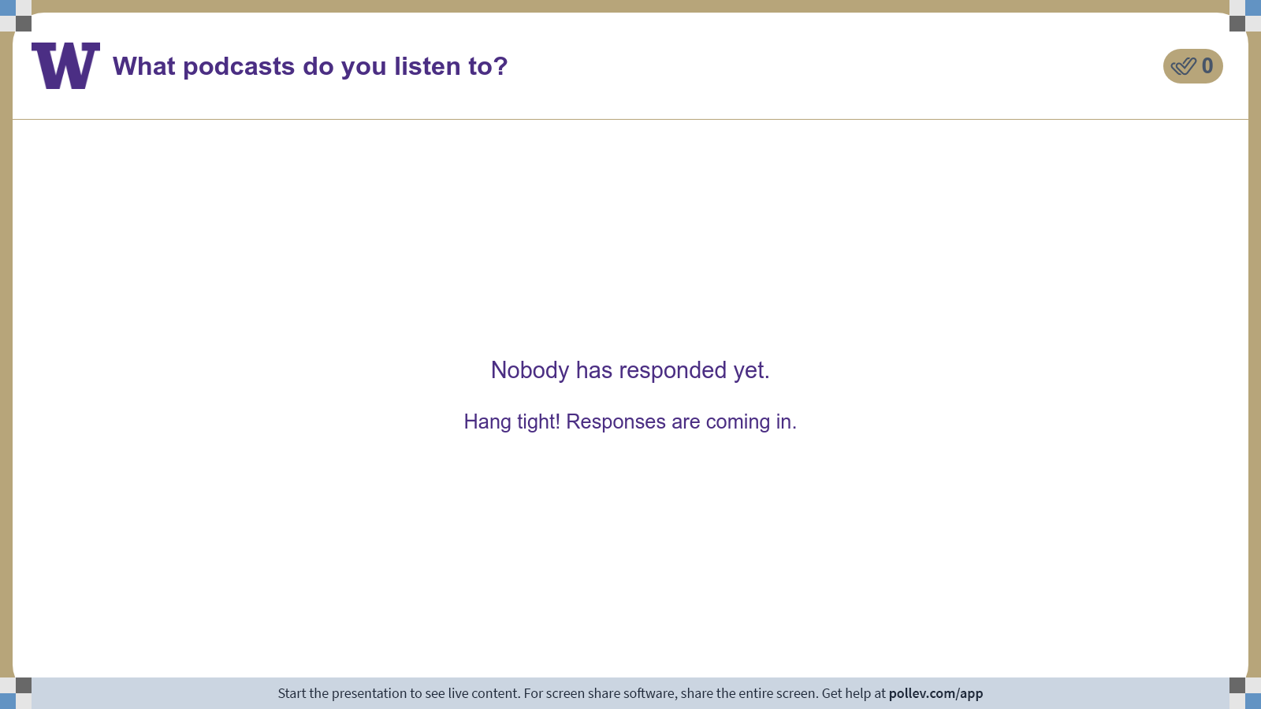
Notes:
Do not modify the notes in this section to avoid tampering with the Poll Everywhere activity. More info at polleverywhere.com/support What podcasts do you listen to?
https://www.polleverywhere.com/discourses/UTHyvtXD8FTS3bAs7amuM

Slide 3

https://www.microbe.tv/twip

Slide 4
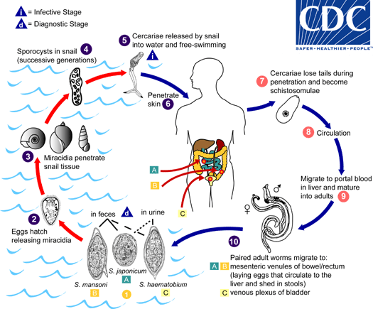

Slide 5
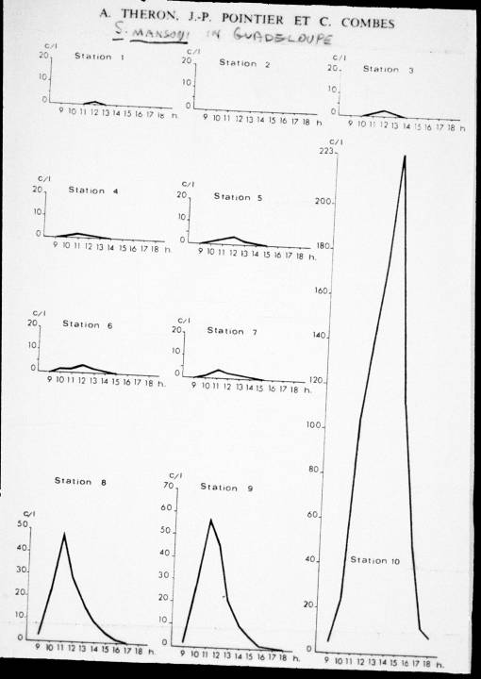

Slide 7
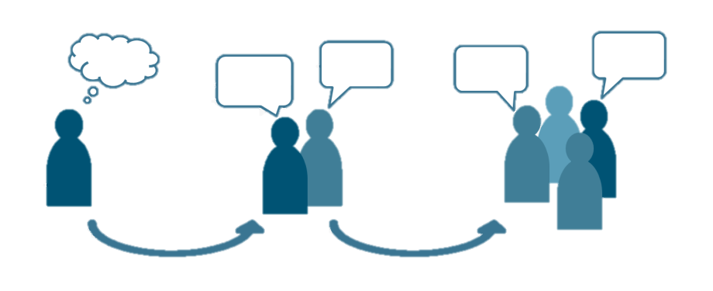
Q1. What does this map of schistosome-competent snail distributions tell you about where risk is greatest for people? Does it suggest that snail control will be easy or hard?
Ponder on your own (5 m), discuss with a partner (5 m), then share with the class (5 m).

Slide 8
Q2. eliminating schistosomes
You are tasked with eliminating schistosomiasis from an entire Senegalese village. Their sole water-access point is shown at left. How would you do it?
Make a plan for what intervention you would put in place.
Design an experiment that would let you monitor whether your intervention is successful.
What could happen to derail your plans? Account for these possible contingencies.
Ponder on your own (10 m), discuss and make a compromise plan with a partner (7 m), then share with the class (10 m).

Slide 9
Class 5: Schistosomes 2

