Slide 2




Notes:
Update date all the time

Slide 4
Notes:
Update date all the time

Slide 5
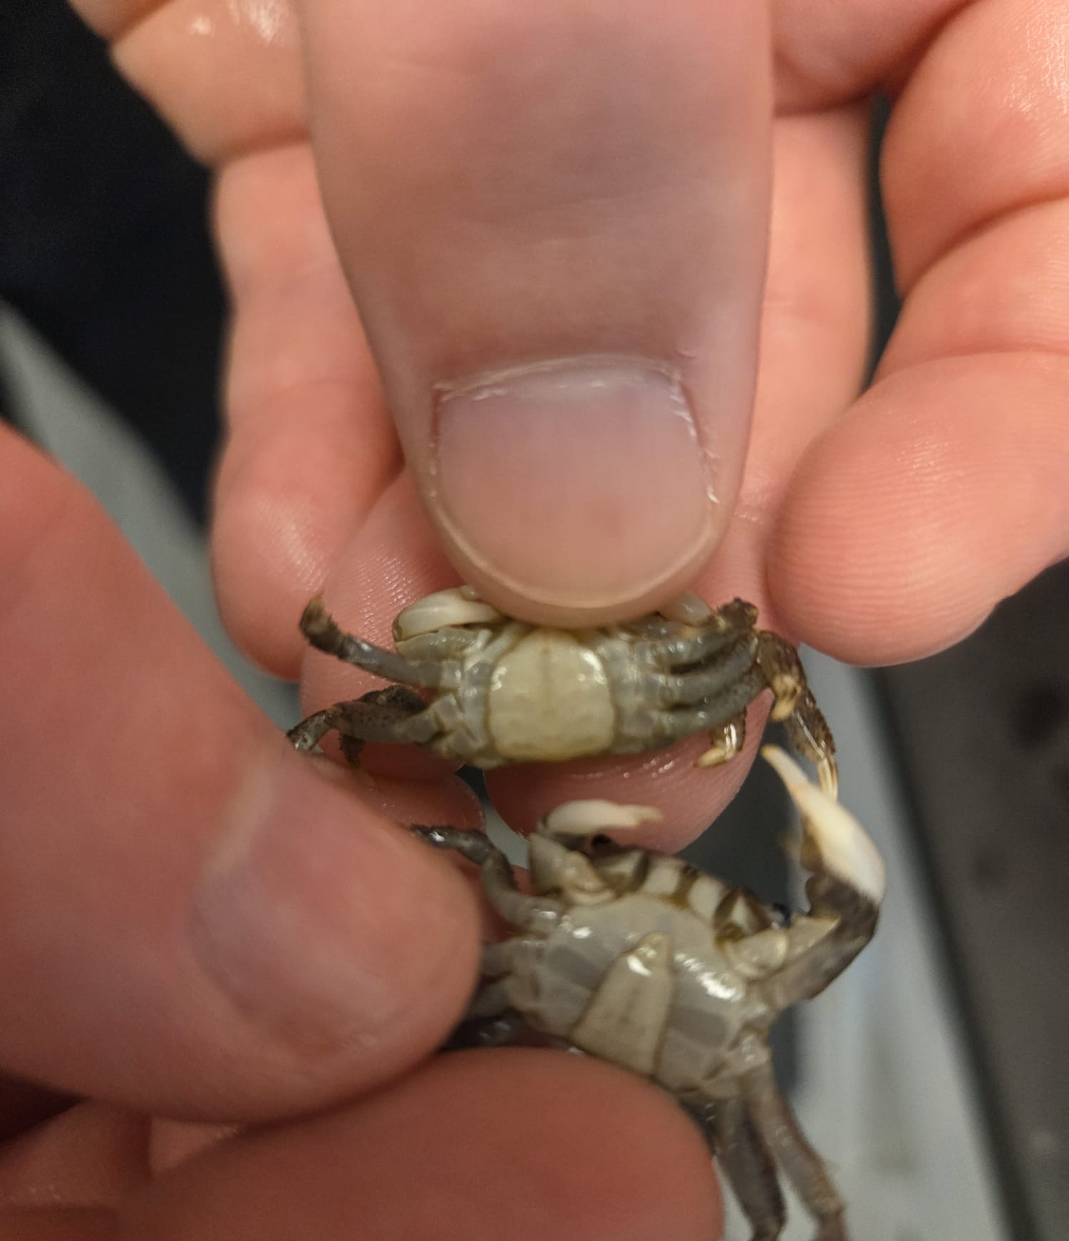
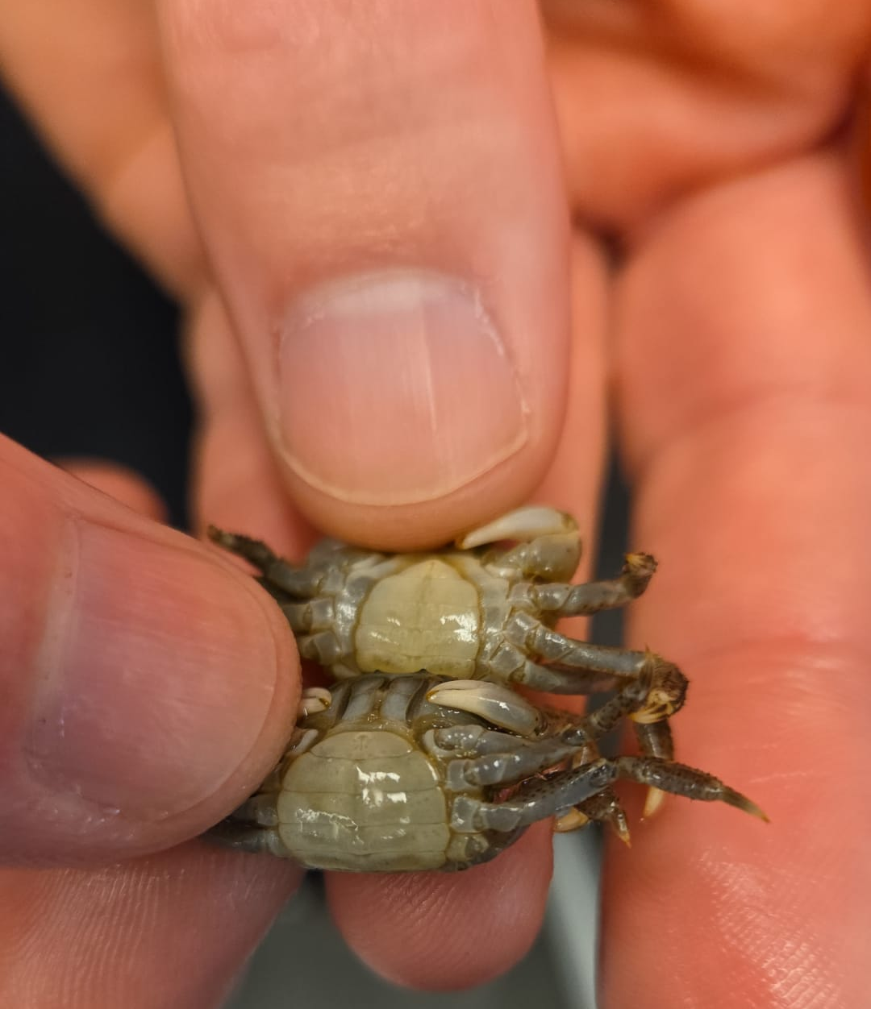
Male with signs of being infected ->
Male with signs of being infected ->
Male->
Female->
We will still evaluate all crabs, since the parasite can still be present in those that don’t show the peculiar telson shape. This can occur when the infection is recent.
Notes:
For longer infections males become feminized due to them getting castrated. The more they molt the more does their telson look wider.

Slide 6
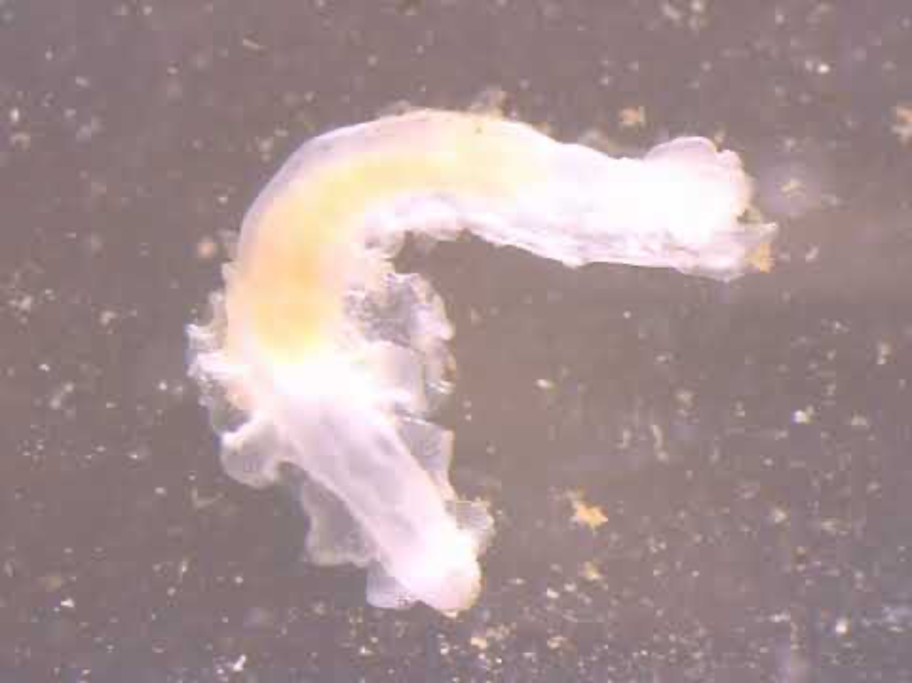

Slide 7


Notes:
We can id them based on the shape of their body

Slide 8
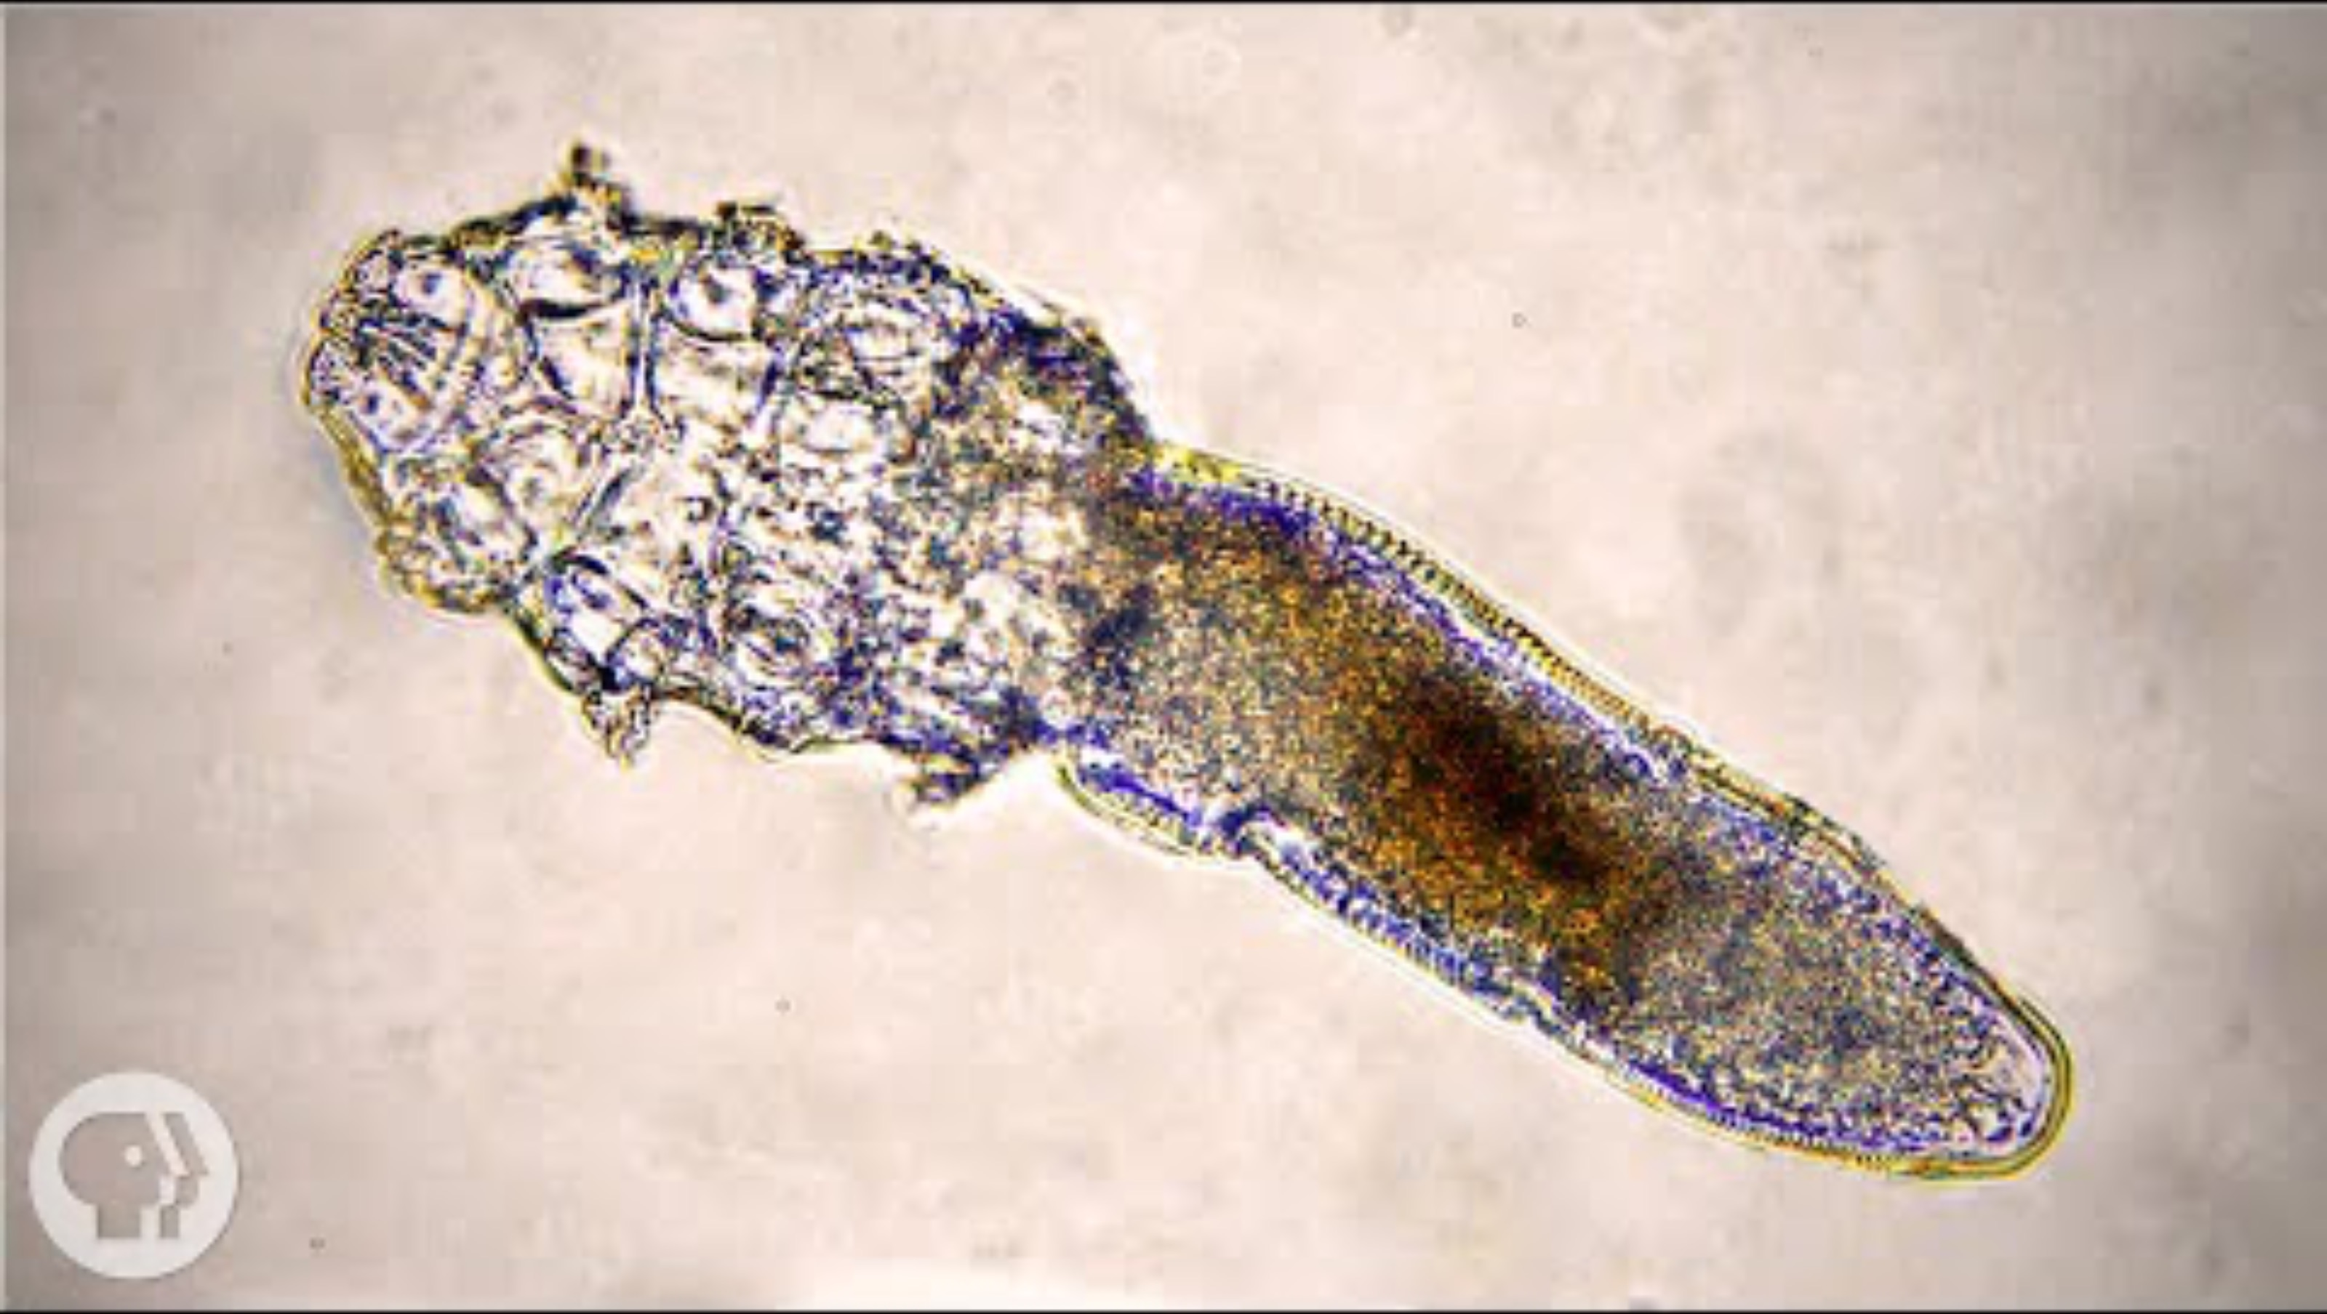

Slide 9
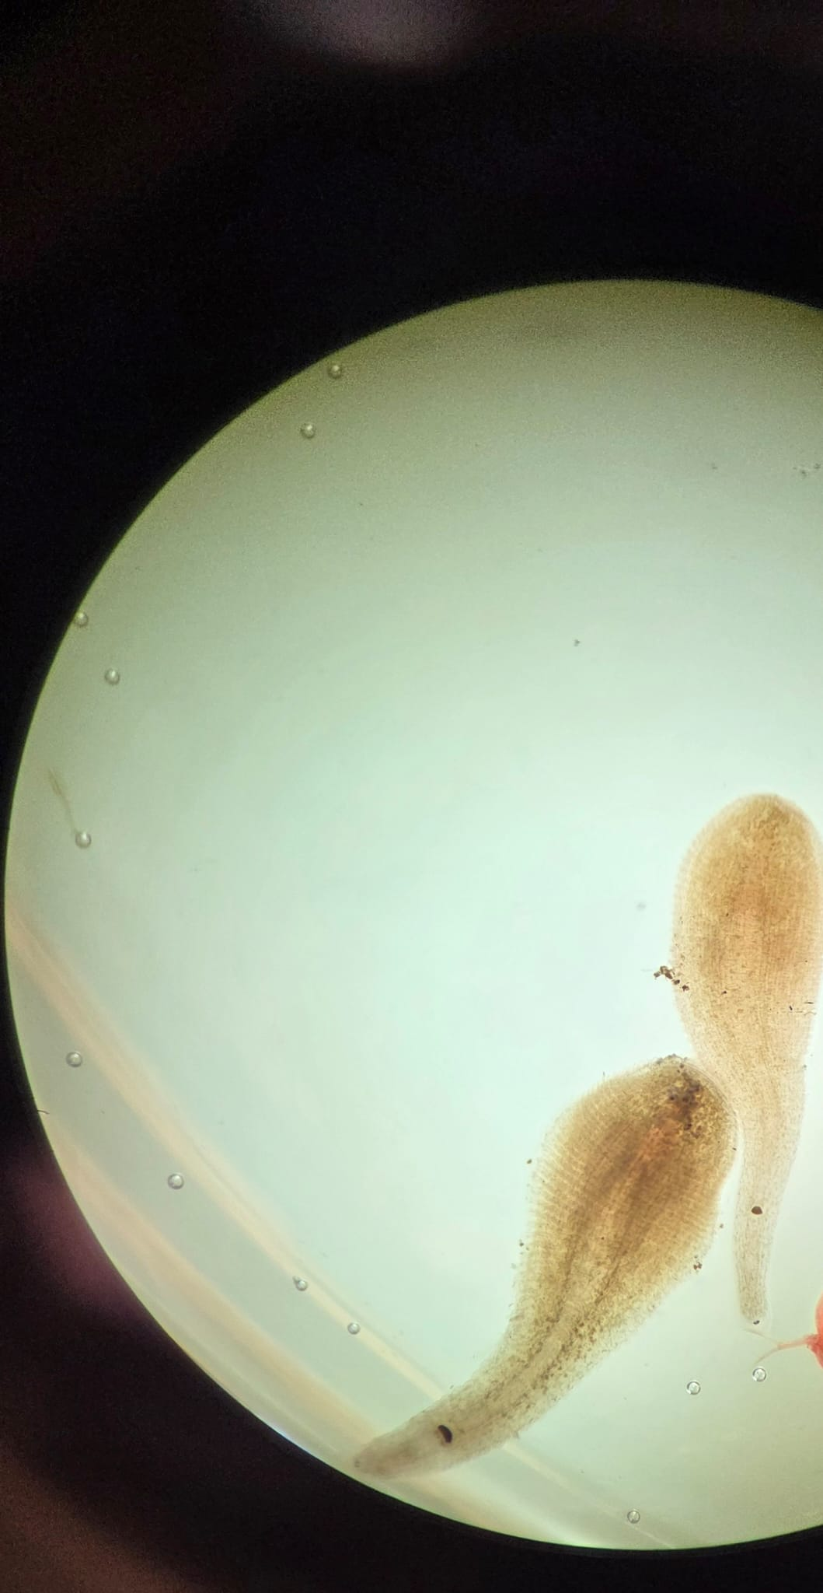
NEW ACTIVITY! LEECHES
Phylum Annelida, Subclass Hirudinea
Micro predators, not parasites (why?)
Collected from a small backyard pond in Edmonds, WA on Saturday, 31 Oct
Pond contains no fish or amphibians
ID the leeches by examining their features + consulting online resources.
Zooplankton - cladocerans
Notes:
Photo FISH 406 Nov 3, 2026 Leeches from Chelsea’s pond

Slide 10












































