Slide 1
Class 24: Parasites – who cares?

Slide 2
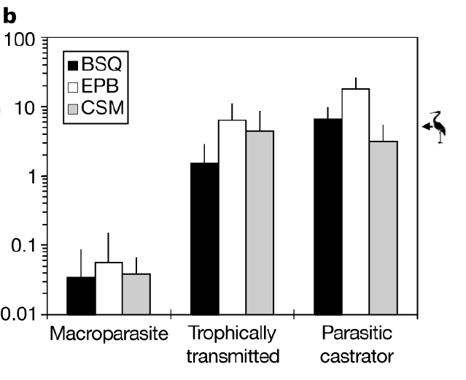

Q1. where are all the “typical” parasites?
When Armand Kuris and his colleagues tallied up all of the parasite biomass in three salt marshes, they found that the trophically transmitted parasites and the parasitic castrators had WAY more biomass than the “typical” parasites. Why?
Ponder on your own (2 m), discuss with your group
(3 m), then share with the class (7 m).

Slide 3
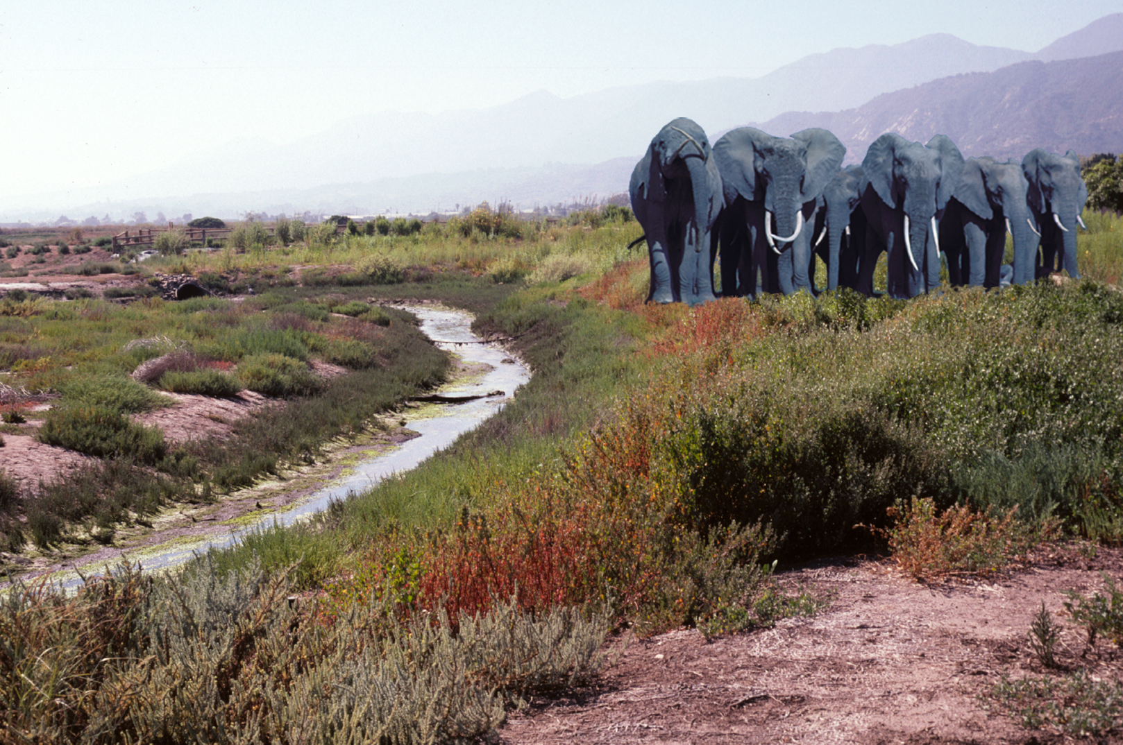
Q2. where should parasites be most/least energetically important?
You saw in the online lectures that parasites make up a large proportion of total biomass in three west coast salt marshes. But this probably isn’t true in every ecosystem. What is it about salt marshes that makes parasites important players there? In what other ecosystems would you expect parasites to attain high biomass? Where should they attain only low biomass? Think deeply and creatively.
Ponder on your own (2 m), discuss with your group
(3 m), then share with the class (7 m).

Slide 4
ecosystems where parasites probably play an important energetic role:

Slide 5
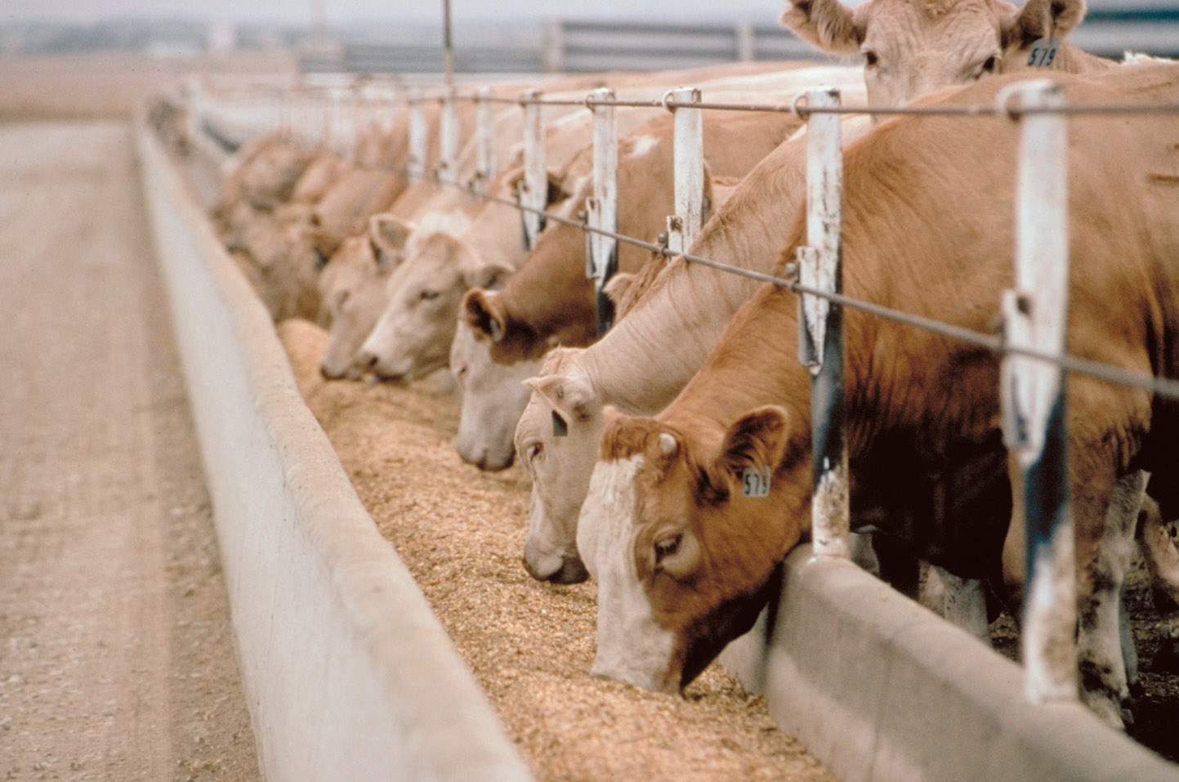
high host density

Slide 6

high host density

Slide 7

high host density

Slide 8
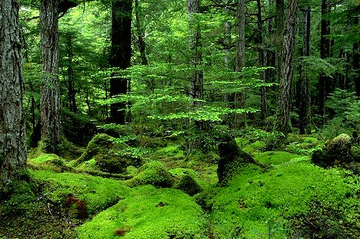
ancient, undisturbed ecosystems

Slide 9
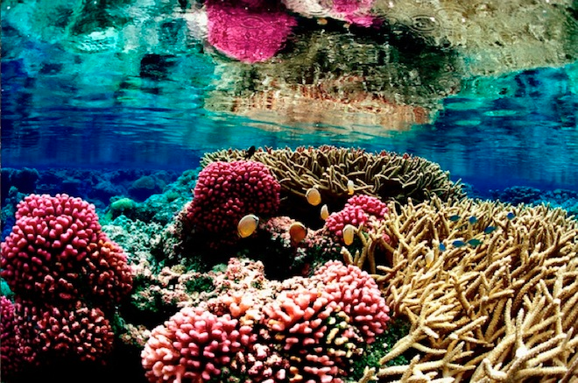
ancient, undisturbed ecosystems

Slide 10
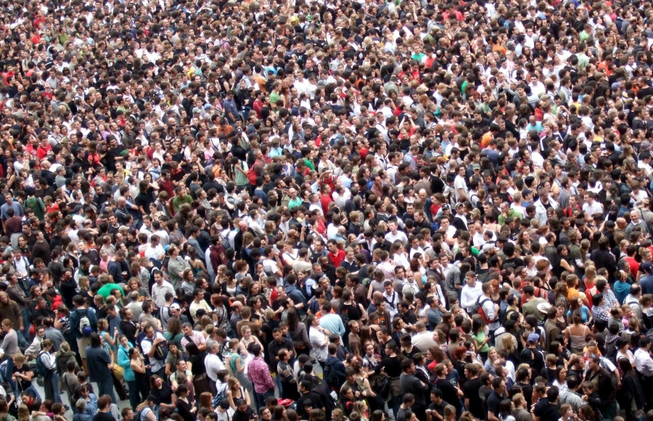
humans

Slide 11
ecosystems where parasites probably DO NOT play an important energetic role:

Slide 12
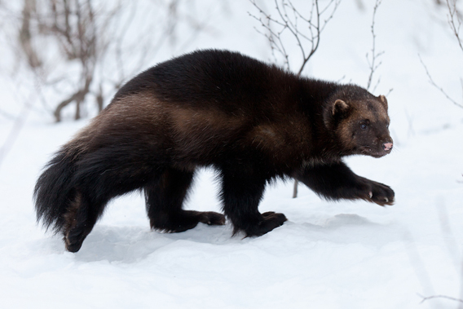
low host density

Slide 13
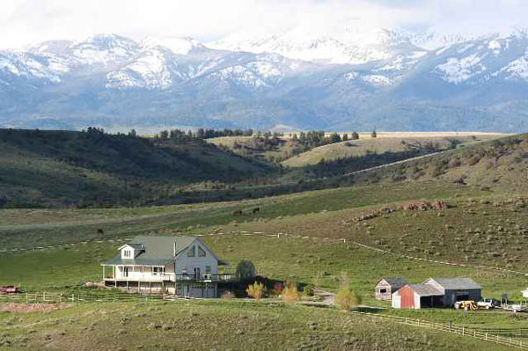

Slide 14
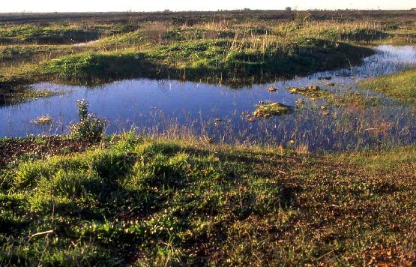
ephemeral environments

Slide 15
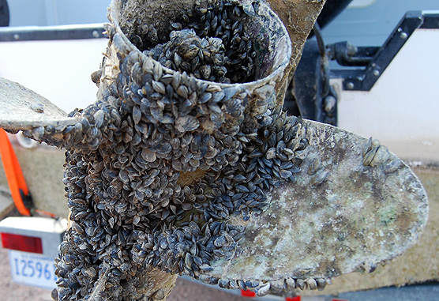
highly invaded ecosystems

Slide 16
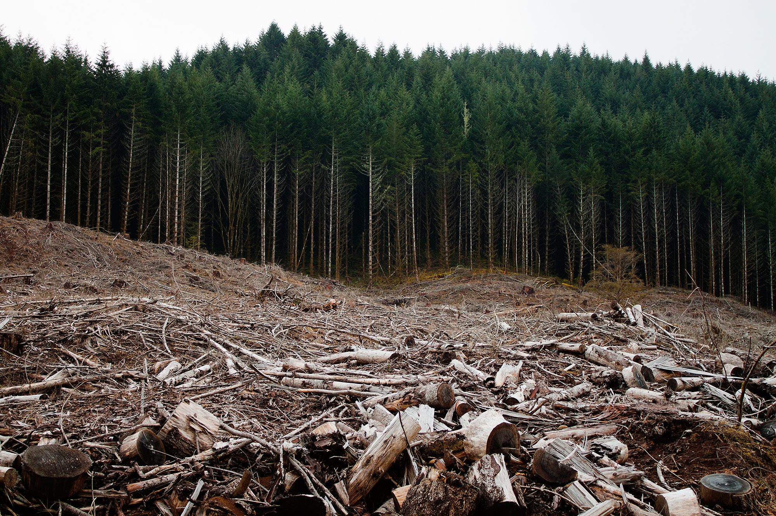
disturbed ecosystems

Slide 17
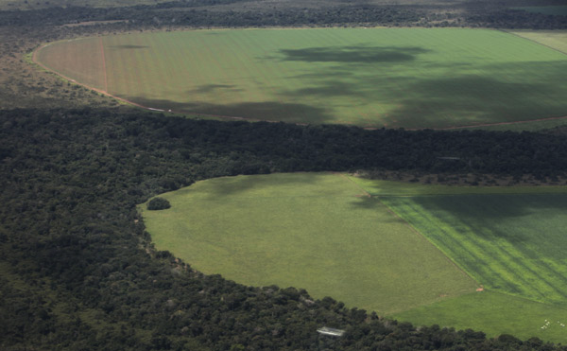
disturbed ecosystems

Slide 18
Q3. Today, we’ve only talked about ONE reason why parasites are ecologically important (i.e., their energetic importance). What are some OTHER ways in which parasites can influence communities and ecosystems?

Slide 19
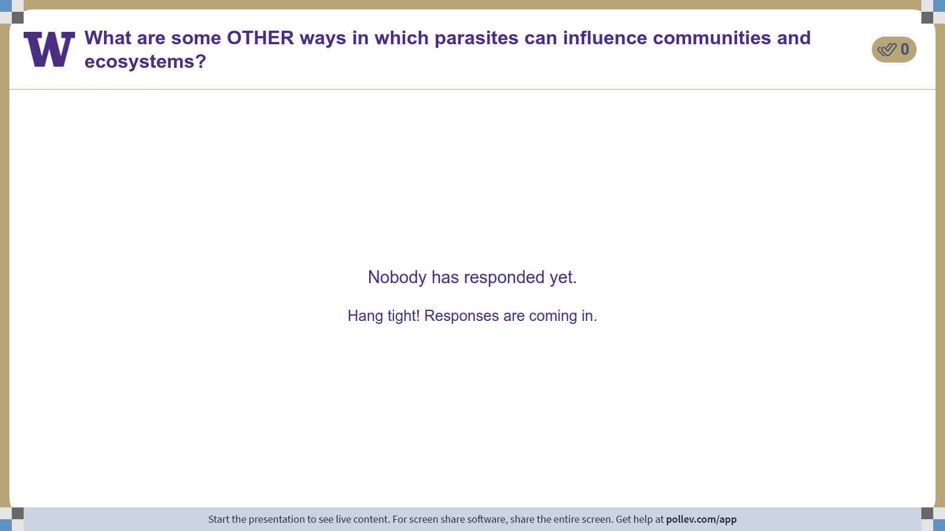
Notes:
Do not modify the notes in this section to avoid tampering with the Poll Everywhere activity. More info at polleverywhere.com/support What are some OTHER ways in which parasites can influence communities and ecosystems?
https://www.polleverywhere.com/discourses/XgXK5uL3Cy8vRQYZkWX1p

Slide 20
Class 24: Parasites – who cares?

