Slide 1
Class 22: The apicomplexan Plasmodium

Slide 2
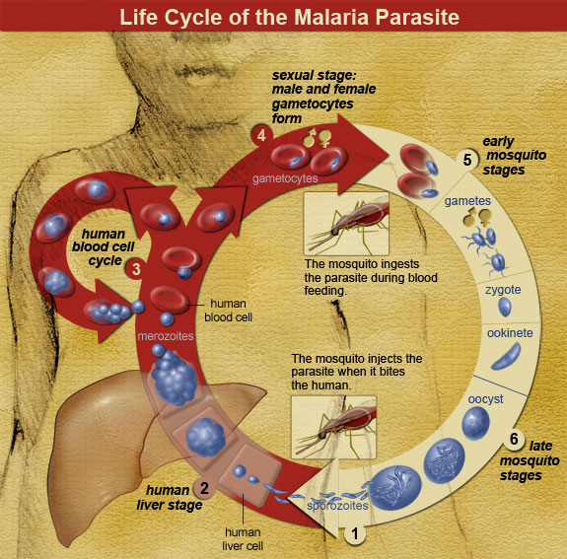
The Situation
Imagine for a moment that you are a Plasmodium parasite, working your way through a host. Every aspect of the Plasmodium life cycle plays a critical role in the proliferation of malaria in a host…

Slide 3
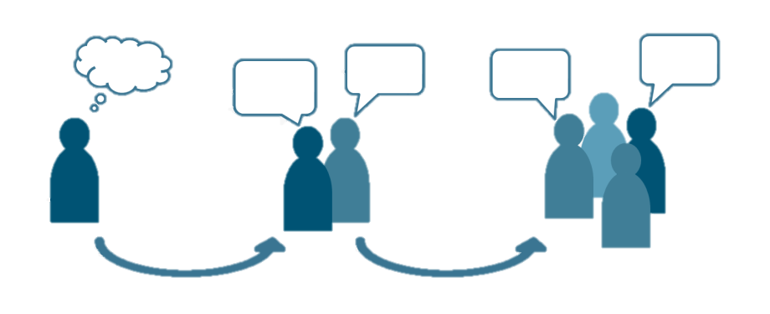
The Roles
In groups, assign the following rolls to each member of the team :
mosquito
zygote
ookinete
oocyst
sporozoites
merozoites
human liver
human erythrocytes
gametocytes
trophozoites
Be assigned into groups (1 min) and assign each other’s roles within the group (3 min).

Slide 4
The Task
In these groups, design a plan to demonstrate to the class the entire Plasmodium life cycle from start to finish. Be sure to note who the definitive host of Plasmodium is and what part of a human you are referencing. How will you express what the parasite is doing during your role?
Discuss with your group how the roles work together (7.5 min) and design a way of clearly communicating the life cycle to the entire class (7.5 min)

Slide 5
The Life Cycle
Now that your plan is fully solidified, we will take turns as groups presenting your life cycle plan to the class. Make sure you fully explain all that is happening as you move through each step.
Present your life cycle to the class (10 min)

Slide 6
Additional Questions

Slide 7
Q1. who is the definitive host of Plasmodium?
Now that you know the malaria life cycle, identify the definitive host. The answer might not be as straightforward as you think, so carefully review the life cycle to figure it out.
Ponder on your own (2 m), discuss with your group
(3 m), then share with the class (7 m).

Slide 8
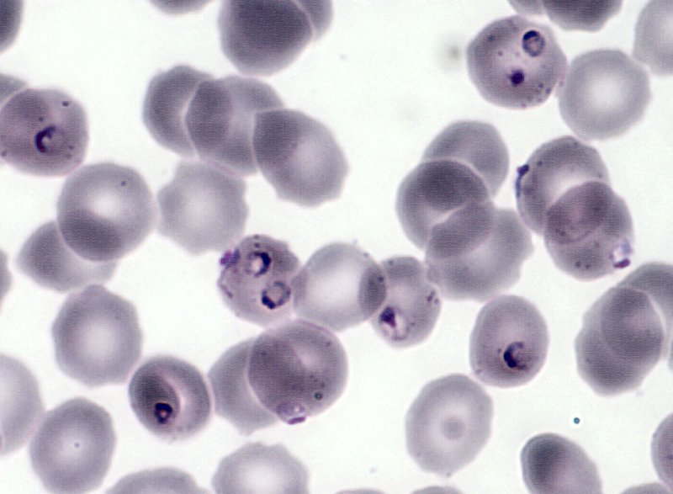
Q2. a synchronized attack
The recurring fevers of malaria result of cycles of schizogony that are synchronized across among many Plasmodium individuals. How might they synchronize their attack? Why might they synchronize their attack?
Ponder on your own (2 m), discuss with your group
(3 m), then share with the class (7 m).

Slide 9
Q2. a synchronized attack
Notes:
Changes in any attribute of a population over time.
Evolutionary change leads to adaptation and must involve a change in the frequency of individual genes in a population from generation to generation.

Slide 10
Q3. Name all the possible approaches to malaria control that you can think of, no matter how off-beat.

Slide 11
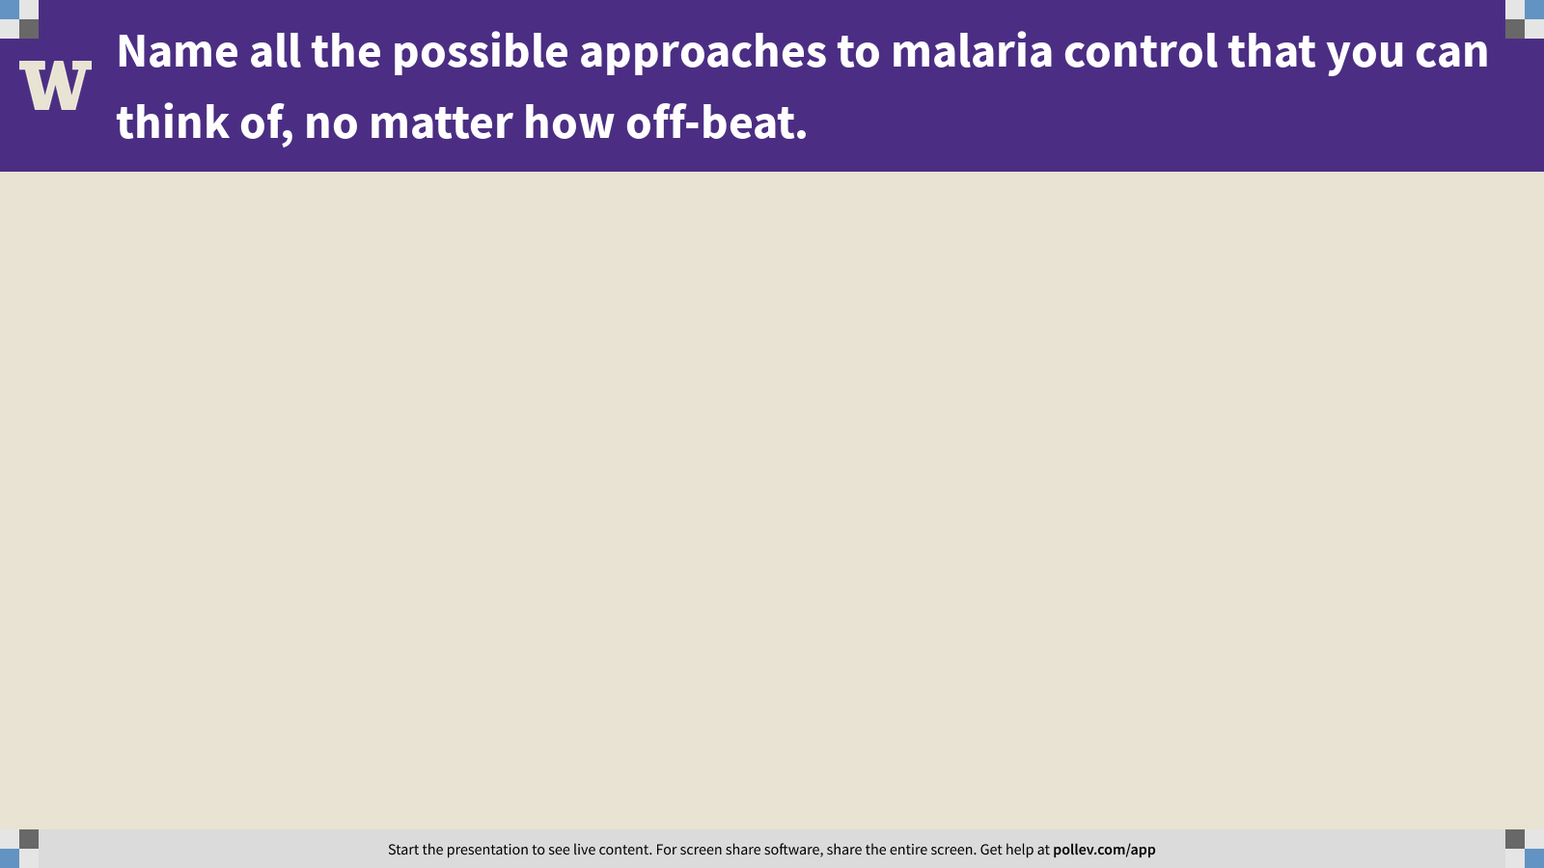
Notes:
Name all the possible approaches to malaria control that you can think of, no matter how off-beat.
https://www.polleverywhere.com/free_text_polls/vsf2KQkyvrM1PaFnc4kyp

Slide 12
Class 22: The apicomplexan Plasmodium

