Slide 1
Class 2: Adaptations to parasitism and introduction to the trematodes

Slide 2
Take the Qualtrics survey!

Slide 3
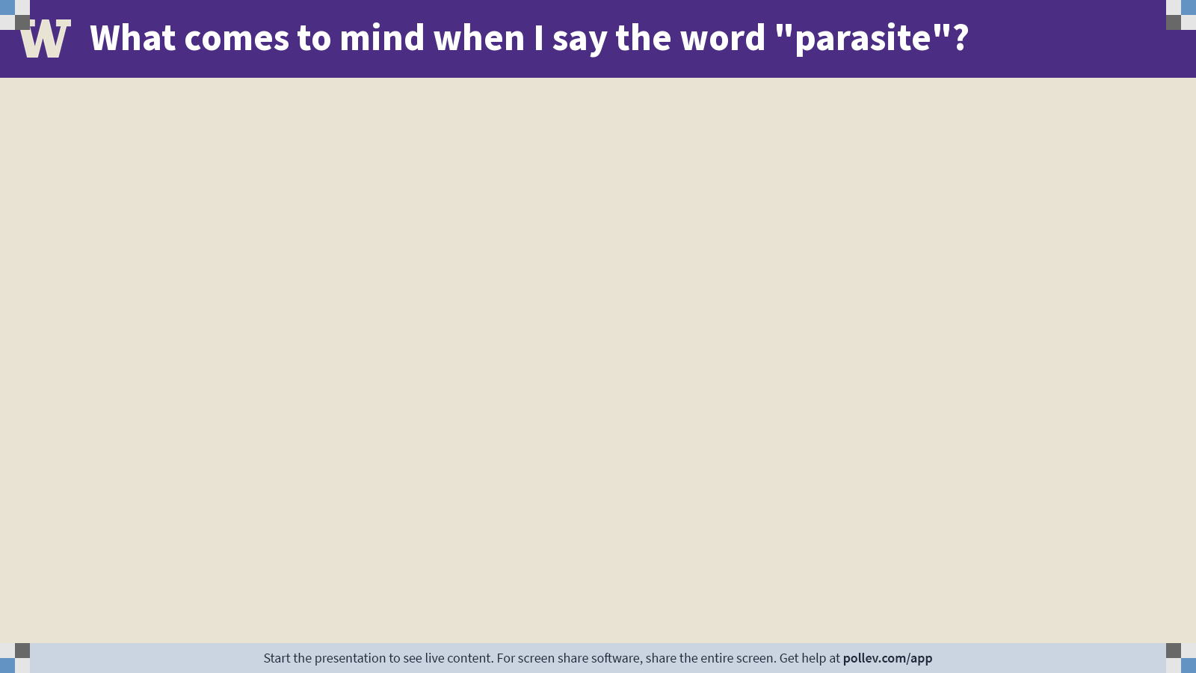
Notes:
Do not modify the notes in this section to avoid tampering with the Poll Everywhere activity.
More info at polleverywhere.com/support
What comes to mind when I say the word "parasite"?
https://www.polleverywhere.com/free_text_polls/n8mRsosII42qUWMLxN3aH

Slide 4
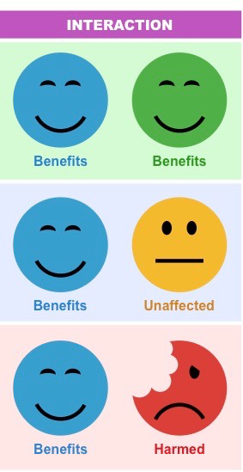
parasites on the spectrum of symbiosis
Parasites are not the only organisms that live in intimate and durable relationships with their hosts.
The class will be split into groups.
Each group will be assigned one kind of symbiont: parasites, commensals, or mutualists.
Generate as many examples of the assigned symbiont as you can.
Each person should assume one role:
  Note-taker
  Timekeeper
  Reporter
Collaborate with your group to come up
with as many examples as you can.

Slide 5
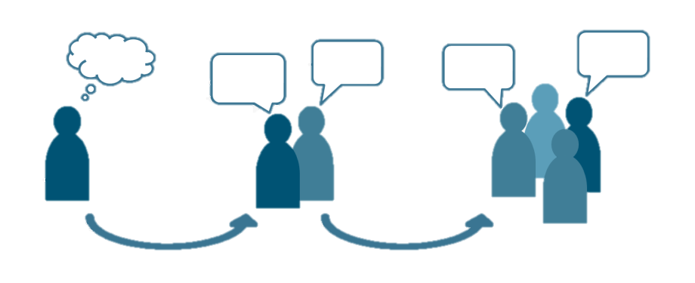
Q1. food conversion efficiency in parasites
Although tapeworms have a reputation for causing weight loss or wasting in their hosts, each worm takes very little energy from its host and uses what energy it takes very efficiently. Brainstorm possible answers to the following questions:
Why are tapeworms so efficient?
Why don’t hosts have food conversion efficiencies equal to those of their parasites?
Work out the answer on your own.
Then compare answers with a partner.

Slide 6
Q1. food conversion efficiency in parasites
Notes:
Changes in any attribute of a population over time.
Evolutionary change leads to adaptation and must involve a change in the frequency of individual genes in a population from generation to generation.

Slide 7
Q2. who has it easier?
Life always forces trade-offs, but those trade-offs look different for parasites than they do for free-living species. Who has it better for each of the following processes – free-living species or parasitic species? Why?
Popping out babies
Dispersing to a new habitat
Surviving in your environment
Increasing your body size
Acquiring food
Avoiding the extinction of your species
Work out the answer on your own.
Then compare answers with a partner.

Slide 8
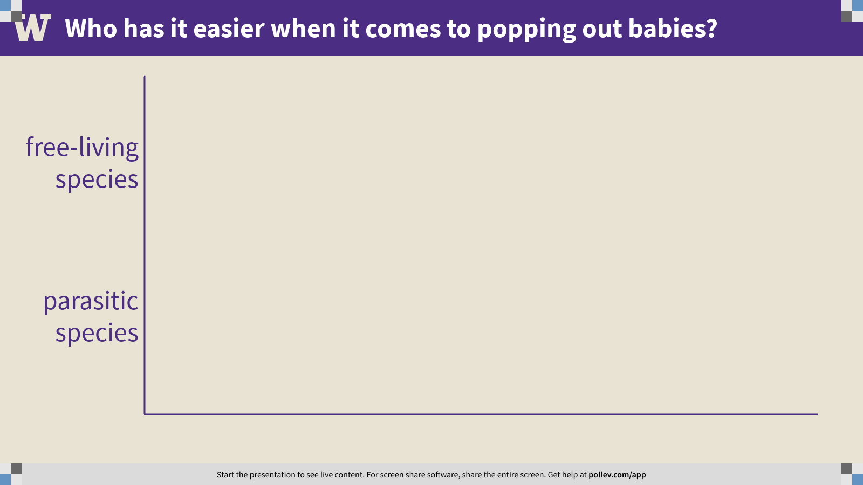
Notes:
Who has it easier when it comes to popping out babies?
https://www.polleverywhere.com/multiple_choice_polls/yX1dNBrTy4p1UBYoJhbrq?flow=Default&onscreen=persist

Slide 9
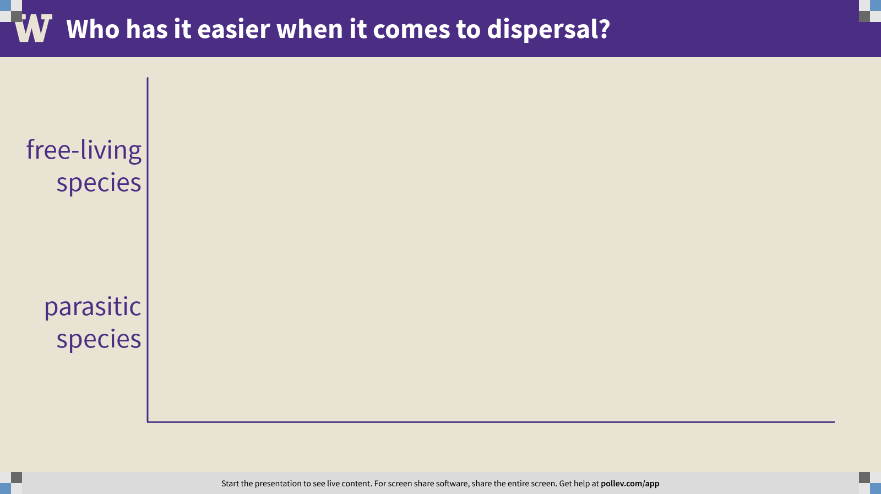
Notes:
Who has it easier when it comes to dispersal?
https://www.polleverywhere.com/multiple_choice_polls/0E0bZ4i1St4IxFjJ2AwXs?flow=Default&onscreen=persist

Slide 10
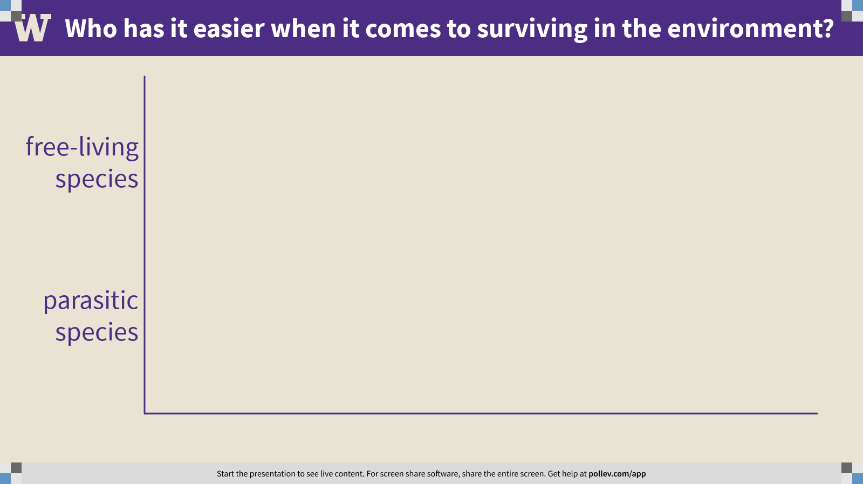
Notes:
Who has it easier when it comes to surviving in the environment?
https://www.polleverywhere.com/multiple_choice_polls/c75ZVabcHpxN7bTwJKWLb?flow=Default&onscreen=persist

Slide 11
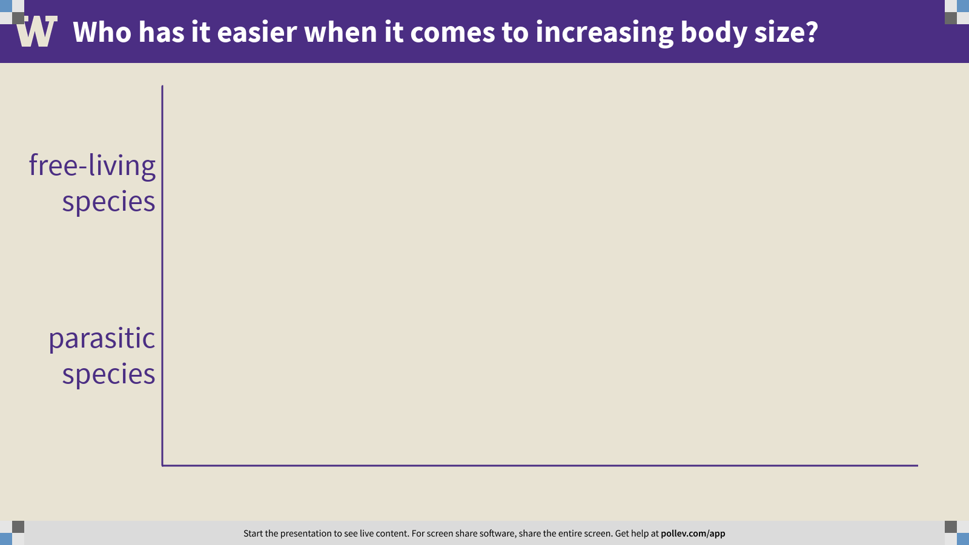
Notes:
Who has it easier when it comes to increasing body size?
https://www.polleverywhere.com/multiple_choice_polls/LmqHs6H1dWdE0h1aEiCtB?flow=Default&onscreen=persist

Slide 12
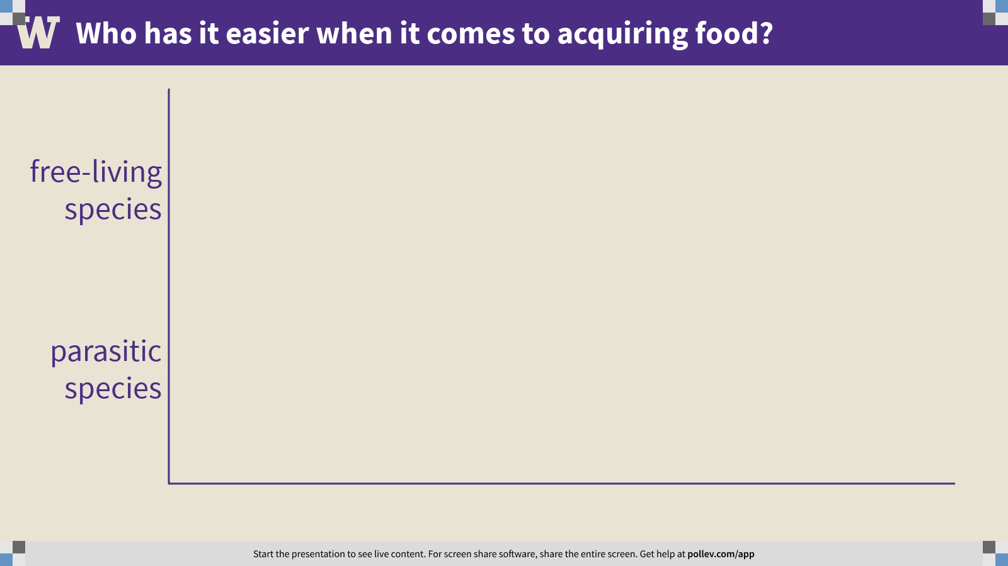
Notes:
Who has it easier when it comes to acquiring food?
https://www.polleverywhere.com/multiple_choice_polls/shfhRBHLRmCQG9QXDwBgt?flow=Default&onscreen=persist

Slide 13
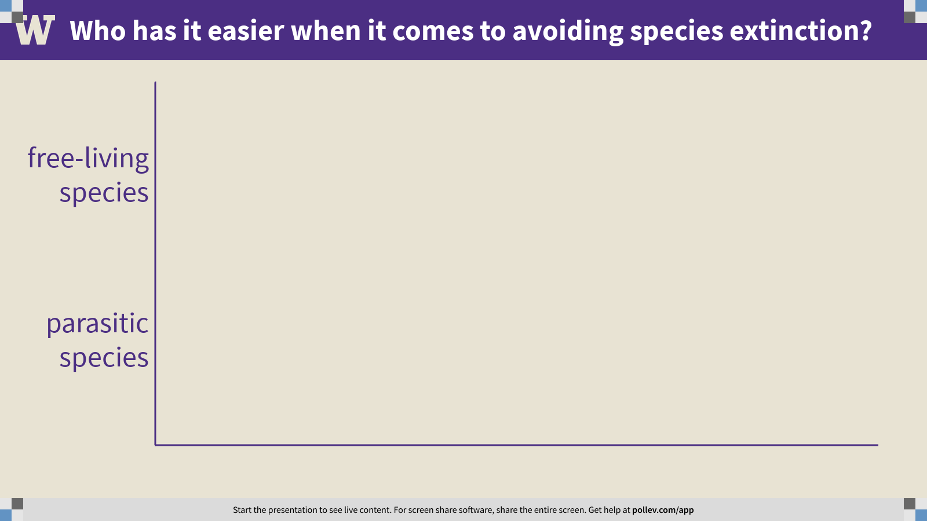
Notes:
Who has it easier when it comes to avoiding species extinction?
https://www.polleverywhere.com/multiple_choice_polls/ePU9YsG7NCRM9THKWXCnW?flow=Default&onscreen=persist

Slide 14
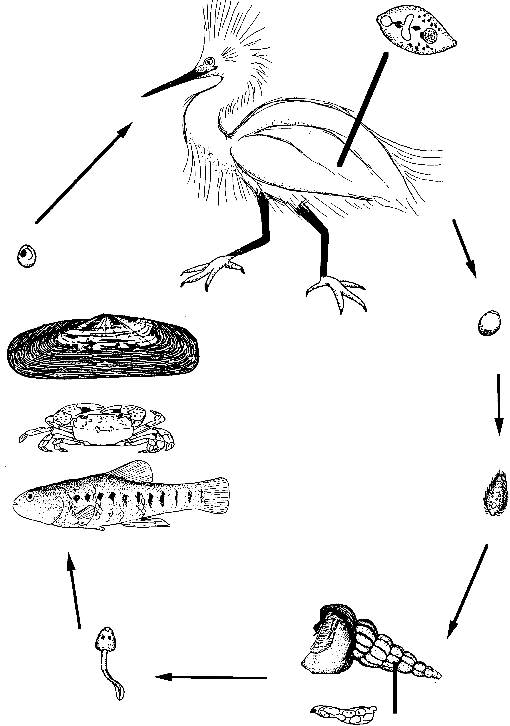

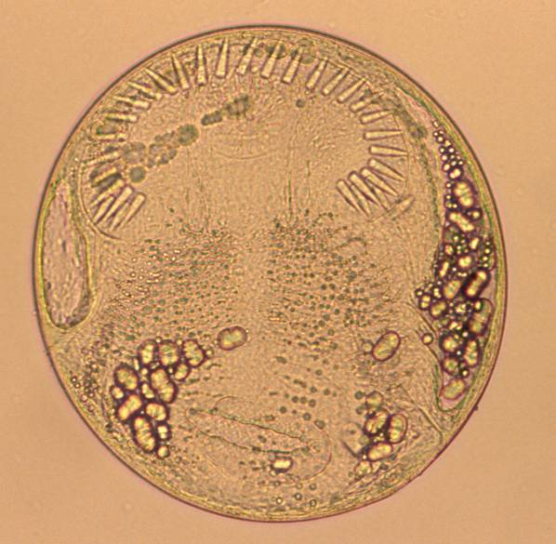
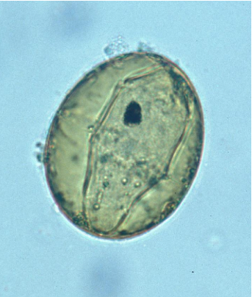

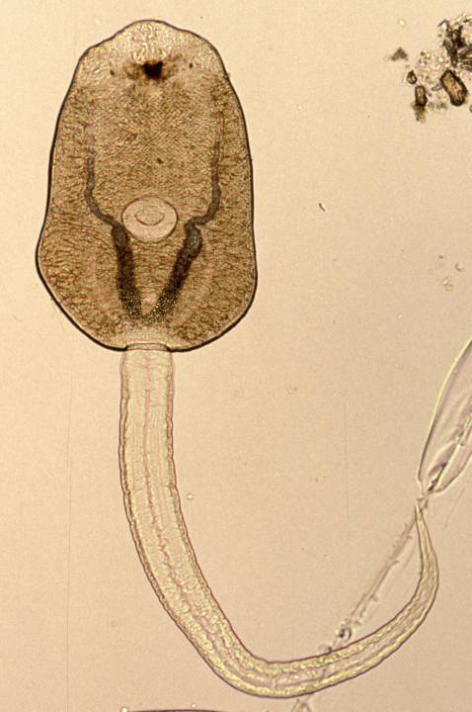
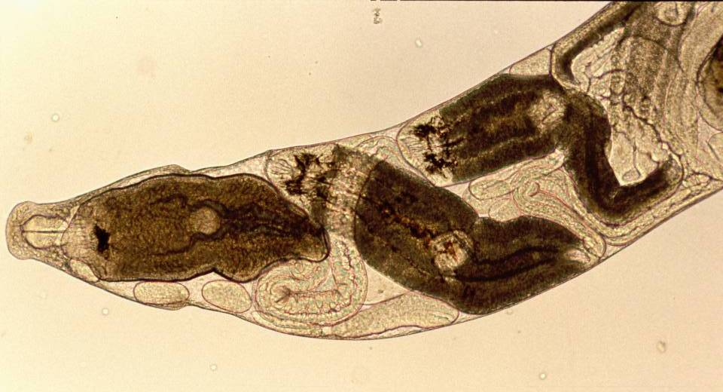
metacercaria
adult
definitive host
second intermediate hosts
egg
cercaria
miracidium
first intermediate host
redia

Slide 15
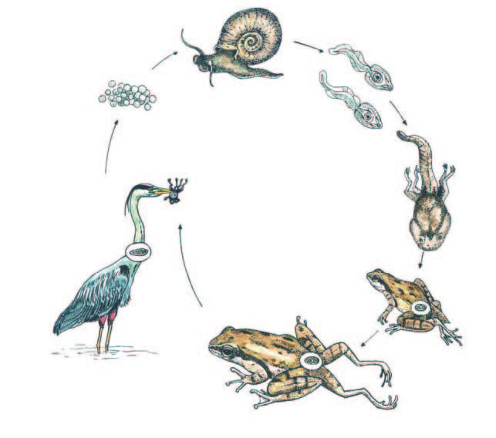

Slide 16
Q2. evolution of the trematode life cycle
Trematodes have wild life cycles, and you might find yourself thinking: how and why would such a complex, precarious, fragile thing evolve?
Propose a solution. How might the complex life cycle of the trematodes have evolved from something simpler? What selective pressures might have driven the evolution of the complex life cycle?
Work out the answer on your own.
Then share your answer with the class.

Slide 17
Class 2: Adaptations to parasitism and introduction to the trematodes

