Slide 1






Slide 2
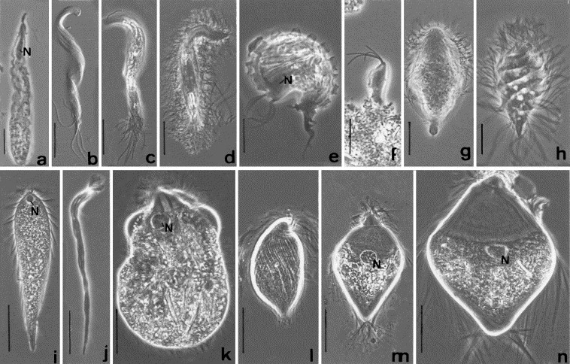

Slide 3





Slide 4
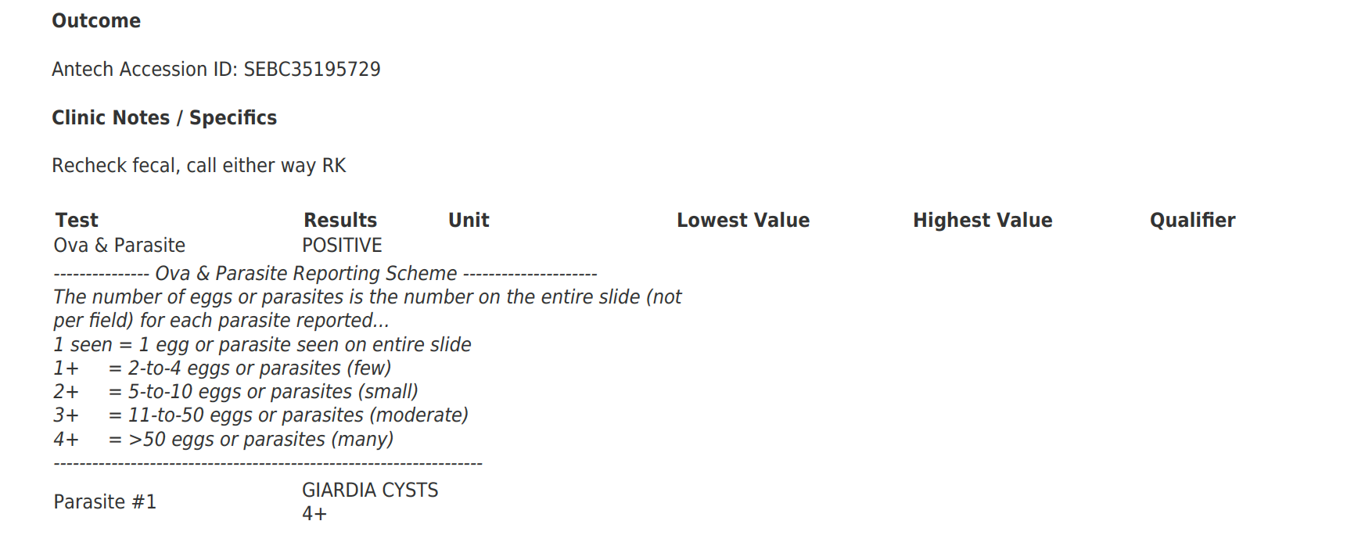
fecal float of Halibut poop
sex = female
age = 13 weeks, 5 days
sample produced = 4 October 2023
body size = ???
mass = ???

Slide 5
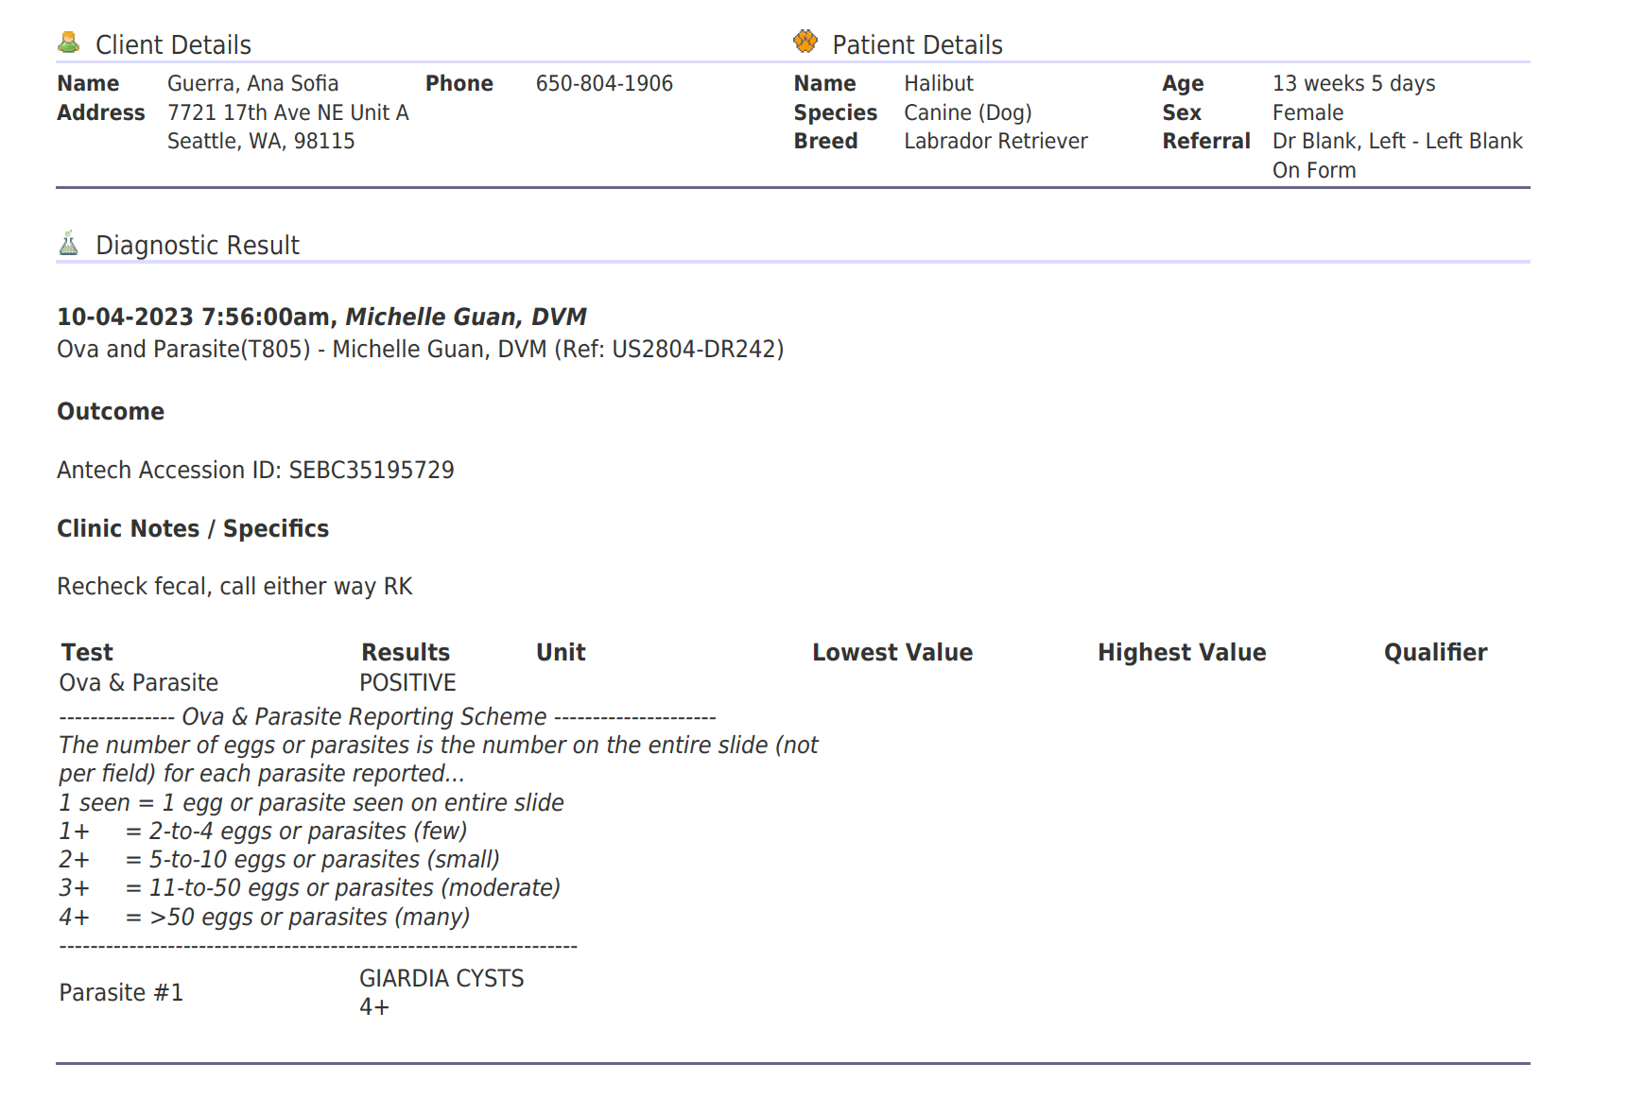
body size = 17.5 inches (44.45 cm) at the shoulder
mass = ???

Slide 6
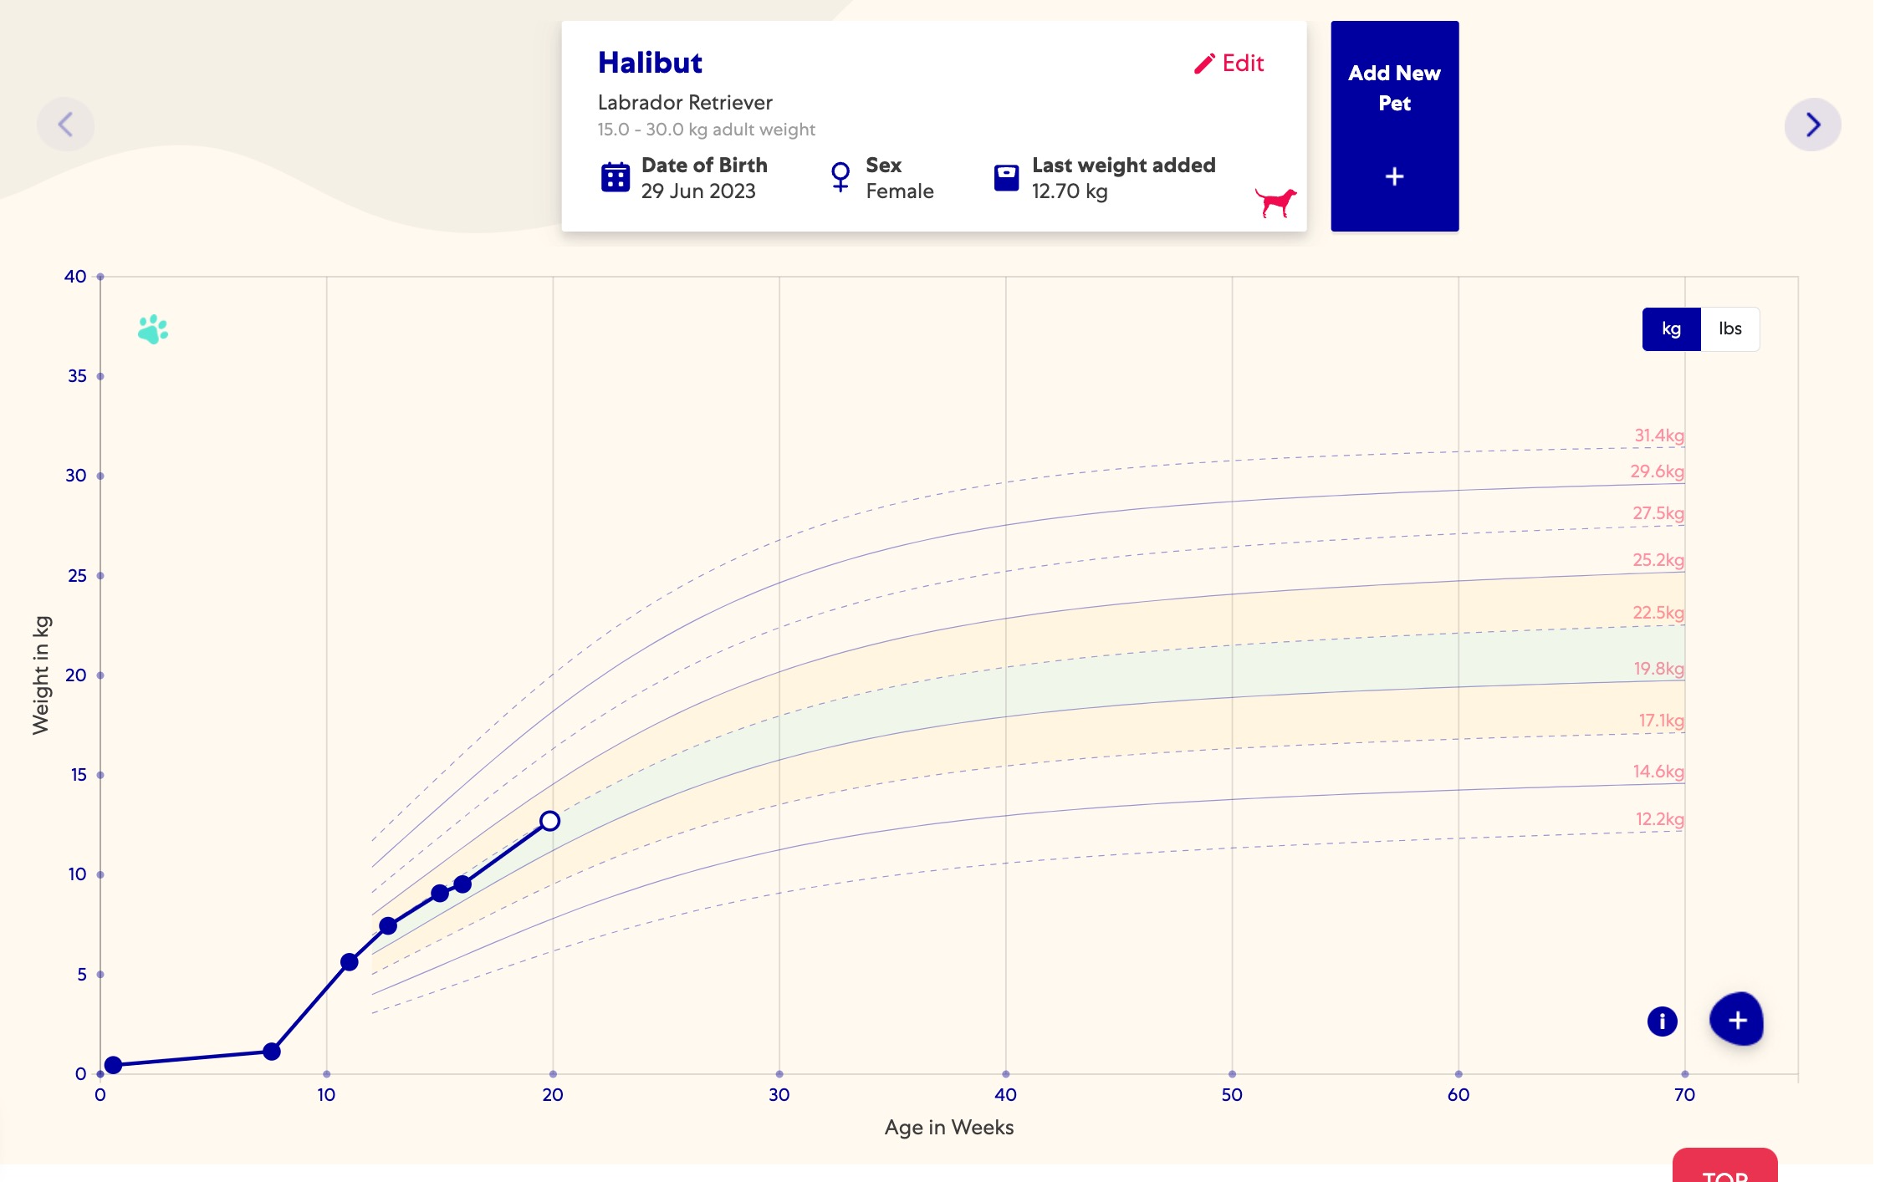
7.4 kg or 16.31 pounds

Slide 7
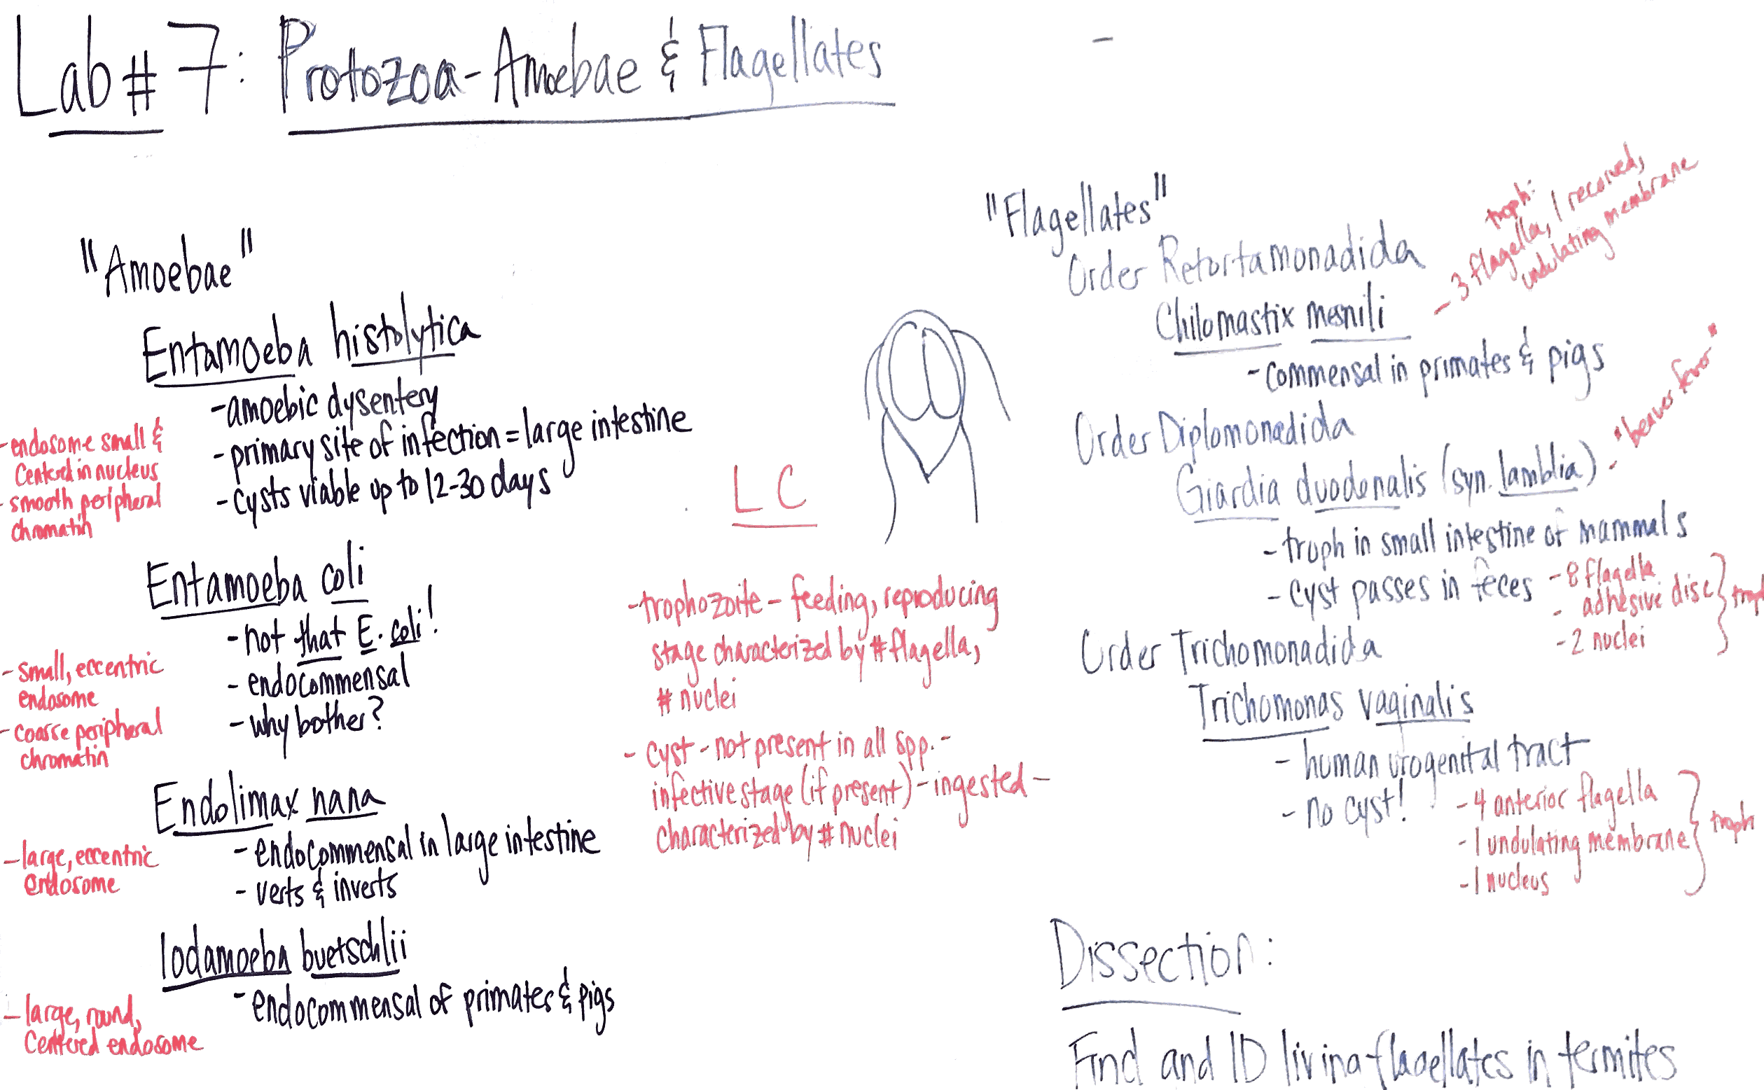







Slide 8
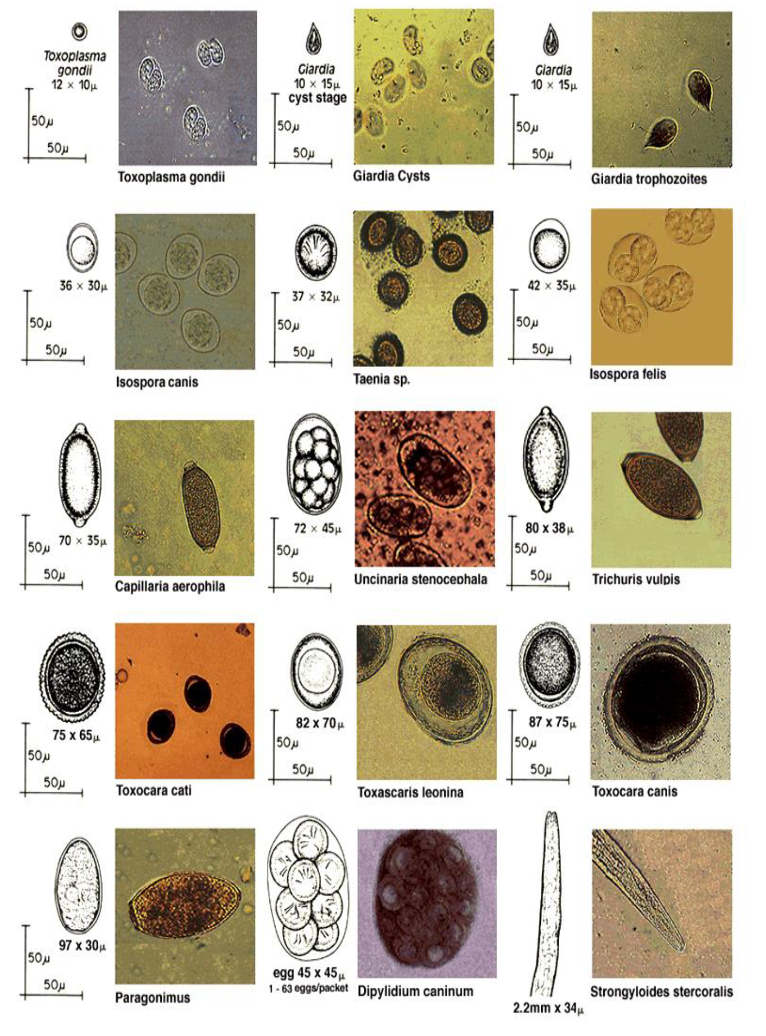

Slide 9
































