Slide 1
Class 16: Arthropods 1

Slide 2
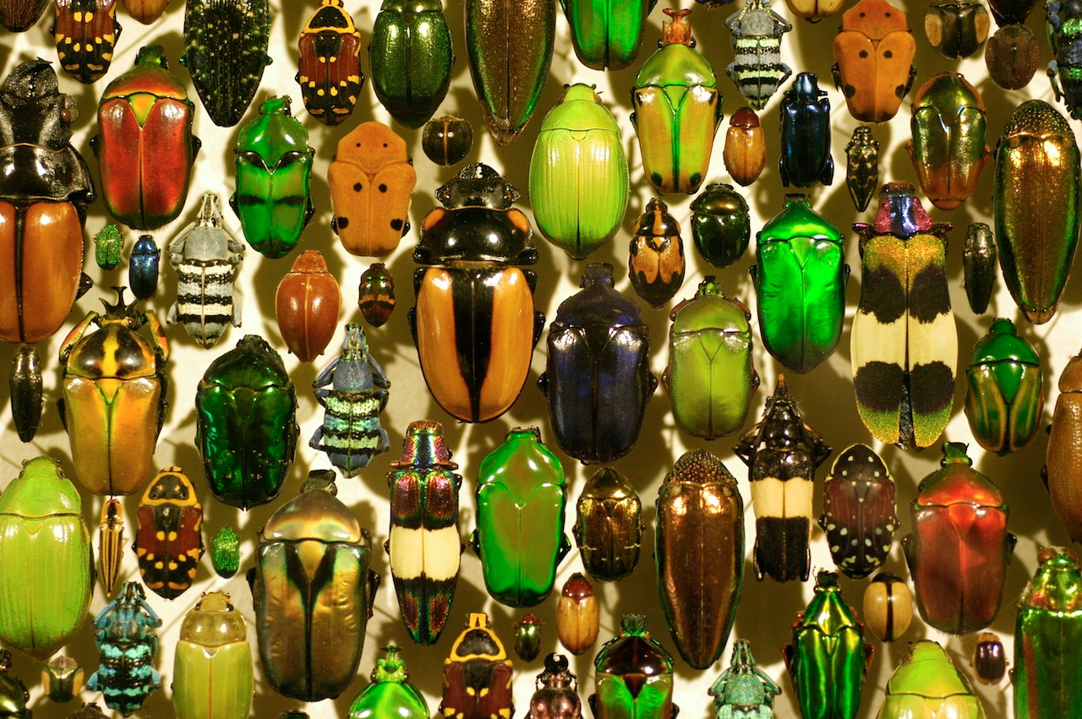

Q1. why so many arthropods?
Arthropods are the most successful group of animals on Earth. They are also pretty successful among the parasites. What traits account for this success?
Ponder on your own (2 m), discuss with your group
(3 m), then share with the class (7 m).

Slide 3
Q2. design your own vector
You are a bacterium that is parasitic in whale sharks but you are terrible at being transmitted through water. You need a vector.
Consider the traits that make a good vector.
Design your vector:
Draw it
Draw its life cycle
Explain why this life cycle makes it a good vector for you.
Ponder on your own (2 m), discuss with your group
(5 m), then share with the class (7 m).

Slide 4
Q3a. Acari or not?

Slide 5

Notes:
Acari or not?
https://www.polleverywhere.com/multiple_choice_polls/f2kmJTnvE7dnnQA8p7ZzO?flow=Default&onscreen=persist

Slide 6
Q3b. Acari or not?

Slide 7
Notes:
Acari or not?
https://www.polleverywhere.com/multiple_choice_polls/f2kmJTnvE7dnnQA8p7ZzO?flow=Default&onscreen=persist

Slide 8
Q3c. Acari or not?

Slide 9
Notes:
Acari or not?
https://www.polleverywhere.com/multiple_choice_polls/f2kmJTnvE7dnnQA8p7ZzO?flow=Default&onscreen=persist

Slide 10
Class 16: Arthropods 1

