Slide 1
Class 26: Your take-home messages

Slide 2
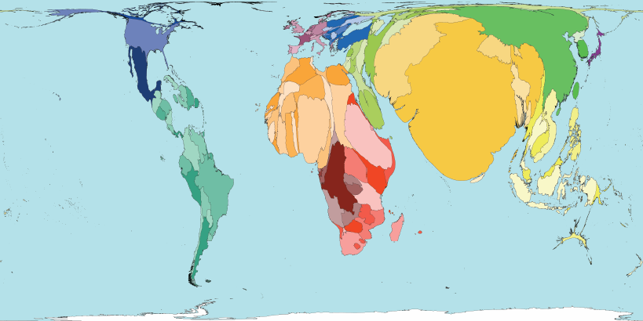

Q1. why the is the burden of human parasites high in the Global South?
We’ve already talked A LOT about poverty as a reason for why so much of the world’s infectious disease burden falls on the “Global South”, but there are also other contributing factors. Brainstorm as many as you can.
Ponder on your own (2 m), discuss with your group
(3 m), then share with the class (7 m).

Slide 3
Q2. What is one thing that you can do to help address NTDs in the developing world?

Slide 4
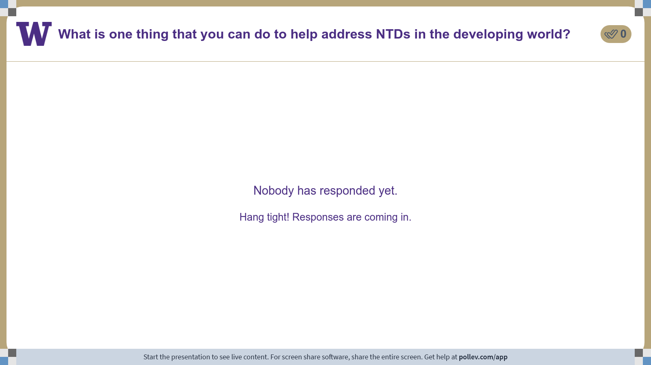
Notes:
Do not modify the notes in this section to avoid tampering with the Poll Everywhere activity. More info at polleverywhere.com/support What is one thing that you can do to help address NTDs in the developing world?
https://www.polleverywhere.com/discourses/xeWFRNguYVqKG9D7X8qVM

Slide 5
Q3. What is the FISH 406 concept that you were most excited to learn?

Slide 6
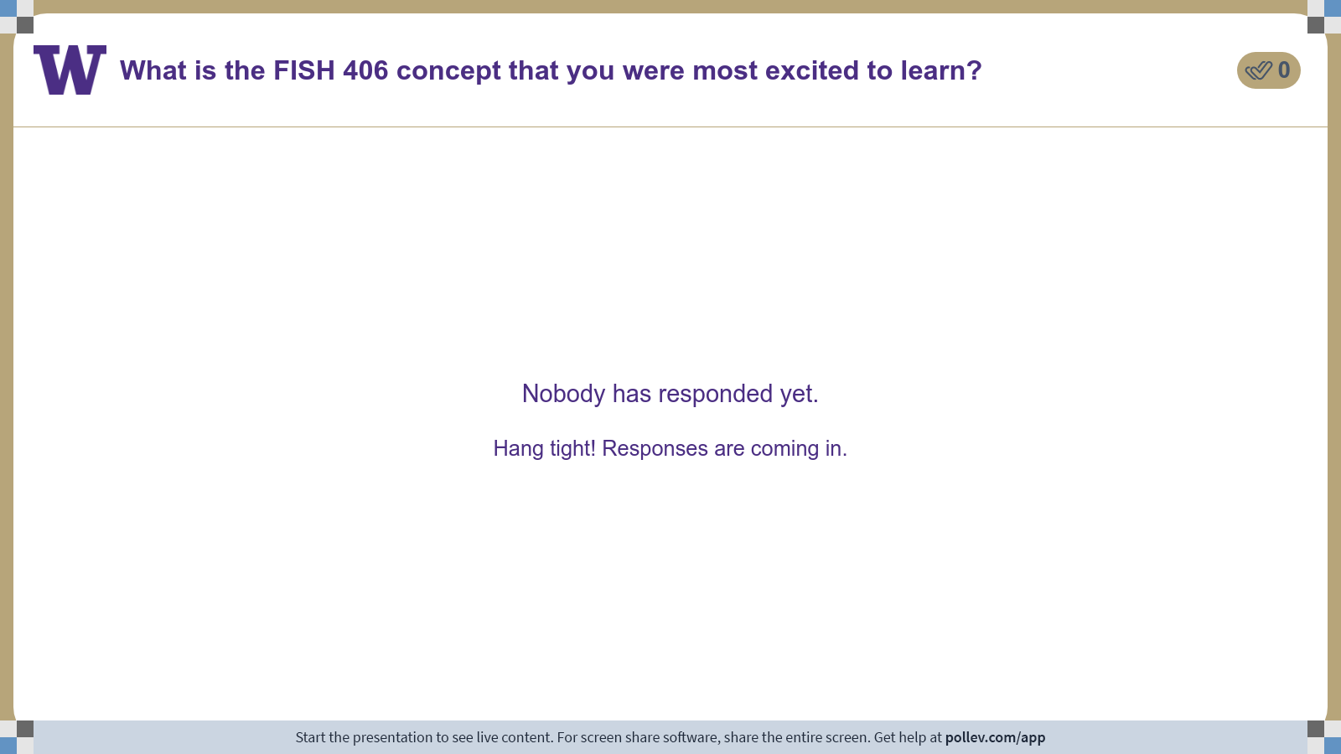
Notes:
Do not modify the notes in this section to avoid tampering with the Poll Everywhere activity. More info at polleverywhere.com/support What is the FISH 406 concept that you were most excited to learn?
https://www.polleverywhere.com/discourses/NG1y0Rz3tDD6uLCE2FzZz

Slide 7
Class 26: Your take-home messages

