Slide 1
Class 6: Turbellarians, fecampiids, and monogenes

Slide 2
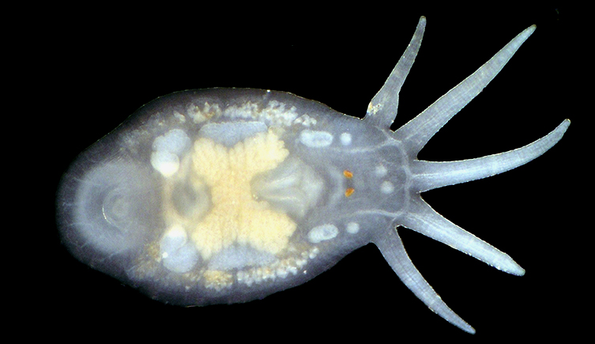
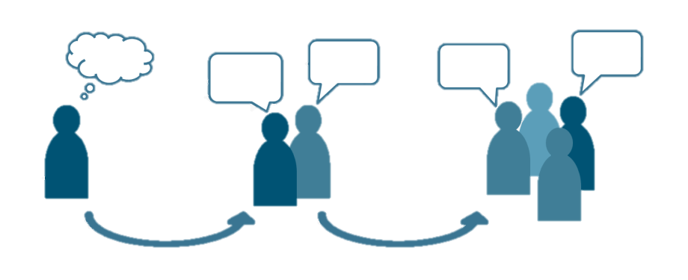
Q1. commensal versus parasite
Turbellarians are generally considered to be commensals, but the line between commensal and parasite can sometimes get blurry.
Think about the temnocephalids (turbellarians parasitic on freshwater crustaceans like crayfish).
What are some circumstances in which temnocephalid commensals might become parasitic?
Generate at least three ideas.
Ponder on your own (5 m) then share with the class (5 m).

Slide 3
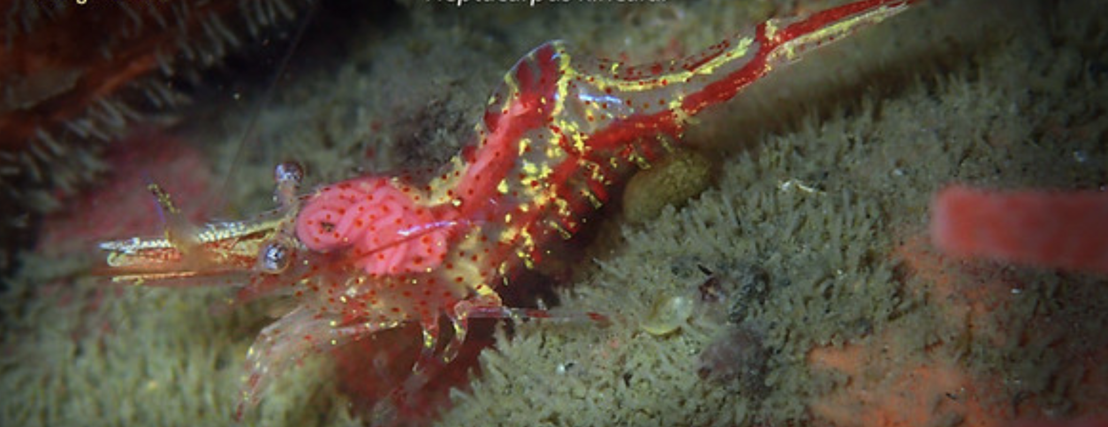
Q2. killing your host
Generally parasites don’t have incentives to kill their hosts.
So why do the fecampiids do it?
Ponder on your own (5 m), discuss with a partner (5 m), then share with the class (5 m).

Slide 4
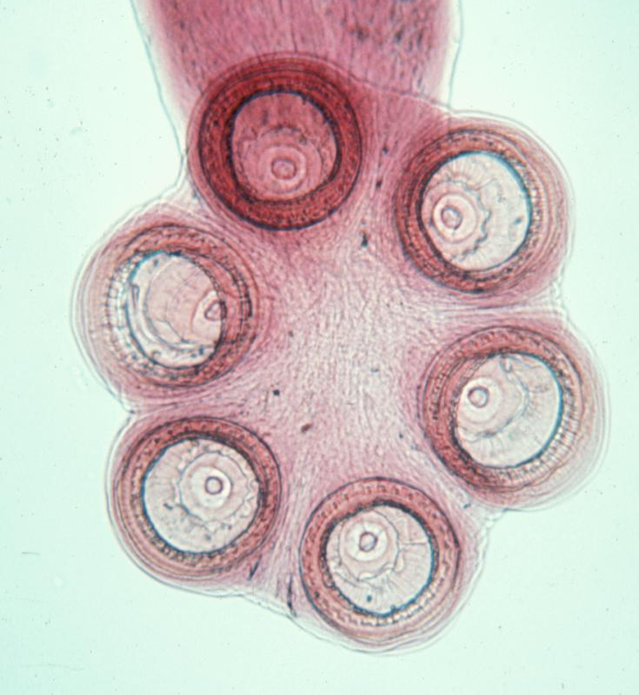
Q3. host specificity
The monogenes exhibit extreme host specificity. If you are a species looking to increase your fitness, is it good or bad to evolve extreme host specificity?
First, brainstorm ideas on our Google Doc.
Then, the class will be split into six groups.
Three groups will argue for the benefits of extreme host specificity.
Three groups will argue for the risks of extreme host specificity.
Google Doc on your own (5 m), then discuss and make a debate plan with your group (5 m), then debate with the class (5 m).

Slide 5
Q4. macroparasites versus microparasites

Slide 6
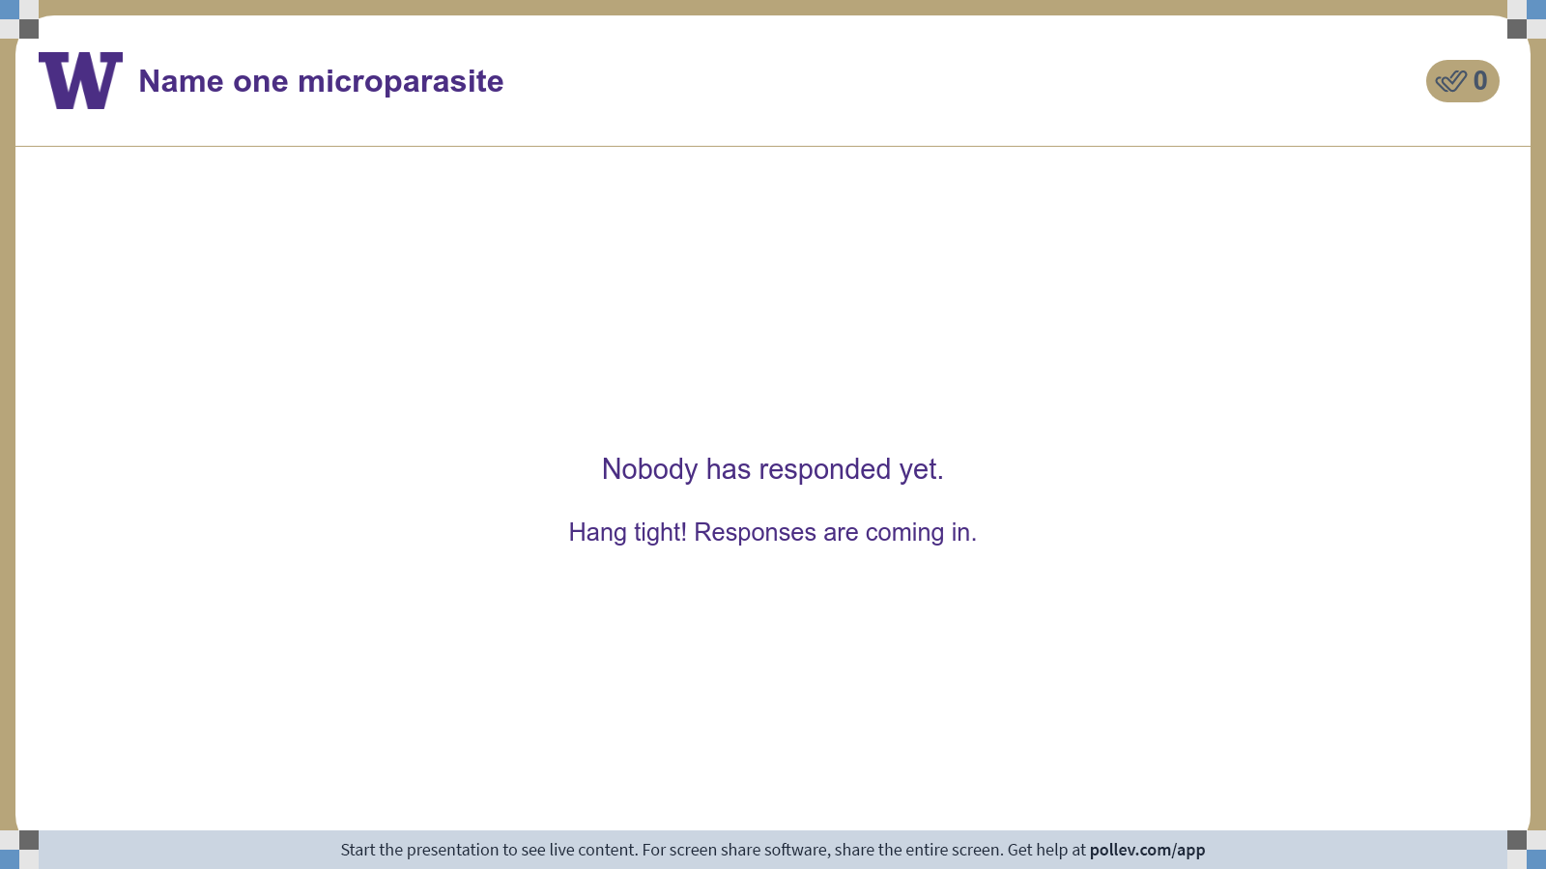
Notes:
Do not modify the notes in this section to avoid tampering with the Poll Everywhere activity. More info at polleverywhere.com/support Name one microparasite
https://www.polleverywhere.com/free_text_polls/1tmJyt0UcEOmnwFFsYh1n

Slide 7

Notes:
Do not modify the notes in this section to avoid tampering with the Poll Everywhere activity. More info at polleverywhere.com/support Name one macroparasite
https://www.polleverywhere.com/free_text_polls/FzcFp94mZGXZ0OD73sF5S

Slide 8
Class 6: Turbellarians, fecampiids, and monogenes

