Slide 1
Class 7: Cestodes 1

Slide 2
Q1. point to the oldest proglottid

Slide 3
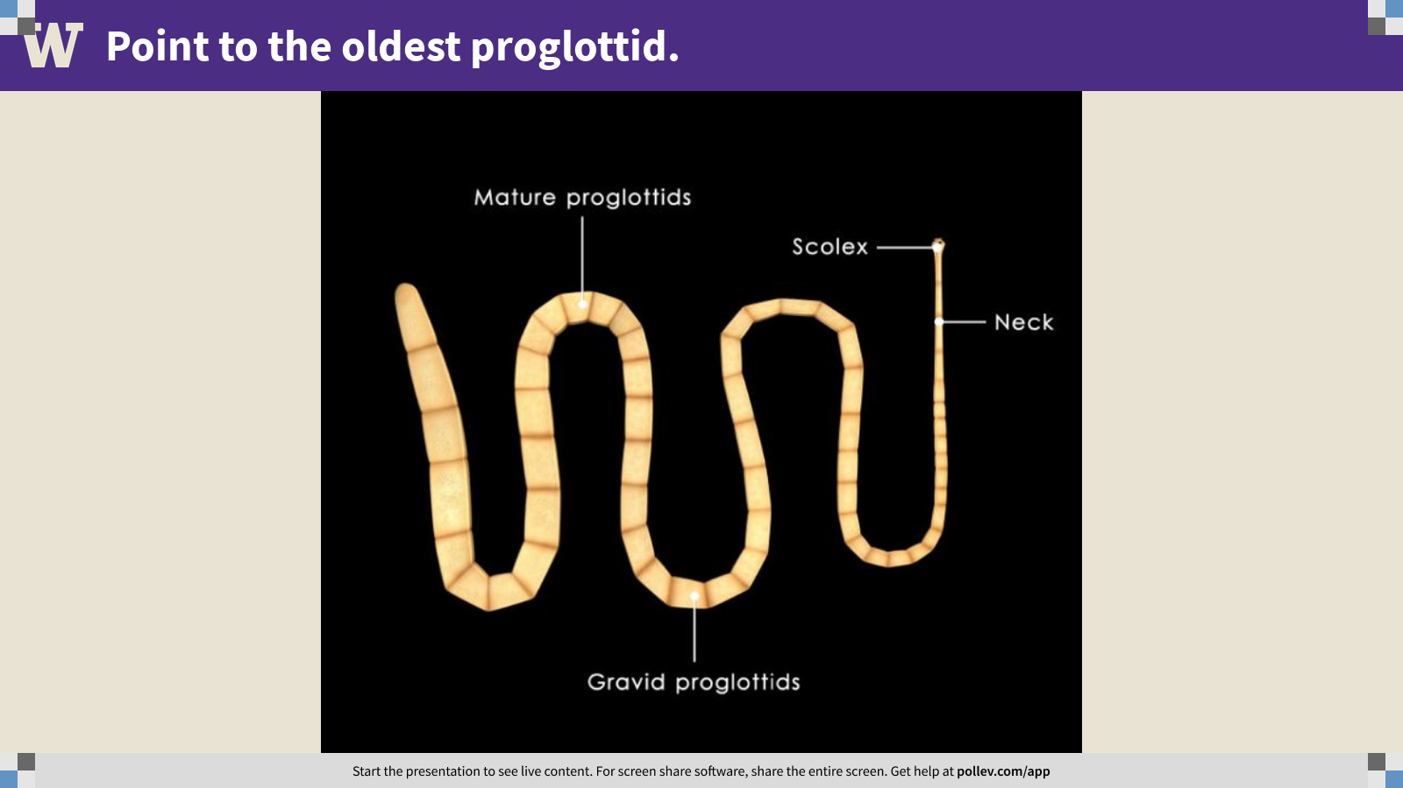
Notes:
Point to the oldest proglottid.
https://www.polleverywhere.com/clickable_images/EQEMkeN9T71ynIOLZce9T

Slide 4
Q2. point to the digestive tract

Slide 5
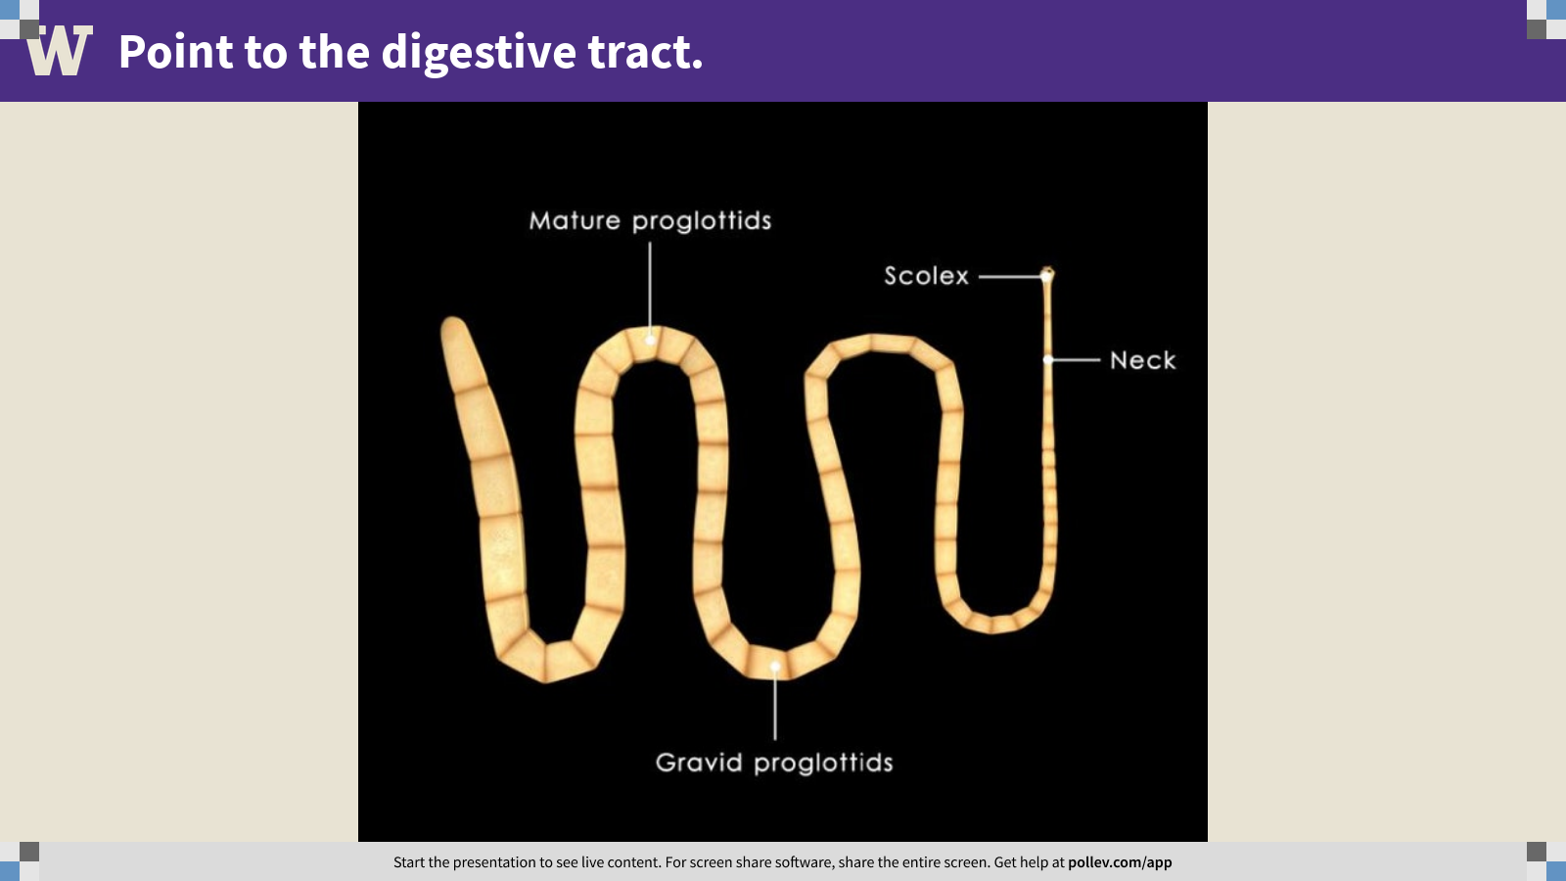
Notes:
Point to the digestive tract.
https://www.polleverywhere.com/clickable_images/dlHV7n50yg4G6HPOKxAW7

Slide 6
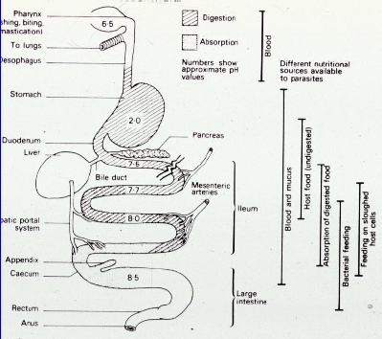
Q3. the vertebrate gut as habitat

Slide 7

Q3. the vertebrate gut as habitat
Imagine you are a tapeworm. Where would you choose to live and why?
Chelsea will put you into NEW GROUPS for discussion. You’ll write your answers on the board (5 m), then share with the class (5 m).

Slide 8
Q4. Would you rather host an adult or larval tapeworm? Why?

Slide 9
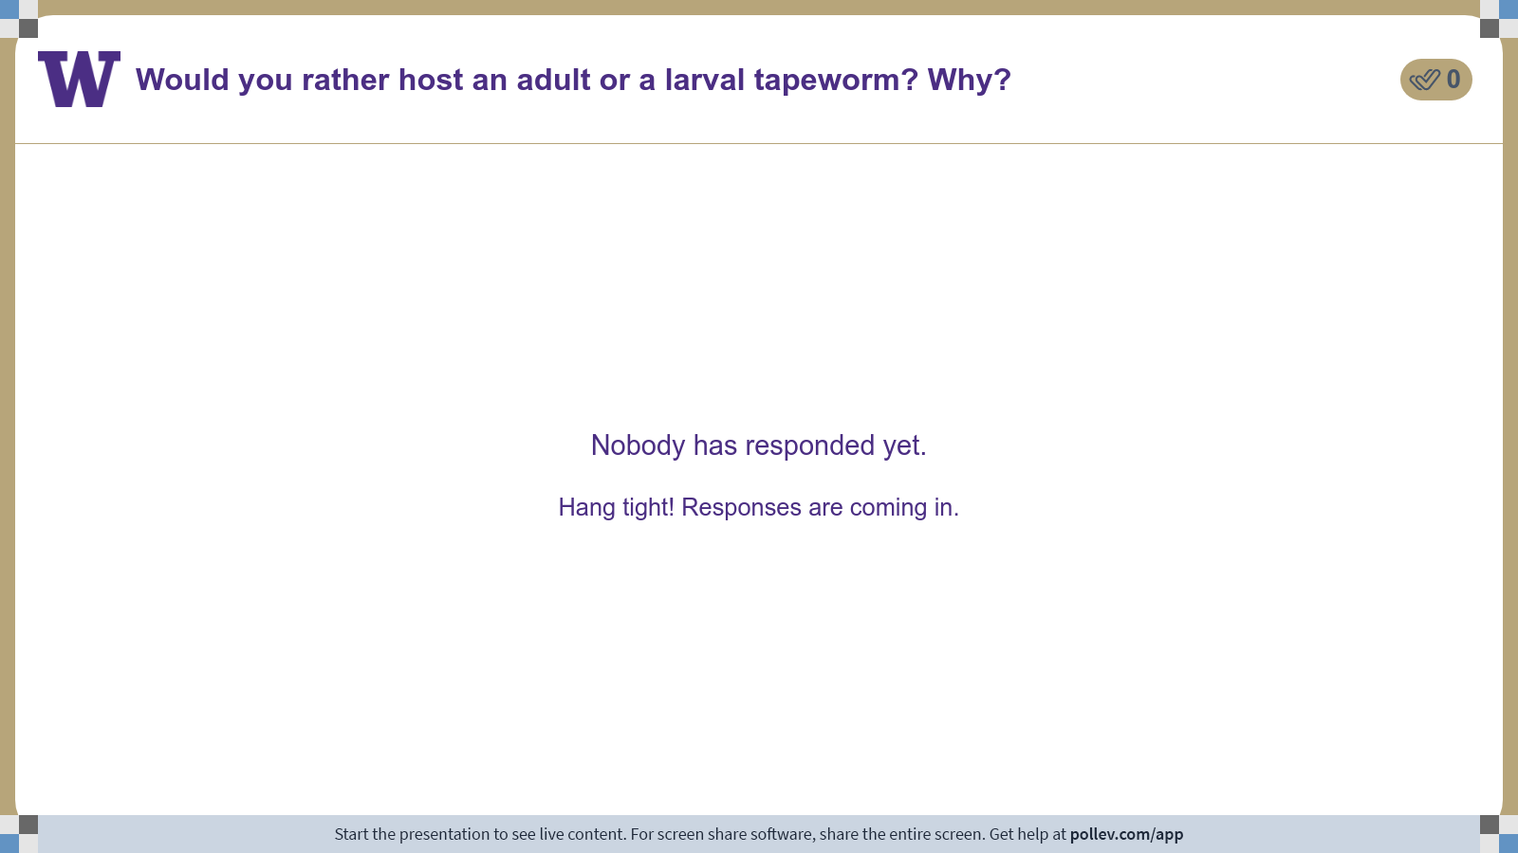
Notes:
Do not modify the notes in this section to avoid tampering with the Poll Everywhere activity. More info at polleverywhere.com/support Would you rather host an adult or a larval tapeworm? Why?
https://www.polleverywhere.com/discourses/vBIAPqZVegpH4w7WjxPPm

Slide 10
Q5. crowding effects?
A coroner keeps track of the distributions of two (made-up) tapeworms that occupy the intestines of bodies sent for autopsy. She counts the number of tapeworms with scolices attached in different sections of the intestinal tract (jejunum -> ileum -> ascending colon -> transverse colon ->descending colon). The table shows the distribution of worms she recovers. Is there evidence for interspecific competition?
Ponder on your own (5 m), discuss with a partner (5 m), then share with the class (5 m).

Slide 11
Class 7: Cestodes 1

