Slide 1
Practical session 14: How to slay a dragon

Slide 3
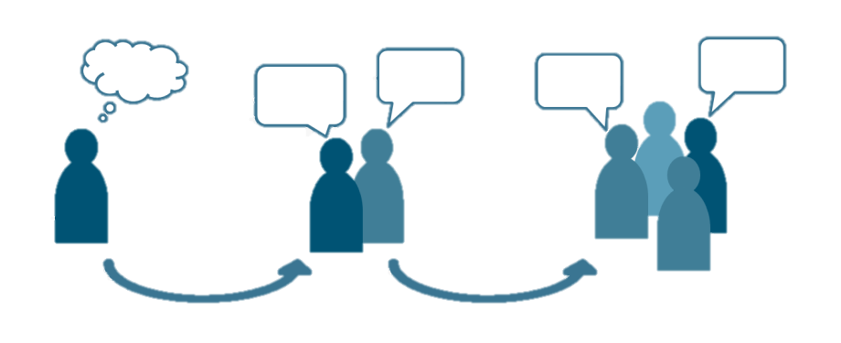
Q1. the poverty trap
Poverty contributes to Guinea worm transmission. But Guinea worm transmission also contributes to poverty. Take a few minutes to discuss the feedback loop between poverty and dracunculiasis. What makes the feedback loop hard to break? What are the factors on each side (poverty / disease) that keep the feedback loop going?
Write on your own (3 m), hone a final answer with your group (4 m), then share with the class (5 m).

Slide 4
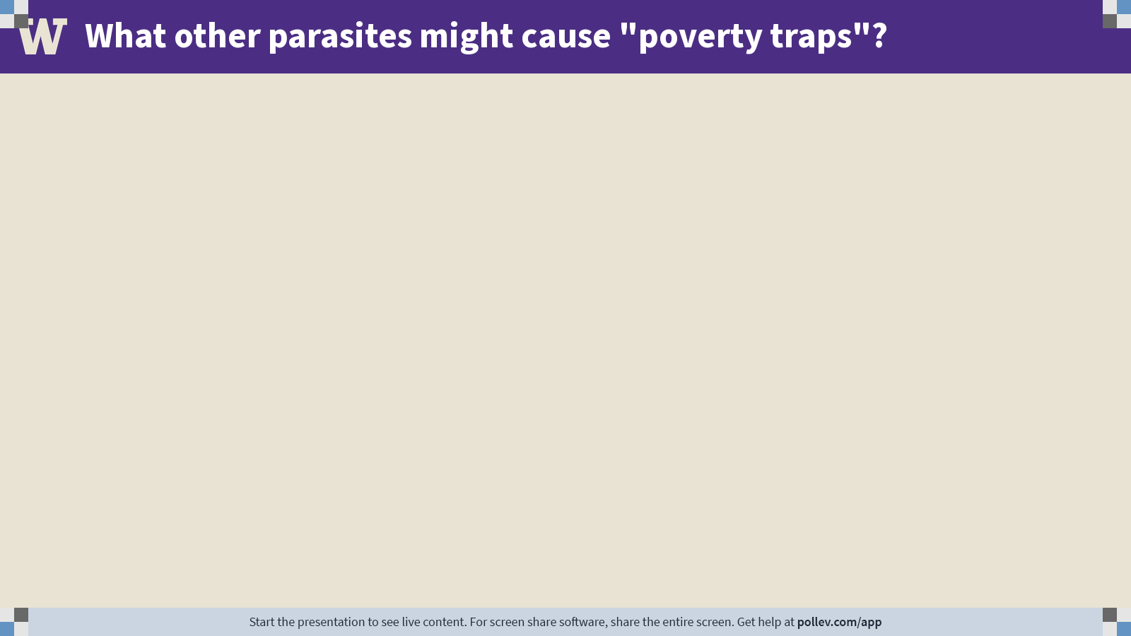
Notes:
Do not modify the notes in this section to avoid tampering with the Poll Everywhere activity. More info at polleverywhere.com/support What other parasites might cause "poverty traps"?
https://www.polleverywhere.com/free_text_polls/iDZ2ysSyiMwbjqJCzrMDE

Slide 5
Q2. eradication
Global eradication of a parasite is difficult to achieve. To date, only two “parasites” have been successfully eradicated following global vaccination efforts: smallpox (1971) and rinderpest, or “cattle plague” (2011). How does the attempted eradication of Guinea worm differ from previous eradication efforts? What steps are being taken and why?
Write on your own (3 m), hone a final answer with your group (4 m), then share with the class (5 m).

Slide 6
Q3. behavioral manipulation
To be considered an adaptive behavioral manipulation (not just a collateral impact of pathology), the behavioral change in question must meet the following criteria:
complex
shows signs of “purposive” design
more likely to be real behavioral manipulations if they have arisen independently in several lineages of hosts or parasites
increases the fitness of the parasite
Do you think that Guinea worm is manipulating the behavior of its vertebrate hosts?
Write on your own (3 m), hone a final answer with your group (4 m), then share with the class (5 m).

Slide 7
Practical session 14: How to slay a dragon

