Slide 1
TEXT SUMMARIZATION IN NLP
Chiriac Ella-Ana-Maria
Semen Valentin-Ion
Stoica Elias-Valeriu

Slide 2
Introduction to Text Summarization
Text summarization is the process of distilling the most important information from a source text to produce a condensed version.

Slide 3
Applications of Text Summarization
News Industry: Quickly generating summaries of news articles for readers on the go.
Academia: Summarizing research papers, thesis, and lengthy academic materials.
Business: Condensing reports, emails, and documents to save time in corporate environments.
Legal Field: Summarizing legal documents and case law for quicker analysis.

Slide 4
Benefits of Text Summarization
Efficiency: Saves time by reducing the amount of text to read.
Accessibility: Makes information more accessible to people with time constraints or cognitive disabilities.
Scalability: Helps in handling and analyzing large volumes of information.
Improved Decision Making: Facilitates quicker and better-informed decisions by highlighting key information.

Slide 5
Datasets

Slide 6
Datasets
For this project we used the RO Text Summarization dataset, provided by Reader-Bench and Alexandru Patrachi and the AlephNews dataset. Both are hosted on Hugging Face.
The datasets are specifically created for the Romanian language and represent a valuable resource for the task of Romanian text summarization, containing a variety of news articles and informational content.
https://huggingface.co/datasets/readerbench/ro-text-summarization
https://huggingface.co/datasets/readerbench/AlephNews

Slide 7
Datasets
Each dataset entry is composed of an original text and its corresponding summary, which helps both training and validating the model’s accuracy.
The RO Text Summarization dataset comes with a training and a test component, while the AlephNews dataset adds a validation component too.
Also, the AlephNews dataset has its original text structured into a list of paragraphs, as opposed to the Ro Text Summarization which has it as a singular text string.

Slide 8
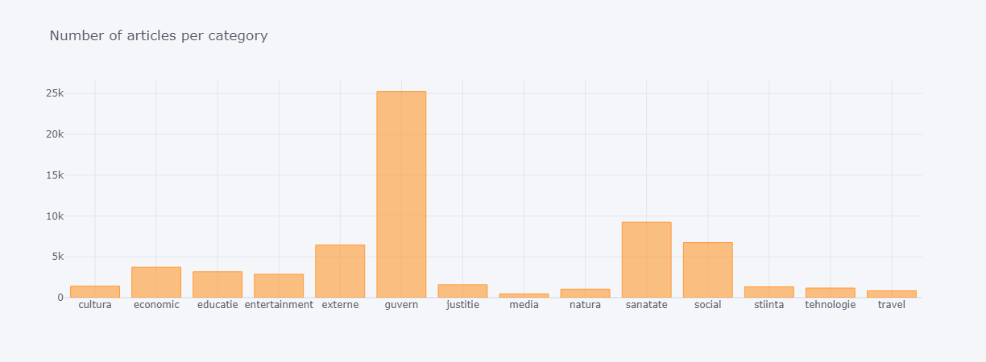
Datasets

Slide 9
Datasets
Both datasets encapsulate a broad amount of information from various domains. This is useful, as the trained model would understand and perceive multiple types of information and topics.

Slide 10
Preprocessing

Slide 11
Preprocessing
Preprocessing is one of the most important parts when developing a NLP project. For this particular project, we have used several preprocessing methods, that are optimized for the Romanian language.

Slide 12
Preprocessing
Cleaning The Text
The first step involved cleaning the text for reducing noise and normalizing the data. We achieved this by removing unnecessary elements such as URLs, addresses, HTML tags, whitespaces, notes. In addition, we modified the corpus into a cleaner format by getting rid of special characters/punctuation using regular expressions and by lowering its case. This standardization removes irrelevant elements that might confuse the model.

Slide 13
Preprocessing
Tokenization
Using NLTK, we tokenized the text into individual sentences. we prepare the data for the Graph Based method for summarization, where any information between each two sentences will be of utmost importance.
For the abstractive methods, the tokenization functions return lists of integers(input IDs, labels) from the raw text, maintaining correct input length via truncation and padding, so that the data could be correctly used with models like Transformers. Also, the prefix “summarize” is added before each paragraph which serves as an instruction or task to the model.
The returned format includes
-Input IDs: sequences of integers representing the input tokens obtained after applying the tokenizer to the input text.
-Attention Mask: sequence of integers of the same length, 1 if the respective token is a real token and not padding, 0 if it is padding
-Labels: sequence of integers representing the tokenized form of the target summary.

Slide 14
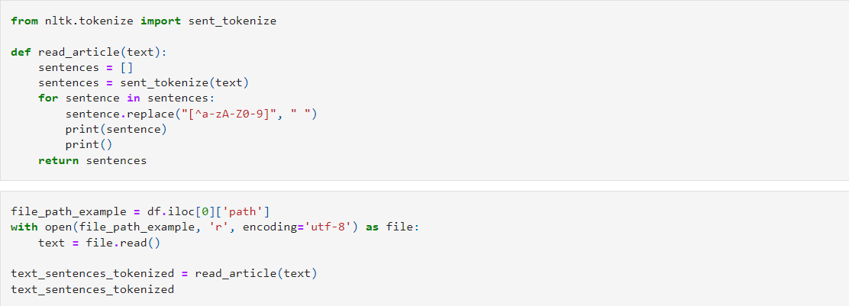
Preprocessing - Extractive method

Slide 15
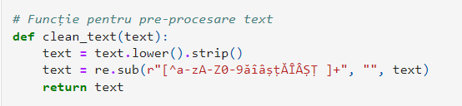
Preprocessing - Abstractive method - Marian

Slide 16
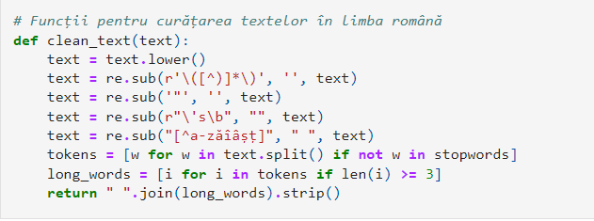
Preprocessing - Abstractive method - LSTM

Slide 17
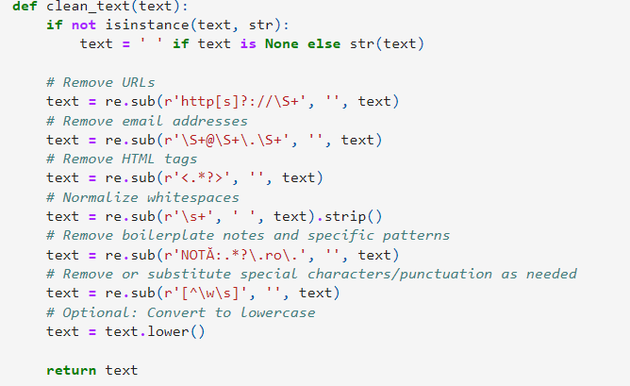
Preprocessing - Abstractive method - T5 Small

Slide 18
Types of implemented methods

Slide 19
Extractive VS. Abstractive methods
The extractive method represents forming a summary from the selection of extracts taken from a corpus.
The abstractive method represents paraphrasing the corpus using newly generated sentences.

Slide 20
Extractive method

Slide 21
Extractive method
The extractive method in text summarization involves selecting and using key sentences from the source text, maintaining the original wording. It uses algorithms to decide which sentences or parts are most relevant, based on criteria such as word frequency. The main advantage of this method is its ability to maintain the factual accuracy of the information, as it does not alter the original wording of the text.

Slide 22
Extractive method - Graph Based
In this method, every sentence of the news text is considered as a vertex of a graph. These sentences are connected with an edge if there exists a common semantic relation between them, and based on this score each edge has a weight. A graph based ranking algorithm is used to decide the importance of each vertex within the graph. The ones with high cardinality (high number of edges connected to it) are considered important sentences and are included in the summary.
For computing the similarities among all the sentences and returning the ones with maximum scores, we use Cosine Similarity as the similarity matrix and TextRank algorithm to rank them based on the importance. vertices and all the links between them as edges.

Slide 23
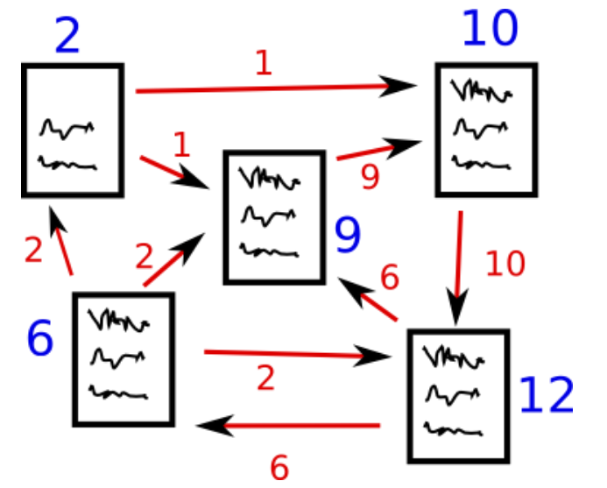
Extractive method - Graph Method

Slide 24
Extractive method - PageRank Algorithm
The PageRank algorithm is the algorithm behind TextRank, that is why we will describe it first. This popular graph based algorithm, which is also used by Google to rank the web pages based on thesearch result, creates a graph with all the pages as vertices and all the links between them as edges.
Then, it calculates the score for each page, like a probability of it being visited by the user. In this way, it manages to display the most relevant links and pages first, which is a good practice in keeping people connected and focused on this activity.

Slide 25
Extractive method - TextRank Algorithm
We use a similar approach but on the similarity of sentences instead of the probability of visiting a page. The most important point of any graph based algorithm is the VOTE. Each vertex that has a link to another one casts a vote for that vertex. Higher the number of votes, higher the importance of that vertex. In order to calculate the score of a vertex, we take into consideration two factors: the number of votes cast for it, and the importance of the vertices that cast votes for it.
After extracting and creating vectors for all sentences, we need to calculate the Cosine Similarity between each pair of sentences. Given a document with n sentences, we construct an n × n similarity matrix, S, where each element Sij represents the similarity between sentence i and sentence j.
This matrix is symmetric, with diagonal elements representing the self-similarity of each sentence, typically set to 1. With this matrix, we can rank the sentences based on the similarity score and return the first N number of sentences that are relevant and must be included in the summary.

Slide 26
Abstractive methods

Slide 27
Abstractive method
The abstractive method in text summarization implies capturing the essence of the original text, often employing paraphrasing techniques. It goes beyond extracting content to actually interpret the main ideas of the text in a new form. This method usually relies on advanced NLP models to understand and recreate the context and meaning. While it can provide more fluid summaries, the factual accuracy can decrease, due to the text reinterpretation.

Slide 28
Abstractive method
For the abstractive approach, we have tried multiple models, including pre-trained and custom models.
Pre-trained
Marian
T5 Small
BART Large
Custom
LSTM based model

Slide 29
Abstractive method - Marian
We tried using the pretrained model, MarianMT, known for its robustness in language translation tools. This model is trained using the Marian framework and it is optimized for accurate translations. We have tried to adapt this to the text summarization task.
A translation tool is useful in the context of text summarization, as it extracts and understands the context, before translating it, which is exactly what we need in order to summarize a text.

Slide 30
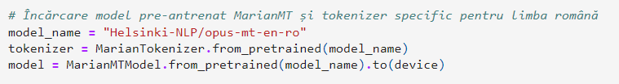
Abstractive method - Marian
We used the Romanian-English Marian model, for higher accuracy on our data.

Slide 31
Abstractive method - T5 Small
Another attempt was done using the Small variant of the T5 Model. The model, designed by Google Research and built on the Transformers architecture, frames all its text-based tasks as a text-to-text problem, where both the input and output are text strings.
T5 Small is a scaled down version of the T5 model, making it faster and less resource-intensive, while still borrowing the Transformers architecture.
The text-to-text approach facilitates the use of a single model across multiple tasks, which enhances the model’s flexibility and scalability.

Slide 32
Abstractive method - BART Large
The BART(Bidirectional And Auto-Regressive Transformers) Large model, designed by Facebook, is a transformers-based machine learning model specifically designed for NLP problems with a strong emphasis on text generation, thus making it a good contender for our project.
BART’s architecture is similar to the original transformer model with an encoder component which processes the input text using a bidirectional mechanism, similar to the BERT Model, allowing BART to have a better understanding of the context from both directions.
BART’s decoder generates text auto-regressively, similar to the GPT Model, predicting the next token based on the previously generated tokens, alongside the context provided by the encoder.

Slide 33
Abstractive method - LSTM Based Model
In addition to the pre-trained models, we have tried to also create a custom model, based on Long-Short Term Memory networks. LSTMs are useful for sequence prediction tasks, as they can remember information for long periods.
Our LSTM model was designed to gradually refine its understanding and generation of summaries through a series of recurrent layers.

Slide 34
Fine Tuning

Slide 35
Training/Fine-Tuning - Marian
The model is trained using the AdamW optimizer and has a learning rate that adjusts itself during the training.

Slide 36
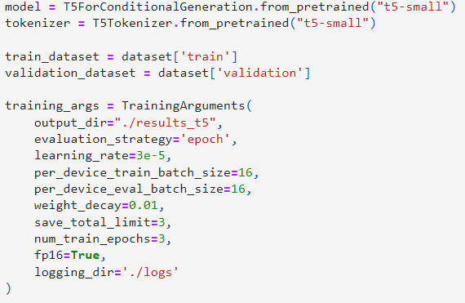
Training/Fine-Tuning - T5 Small
s
The model undergoes fine-tuning by training on the custom dataset with the respective training arguments, specifying batch size, learning rate, evaluation strategy, number of epochs and so on.

Slide 37
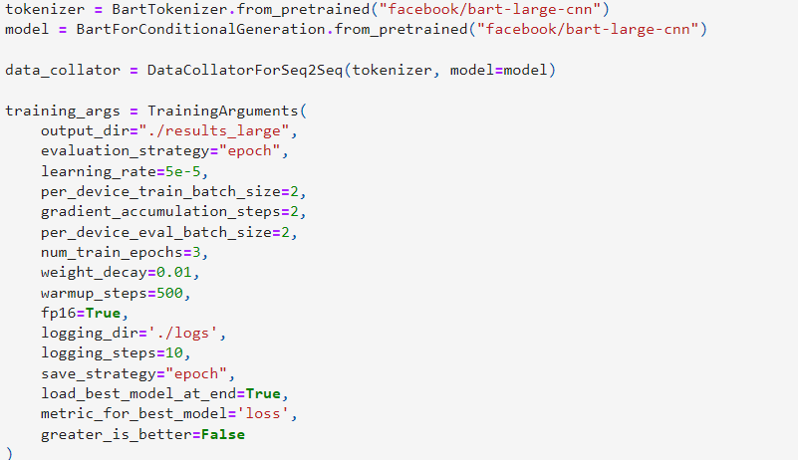
Training/Fine-Tuning - BART Large
The trainer instance is used to fine-tune the model with these parameters, utilizing gradient accumulation to handle small batches efficiently. The best model, along with the tokenizer, based on the lowest evaluation loss is saved. In addition, a DataCollatorForSeq2Seq is used to structure the data for the input/output pairs

Slide 38
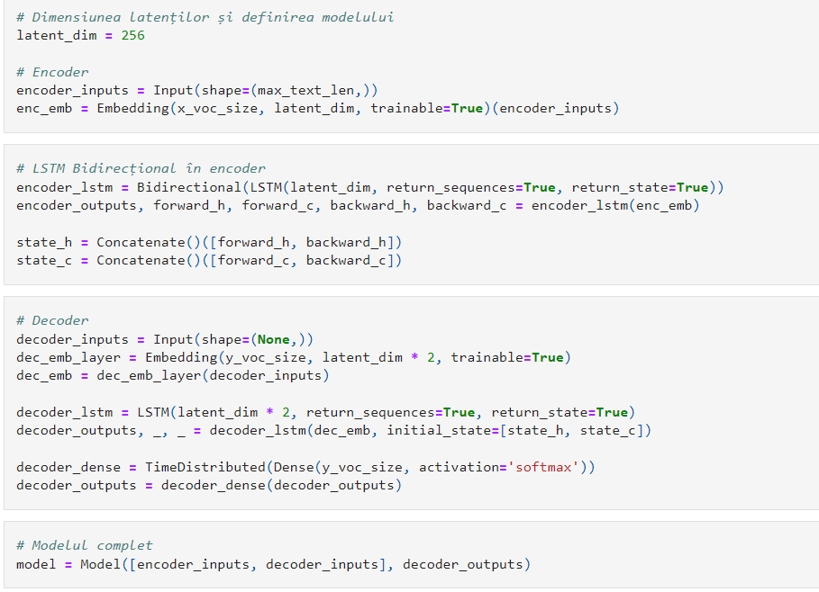
Training/Fine-Tuning - LSTM Model
Long Short-Term Memory (LSTM) networks are a type of recurrent neural network (RNN) designed to recognize patterns in sequences of data, ideal for processing text for tasks like summarization.
We tried implementing a sequence-to-sequence (seq2seq) model using LSTMs for automatic text summarization.
Encoder: Processes the input text using a bidirectional LSTM to capture contextual information from both directions (forward and backward).
Decoder: Uses the states from the encoder to generate a summary, producing one word at a time until the summary is complete.

Slide 39
Results

Slide 40
Results
The ROUGE (Recall-Oriented Understudy for Gisting Evaluation) metrics are a set of measures widely used in the evaluation of automatic text summarization and other natural language processing tasks.
The BLEU score measures how many n-grams in the generated text match the reference text, adjusted for the proportion of matches. It primarily evaluates the fluency and accuracy of the generated summaries compared to the reference summaries. Unlike ROUGE that focuses more on recall, BLEU provides a balance of precision and recall, making it a valuable metric for summarization tasks
These metrics assess how closely the computer-generated summaries resemble reference summaries created by humans. Here, we outline the most commonly used ROUGE metrics in our study.

Slide 41
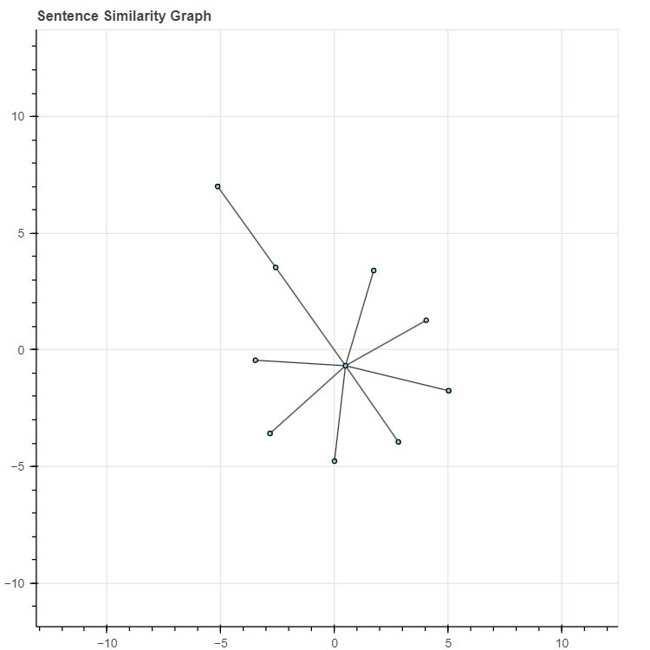

Results - Extractive
The Universal Sentence Encoder (USE), developed by Google, is designed to convert text into high-dimensional vectors. These vectors are then used to calculate sentence similarities. The similarity between two sentences, s1 and s2, is computed as follows:
where x and y are the vector embeddings of s1 and
s2, respectively, obtained using USE.

Slide 42
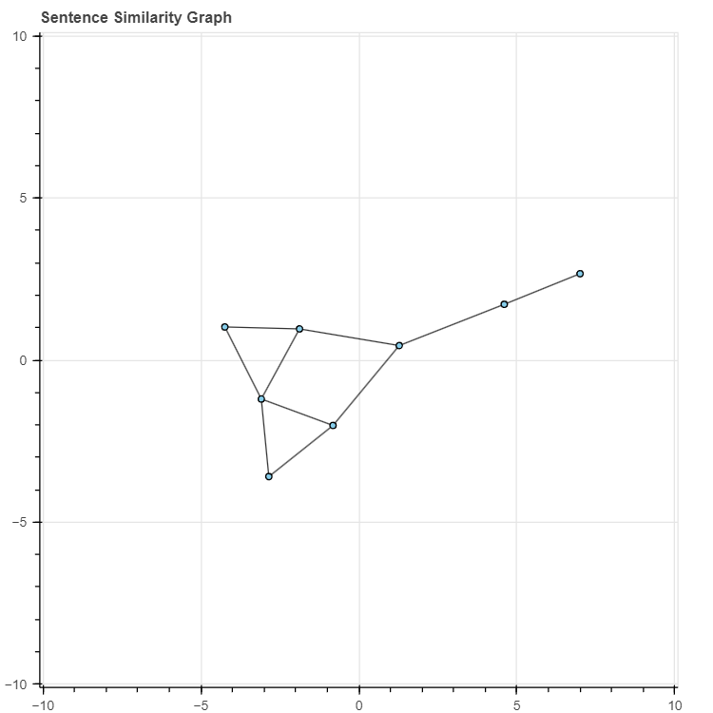
Results - Extractive
The Sentence Transformers framework, specifically the “paraphrase-xlm-r-multilingual-v1” model is a framework that enhances the BERT architectures to produce more accurate embeddings for sentence similarity tasks. The cosine similarity between two sentence embeddings is calculated as:
where e1 and e2 are embeddings of s1 and s2.

Slide 43
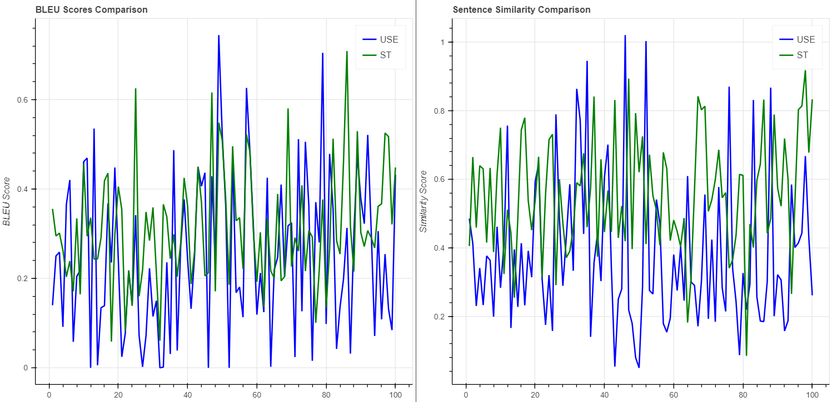
Results - Extractive
Both methods output a similarity score that ranges from -1 (completely dissimilar) to 1 (identical), which we then utilize to populate the similarity matrix S.

Slide 44
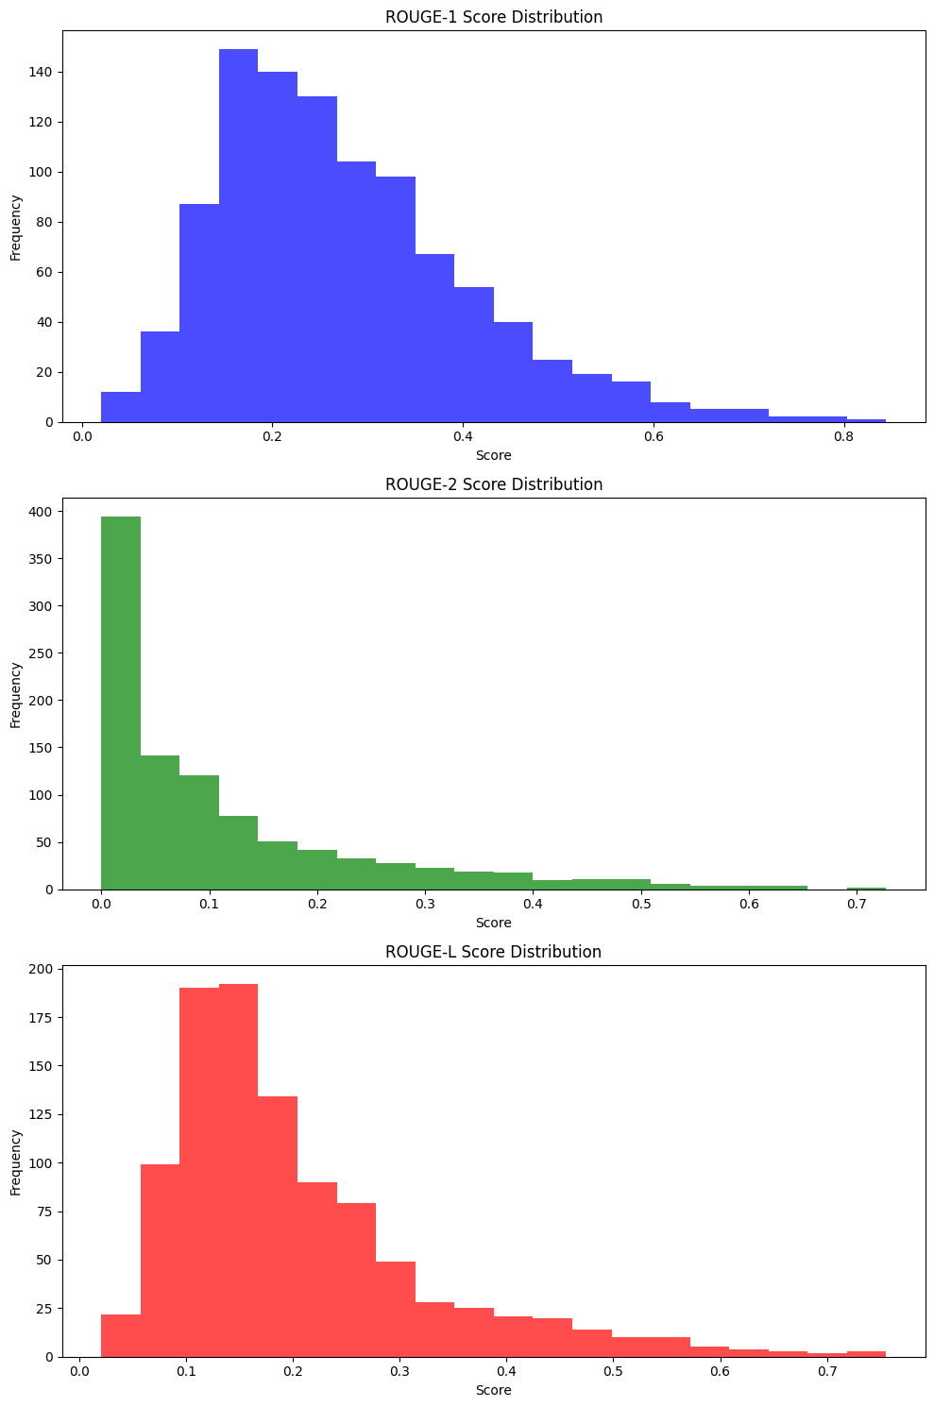
Results - Marian
Average ROUGE-1 F-Measure: 0.275
Average ROUGE-2 F-Measure: 0.111
Average ROUGE-L F-Measure: 0.203
Overall BLEU Score: 0.042
ROGUE-1: Achieving an average score of 0.275, this indicates that approximately 27.5% of the generated summaries matched the original summaries. The score distribution suggests moderate effectiveness with most scores distributed from 0.1 to 0.3.
ROGUE-2: With an average score of 0.111, this score reflects challenges in maintaining coherent word sequences and the logical flow of ideas, with most scores under 0.2.
ROGUE-L: The average score of 0.203 indicates the model's limited ability to preserve longer words, with scores ranging from 0.1 to 0.3.
BLEU-SCORE: The score of 0.042 points to substantial challenges in achieving summaries that closely mirror the original texts, indicating issues with fluency and grammatical accuracy.

Slide 45
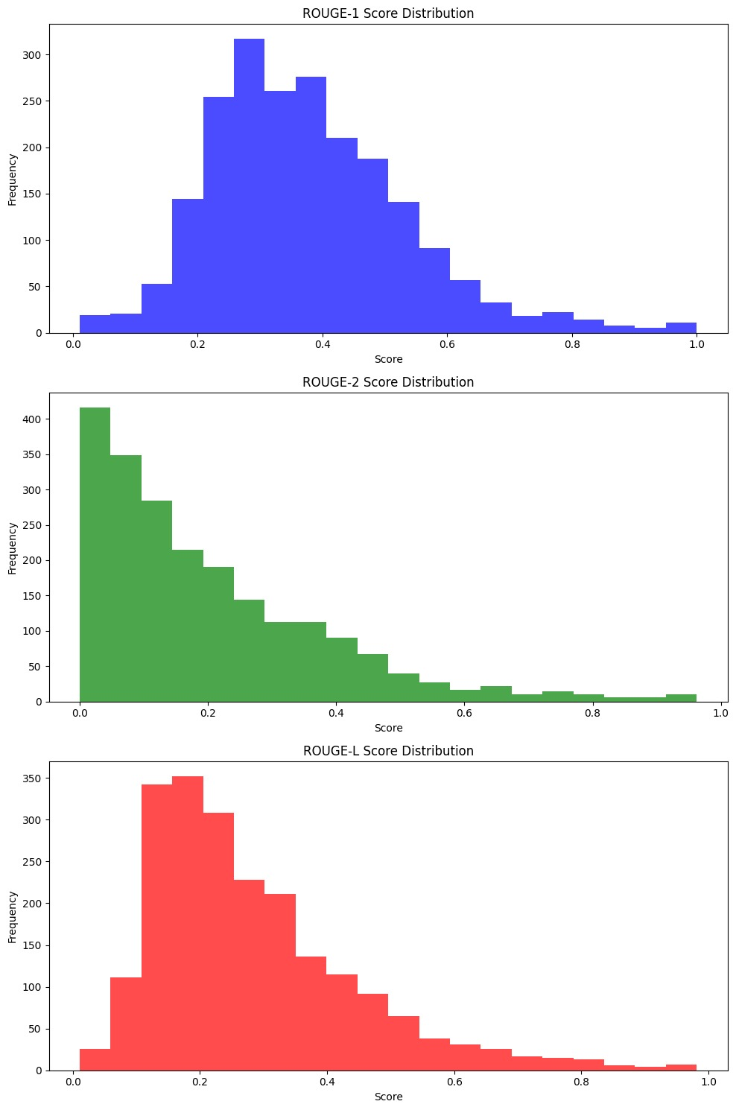
Results - T5 Small
Average ROUGE-1 F-Measure: 0.378
Average ROUGE-2 F-Measure: 0.201
Average ROUGE-L F-Measure: 0.283
Overall BLEU Score: 0.151
ROGUE-1: The average ROUGE-1 score was 0.378, indicating that approximately 37.8% of the generated summaries matched the original summaries. The distribution primarily spans from 0.2 to 0.6, peaking between 0.3 and 0.4, suggesting moderate effectiveness in capturing key information.
ROGUE-1: The average ROUGE-2 score was 0.201, demonstrating that 20.1% of diagram from the generated summaries matched the original ones. This score, which is lower compared to ROUGE-1 reflects the model's difficulty in maintaining coherent word sequences. The majority of scores were below 0.2, indicating struggles in preserving sentence coherence.
ROGUE-L: With an average score of 0.283, the ROUGE-L metric shows that about 28.3% of the longest common subsequences were correctly captured, highlighting challenges in maintaining longer word structures consistently. Scores mostly ranged between 0.1 and 0.3, underscoring issues with retaining structured language over longer stretches.
BLEU-SCORE: The BLEU score of 0.151 points to substantial challenges in achieving translations or summarizations closely mirroring the reference texts.

Slide 46
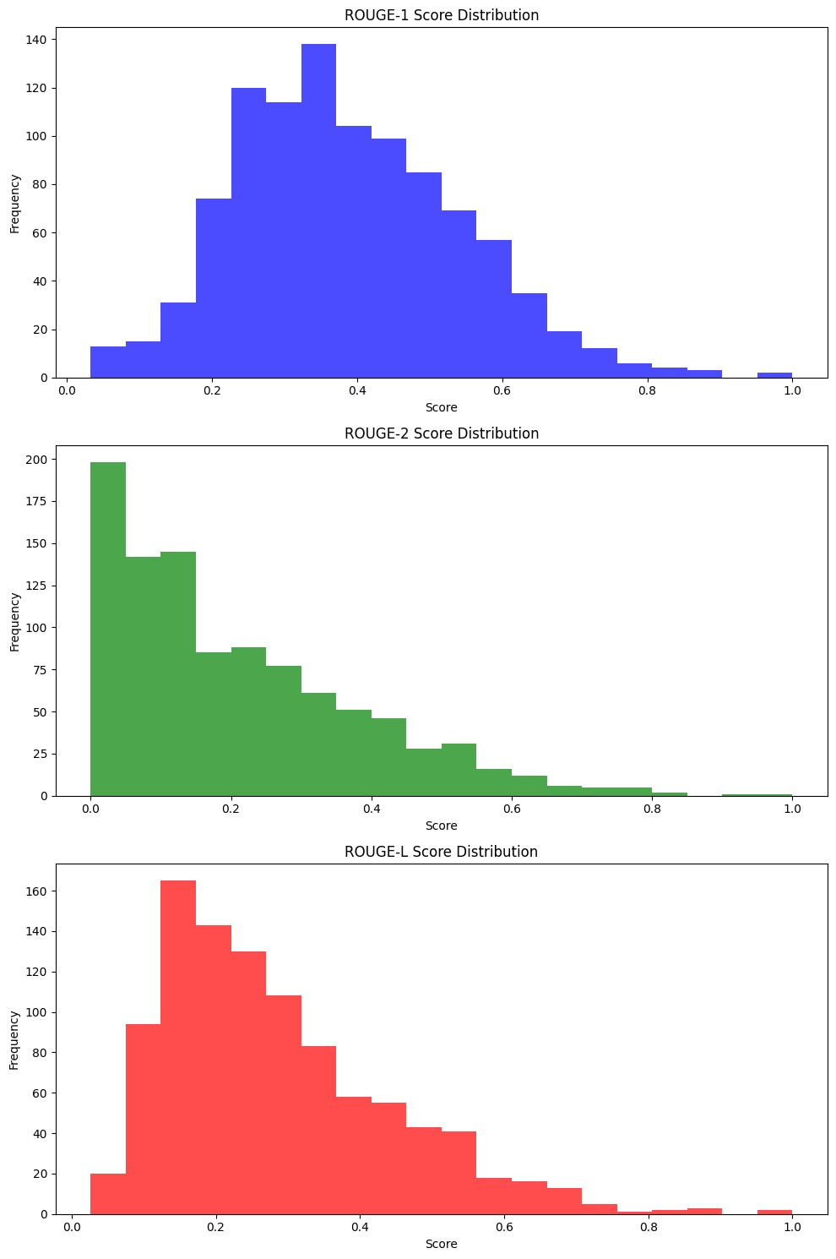
Results - BART Large
Average ROUGE-1 F-Measure: 0.389
Average ROUGE-2 F-Measure: 0.208
Average ROUGE-L F-Measure: 0.285
Overall BLEU Score: 0.160
ROGUE-1: The average ROUGE-1 score was 0.389, indicating that about 38.9% of the generated summaries matched the original summaries. This demonstrates a relatively good capability of the model to capture essential keywords from the source texts, with most scores clustering around 0.3 to 0.4.
ROGUE-2: Achieving an average score of 0.208, this metric shows the model's moderate effectiveness in maintaining coherent sequences, with most scores falling between 0.1 and 0.3.
ROGUE-L: The average ROUGE-L score of 0.285 signifies the model's capacity to align about 28.5% of the longest common subsequences with the reference summaries, indicating a moderate ability to maintain text structure over longer stretches.
BLEU-SCORE: A BLEU score of 0.160, though modest, indicates an improvement in the fluency and grammatical accuracy of the generated texts compared to the original texts, compared to the previous models.

Slide 47
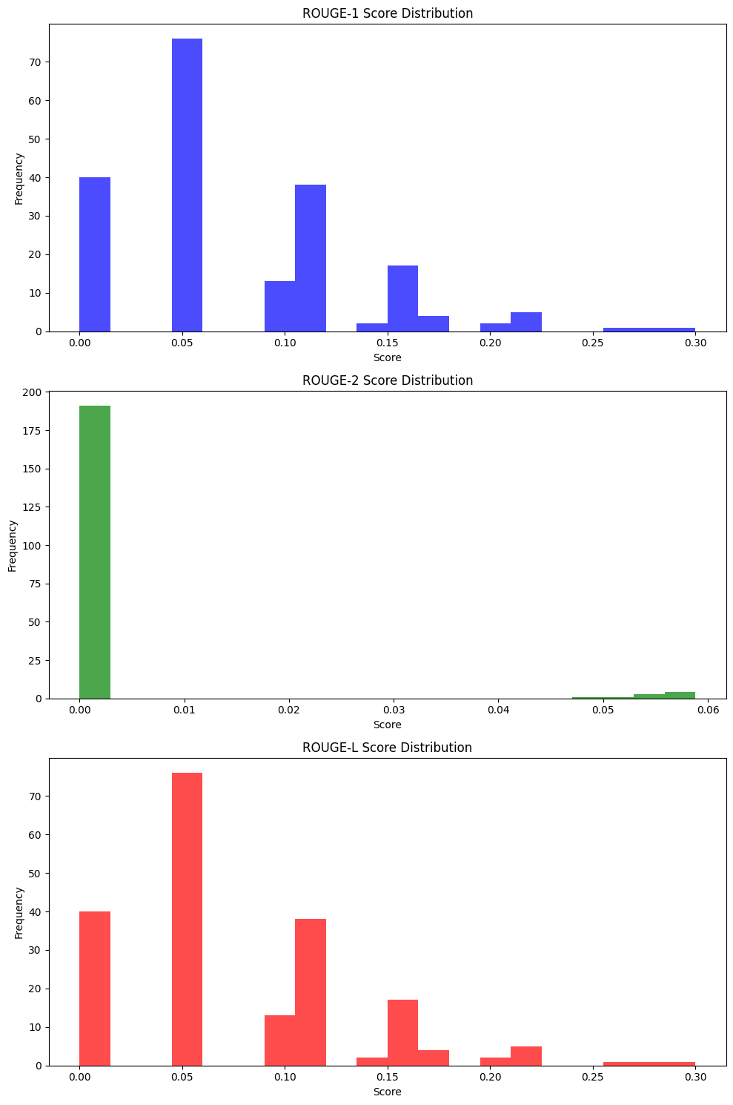
Results - LSTM Based model
Average ROUGE-1 F-Measure: 0.077
Average ROUGE-2 F-Measure: 0.002
Average ROUGE-L F-Measure: 0.077
Overall BLEU Score: 0.111
ROGUE-1: The average ROUGE-1 score of 0.077 indicates that only about 7.7% of the generated summaries matched the original summaries, suggesting poor capture of essential content.
ROGUE-2: An extremely low average score of 0.002 reveals major difficulties in maintaining coherent word sequences.
ROGUE-L: The average score, also at 0.077, underscores similar challenges in preserving the order and structure of words in the summaries, aligning poorly with the original summaries.
BLEU-SCORE: A BLEU score of 0.111, while relatively better than the ROUGE scores, remains low, highlighting the generated texts' lack of fluency and grammatical accuracy compared to the reference texts.

Slide 48
Conclusions

Slide 49
Conclusions
Going through all of these results, we can definitely say that BART Large is the most adequate model for the text summarization purpose, since it provided the best ROGUE and BLEU scores.
The extractive method was also very effective, even more effective than some abstractive models we have implemented.

Slide 50
Further work
It would be very interesting to look further into the custom LSTM model, and play a bit more with the parameters in order to get a more satisfying result for the text summarization tool. However, this can be a very time-consuming task due to the large amount of resources the model consumes when using larger parameters.

Slide 51
Positive & Negative aspects
During this process, we have encountered both positive and negative aspects:
Positive
We “played” with lots of different models, in order to try to achieve the best results
We experienced the clash between simple exercises and real-world scenarios by trying to resolve one underrated problem in today's world.
Negative
As previously mentioned, some of the models were very time-consuming to train, due to their large parameters

Slide 52
THE END

