Slide 1
The Landslide Detection System
WELCOME

Slide 2
Introduction
INTRODUCTION
Landslides pose significant risks to life, property, and infrastructure, often occurring suddenly and with little warning. Factors such as heavy rainfall, soil saturation, and seismic activity contribute to these geological hazards. To mitigate the impact of landslides, timely detection and warning systems are essential. This project proposes a Landslide Detection System that integrates a soil moisture sensor and a vibration sensor (SW-420) to monitor critical environmental parameters. Utilizing an Arduino microcontroller, the system provides real-time alerts through an LCD display and a buzzer, enhancing public safety and enabling proactive responses to potential landslide conditions.

Slide 3
APPARATUS
To build a Landslide Detection System, you'll need:
Arduino UNO: Processes sensor inputs and controls outputs.
SW-420 Vibration Sensor: Detects ground vibrations signal instability.
Soil Moisture Sensor (e.g., FC-28): Measures soil moisture levels.
Buzzer: Sounds alerts for critical conditions.
16x2 I2C LCD: Displays real-time data and alerts.
Jumper Wires: Connect components.
Breadboard (optional): For prototyping connections.
APPARATUS

Slide 4
Demonstration
Setup: Once assembled, connect your Arduino to your computer via USB and upload your code using Arduino IDE.
Power On: After uploading, open your Serial Monitor in Arduino IDE set at 9600 baud rate. This will allow you to view debug messages from your system.
Monitoring Soil Moisture:
The LCD will display real-time readings of soil moisture percentage.
If moisture levels exceed 60%, it will trigger an alert message indicating "Landslide Alert!" along with activating an audible alarm through the buzzer.
Demonstration

Slide 5
Demonstration
Testing Vibration Detection:
To simulate ground vibrations, gently shake or tap near the SW-420 sensor.
When vibration is detected, you should hear a buzzing sound for up to 5 seconds, accompanied by a message in Serial Monitor indicating "Detected vibration... Activating buzzer."
Observation:
Observe how changes in soil moisture affect system behavior.
Test various scenarios by adjusting moisture levels and inducing vibrations to see how well your system responds.
Demonstration

Slide 6
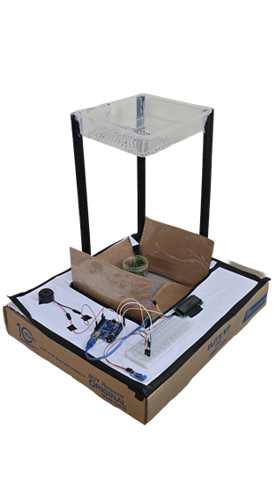


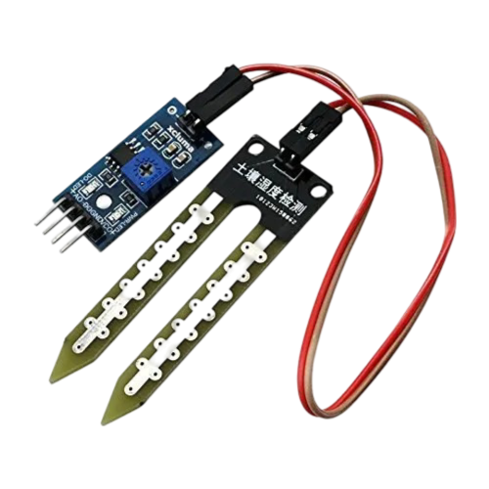
Images

Slide 7
ADVANTAGES
Early Warning Capability: Provides real-time alerts for potential landslides, enabling timely evacuations and risk mitigation.
Real-Time Data Display: Displays soil moisture levels and alerts on a 16x2 I2C LCD, facilitating immediate understanding of conditions.
Cost-Effective Solution: Utilizes affordable components, making it accessible for deployment in various regions without high costs.

Slide 8
ADVANTAGES
Low Power Consumption: Operates efficiently, suitable for remote locations with limited power supply.
Ease of Deployment: Wireless sensors simplify installation in challenging terrains prone to landslides.
Scalability: Easily expandable by adding more sensors to cover larger areas or multiple monitoring points.
User-Friendly Interface: Simple LCD display allows non-technical users to monitor conditions effectively.
.

Slide 9
DISADVANTAGES
Limited Detection Range: The system may only monitor specific areas, missing landslides occurring outside the monitored range.
Sensitivity Issues: The vibration sensor may not detect all ground movements, leading to false alarms or missed alerts for minor vibrations.
Environmental Sensitivity: Weather conditions (e.g., heavy rain or snow) can affect sensor performance and accuracy.
.

Slide 10
DISADVANTAGES
Maintenance Requirements: Regular maintenance is needed to ensure sensors function properly, as they can become damaged or corroded over time.
Cost Implications: While initial costs may be low, deploying multiple sensors across larger areas can become expensive.

Slide 11
THANK YOU

