Slide 1
Tuition Reimbursement Management System
Presented to you by:
Mario “The Hammer” Battle
Grant “High-Speed” Onate
Bryan “HIMARS” Wood

Slide 2
Technologies
Java EE 8
Apache Maven Project
Postgres Sql Version 42.2.8
Html 5
Materialize Css
Java servlet
JavaScript
Postman

Slide 3
Development Strategy
Agile/Scrum Development Style
  “Divide and Conquer”
  Optimize man-hours
  Focuses on communication
Version Control
  Git
    Durable development versions
Remote Repository
  Seamless merging of completed features
  Insulates against catastrophic failures

Slide 4
Why do we need a Tuition Reimbursement Management System?
Tuition reimbursement is a system designed by an employer to offset the cost of continued education for their employees. Upon the successful completion of coursework under the guidelines set by the company, an employee will receive partial or full compensation for their tuition.
Our company, Revature has made a system to easily apply for a reimbursement program by just a few clicks here and there of your hands.

Slide 5
Current System vs Proposed System
Current system
relies solely on email communication
requires manual lookups of available funds
error-prone due to inbox clutter and incorrect routing
reimbursements awarded not recorded nor reported
Proposed System
streamlined application process for a reimbursement
Awards and available funds are tracked via the automated system, eliminating much of the human error

Slide 6
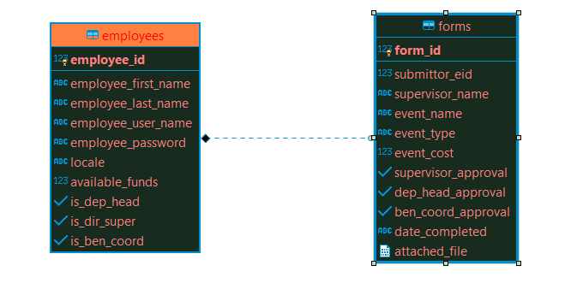
Database Schema

Slide 7
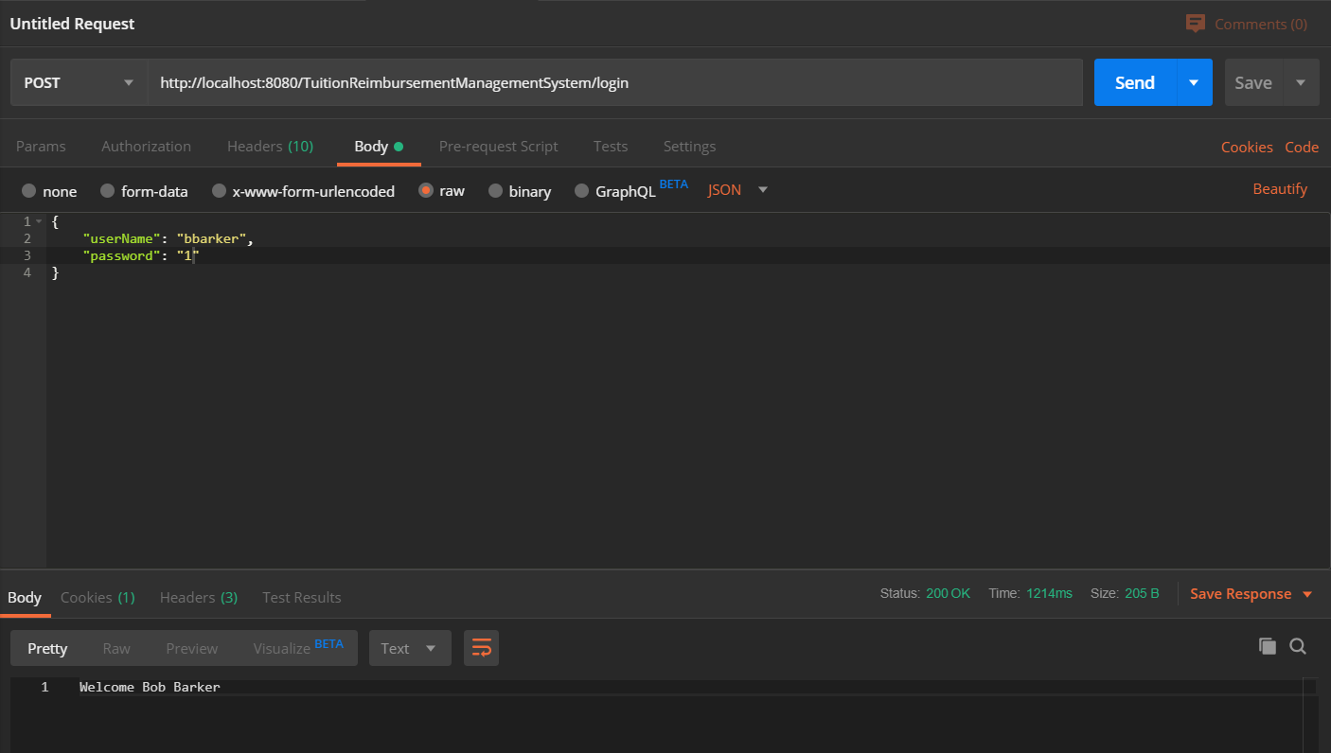
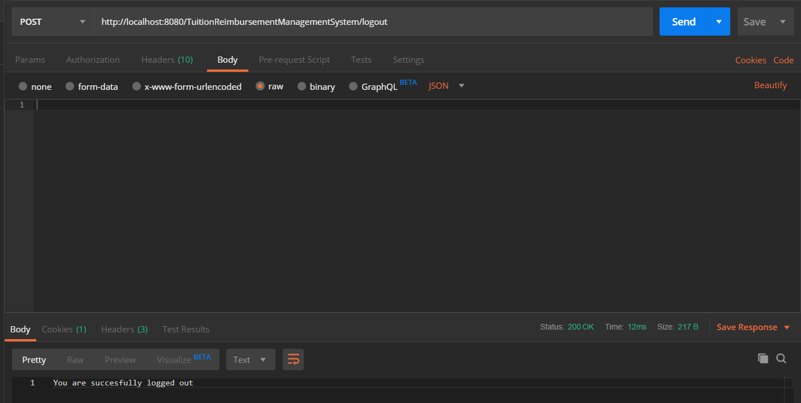
Postman Verification

Slide 8
Project Demo

Slide 9
Thank you for listening .
Mario Battle / Backend Developer/Servlet Master
Bryan Wood /Database Manager/Scrum Master
Grant Onate/Front End Developer/Project Coordinator

Slide 10
Questions?

