Slide 1
Logical Modelling
IN705 Databases 3 - 2019
Notes:
Based on Churcher, chapters 7-9

Slide 2
Purpose
To transform an entity-relationship model into a normalised relational schema
Notes:
A “relational schema” means a set of tables, with all their columns with data types and domains defined, and all primary and foreign keys identified.
So it’s something we can implement in Oracle or Access or SQL Server or FileMaker, using the local dialect of SQL, or the provided GUI tools
Unlike the ERD, it does depend on the DBMS you are using
Don’t worry about the “normalised” part if you don’t remember it, we will get there.
Unlike conceptual modelling, which is artistic voodoo, logical modelling is fairly mechanical, so much easier
However, there are still decisions to be made, and it’s still important to get them right
Failure to do so will lead to a performance hit when the database is implemented. In the worst scenario, some use cases may not be implementable if you get things wrong enough.
Again, since you have seen this before, we will review quickly, then concentrate on the complex issues that you might not have encountered, or which are generally likely to cause problems.

Slide 3
Process
Follow through mechanical conversion steps.
Normalise as required
Notes:
We will go through both of these parts
The first bit is quite deterministic
Normalisation is also very methodical, but does involve a few more decisions
Regardless, it’s still a lot easier than making the conceptual model

Slide 4
Mechanics of Conversion
Entity | Becomes a table
Attribute | Becomes a column Choose data type carefully Identify primary key for each table
1-Many relationship | Give the table at the many end a foreign key to the table at the one end
Many-to-Many relationship | Insert a table between, with two 1-Many relationships
Optionality = 1 | Make the foreign key NOT NULL
Parent/Child | Tricky
Notes:
You have an ERD with entities, relationships with ordinality and cardinality defined, and lists of attributes for each entity
For each element, do as shown
So, for each entity, you write a CREATE TABLE….
Each attribute is a column in the CREATE TABLE. Do we need to go over the SQL data types?
We will look at an example of the Many-to-Many process
We will also look at Parent/Child in detail, in a minute. As mentioned, it is not directly supported, so we have to work around a little

Slide 5
Dealing with Inheritance
The relational model, and by extension, relational DBMSs do not support inheritance.
Notes:
So you have to fake it

Slide 6
Dealing with Inheritance
Options:
Flatten:
Implement only the children
Add all attributes from the parent to each child
Roll up:
Implement only the parent.
Add a type attribute to distinguish child classes
Make non-common attributes optional
Approximate:
Implement both parent and child tables
Build a 1-1 relationship between each child and its parent
Notes:
Which of these is best depends on your model.
For example, the number of different child classes, the number of common and non-common attributes, etc.
You may have to try various ways and test which is most efficient and best insures data quality.
Speaking of which…

Slide 7
Data Quality
Data integrity:
All data values are from the appropriate domain.
Data uniqueness
All values that represent the same property of an instance must have the same value
Referential integrity:
For any value of a foreign key in a dependent table, a record with that value as primary key must exist in the referenced table.
Notes:
With hundreds of tables and thousands of records, the risk of errors is very high.
There are three technical ways that we talk about error-free database contents:
Integrity
An attribute’s “domain” is the set of legal values it may hold. If, for example, we are storing street names in Dunedin, the variable data type will be some sort of text option (char, varchar, whatever) but the domain will be only those strings that correspond to actual streets in Dunedin.
Typos on data entry are the most common cause of domain violations
Uniqueness:
You don’t want to have somebody’s address as one value in one table and another value in another table
Ref int:
If your Player records holds Team 17 as a foreign key, there needs to be a Team 17
If we build our tables correctly, the DBMS will enforce data quality so that errors cannot occur. Problems will be resolved before the data ever leaves the server. This is the safest practice.

Slide 8
Data Quality
Violations can be caused by:
Data entry error
Update Anomalies

Slide 9
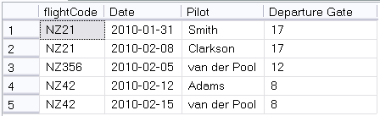
Update Anomalies
A situation where changing a record in the database (via insert, update or delete) causes an inconsistency with other records.
UPDATE Flights
SET gate = 71 WHERE pilot = ‘Clarkson’
Notes:
Look at this table.
It records the pilot of Air New Zealand filghts. Each flight always leaves from the same gate, but can have a different pilot in each instance
What is the primary key?
Not Flight code, that repeats
Not date, there could be two flights on the same day
Assuming that each flight goes only once a day (which is how it works), a good primary key is (flightCode, Date)
A given flight leaves each day from the same gate, as shown. Our data have integrity.
So now this update happens. This is perfectly legal. Gate is not part of the primary key, so the system will execute the update.
The gate is wrong, and we can’t tell which is correct 17 or 71
Anything about the constraints of the database that would prevent this? No.
This is an update anomaly. One of several types that can occur.
Such things can only happen when there are flaws in the design of your tables. Can you see the flaw here?
Perhaps you can, perhaps you can’t. But you don’t want to be in situations where you’re having to try to intuitively guess your table into shape. We’re going to look now at a process which, when followed, will guarantee (almost) that your tables can’t get into a bad state.

Slide 10
Normal Forms
Data quality violations are possible because of flaws in the table design.
The specific requirements for a table design that is not at risk have been determined.
They are called “normal forms”.

Slide 11
Normal Forms
There are five normal forms
1st, 2nd, 3rd (& Boyce-Codd), 4th & 5th
They are
Increasingly safe
Increasingly complicated to implement
Your databases should always be in at least” 3rd normal form.
If your tables are in the appropriate normal form, update anomalies and data entry errors cannot occur.
Notes:
Really 6, but two of them are just variations
If your database is mission critical, so that errors would be life and death, and you can’t stand putting any checking into the GUI, you can consider 4th and 5th Normal Form. Look it up if interested.

Slide 12
Normalisation
The process of putting your tables into the correct normal form is called “normalisation”.
Each normal form addresses a particular structural flaw
There is a two-step process for each normal form:
Detect the flaw
Fix the flaw
After you have constructed your logical model, you should work carefully through normalisation
Notes:
Each form has its own particular problem that you look for
There is also a detailed rule for fixing the flaw if you find it

Slide 13
First Normal Form
A table is in First Normal Form if
It has no multiple-valued attributes
There is no ordering to the columns
There is no ordering to the rows
There are no duplicate rows
Notes:
You will often see “multiple-valued attributes” called “repeating groups”. Same things
Technically, there are actually a few more rules about First Normal Form because it is really simply the base definition of what a relational table looks like
These other rules are rules, but nobody ever gets them wrong, so we don’t worry about “how to fix”
Note that the “no ordering to the rows” thing doesn’t mean you can’t sort it. It just means that it’s the same table, regardless of sort order. You don’t lose any data if the sort order changes.

Slide 14
First Normal Form
Flaw:
A table is not in 1st Normal Form if it is keeping multiple values for an attribute.
Fix:
Remove the multivalued information from the table.
Create a new table with that information, and the primary key of the original table.
Notes:
Most likely, with a little experience in data modelling, you won’t ever try to create a table that isn’t in 1st Normal Form.
But you know what to look for, and what to do.

Slide 15
Example
Enrollment
Student
studentID
studentID
instrument
lastName
grade
firstName
fee
Notes:
The Saturday Morning Music Classes in Dunedin have hundreds of students, both child and adult.
They teach all different instruments at all different grades
The fee structure is based on instruments (recorder is cheaper than trombone because of the teacher/student ratio required)
Here’s the database they use to record their enrolment information.
You can see they have separate fields for lastName and firstName. The studentID is an IDENTITY field so must be unique.
It therefore correctly serves as a foreign key in Enrollment
Here are some data values in

Slide 16
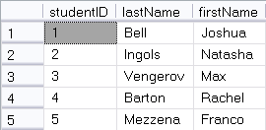
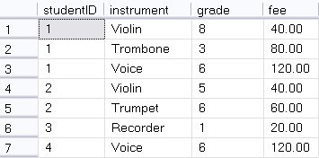
Example
UPDATE Enrollment
SET fee = 50
WHERE studentID = 1 and instrument = 'Violin'
Notes:
This structure looks pretty good.
Think about the questions we might want to ask, and make sure we can ask them
Can you list all the violin players together?
Can you tell how much money Joshua Bell owes? If you knew his ID number? If you didn’t?
So, where is there a problem with this database?
Look at this query
Is it legal? (i.e. does it violate any constraints, here specifically the foreign key or record uniqueness?)
So the system will allow it. It is a perfectly ok query.
But what is the result?
Joshua will pay 50.00 for his violin lesson and Natasha will pay 40 for hers. Looking at the database, can anyone tell which was the error and which is correct?
This is an update anomaly (modification) causing a data uniqueness error

Slide 17
Example
DELETE Enrollment
WHERE instrument = ‘Trombone’
AND studentID = 1
Notes:
How about this one?
Legal?
Consequence? You no longer have any record of the fee for Trombone. Joshua was the only student taking it, and because he dropped it, you lost that piece of information.
This is an update anomaly (deletion)
So this particular table is at risk of both modification and deletion anomalies (insertion too, if there’s a data entry error on fee….)
Can you see, intuitively, what the problem is?
To understand formally what this error is (which will allow us to establish an orderly process for fixing it) we need to look carefully at what’s happening with the primary ketys….

Slide 18
Example
Student(studentID, lastName, firstName)
Enrollment(studentID, instrument, grade, fee)
What is the primary key of Enrollment?
Notes:
Recall that the primary key must be unique for every record, guaranteed
studentID? No, the same student can take multiple instruments
Instrument? No, there are lots of duplicates?
And obviously not grade and fee, no uniqueness there.
If no single key can be primary, look to combinations of keys.
(Assuming that we aren’t keeping any historical record of grade) What combination will be unique?
studentID and instrument. There would be no meaning to listing the same student/instrument combination twice. This makes a good primary key

Slide 19
Example
Student(studentID, lastName, firstName)
Enrollment(studentID, instrument, grade, fee)
What is the primary key of Enrollment?
For all the non-primary fields, what fields determine them?
Grade is determined by studentID and instrument
Fee is determined by only instrument
Notes:
Let’s think now about what a primary key is supposed to tell us.
The primary key is the unique identifier of a record. So technically, the primary key of a record should determine all the other values. Meaning, if you know the value of the primary key, you know the value of all the other fields.
E.G. your student ID number determines your name and address, and so on. My name determines my office. The paper and stream determines the classroom. Your address determines your postcode, etc.
Looking back at our table, for each of the non-primary keys, what fields determine them. That is, what fields would you have to know to be able to tell their value
Grade <- studentID and instrument. You can’t tell the grade unless you know both the student and the instrument
Fee is determined by only instrument. You don’t have to know the student to know the fee. It is only based on the instrument, and that is the problem

Slide 20
Definition
Functional Dependence
If A and B are two fields in a relation and A uniquely determines B
B is functionally dependent on A
A → B
In our example
(studentID,instrument) -> grade
Instrument -> fee

Slide 21
Caution!
You should never have a table where
The primary key is composite, AND
Any field is functionally dependent on only some of the fields making up the primary key
Such a table will be at risk of update anomalies.
Uniqueness of the primary key is not enough to guarantee correct values for all the other fields.
Notes:
This is exactly the problem in our table.
Our primary key is (studentID, instrument) but the fee field is only functionally dependent on instrument.

Slide 22
To Fix This Problem
Pull the partially dependent columns out into their own table.
Make the part of the primary key they depend on their new primary key.

Slide 23
To Fix This Problem
Student
Instrument
studentID
instrument
lastName
fee
firstName
Enrollment *
studentID
instrument
grade
Notes:
Now.
Are all field in Student FD on all elements of their PK?
Instrument?
Enrollment?
Congratulations, you’ve got second normal form

Slide 24
Second Normal Form
A table is in 2NF iff:
It is in 1NF
All non-key fields are functionally dependent on all parts of their primary key

Slide 25
Second Normal Form
Flaw:
Some non-key column is functionally dependent on only a subset of the fields which comprise the primary key
Fix:
Remove the non-key fields that are not dependent on the whole primary key
Make a new table with all these fields and the part of the primary key they depend on as the new primary key

Slide 26
Question
If a table is in 1NF and uses an auto-incrementing IDENTITY variable as a primary key, must it also be in 2NF?
Notes:
Yes. If the primary key is only one field, nobody can be FD on part of it.
Let’s look now at those update anomalies we had before

Slide 27
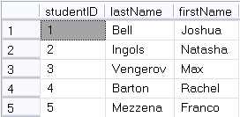
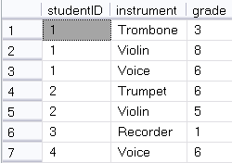
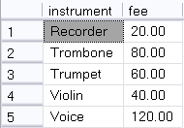
2NF
Notes:
Can you still answer all the questions you want to know?
All the violins? Yes.
How must Max owes? (A 3-table join now)
Is it now possible for Joshua and Natasha to be charged a different amount for Violin lessons? No.
If Joshua decides to drop the Trombone, do we still know what the fee for Trumpet is? Yes.

Slide 28
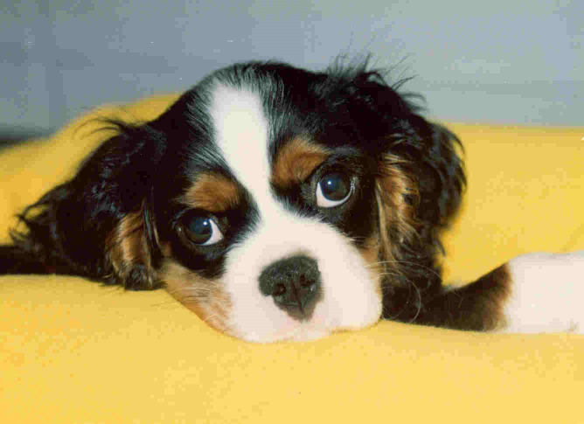
Example

Slide 29
Example
CavEvent
eventID
eventDate
eventLocation
eventJudge
dogName
dogOwner
Notes:
You’re keeping track of winning Cavalier King Charles Spaniels in dog shows

Slide 30
Example
EventID | Day | Location | Judge | Dog | Owner
1 | 2/10/2009 | Westminster | Beth Sweigart | Ch Timsar Mister Moonlighter | Cindy Huggins
2 | 30/09/2009 | Inglison | Robert Waddington | Ch Nottus Hooray Henry | James Jackson
3 | 8/11/2009 | Higham | Michale Forte | Ch Cinderlace Cromwell | Albert Vella
4 | 12/12/2009 | Los Angeles | Beth Sweigart | CH Pinecrest Rock The Boat | Margaret duBois
5 | 14/06/2009 | Bristol | Vladimir Lizorov | Ch Timsar Mister Moonlighter | Cindy Huggins
6 | 20/02/2009 | San Diego | Paula Mitchell | CH Pinecrest Rock The Boat | Margaret duBois
7 | 11/01/2009 | Boston | Kevin Sherman | CH Anberran Ginger Truffle | Evan Mondrian
8 | 9/03/2009 | Edinbirgh | Vladimir Lizorov | Ch Timsar Mister Moonlighter | Cindy Huggins
Notes:
No repeating values, so this is in 1NF
A non-composite primary key, so it’s in 2NF
So, no problems?
See the trouble? What happens when Cindy Higgins sells Timsar Mister Moonlighter?
You would have to change all the occurrences, which, like code duplication in programming, is just asking for data inconsistencies to be introduced
And, if you have a big database with all the dozens of shows each dog has won? The mess is just worst.
So based on your understanding of the whole database thing now, what would you suggest?

Slide 31
Example
Dog -> Owner
Dog is not a primary key
Therefore, you can have repeated instances of Dog in the table
In which case you will have repeated instances of (Dog, Owner) in the table
If (Dog, Owner) changes, you must update all repetitions

Slide 32
Caution!
If any column is functionally dependent on a non-primary key your table is at risk of update anomalies.
Notes:
Get rid of them, and you’ve got 3rd normal form

Slide 33
Third Normal Form
Flaw:
Some column is functionally dependent on a non-key column.
Fix:
Pull the dependent column out into its own table. The column on which it depends becomes it primary key.

Slide 34
Make Robust Tables
1NF:
Remove repeating values
2NF:
Remove any functional dependencies on partial primary keys
3NF:
Remove any functional dependencies on non-primary keys
Notes:
Usually your tables will start out in 1NF. So it just becomes a process of looking at the FD of every column in every table.
With practice, you’ll be able to see these problems well.

Slide 35
Make Robust Tables
“Your data should depend on the key (1NF), the whole key (2NF) and nothing but the key (3NF)”

Slide 36
Exercise
Notes:
Handout
ERD conversion task
Normalisation task (theatres)
This is a checkpoint

