Slide 1
Week 13 Lab 1 – Backup and recovery
Databases 3

Slide 2
Data Backup
Protect data
Whole database
Files or filegroups
Back up (verb)
Backup (noun)
Prevent the transaction log from filling
Recovery Models
Notes:
The scope of a backup of data (a data backup) can be a whole database, a partial database, or a set of files or filegroups. For each of these, SQL Server supports full and differential backups.
Two concepts here,
Back up (verb) means to copy data and log records from a SQL Server database to a backup device. The backup device can either be disk or a tape device.
Backup (noun) means a copy of SQL Server data that can be used to restore a database after a failure. A backup of SQL Server data is created at the database level or one of the database files. You cannot backup individual tables
If a database uses either the full or bulk-logged recovery model, you must back up the transaction log regularly enough to protect your data and to keep the transaction log from filling. Regularly could be hourly, daily or weekly depending on your situation
A recovery model is a property of a database that controls transaction log use. Three models exist, simple, full and bulk logged

Slide 3
Data Backup
“Your data is only as good as your last backup.”
Notes:
The scope of a backup of data (a data backup) can be a whole database, a partial database, or a set of files or filegroups. For each of these, SQL Server supports full and differential backups.
Two concepts here,
Back up (verb) means to copy data and log records from a SQL Server database to a backup device. The backup device can either be disk or a tape device.
Backup (noun) means a copy of SQL Server data that can be used to restore a database after a failure. A backup of SQL Server data is created at the database level or one of the database files. You cannot backup individual tables
If a database uses either the full or bulk-logged recovery model, you must back up the transaction log regularly enough to protect your data and to keep the transaction log from filling. Regularly could be hourly, daily or weekly depending on your situation
A recovery model is a property of a database that controls transaction log use. Three models exist, simple, full and bulk logged

Slide 4
Data Backup
“Your backups are only as good as your last restore.”
Test your backups!!!
Notes:
The scope of a backup of data (a data backup) can be a whole database, a partial database, or a set of files or filegroups. For each of these, SQL Server supports full and differential backups.
Two concepts here,
Back up (verb) means to copy data and log records from a SQL Server database to a backup device. The backup device can either be disk or a tape device.
Backup (noun) means a copy of SQL Server data that can be used to restore a database after a failure. A backup of SQL Server data is created at the database level or one of the database files. You cannot backup individual tables
If a database uses either the full or bulk-logged recovery model, you must back up the transaction log regularly enough to protect your data and to keep the transaction log from filling. Regularly could be hourly, daily or weekly depending on your situation
A recovery model is a property of a database that controls transaction log use. Three models exist, simple, full and bulk logged

Slide 5
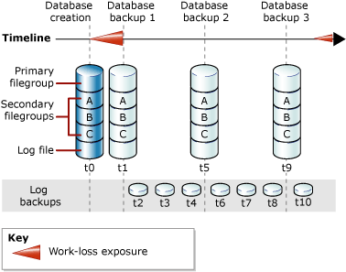
Types of backup
Full
Database and log backed up
Point in time recovery
Broadest range of failure scenarios
Notes:
For databases that use full and bulk-logged recovery, database backups are necessary but not sufficient. Additional transaction log backups are also required. The following illustration shows the least complex backup strategy that is possible under the full recovery model.
Bulk-logged is a temporary solution for bulk inserts that otherwise would create a HUGE amount of logging. If a log backup contains any bulk-logged operations, you cannot restore to a point-in-time within that log backup; you can restore only the whole log backup.
Because every transaction is logged, over time the log file will either become too big for your storage or full. Once the log is full, as some of you found out, nothing works on the database. You need to create a SQL backup job to backup and clear the log files to an external data storage object. Backups usually are required nightly depending on what sort of data changes occur.
Simple recovery model supports both database backups and file backups, which contain both user data and active transaction log data. But separate log backups are not supported, a database can be restored only to the end of the most recent backup for the data file (bitdev 6.30 and 7pm).

Slide 6
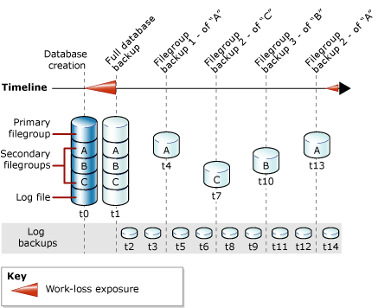
Types of backup
File
Back up data files individually
Pros
Individual files
Smaller
Cons
Complex
Notes:
The files in a SQL Server database can be backed up and restored individually

Slide 7
Types of backup
Transaction log
Created a full database backup
Just need transaction logs
Transaction log isn’t truncated
Notes:
Minimally, you must have created at least one full backup before you can create any log backups. After that, the transaction log can be backed up at any time unless the log is already being backed up. We recommend that you take log backups frequently, both to minimize work loss exposure and to truncate the transaction log. Typically, a database administrator creates a full database backup occasionally, such as weekly, and, optionally, creates a series of differential database backup at a shorter interval, such as daily. Independently of the database backups, the database administrator backs up the transaction log at frequent intervals, such as every 10 minutes. For a given type of backup, the optimal interval depends on factors such as the importance of the data, the size of the database, and the workload of the server.
Issues…..
If a transaction log is damaged, work that is performed since the most recent valid backup is lost.

Slide 8
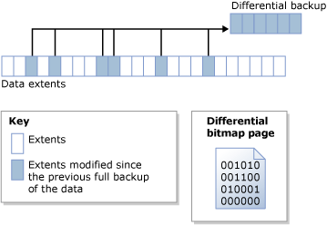
Types of backup
Differential
Pros
Quick, small,
Cons
Lots
Notes:
A differential backup is based on the most recent, previous full data backup.
A differential backup captures only the data that has changed since that full backup. The full backup upon which a differential backup is based is known as the base of the differential.
A differential backup records only the data that has changed since the full backup upon the differential backup is based. This facilitates taking frequent data backups, which decrease the risk of data loss.
However, before you restore a differential backup, you must restore its base. Therefore restoring from a differential backup will necessarily take more steps and time than restoring from a full backup because two backup files are required.
Differential database backups are especially useful if a subset of a database is modified more frequently than the rest of the database. In these cases, differential database backups enable you back up frequently without the overhead of full database backups.

Slide 9
Types of backup
Differential Backup
Backs up data and log
Only data that has changed since the last backup
Relatively fast
Little space required

Slide 10
Types of backup
Copy-only
Independent
Transaction log isn’t truncated
Notes:
A copy-only backup is a SQL Server backup that is independent of the sequence of conventional SQL Server backups. Usually, taking a backup changes the database and affects how later backups are restored. However, occasionally, it is useful to take a backup for a special purpose without affecting the overall backup and restore procedures for the database. copy-only backups serve this purpose. The transaction log is never truncated after a copy-only backup.

Slide 11
Example
Time | Event
7.30 am | Create database
7:35 am | Back up of database and log
8.00 am | Back up transaction log
9.00 am | Back up transaction log
10.00 am | Differential backup
11.00 am | Back up transaction log
12.00 noon | Back up of database and log
1.00 pm | Back up transaction log
Notes:
Think about what data is being backed up.
How big are the backup sizes going to be for the data and log?
When is the log file cleared?

Slide 12
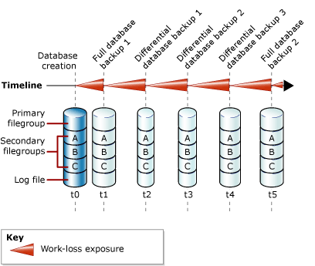
Backup Models
Simple Recovery
Database file restores only
No log, created again
Simple
Notes:
With the Simple Recovery model, the database can be recovered to the point of the last backup. However, you cannot restore the database to the point of failure or to a specific point in time.
Database backups. Differential backups (optional).

Slide 13
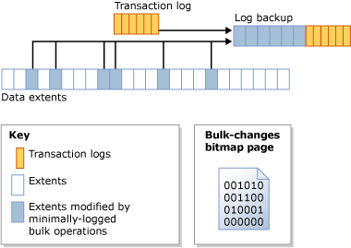
Backup Models
Bulk-Logged
Temporary
Same as full, but for bulk queries
Minimally logs bulk operations
Notes:
The Bulk-Logged Recovery model provides protection against media failure combined with the best performance and minimal log space usage for certain large-scale or bulk copy operations. Cannot be controlled on an operation-by-operation basis
These operations are minimally logged…
SELECT INTO
Bulk load operations like BULK INSERT
CREATE INDEX (including indexed views)
text and image operations (WRITETEXT and UPDATETEXT)

Slide 14
Copy-only backup
Usually backups are scheduled
Independent
Doesn't affect backup/restore plans
Change to a different path
Notes:
A copy-only backup is a SQL Server backup that is independent of the sequence of conventional SQL Server backups. Usually, taking a backup changes the database and affects how later backups are restored. However, occasionally, it is useful to take a backup for a special purpose without affecting the overall backup and restore procedures for the database. For this purpose, copy-only backups were introduced SQL Server 2005. The types of copy-only backups are as follows:
Copy-only full backups (all recovery models) A copy-only full backup cannot serve as a differential base or differential backup and does not affect the differential base.
Copy-only log backups (full recovery model and bulk-logged recovery model only) A copy-only log backup preserves the existing log archive point and, therefore, does not affect the sequencing of regular log backups. Copy-only log backups are typically unnecessary. Instead, you can create another routine, current log backup (using WITH NORECOVERY), and then use that backup together with all other previous log backups that are required for the restore sequence. However, a copy-only log backup can be created for performing an online restore.

Slide 15
Scheduling Backups
SQL Server Agent
SQL Server Maintenance
SQL Jobs
Agent
Each job contains one or more steps
Each step contains its own task
Schedule, in response or on DBA demand
Notes:
SQL Server Agent is a Microsoft Windows service that executes scheduled administrative tasks, which are called SQL Server jobs. SQL Server Agent uses SQL Server to store job information.
Jobs contain one or more job steps.
Each step contains its own task, for example, backing up a database.
SQL Server Agent can run a job on a schedule, in response to a specific event, or on demand.
For example, if you want to back up all the company servers every weekday after hours, you can automate this task. Schedule the backup to run after 22:00 Monday through Friday; if the backup encounters a problem, SQL Server Agent can record the event and notify you.
SQL Server database engine has its own tool for running backups. SQL Server Jobs via the maintenance wizard. We will create a job later

Slide 16
Concurrency Restrictions
Online backup process
Allows for data use
Select, Insert, update and delete
Cannot modify database object
Alter database, add file or remove file
Shrink database
Overlaps causes the second operation to wait
Notes:
Concurrency Restrictions During Backup
SQL Server uses an online backup process to allow for a database backup while the database is still being used. During a backup, most operations are possible; for example, INSERT, UPDATE, or DELETE statements are allowed during a backup operation. However, if you try to start a backup operation while a database file is being created or deleted, the backup operation waits until the create or delete operation is finished or the backup times out.
Operations that cannot run during a database backup or transaction log backup include the following:
File-management operations such as the ALTER DATABASE statement with either the ADD FILE or REMOVE FILE options.
Shrink database or shrink file operations. This includes auto-shrink operations.
If you try to create or delete a database file while a backup operation is in progress, the create or delete operation fails.
If a backup operation overlaps with a file-management operation or shrink operation, a conflict occurs. Regardless of which of the conflicting operation began first, the second operation waits for the lock set by the first operation to time out. (The time-out period is controlled by a session time-out setting.) If the lock is released during the time-out period, the second operation continues. If the lock times out, the second operation fails.

Slide 17
Restoring
Full recovery
Backup! Or restore to a new database
WITH NORECOVERY
Restore last full
If differential, restore those
Restore logs in order
Notes:
In a complete database restore, the goal is to restore the whole database. The whole database is offline for the duration of the restore. Before any part of the database can come online, all data is recovered to a consistent point in which all parts of the database are at the same point in time and no uncommitted transactions exist.
Under the full recovery model, after you restore your data backup or backups, you must restore all subsequent transaction log backups and then recover the database. You can restore a database to a specific recovery point within one of these log backups. The recovery point can be a specific date and time, a marked transaction, or a log sequence number (LSN).

Slide 18
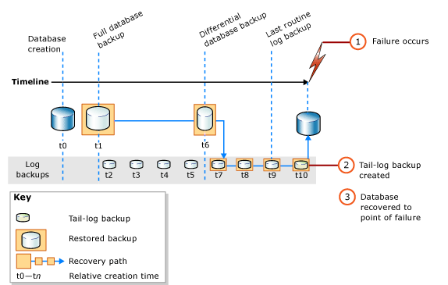
Restoring

Slide 19
Restore syntax
RESTORE DATABASE database FROM full database backup WITH NORECOVERY;
RESTORE DATABASE database FROM full_differential_backup WITH NORECOVERY;
RESTORE LOG database FROM log_backup WITH NORECOVERY;
RESTORE DATABASE database WITH RECOVERY;

Slide 20
Error Checking
DBCC CHECKDB for allocation or consistency errors.

