Slide 1
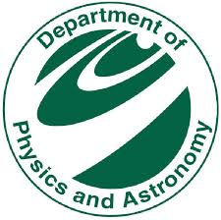

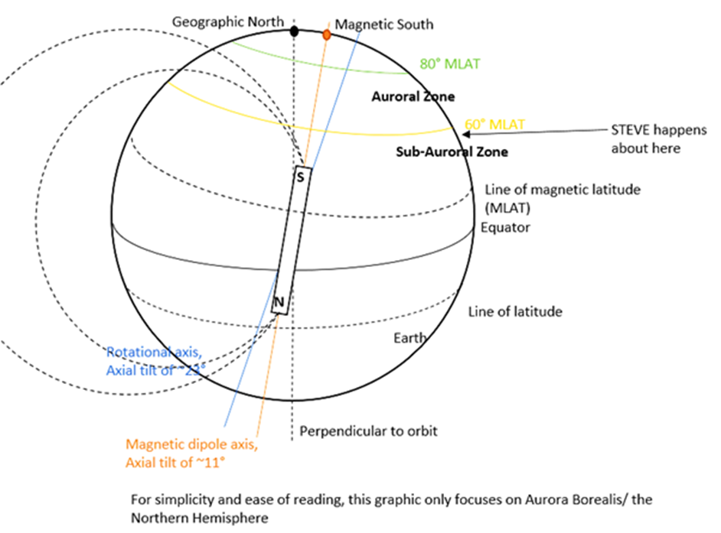
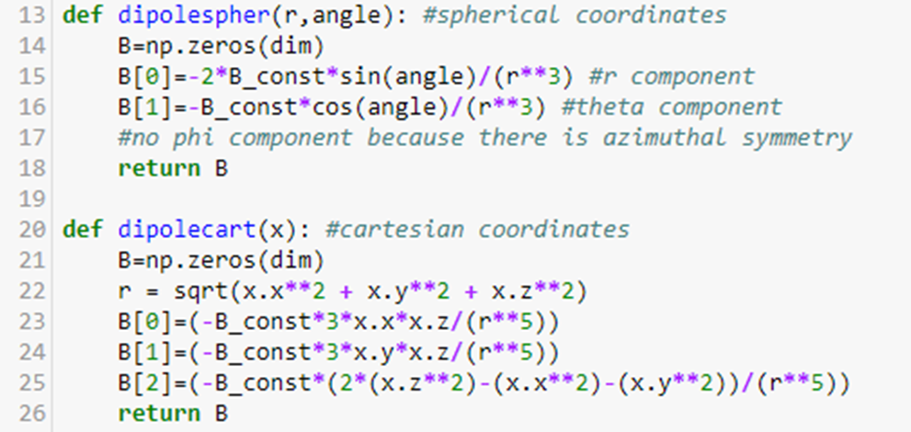
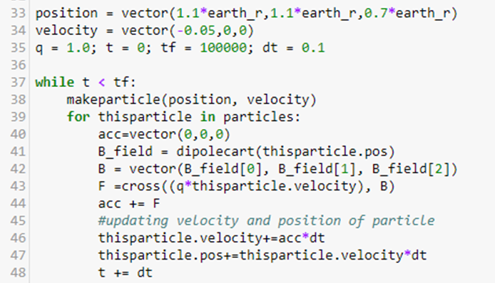
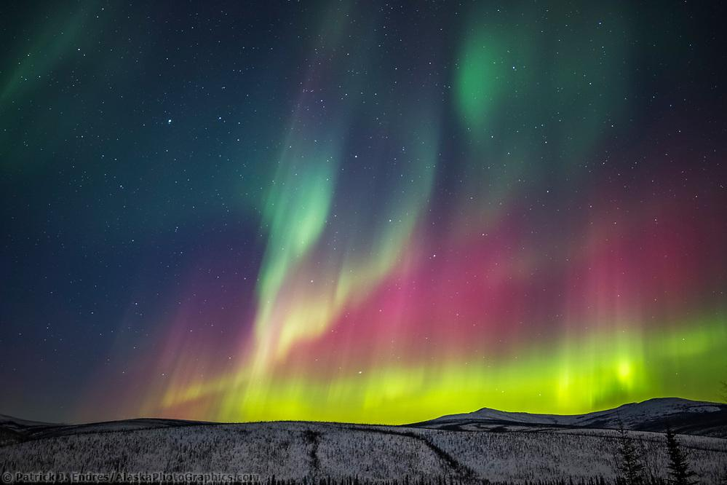
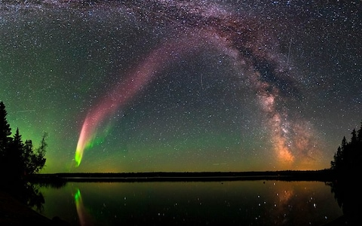
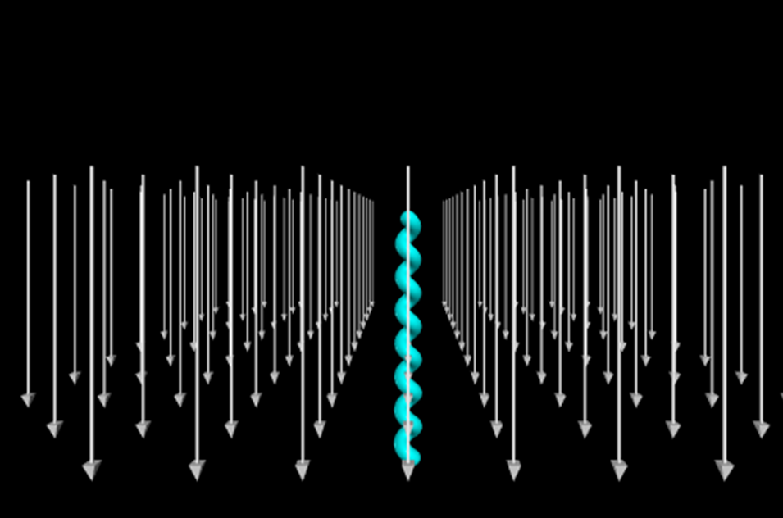
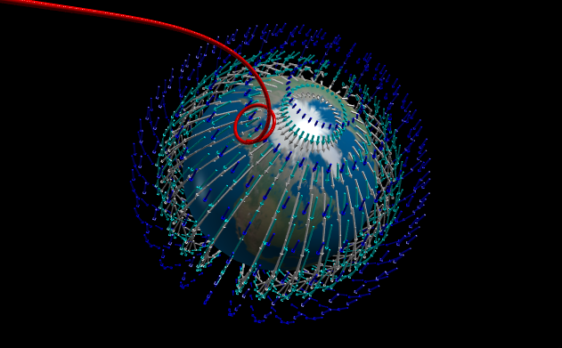
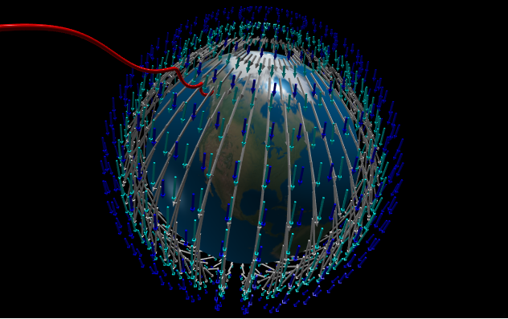
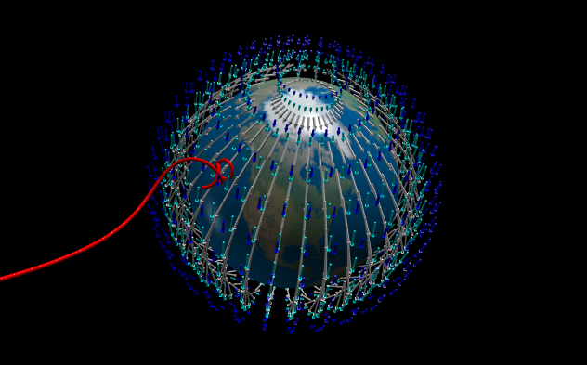
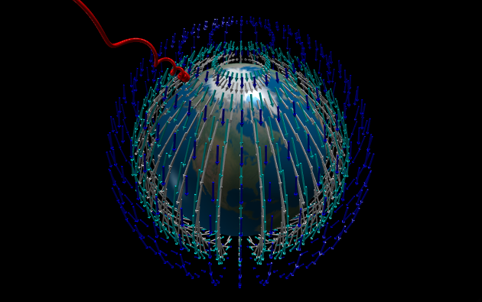
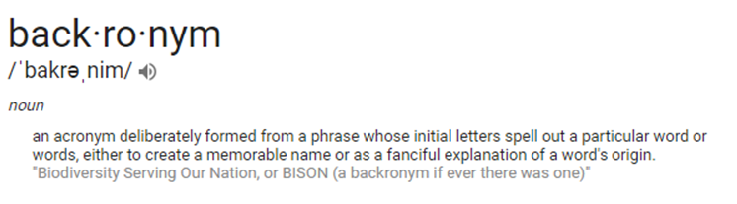
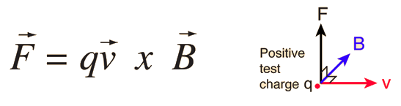
Modelling Aurora Borealis through Lorentz Force
A Comparison of Aurora and STEVE
Brean Prefontaine and Laura Wood
Background
Physics of Aurora Borealis
Development of Model
How do the auroras form?
Solar wind → Earth’s magnetic field ⇒ generates electrical currents in the magnetosphere
Accelerate charged particles into upper atmosphere, which collide with various gases
Randomly transfer energy to atmospheric atoms and release energy through fluorescent emission
Assumptions:
Earth’s magnetic field is a dipole magnetic field
Only interaction between charged particle and earth’s magnetic field is Lorentz force
Earth radius is 1 and constant in magnetic field equations is 1
Lorentz force is cross product between particle’s velocity and the magnetic field at the particle’s location
Overview of code:
Set constants
Define dipole equations in spherical and cartesian
Allows for different uses depending on convenience and necessity of coordinate system changes
Make “set of particles”
We made a “new particle” for each update of position and velocity
Show visual of magnetic field vectors for a range of distances from Earth
Set particle’s initial position and velocity
Update position and velocity according to Lorentz force
Aurora Borealis
Usually green, yellow, and red
Can also be pink, violet, and blue
Curtain shaped
60-80⁰ MLAT (magnetic latitude)
Formed by charged particles in solar wind that interact with the earth’s magnetic field
Last about 10 mins to all night
Highest activity in the northern hemisphere (borealis) is during spring because of solar magnetostorms
Activity happens in 22 year cycles
About 10 degrees latitude high
STEVE
Purple in color
Sometimes seen with green aspects
Typically a vertical arc
Below 60⁰ MLAT
Formed by subauroral ion drifts that occur during substorms
Last about 20 mins to an hour
Seasonal: not observed in winter (October - February)
About 0.5 latitude wide
Representation of Earth’s magnetic field in the dipole approximation model with indications of how and where auroras and STEVE form
Particle in Constant Field
Particle in Dipole Field
Comparison of Velocity and Position Parameters
Comparison of key features of the aurora borealis and of STEVE (Strong Thermal Emission Velocity Enhancement)
STEVE is a backronym given to a special kind of aurora that was recently discovered by scientists
STEVE is narrower and more vertical than typically studied auroras and usually purple, while auroras can be many other colors
The colors of auroras are dependent on interactions of specific gases
STEVE forms due to subauroral ion drifts -
Also called polarization jets, form during substorms
Seasonal, coincides with space weather
Representation of charged particle moving through uniform magnetic field, under effects of Lorentz force
Particles moving through Earth’s dipole magnetic field from different starting positions and at different velocities
We see that at sub-auroral latitudes, the aurora is more vertical, as we expect from descriptions of STEVE
At higher latitudes, the aurora is more oriented sideways and we could see that with more particles they would form a curtain shape
At greater speeds, the corkscrew wound by the particle has a larger radius → slower speeds wind tighter corkscrews
Approximately auroral latitude
“Fast” velocity
How does a charged particle interact with a magnetic field?
The particle experiences a force, called the Lorentz force, which is the cross product between the velocity of the particle and the magnetic field
This causes the particle to spiral around the magnetic field
Approximately sub-auroral latitude; “Slow” velocity
Approximately sub-auroral latitude
“Fast” velocity
Approximately auroral latitude
“Slow” velocity
References
[1]Blake, E. (2018, March 21). Northern Lights forecast: New aurora Steve discovered above Scotland. Retrieved from https://www.express.co.uk/travel/articles/935071/the-northern-lights-2018-new-aurora-steve-discovered
[2]Colors of Aurora. (n.d.). Retrieved from http://www.webexhibits.org/causesofcolor/4D.html
[3]MacDonald, E. A., Donovan, E., Nishimura, Y., Case, N. A., Gillies, D. M., Gallardo-Lacourt, B., . . . Schofield, I. (2018, March 01). New science in plain sight: Citizen scientists lead to the discovery of optical structure in the upper atmosphere. Retrieved from http://advances.sciencemag.org/content/4/3/eaaq0030
[4]Meet 'Steve,' a Totally New Kind of Aurora. (2018, March 15). Retrieved from https://news.nationalgeographic.com/2018/03/steve-auroras-identified-plasma/?beta=true
[5]Salat, T. (n.d.). Aurora Hunter. Retrieved from https://www.aurorahunter.com/how-the-aurora-borealis-form.html
[6]Staff, S. (2017, October 11). Aurora Borealis: What Causes the Northern Lights & Where to See Them. Retrieved from https://www.space.com/15139-northern-lights-auroras-earth-facts-sdcmp.html
[7]Substorms. (n.d.). Retrieved from https://www-spof.gsfc.nasa.gov/Education/wsubstrm.html
[8]Tail of the Magnetosphere. (n.d.). Retrieved from https://www-spof.gsfc.nasa.gov/Education/wtail.html
[9]What causes the aurora borealis? (n.d.). Retrieved from http://earthsky.org/earth/what-causes-the-aurora-borealis-or-northern-lights
Future Work
Improve on model’s assumptions that the particles only interact with the Earth’s magnetic field and experience acceleration from the Lorentz force, as well as that the only magnetic field vector that matters is at the particle’s location
Auroras form due to plasma being trapped in certain regions of the atmosphere and interactions with various gases; our charged particles should be radiating
Additionally, our model has the Earth’s radius and the strength of the magnetic field set to one for simplicity; with more time, we could scale these values to realistic values
Another addition could include the Earth’s magnetic field experiencing a compression effect from solar wind that forms a “magnetotail” which would cause the charged particles to interact slightly differently
Also would make code more efficient to have a trace on a single particle’s motion instead of making a new particle for every update in position and velocity

