Slide 1
¹³C Nuclear Spins — Comparison of Three Methods' Results
2021 paper – limitations of Dr. Jung's method, with comparison table
 | Manual analysis | 2021 method (Dr. Jung's method) | WD method
NV1 Dataset | 4 spins (−88, 47) (−5, 35) (+8, 31) (−38, 37)* | Output = 5 high-probability positions on the A∥ probability curve (only says 'a spin is near this A∥' — A⊥, count, and exact values are not output) ① Region A∈[−6, +12] (site of 5 WD spins) ② Region A∈[+40, +46] (near WD +39/+48) ③ Peak −20 = WD (−18.8) site ④ Peak +22 = WD (+24.3) site ⑤ Peak −34 = none; matches off-list candidate −32 | 14 spins — (A∥, A⊥) (−87.9,18) (−18.8,16) (−11.5,14) (−5.1,22) (+0.6,17) (+4.0,26) (+8.4,28) (+14.2,22) (+24.3,20) (+39.0,28) (+48.0,25) (+65.6,28) (+91.9,33) (+114.4,24)
NV2 Dataset | 3 spins (−340, 290) (+150, 110) (−42, 150)* | — Not evaluable: single-channel, strongly-coupled data is out of scope | 10 spins — (A∥, A⊥) (−151.2,95) (−58.9,182) (−45.9,50) (−38.9,67) (−12.6,42) (−2.7,37) (+51.7,91) (+55.9,55) (+346.9,261) (+430.7,58)*
Notes | Rough position anchors from visual reading — all 7 rediscovered in the WD list. A⊥ tends to be overestimated | Gets positions right, but the list is incomplete - Outputs only down to region/peak level Later regression stage fixing count and exact A∥, A⊥ is out of scope | Count (BIC, consistent with RJMCMC posterior) · complete with A⊥ values · 95% CI Reproduces 3 measurements simultaneously, RMSE 0.088–0.176
*A∥ signs from manual analysis differ by m_s branch convention · *withheld due to possible strong coupling or degeneracy
† BIC (Bayesian Information Criterion) = statistical rule that increases the count only when the fit improvement from adding a spin outweighs the complexity penalty
· 95% CI (confidence interval) = 'interval containing the true value with 95% probability' (error bars), measured from the value spread across 60 residual-bootstrap refits

Slide 2
2021 Method vs Our Method
Compared in the same measured spin environment (NV1) — WD method ahead by ×2.2 cryo, ×1.5 room temp, ×1.7 error-injected
 | 2021 method (core-pipeline reproduction) | WD method (PF→RJMCMC hybrid v2)
Architecture | 61 independent per-window MLPs + separate denoiser | Neural detection (cross-window attention) + region-constrained physics fitting + BIC
Output | High-probability regions (A∥ position candidates); A⊥ and count require a separate stage | Final spin list {(A∥, A⊥)} × k* — count automatic · 95% CI provided
Measured 50-spin validation (F1) | Cryo 0.38 · room temp 0.37 · error-injected 0.35 | Cryo 0.84 · room temp 0.57 · error-injected 0.61
False alarms (precision) | 0.55–1.00 (collapses at room temp) | 0.87–1.00 (0.87 even with error injection)
Real data NV1 | 2 high-probability regions + 3 peaks (individual spins not resolvable) | 14 spins confirmed (with CI); reproduces 3 measurements simultaneously, RMSE 0.09–0.18
Prerequisites | Cryogenic · high SNR · long N=32/256 measurements | Works at room temp · 700 points · N≤20
• Fairness — 2021 figures are from a core-pipeline reproduction · both methods use the same forward model and the same scoring rules

Slide 3
Model Comparison: Block Diagram
Only the window-folding step is shared — our model is designed to also determine how many spins there are
CPMG signal
1 channel (700,)
Period folding
13×53 image
MLP ×61
independent per window
3-class probability
(3,) per window
Peak detection
A regions only
2021 method
Assumes cryogenic, long measurements
One candidate period at a time
No cross-talk → false alarms
P(0/1/2 spins)
Count & B unresolved
↕ Both start from the same 'period folding' — 2021 stops there (isolated decisions); we bundle the 61 folded windows into tokens that "confer", then focus on the resulting regions and enumerate spins by fitting
3-channel signal
(3, 700)
61-window folding
tokens (61,3,13,53)
Attention ×4
windows 'confer'
P(spin) → regions
candidate intervals
Region-constrained
RJMCMC + BIC*
physics-formula fitting
Spin list
{(A∥,A⊥)}×k*
WD method
N=8/16/20 together
All periods at once
Only real spins pass · 0 false alarms
Decides where to dig
Count decided statistically
NV1: 14 spins · with CI
*Reversible-Jump Markov Chain Monte Carlo : https://en.wikipedia.org/wiki/Reversible-jump_Markov_chain_Monte_Carlo
Bayesian information criterion : https://en.wikipedia.org/wiki/Bayesian_information_criterion
Feature | 2021 method | WD method
Window decisions | 61 windows decide individually (isolated) — no cross-reference → false alarms | Attention lets windows reinforce each other ('confer') → filters out fake signals · 0 false alarms
Spin search | Peak finding without regions — only A∥ position clues | Region-constrained enumeration — physics fitting only within candidate intervals + count decided by BIC
Output | Up to A∥ position candidates (regions/peaks) | Complete spin list: count k* · A∥ · coupling strength A⊥ · 95% CI
Validation (measured 50-spin F1) | 0.35 ~ 0.38 | 0.57 ~ 0.84

Slide 4
WD Method in Detail ① — Detection Stage (Neural): Blocks 1–4
▶ Key idea: 'stand up 61 period hypotheses at once, let them confer, keep only the real ones'
① Input: 3-channel CPMG signal (3×700)
M(τ) from the N=8/16/20 measurements enters together
Divided by the envelope (Eq.5 stretched-exp) to remove decay
Why 3 channels: a real spin shifts its dips with N following physics
→ the decisive cue separating real spins from noise dips
② 61-window folding → tokens (61,3,13,53)
For each of 61 candidate A∥ (−60…+60 kHz, 2 kHz steps),
fold the signal at that A's target period T_P(A) into a 13×53 image
Right period → dips align as vertical stripes; wrong → scattered
(same folding as 2021) → 61 hypotheses stood up in parallel
③ Shared CNN embedding + attention ×4
Shared CNN: each token (3×13×53) compressed to one vector
— all 61 windows share one CNN, so 'aligned' is judged uniformly
4 attention layers: windows cross-reference each other ('confer')
— joint excitement (continuous high-prob interval / harmonics)
is resolved by context → removes 2021's isolated-MLP false alarms
④ Output: P(spin) curve → candidate regions
61 per-window probabilities → contiguous p>0.35 runs merged
Output = candidate regions [lo, hi] (e.g. [−6,+12], [+40,+46] on NV1)
This stage only decides where to dig —
count and exact (A∥,A⊥) are left to the physics-fitting stage
Block ② uses the same folding as 2021; the decisive difference is ③, where one model sees all 61 windows together — the root of 0 false alarms at room temperature

Slide 5
WD Method in Detail ② — Confirmation Stage (Physics Fitting): Blocks 5–6
▶ Key idea: 'only inside the network-proposed regions, physics formulas and statistics finalize even the count'
⑤-1 Region-constrained RJMCMC — 3 moves
birth: propose a new spin (A,B) only inside PF regions (20%)
death: try removing an existing spin (20%)
perturb: keep count, nudge A±2 kHz · B±5 kHz (60%)
Out-of-region proposals rejected → search volume shrinks
tens-fold = speed and accuracy at once
⑤-2 Acceptance rule — the 'rent' test
Objective: −2lnπ = SSE/σ² + 2k·ln(n) (n = 3 channels × 700 pts)
Accept prob = min(1, exp(−Δ/2T)) — always if better, else stochastic
A new spin must pay rent 2ln(n)≈15.3 in residual reduction to survive
Annealing T: 20→1 (broad early exploration → strict settling)
Joint 3-channel residual → single-channel-only fits die out
⑤-3 Deciding the count — double check
BIC trace over k=1,2,…: minimum at k*=14 (NV1)
RJMCMC posterior P(k|data): mode 15
Two independent procedures, same answer (14±1)
Output: MAP spin list {(A∥,A⊥)}×k*
⑥ Final list + 95% CI
Residual bootstrap, 60 refits → error bars (95% CI) per (A∥,A⊥)
Non-overlapping CIs = statistically distinct entities
Checks: anchors 7/7 recovered · NV1 three measurements
reproduced simultaneously, RMSE 0.088–0.176
Final: NV1 14 · NV2 9 + 1 withheld
Block ⑤ in one line: the network's intuition (regions) is finalized by the referee of physics (forward-model residual + statistical penalty)

Slide 6
Related Work — Poteshman et al. (with Taminiau group, Quantum 2026)
▶ An independent contemporary study reaches the same conclusion (trans-dimensional Bayesian is the right tool) — the difference is what narrows the search: DFT lattice vs learned attention
Aspect | Poteshman 2026 (hybrid MCMC) arXiv 2506.18802 · published in Quantum | WD method (PF→RJMCMC hybrid v2)
Search proposal (prior) | DFT lattice discretization — search only over computed hyperfine values at 3,518 diamond lattice sites (|A|>5 kHz) | Candidate regions from a learned attention detector (PF) — no DFT/lattice info needed, proposed from data
Engine | RJMCMC + parallel tempering (10 replicas) + RWMH cycle (50/100/25-step cycles, 5 ensembles × 25,000 steps) | Region-constrained RJMCMC (birth/death/perturb) + annealing + independent BIC cross-check
Decay · data | decay λ co-estimated inside the likelihood cryo 3.7 K · N=32 single channel · τ 6–8 µs, 250 pts | stretched-exp envelope pre-normalization (Eq.5) room temp · N=8/16/20 three channels jointly · 700 pts
Results | modal k=46 (ref. 50) · 45 of 48 spins in posterior 1 strong spin (C36) missed — depends on DFT accuracy weak coupling <25 kHz stated unresolved | twin F1: cryo 0.84 / room 0.57 / error-injected 0.61 NV1 14 confirmed (95% CI) · anchors 7/7 recovered weak-coupling kHz band is the design target
Compute | ~750k forward evaluations · 5 CPU cores, ~8 h · no training | PF trained once (GPU, tens of min; reused per condition) + RJMCMC in minutes
Companion paper arXiv 2506.19259 (Poteshman et al.): a high-throughput spin-defect characterization framework — the arena our automated pipeline targets. Both will be cited: contemporary work independently validating the direction, while room-temperature operation, multi-channel input, learned proposals, and a completed list with CIs remain our contributions.

Slide 7
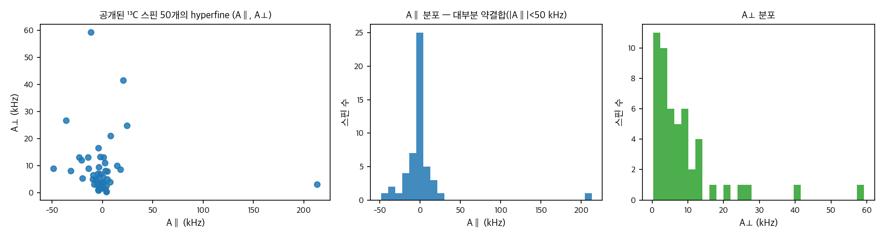
Overview of the Public 50-Spin Dataset (van de Stolpe et al. 2024)
A network of 50 ¹³C nuclear spins around a single NV center in diamond — a measured dataset with all per-spin parameters published
System | One single NV center in diamond + 50 surrounding ¹³C nuclear spins (+1 nitrogen) — entire network mapped with correlated-sensing (concatenated double-resonance) sequences
Measurement conditions | Cryogenic 3.7 K · B = 403.553 G (along NV axis) · presumably the same NV sample as Jung 2021
Published spin information | Per-spin hyperfine (A∥: −48.5 to +213.2 kHz, A⊥: 0.2 to 59.2 kHz) · spin frequencies · 3D lattice positions · 474 measured nuclear–nuclear couplings (mostly a few Hz)
File contents | spin_table / spin_frequencies / spin_positions / spin_measured(predicted)_couplings (xlsx·pkl) + notebooks reproducing the paper's figures
"Mapping a 50-spin-qubit network through correlated sensing" — Nature Communications 15, 2006 (2024) · Delft(Taminiau group)
Paper: doi.org/10.1038/s41467-024-46075-4 Data (4TU.ResearchData): doi.org/10.4121/aba1cc84-0aea-4cdc-93ca-68b0db38bd81.v1

Slide 8
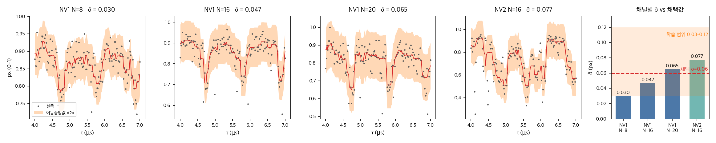
Noise Modeling — Basis for the Synthetic σ
σ extracted by statistical estimation from measured NV1/NV2 data; scheme for mixing cryogenic data into room-temperature data
Step | Method / Value | Meaning
① σ estimator | Adjacent-point differences dᵢ = yᵢ₊₁ − yᵢ → σ̂ = std(d)/√2 | Slow signal components cancel out, leaving only noise (standard estimator under an independent-Gaussian assumption)
② Measured results | NV1 σ̂ = 0.030 / 0.047 / 0.065 (N=8/16/20) · NV2 σ̂ = 0.077 | Biased toward overestimation where dip signal mixes in = conservative upper bound
③ Noise mixing | Room-temp twin σ = 0.06 · cryo twin σ = 0.02 (white Gaussian) + T2 decay curves and contrast also randomized within measured ranges | Room temp matches the NV1 channel level; cryo follows literature conditions
④ Training randomization | Training data uses σ ∈ [0.03, 0.12], uniformly random | Prevents the detector from specializing to one noise level (avoids overfitting)
• Figure: zoom of raw NV1 (N=8/16/20) and NV2 (N=16) data (τ 4–7 µs) — scatter around the moving median (red) matches the ±2σ̂ band
• Rightmost figure: per-channel σ̂ vs adopted value (0.06) and training range (0.03–0.12)

Slide 9
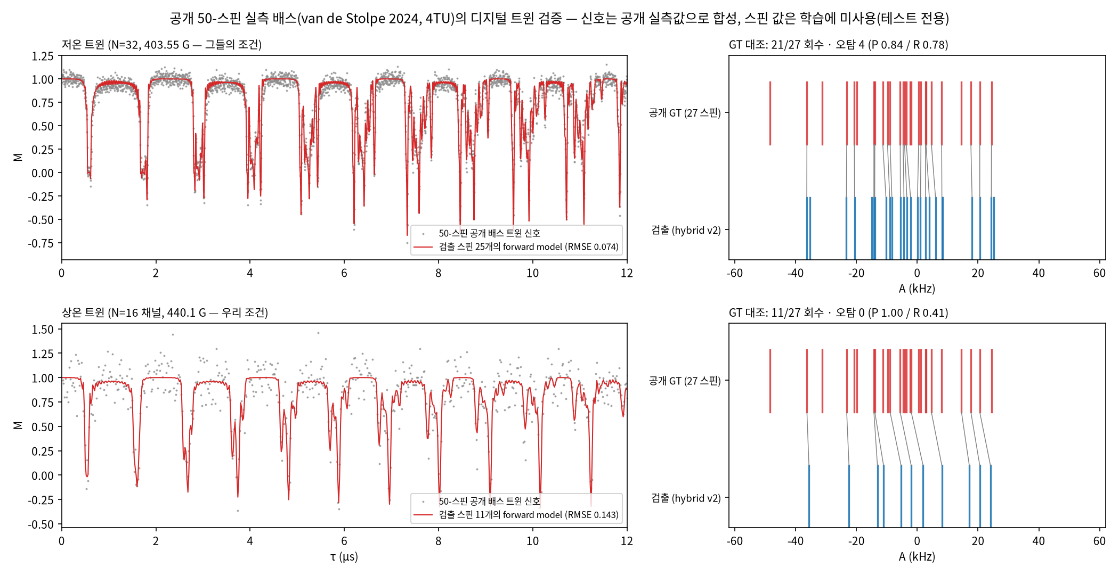
Validation on the 50-Spin Data
Cryo data: 21/27 confirmed (RMSE 0.074) · room-temp mixed data: 11/27 · 0 false alarms — TEST spin values not used in training
• Benchmark summary (F1): the proposed hybrid v2 ranks 1st in every condition — cryo 0.84 / room temp 0.57 / error-injected 0.61 (2021 reproduction 0.38/0.37/0.35, classical DE 0.71/0.50/0.48, RJMCMC 0.84/0.56/0.52)

Slide 10
Final Confirmed NV1 / NV2 ¹³C Nuclear Spin Lists
NV1: 14 + NV2: 9 (+1 withheld) — spin lists confirmed by physics, statistics, and cross-validation
NV1 — 14 spins
NV2 — 9 spins + 1 withheld
(−87.9 ±0.9, 18.3)
(−18.8 ±1.2, 15.5)
(−11.5 ±1.7, 13.9)
(−5.1 ±0.6, 22.5)
(+0.6 ±1.5, 17.1)
(+4.0 ±0.7, 26.2)
(+8.4 ±0.6, 27.8)
(+14.2 ±1.0, 21.7)
(+24.3 ±1.5, 20.1)
(+39.0 ±2.0, 28.2)
(+48.0 ±2.6, 25.1)
(+65.6 ±1.0, 27.6)
(+91.9 ±0.7, 32.6)
(+114.4 ±1.7, 23.9)
(+346.9, 261)
(−151.2, 95)
(−58.9, 182)
(−45.9, 50)
(−38.9, 67)
(−12.6, 42)
(−2.7, 37)
(+51.7, 91)
(+55.9, 55)
(+430.7, 58) withheld: unclear whether strongly coupled or degenerate
Count basis | BIC minimum k*=14 · consistent with RJMCMC posterior mode 15 (the most probable value in the count distribution) · only spins passing the addition penalty are accepted
Statistical reality | All 14 have mutually non-overlapping 95% CIs (60 bootstrap runs)
Physical reproduction | A single list explains all three N=8/16/20 measurements at once, RMSE 0.088/0.116/0.176 (reaching the noise floor)
External consistency | Confirmed consistent with manual-analysis anchors: NV1 4/4 · NV2 3/3
NV2 caveat | Single channel (CPMG-16), so A⊥ is a representative value · (+430.7) may be a degeneracy artifact → to be settled with additional CPMG-8/20 measurements
Off-list candidate | NV1 A ≈ −32±3 (supported by 3 series, not included in the final fit)

Slide 11
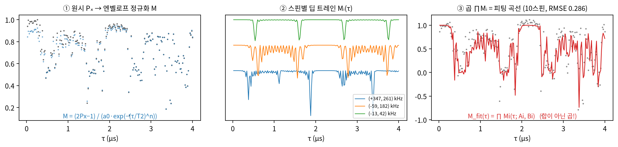
Fitting-Curve Synthesis — Product of Per-Spin Dips
How predicted values are computed from the spin list; the fitting-curve method
Implemented per Jung 2021 Eq.1–3 · cpmg/physics.py
Eq.1 Single-spin dip: Mₖ(τ) = 1 − K·sin²(Nφ/2), K = mₓ²·(1−cos α)(1−cos β)/(1+cos φ)
Eq.2 Phase: cos φ = cos α·cos β − m_z·sin α·sin β, α = ω̃τ (spin precession) · β = ω_L τ (Larmor precession)
Eq.3 Spin axis: ω̃ = √[(A∥+ω_L)² + A⊥²], m_z = (A∥+ω_L)/ω̃, mₓ = A⊥/ω̃
→ Total product M(τ) = ∏ₖ Mₖ(τ), Pₓ = ½(1 + a₀·M·e^−(τ/T₂)ⁿ)
① Divide the experimental Pₓ by the envelope to normalize to the model's M scale → ② each spin (Aᵢ, Bᵢ) generates a dip train Mᵢ at its own period → ③ the total product ∏Mᵢ is the fitting curve
Each added spin adds a factor to the product, reproducing finer structure
— On NV2, going from 6 to 10 spins lowers RMSE 0.308→0.286 (passes BIC; residual decrease = not overfitting)

Slide 12
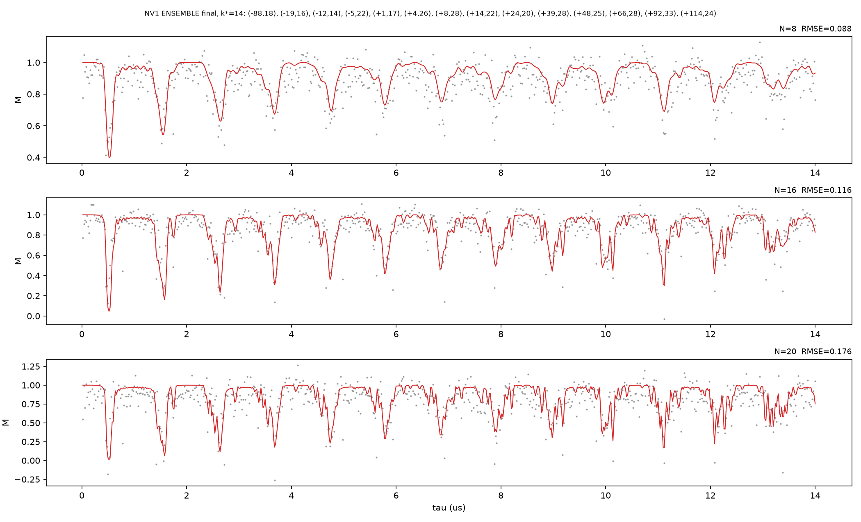
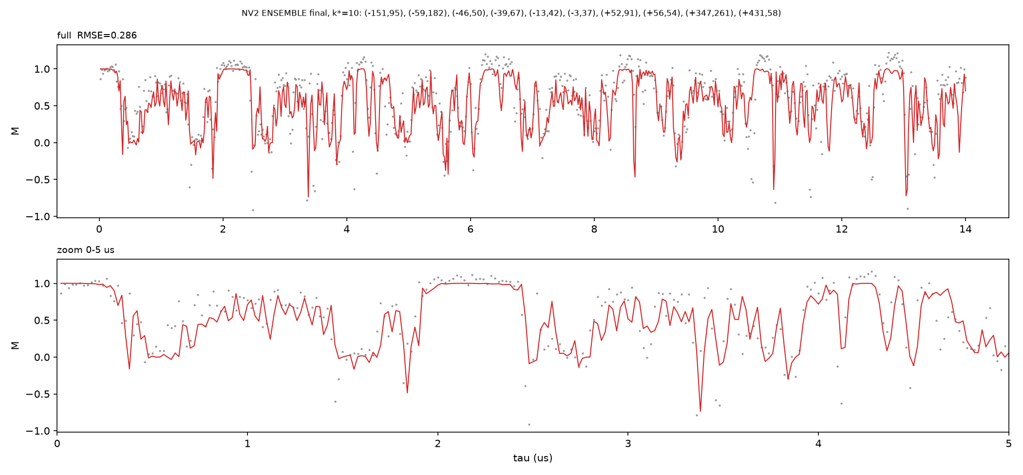
Final Fit: Real CPMG Data (NV1: N=8/16/20 · NV2: N=16)
NV1: 14 spins reproduce all three measurements (N=8/16/20) simultaneously (RMSE 0.088/0.116/0.176) · NV2: 10 spins, RMSE 0.286
Gray = experiment · red = forward model from the detected spins
• Left, NV1: top→bottom N=8/16/20 — one and the same 14-spin list explains all three datasets
• Right, NV2: tracks even the strong-coupling fringe structure (1 spin withheld due to the single-channel limit)

