Slide 1
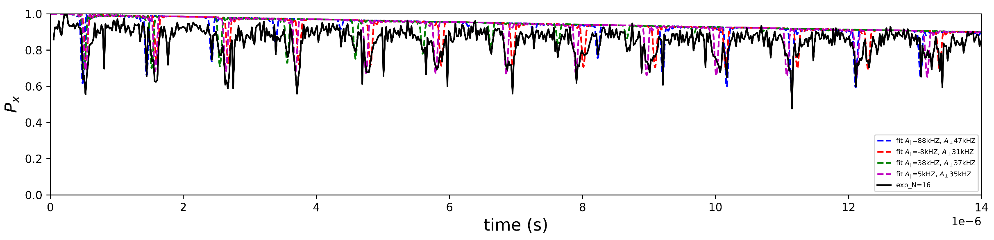

NV1 CPMG16
CPMG Signals
Spin Candidates (¹³C nuclear spin)
Experimental Condition
Spin 1 :$A_{∥}=−88 kHz ,A_{⊥}=47 kHz$
Spin 2 :$A_{∥}=8 kHz ,A_{⊥}=31 kHz$
Spin 3 : $A_{∥}=−38 kHz ,A_{⊥}=37 kHz$
Spin 4 : $A_{∥}=−5 kHz ,A_{⊥}=35 kHz$
Frequency : 1.63771 GHz (B-field : 440.1 G)
Tau : ~ 14 μs
Iteration # : 22

Slide 2
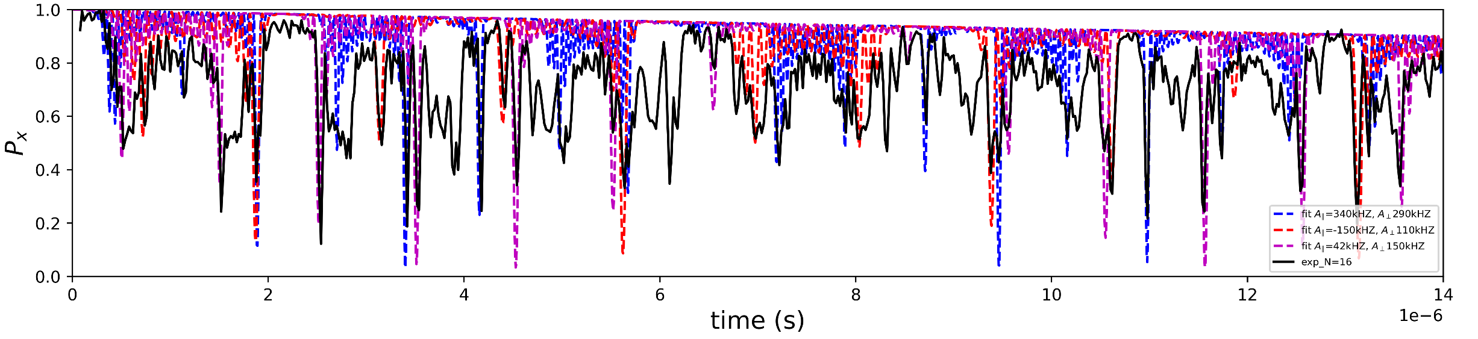
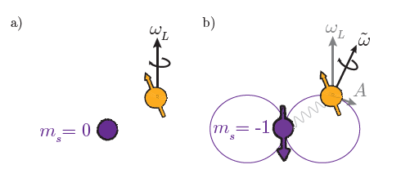
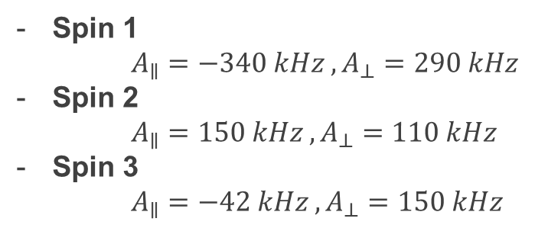
NV2 CPMG16
CPMG Signals
Spin Candidates (¹³C nuclear spin)
Spin 1
$A_{∥}=−340 kHz ,A_{⊥}=290 kHz$
Spin 2
$A_{∥}=150 kHz ,A_{⊥}=110 kHz$
Spin 3
$A_{∥}=−42 kHz ,A_{⊥}=150 kHz$
J.Cramer, Quantum error correction with spins in diamond. 2016

