Slide 1
Cyber Security as an Evolving Host-Parasite System
Russell Thomas
George Mason University
russell.Thomas@meritology.com
Mathew Woodyard
Bank of America
mat@matwoodyard.com
Notes:
[0.25 min.]
I’m Mat Woodyard at B of A. This is joint work with Russell Thomas, PhD Candidate at George Mason, who could be here today.
I’m presenting a computational model of Cyber Security investments, as an evolving ecosystem, including host-parasite relationships

Slide 2
Main Points
We extend computational game theory w/ reinforcement learning, adding features relevant to cyber security as a Red Queen innovation arms race.
In certain conditions, simulations exhibit regime changes where “losers” become “winners”, etc.
This type of result is not possible in static analytic and computational models
These are stepping stones to host-parasite dynamics
Presentation slides and NetLogo code is here:
http://xxxxxx
Notes:
[0.75 minutes, 1.0 min elapsed]
In this brief presentation, I will focus on these three points. I’ll come back to them at the end. (DON’T read them!)
Other material is at the end of the slides and full NetLogo code (work in progress) is also available.

Slide 3
Starting Place: Iterated Game Theory
Player A
Move 1
Move 2
Move 1
3 , -3
1, 1
Player B
Move 2
-1 , 2
5 , -2
Payoff to A , Payoff to B
Notes:
[0.25 min, 1.25 min. elapsed]
This may be familiar to many of you – a 2 by 2 Normal Form Game. This is our starting place.

Slide 4
Starting Place: Iterated Game Theory
What is a “move”?
… a “payoff”?
Player A
Move 1
Move 2
Move 1
3 , -3
1, 1
Player B
Move 2
-1 , 2
5 , -2
Payoff to A , Payoff to B
Notes:
[0 min., 1.25 min. elapsed]
What do we mean by “move” and “payoff”?

Slide 5
Abstract Model of Cyber Security Investment
Each Time Step, every Player chooses a “move” from a large number of possibilities.
Each “Time Step” is a unit of time on the order of a week, a month or quarter. Payoffs reflect sum of transactional payoffs during that time.
Each “move” is a functionally distinct combination of tactics (e.g. settings, policies, staffing, etc.)
e.g. All combinations of 9 components yield 510 possible moves
Random payoffs ➔ statistical analysis of randomized experiments
The number of possible “moves” and the specific possibilities are dynamic and endogenous.
Players can have “blind spots”, especially regarding other player’s moves
OUR FOCUS is on investment decisions that change the possible moves, and also on move selection rules
Notes:
[1.5 minutes, 2.75 min elapsed]
This is the touchstone to cyber
We are creating an abstract, idealized model at the level of investment. No attack trees or controls: we are abstracting above those.
Focus on bullet 2. Define move. These 9 components can be existence of a control, staffing to manage, etc.
What determines loss event frequency and severity

Slide 6
What is a Functional Ecosystem?
Different from Biological ecosystems
Flows of energy and resources
Reproduction and death processes at population level
Focus: Carrying capacity, diversity, niche structure, evolution, etc.
Functional Ecosystem is:
State changes in the system through functional mechanisms, e.g.
Making, Modifying, Monitoring, Filtering, Detecting, Alerting, …
Abstracted as informational and computational mechanisms
The ecosystem is a network of affordance relationships between functions, characteristics, capabilities, etc.
Focus: functional performance (“getting the job done”), productivity, success rate, innovation.
Notes:
[1 min. 4.75 min elapsed]
Touchstone into ecosystems
What do we mean by ecosystem? We mean a functional ecosystem. Contrast with biological in two sentences. Meta-message: we are taking the word “ecosystem” seriously.

Slide 7
Classes of Ecosystem Relationships
Cooperative / Synergistic
Positive sum game with positive correlation between payoffs
Competitive
Positive or Zero sum game with negative correlation between payoffs
Predatory
Zero sum games with negative correlation between payoffs
Host – Parasite
Key mechanism: parasites co-op host resources, functions, and signals
Cannot be modeled with traditional Game Theory
Dynamic rather than static game structure
Equilibrium solutions can no longer be assumed.
Agents must rely on dynamics strategies and adaptive learning rather than traditional rationality.
Notes:
[1.25 min., 6.0 min. elapsed]
Here are three classes of relationships. The first three have game theory representations, but host-parasite cannot be modeled with game theory. ~2 minutes
In the realm of cybersecurity, host-parasite systems are often mentioned, but seldom explicitly modeled.
You cannot get to the three subsubbullets at the bottom until you address the host-parasite model.
Transformations in the host-parasite relationship cause them to evolve together—the lifecycle of hosts and parasites leads to innovation and a dynamically changing environment.

Slide 8
Literature
Galla & Farmer (2013)
Computational model with reinforcement Learning in 2-Player random complicated games
Tria, et. al. (2014)
Computational model of stochastic novelty generating process
Galla, T., & Farmer, J. D. (2013). Complex dynamics in learning complicated games. Proceedings of the National Academy of Sciences, 110(4), 1232–1236
Tria, F., Loreto, V., Servedio, V. D. P., & Strogatz, S. H. (2014). The dynamics of correlated novelties. Nature Science Preport, 4.
Notes:
[0 min., 6.0 min elapsed]
Here’s to references to literature we have drawn on. In the interest of time, I’ll skip the descriptions.

Slide 9
Our Contribution
Complicated Dynamic Games over a Network
Large number of moves (➞400), unknown opponent payoffs, changing structure of moves and payoffs
N defender Players (green) vs. M attacker Players (red)
Pairwise games with any degree cooperative vs. competitive relationships, including mixed.
Player learning: “Experience Weighted Learning”
Plus optional social learning of “best practices”
“Move” selection using quantitative risk assessment
And variants, incl. blind spots, distortion, H-M-L ordinal score, etc.
These are stepping stones to host-parasite relationships (future work)
Where attacker Players can co-op defender investments and move selection process
Notes:
[4 min., 10.0 min.]
7 reiterates 4. 7 gives it meaning and shows it in action.
[Read each point. These are extensions to existing computational game theory models]
Point 1: Extending Galla & Farmer by complicated we mean many alternative stratagems, not a small number (up to 400 in our model). No direct knowledge of opponents’ payoffs, only probabilistic knowledge of possible moves.
Point 2: the payoff matrix changes in structure over time of the game based on player investments.
Point 3: Adopting experience-weighted learning from other work as a procedural rationality used in complicated dynamic games. This is a good approximation of complicated rationality in dynamic circumstances. We must obtain results experimentally (simulation) rather than analytically. Will define move in slide 8
Point 4: Interpretation of Galla and Farmer. Selecting moves based on quantitate risk assessment.
Sub: but we want to test experimentally when players have different capabilities (use H/M/L risk scores)
All of this gets to the core of the host-parasite dynamic.
The model is equivalent to quantities risk assessment, but admits players using incorrect or overly simplistic models.

Slide 10
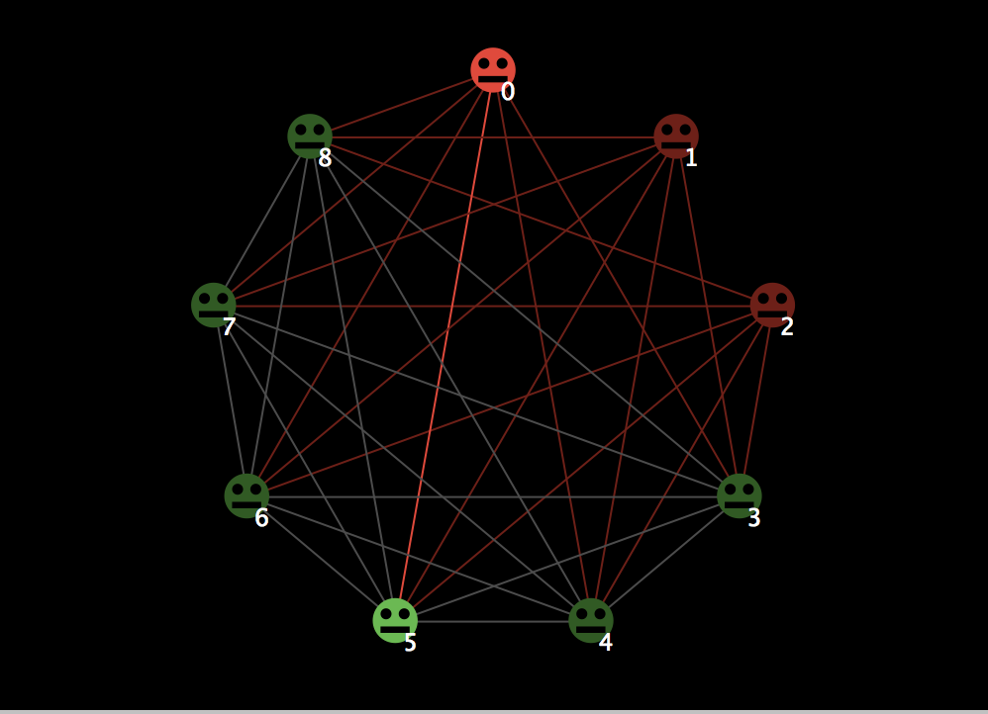
Notes:
[1 min. 11.0 min. elapsed]
Here is a schematic of the network of games.
In this setting, there are nine players: five green and three red.
Every player interacts (potentially) with every other, though red players only interact with green. Green-to-Green games are cooperative. Green-to-red games are competitive.
Each line is a two-player game. Bright colors and lines indicate the game that is highlighted in the simulation interface. (graphs, etc.)
In every time step, each player choses a single move, and this move is applied to all their games.
Here is one major different from other simulations: A player’s “move” should enable good payoffs while minimizing bad payoffs. This creates a functional ecology of cooperative and competitive relationships.
(In contrast, other Game Theory computational models of cyber security feature only attacker-defender relationships, or information-sharing among defenders but not actual transactional relationships)

Slide 11
Sample Results
Notes:
Now I’ll show three types of illustrative results.
The first two results show what sort of dynamics can arise in complicated games.
The last result shows what can happen when novelty arises (i.e. players acquire new possible “moves”, and maybe discard existing “moves”)

Slide 12
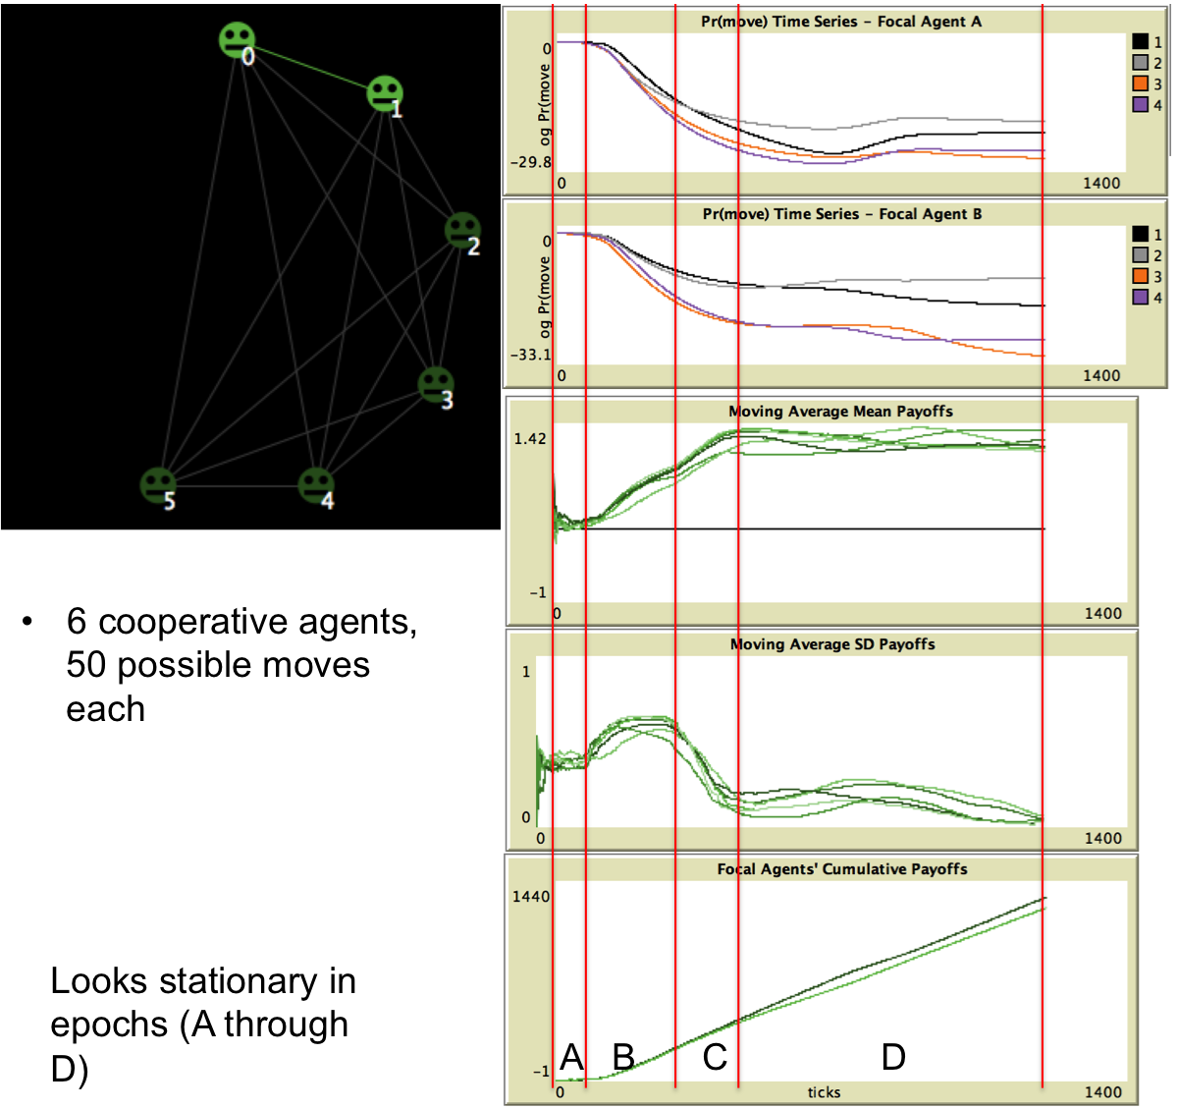
FIXED
POINT
(Equilibrium)
Notes:
[0.5 min., 11.5 min. elapsed]
All of these charts are time series for a single simulation run.
The top two charts show the time evolution of move probabilities for 4 of the 50 possible moves, for Player A and B. Move probabilities evolve through a deterministic dynamical process.
The bottom three charts are simulation outputs – i.e. realization of random variables:
1) Mean payoffs over last 100 time steps for all 6 players; 2) Standard deviation of payoffs over last 100 steps for all 6 players; and 3) Cumulative payoffs for the two focal players
RESULTS: transient followed by equilibrium, conforming 2-player results from Galla and Farmer (2013).

Slide 13
Chaos
(Far from Equilibrium)
Notes:
[1 min., 12.5 min. elapsed]
The difference here is that we have added one adversarial player (red), which has 100 possible moves, compared to the 50 possible moves of the 6 green players. Having more moves gives the Red player an advantage, and it can also “free ride” on the cooperative behavior of Green players. Finally, the learning parameters for Red is set so that it has longer memory. This leads to chaotic dynamics.
RESULTS: chaotic dynamics, conforming 2-player results from Galla and Farmer (2013).
(When the system does not settle into equilibrium and exhibits non-stationarity, then traditional Game Theory methods don’t apply)

Slide 14
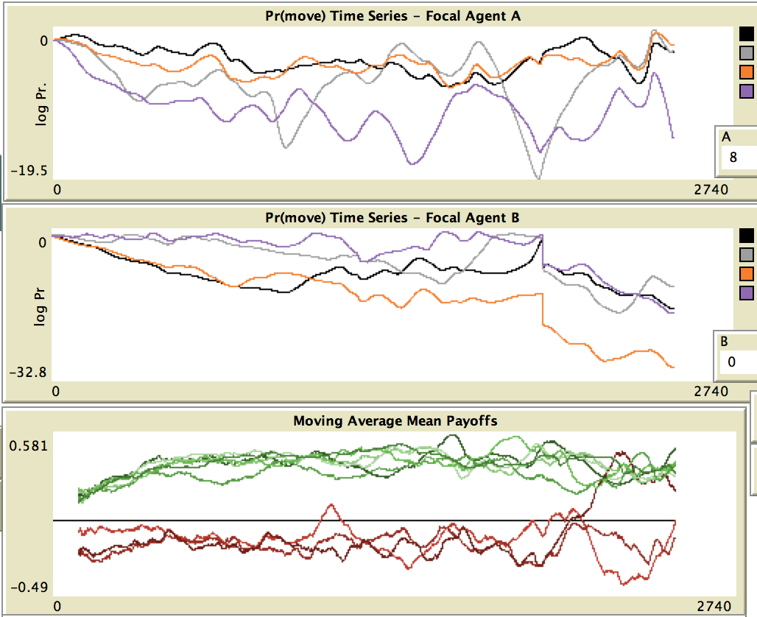
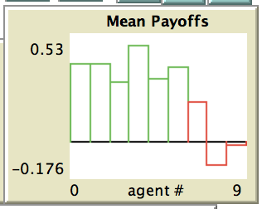
Treatment: Novelty (Red)
t = 2500
Regime Change
One Attacker Starts to Thrive
Green Agents Dominate Initially
Notes:
[1.5 min., 14.0 min. elapsed]
Finally, here a simulation of 6 green players and 3 red players.
Initially, the red players have fewer moves than green, but they have the capability to discovery and utilize new moves (correlated novelty mechanism from Tria, et. al., 2014)
Because green players have more moves and are more numerous, they initially are all profitable (“dominate”). All the red players are unprofitable.
Here is the interesting result: at about t=2,000, there is a regime change as one of the red players has discovered and started to use new moves that place green at disadvantage. This one red player becomes sustainably profitable. All the other players adjust to react to this new dynamic.
This is just one example of the sort of result that this computational model can produce, which is out of reach using previous models.

Slide 15
Other Treatments & Institutions
Varieties of ignorance, error, and uncertainty
Social imitation, information sharing, and “best practices”
Investment policies at two levels
Capabilities
Infrastructure
Future:
Host-parasite dynamics
Incentive instruments (incl. insurance)
Notes:
[1 min., 15.0 min. elapsed]
To conclude, the current model includes several other features that allow experiments on varieties of ignorance and uncertainty, social imitation, and investment policies that affect the space of possible moves.
All of what we have presented so far is prerequisite for the ultimate goal: to model the host-parasite dynamics in systems like cyber security, and also the influence of institutions like information sharing and insurance.
A variety of host-parasite mechanisms might be added to this model:
Green player (defender) “moves” might be appropriated by Red players (attacker) through a discovery process.
Green/Defender capabilities might also be appropriated, which enable Red “moves” as if the Red player had made those investments
Green/Defender “signals” might be appropriated so that the guide Green/Defenders make “moves” that favor the Red/Attacker

Slide 16
Conclusion: Main Points
We extend computational game theory w/ reinforcement learning, adding features relevant to cyber security as a Red Queen innovation arms race.
In certain conditions, simulations exhibit regime changes where “losers” become “winners”, etc.
This type of result is not possible in static analytic and computational models
These are stepping stones to host-parasite dynamics
Presentation slides and NetLogo code is here:
http://xxxxxx
Notes:
[any time remaining]
Here again are our main points

Slide 17
Q&A
Slides and Code:
(GitHub)
Russell Thomas
George Mason University
russell.Thomas@meritology.com
Mathew Woodyard
Bank of America
mat@matwoodyard.com

