Slide 1
Reading Regression Output Without Taking Econometrics
James Woods

Slide 2
The Goal
Most of the papers you read are looking for evidence that something caused something else.
Some of this evidence is from hypothesis tests.
Some is through how the data is collected

Slide 3
Cause
What we usually want to know is what is the effect of changing one variable on another variable.
We want cause, not just correlation (https://www.tylervigen.com/spurious-correlations)

Slide 4
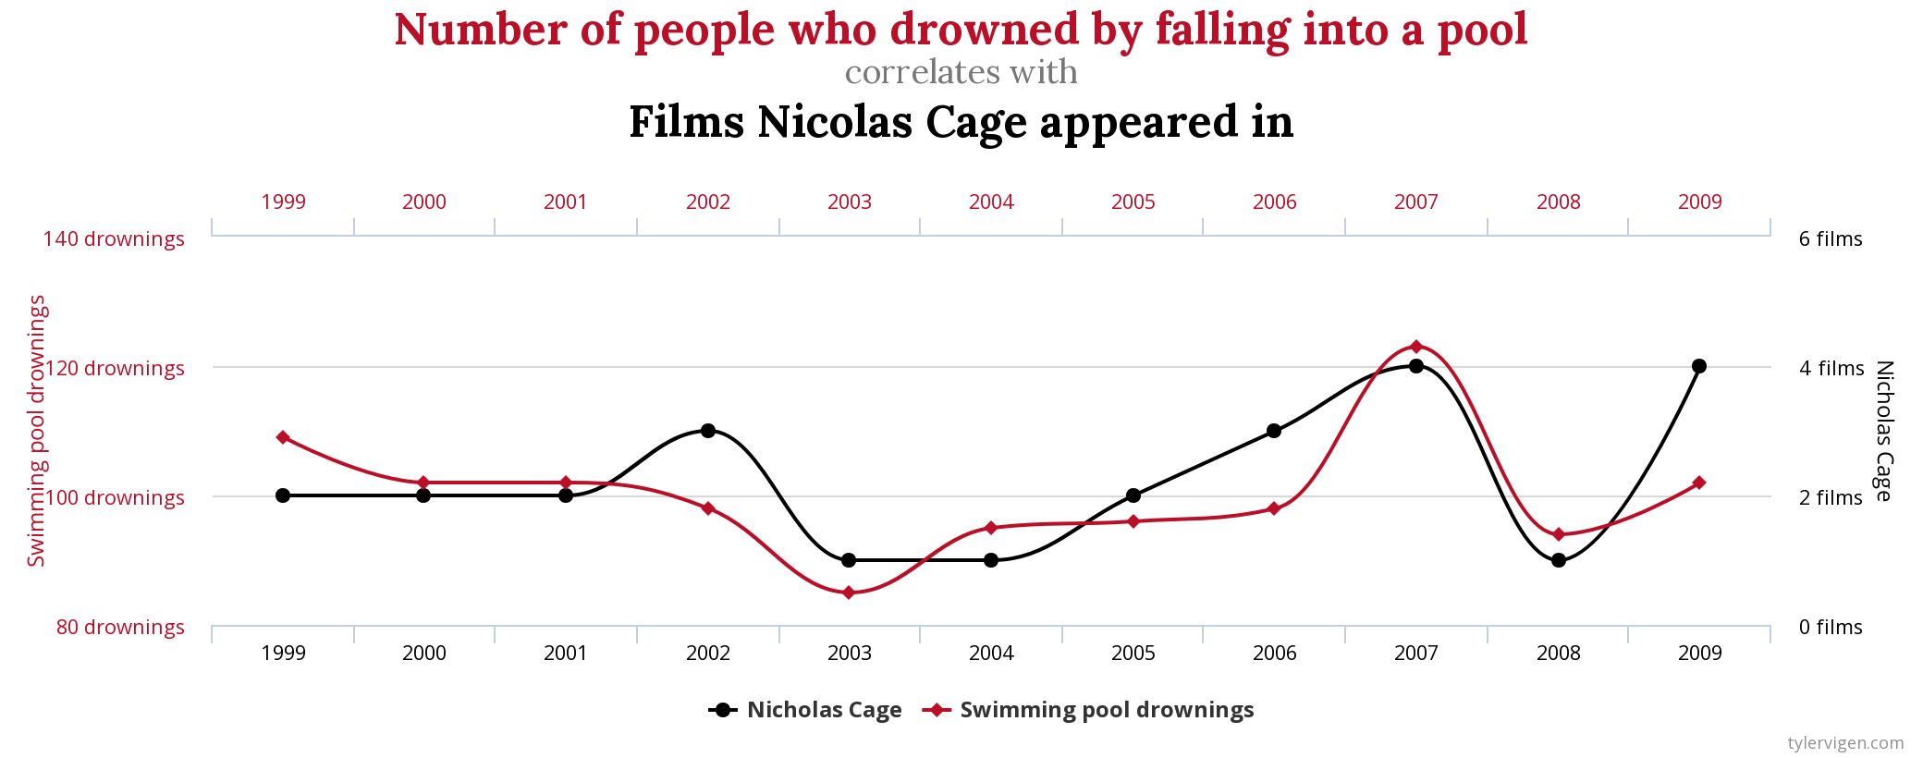
Please Stop Nicolas Cage

Slide 5
Ideal
Run an experiment (Randomized Control Trial or RTC):
Get a well mixed relativly homogenous group.
Randomly subdivide in to two or more groups.
One group is the control
Treat the others.
Observe response.
Difference response between control and each group is the average response, which has a mean and variance and you can do stats with.

Slide 6
Easy Right
What if the groups are not quite the same, the technical term is unbalanced, which is just one definition of the unbalanced?
One group has more old people or poor people.
You need to make sure you take into account these differences.
Because treating things that are different as if they are the same is bad.
Simpson’s Paradox

Slide 7
Example
Votes in the U.S. House of Representatives in favor of passing the Civil Rights Act of 1964:
On average, Republicans tended to vote for passage more than Democrats

Slide 8
But there is another factor
In both North and South, Democrats are more likely to vote for passage than Republicans. We treated Northerners and Southerners the same in the first chart – Here they are shown to be different.

Slide 9
How Easy is That?
You know how to do Chi-squared test?
Just gather factors and …
Eye color (8)
Hair color (8)
D2/D4 (2)
128 cells so far.
You just found the curse of dimensionality. You need to combine or ignore some of these because you will not have enough observations.

Slide 10
Continuous Variables
Height:
Less than or equal to 5’5“, greater than 5’5”
But 5’5" and 4’ 11" are in the same category and 5’4" and 5’ 6" are not?
Need a way of matching with continuous variables. Regression allows you to do this.

Slide 11
Just Basics
Doing Econometrics well is hard.
EC 460 will teach you the basics of single-equation regression, e.g., demand estimation, and how to fix some things.
Make you overconfident.
Functional work requires:
Systems equation estimation, e.g., supply and demand at the same time.
Discrete choice, e.g., Yes/No or make and model of a car.
Knowledge of how to get causality, experimental, e.g., RCT, and quasi-experimental methods, e.g., regression discontinuity.

Slide 12
BASICS Single Equation
Explain something, often called the left-hand side or endogenous variable, with explanatory, right-hand side or exogenous variables.
$$Weight=α+βHeight+ϵ$$
Weight is left-hand side
$α$ intercept term, expected weight given you have no height.
$β$ How much your weight increases for every inch of height.
$ϵ$ How far off we were.
All the greek letters are random variables. We estimate the means and variances of those.
Generating Fake Data with Weight = 20 + 2.75 Height + n(0,40)

Slide 13
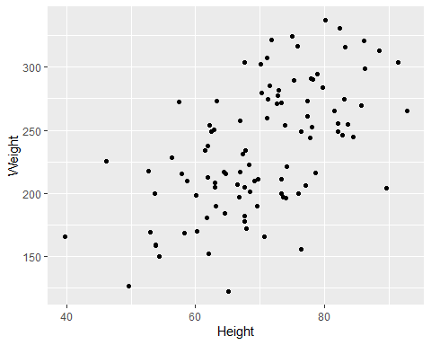
Fake Data

Slide 14
Regression Output

Slide 15
The parameters
The Parameter Estimates:
Estimates of the line through the data $Weight=35.6266856+2.8454856Height$
The True values are: $Weight=20+2.75Height+n(0,40)$
Note that the values are not the same. Each of the estimated values comes with uncertainty. It is a random variable. Those are the numbers in parentheses are standard deviations of the estimate.

Slide 16
With Confidence Intervals

Slide 17
Of Note
95% confidence intervals are about +/- 2 standard deviations
There is a 95% that the true value is in that interval
Asterix indicate that the probability of seeing this value by chance alone is small. Commonly called significance.

Slide 18
The Lower Part of the Table

Slide 19
Overall
Regression as a whole:
$R^{2}$ fraction of variation in LHS explained by variation in RHS.
Because if you add more variables $R^{2}$ goes up, Adjusted $R^{2}$, penalizes for having more variables.
Residual Std. Error is the standard deviation of the error term. We generated the data with N(0, 40)
$F$ Difference between model that is mean of LHS alone, just the intercept, vs model with RHS. IOW, things other than the constant explain things.

Slide 20
Complications
Dummy Variables, which indicate categories like eye color
Transformations like log and powers

Slide 21
Categories
They usually leave one out, often the control or most common category.
These get accumulated in the constant term
The constant could be Blue eyes, Short, non-economist
Additional coefficients would indicate the difference between brown eyes and blue. Another would be tall vs short.
Always figure out who the constant represents.
The reason is a math thing about minimization or maximization.

Slide 22
Transformations
Usually these are because reality works this way, the amount of light from a source decreases by the square of the distance.
Sometimes it solves a problem with residuals (heterskedasticity)
Often come with interpretation
$Y=α+βx$
$ln(Y)=α+βx$: A 1% increase in x increases y by $β\%$.
$ln(Y)=α+βln(x)$: $β$ is an elasticity. 1% increase in x increases y by $β\%$.

Slide 23
When Reading a Table
Never just go, this is significant and this isn’t. Understand how it fits in the story.
Some of the variables are “just controls” and others are the key variables.
Tell the story of the key variables.

Slide 24
Problems
LHS is a dummy variable, e.g., buy or don’t buy, then we use a probit or logit.
One of the RHS variables is endogenous, like how renting or buying is determined by income credit and cost of living in the area. We use instrumental variables for this.

Slide 25
How We Use Regression for Causality
In real randomized experiments like RTC, to balance taking into account that the randomly generated groups could have slightly different characteristics that are important.
With Quasi-Controls
Matching like caliper or coarsened exact matching.
With outside pseudo-randomizer like regression discontinuity test.
Difference-in-Difference, match pre-treatment movements and parameters with a control group and then look for differences post intervention

Slide 26
Coarsened Exact Matching (CEM)
Break RHS variables into histograms.
Multivariate histograms
Remove observations that do not have a treatment and a control observation.
Remove influence of observations not in joint support.
Balance the cells for treated and not treated.

Slide 27
Hypothetical Data
## ## Using 'Group'='Control' as baseline group

Slide 28
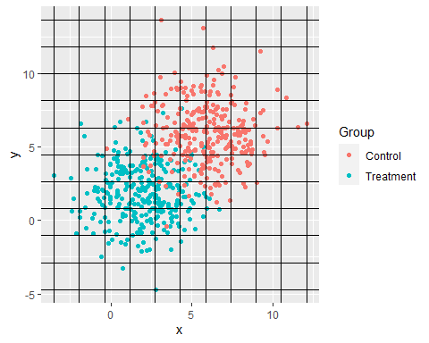

Slide 29
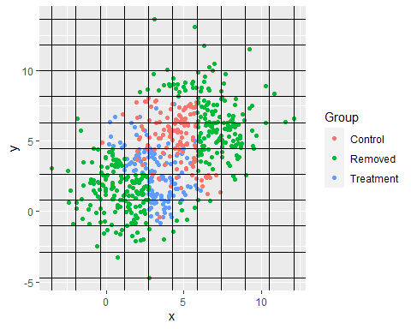
With Unmatched Observations Removed

Slide 30
Differences-in-Differences (DID)
Start with a treated group and go looking for an untreated controls group.
Test if there is parallel movement, basically all the parameters except the constant term are the same.
Check if the treated group reacts differently after the intervention.

Slide 31
Example
Relationship between height and weight. One group got free passes to the gym if they went a few times a month and the other did not
Parallel movement test is $β_{treated,pre}=β_{control,pre}$ but not $α_{treated}=α_{control}$.
Average effect is $β_{treated,post}−β_{control,post}$
Can be more complex than this if the treatment changes multiple terms – including the intercepts.

Slide 32
Lets Pull Some of Your Regessions

