Slide 1
Intro To Coal

Slide 2
What is Coal?
Start with boggy land.
The decaying plants turn into peat.
The peat gets buried
Over time, millions of years, turns into coal.
More time and more pressure (most of the time deeper), better coal.
Better means higher carbon content and BTU/lb

Slide 3
What are the Kinds of Coal?
In general, the deeper the coal the older it is and the more likely it is higher quality. The names vary by country and the number of grades (ranks) differs by country.
Anthracite: Highest quality
Bituminous
Sub-Bituminous
Lignite: Lowest quality

Slide 4
Coal is often separated into two major groups.
Metallurgical Coal: Expensive and almost pure carbon, used to make steel.
Coke, which is cooked coal, like charcoal is cooked wood, is a frequent substitute.
Steam Coal: Used in electricity production.
“Steam Coal” is different depending on the country.

Slide 5
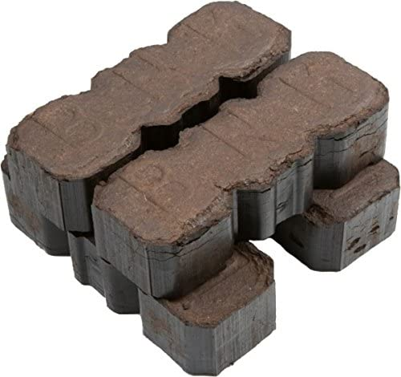
Pictures: Peat

Slide 6
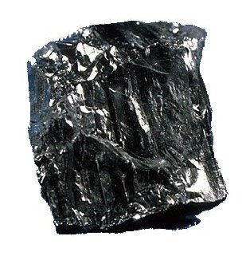
Pictures: Anthracite

Slide 7
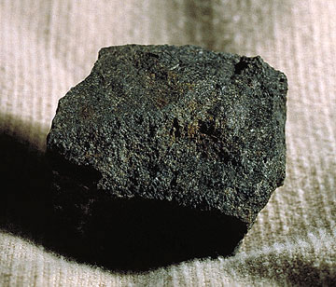
Pictures: Bituminous

Slide 8
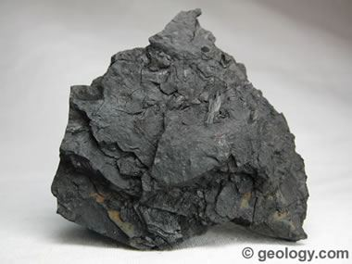
Pictures: Lignite

Slide 9
Heat Content, Sulfur, Carbon.
Heat content, kJ/kg or BTU/lb in merican, varies a little bit within category.
1 BTU = 1.055 kJ
1 BTU is enough to raises one lb of water 1 F.
EIA swaps from BTU/ton to BTU/lb frequently.
(short) ton = 2000 lbs
Sulfur can vary widely but except for lignite is less than 1%. This is a pollutant.
Carbon content virtually defines the ranks.

Slide 10
The Numbers
Type | Carbon% | BTU/ton
Lignite | 30% | 10M -15M
Sub-Bituminous | 40% | 16M -20M
Bituminous | 50%-70% | 22M -30M
Anthracite | 90%+ | 28M+

Slide 11
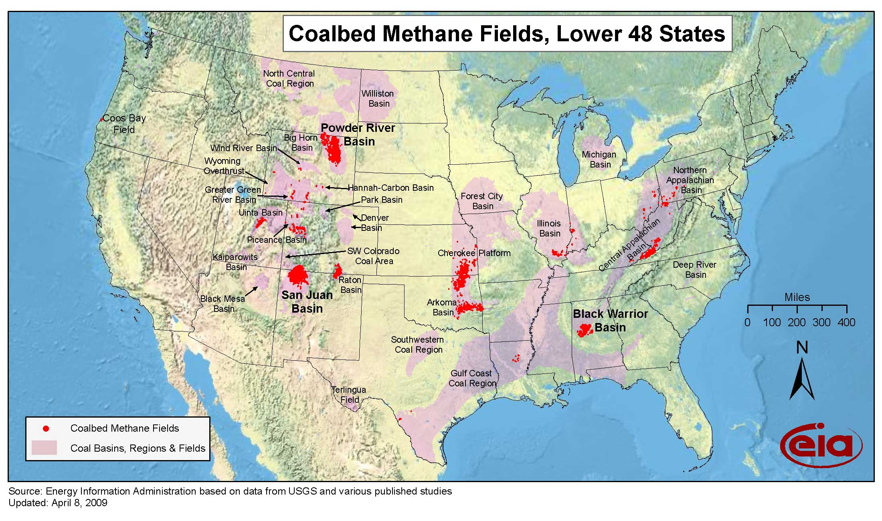
Where do you find it in the US?

Slide 12
How do you mine it?
Surface (Most common in US)
Open Pit
Strip - Take the overburden off, then it is like double digging in your garden. Common in Western US coal mining
Contour - Like strip for hills
Mountaintop removal - Get coal off from under mountain top and throw it into the valley. An Appalachian thing
Underground mining
1000s of feet deep and for miles.
Various techniques: Long wall, room and pillar.

Slide 13
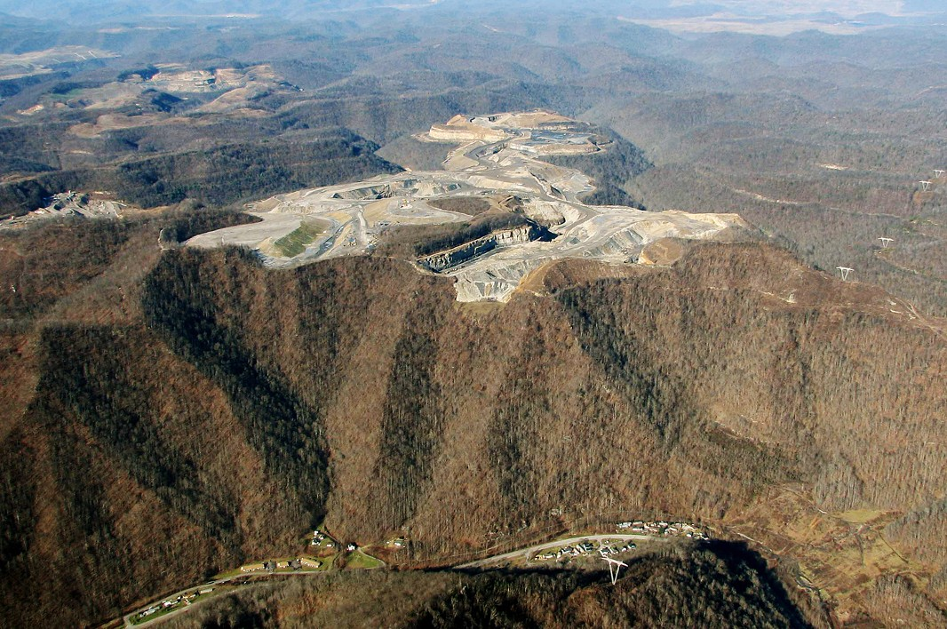
Mountaintop Removal

Slide 14
Underground Fires
Coal fires are a thing. The most famous US fire is Centralia, which started in 1962.
The most famous world wide is Mt Wingen in New South Wales, which has been burning for 6,000 years.
There are a few thousand burning at any given moment.
Besides CO2 and SOX
Mercury

Slide 15
How is it transported?
Railroads 68.7% of the domestic coal
River Barge 11.9%
Truck about 10.5%
Tramway, Conveyor, and Slurry pipeline accounted for 8.9%. (Short distance) source: https://www.eia.gov/coal/distribution/annual/
Keep in mind that transportation is often more expensive than mining.

Slide 16
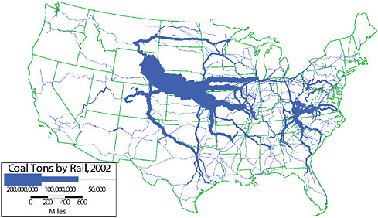
Rail Map

Slide 17
A few comments on the map
That huge wave coming out of Wyoming wasn’t there till the 90s.
That is Powder River
It has low sulfur and was not used until SOX controls on power plants were required in 1990.
Tends to be cheap
BLM land
Auctions on mining rights almost always had one bidder.
Those mining rights are a current topic.

Slide 18
Burning Coal is a tradeoff
If you burn at high temperatures
You get lots of kWh per BTU
Generate more NOX and SOX
If you burn at lower temperatures
You get less kWh per BTU
Less NOX and SOX
More particulates PM 10 and PM 2.5
You either start with low sulfur coal, burn at lower temperature or scrub after. Trade-offs depend on prices and technology.

Slide 19
Why coal?
Historical point of view:
Coal burns hotter than wood, but so does charcoal.
Coal (anthracite) burns with less ash and smoke than wood, but so does charcoal.
Charcoal requires a lot of wood to make.
We could not keep up with heating and steel demand. The first industrialized countries had good (anthracite) coal with low transportation costs.

Slide 20
We tried with wood and Hydro
The UK and US killed a lot of trees to keep up.
UK would have run out of mill sites by 1830.
Even used intensive management like pollarding to produce more wood.

Slide 21
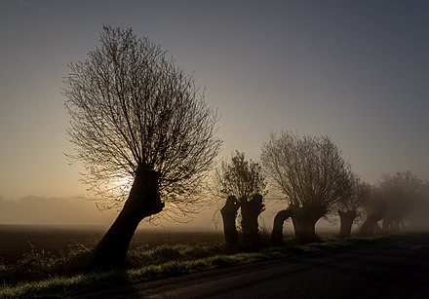

Slide 22
Metalurgical Uses
You need carbon, and other things, to turn iron into steel.
You also need carbon to smelt iron.
You need a lot of energy to do this.
Metallurgical coal is ~ $200/ton. Steam coal is <$50/ton.

Slide 23
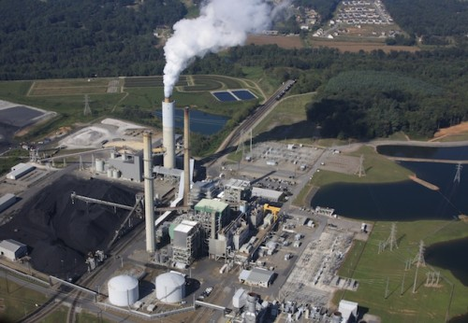
Electrical Generation from the outside

Slide 24
Source: http://appvoices.org/images/uploads/2012/02/Asheville-coal-plant-e1432059203783.jpg

Slide 25
Coal on the inside
Pulverize the coal, picture something that can do 20 Tons/hr
Blow it into combustion chamber to burn
Steam turns turbine, etc. https://youtu.be/IdPTuwKEfmA
Clean up
NOx with ammonia common but plenty of others
Recover fly ash and sell it, great for concrete.
SOx, Mercury and other. BTW Radiation

