Slide 1
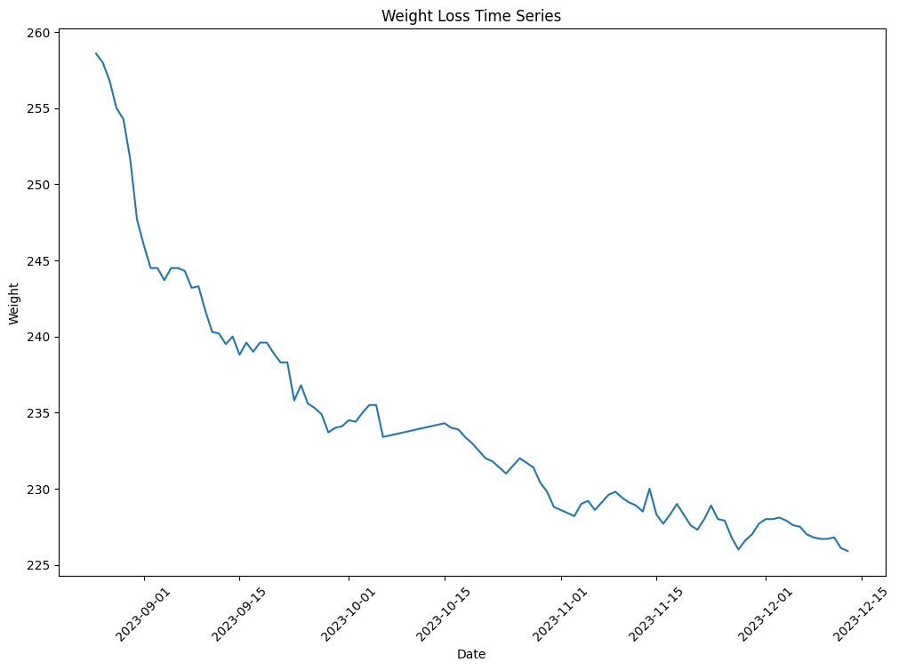
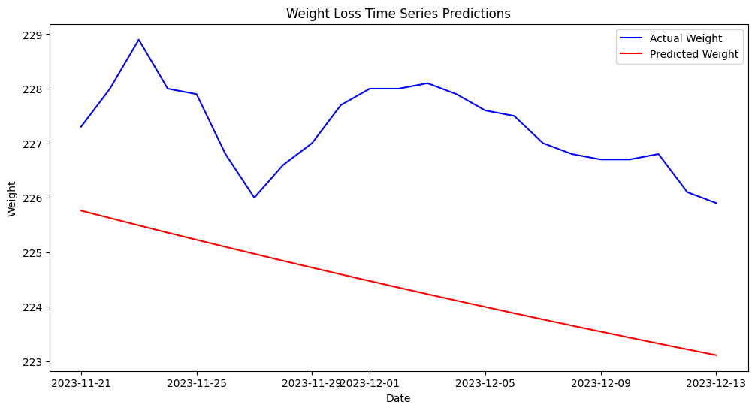
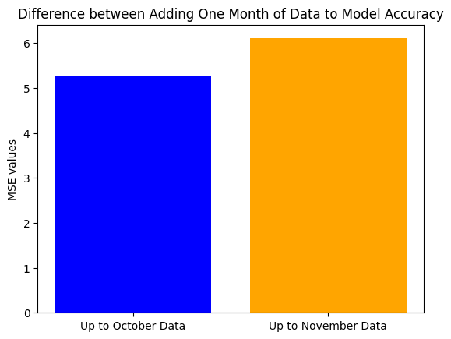
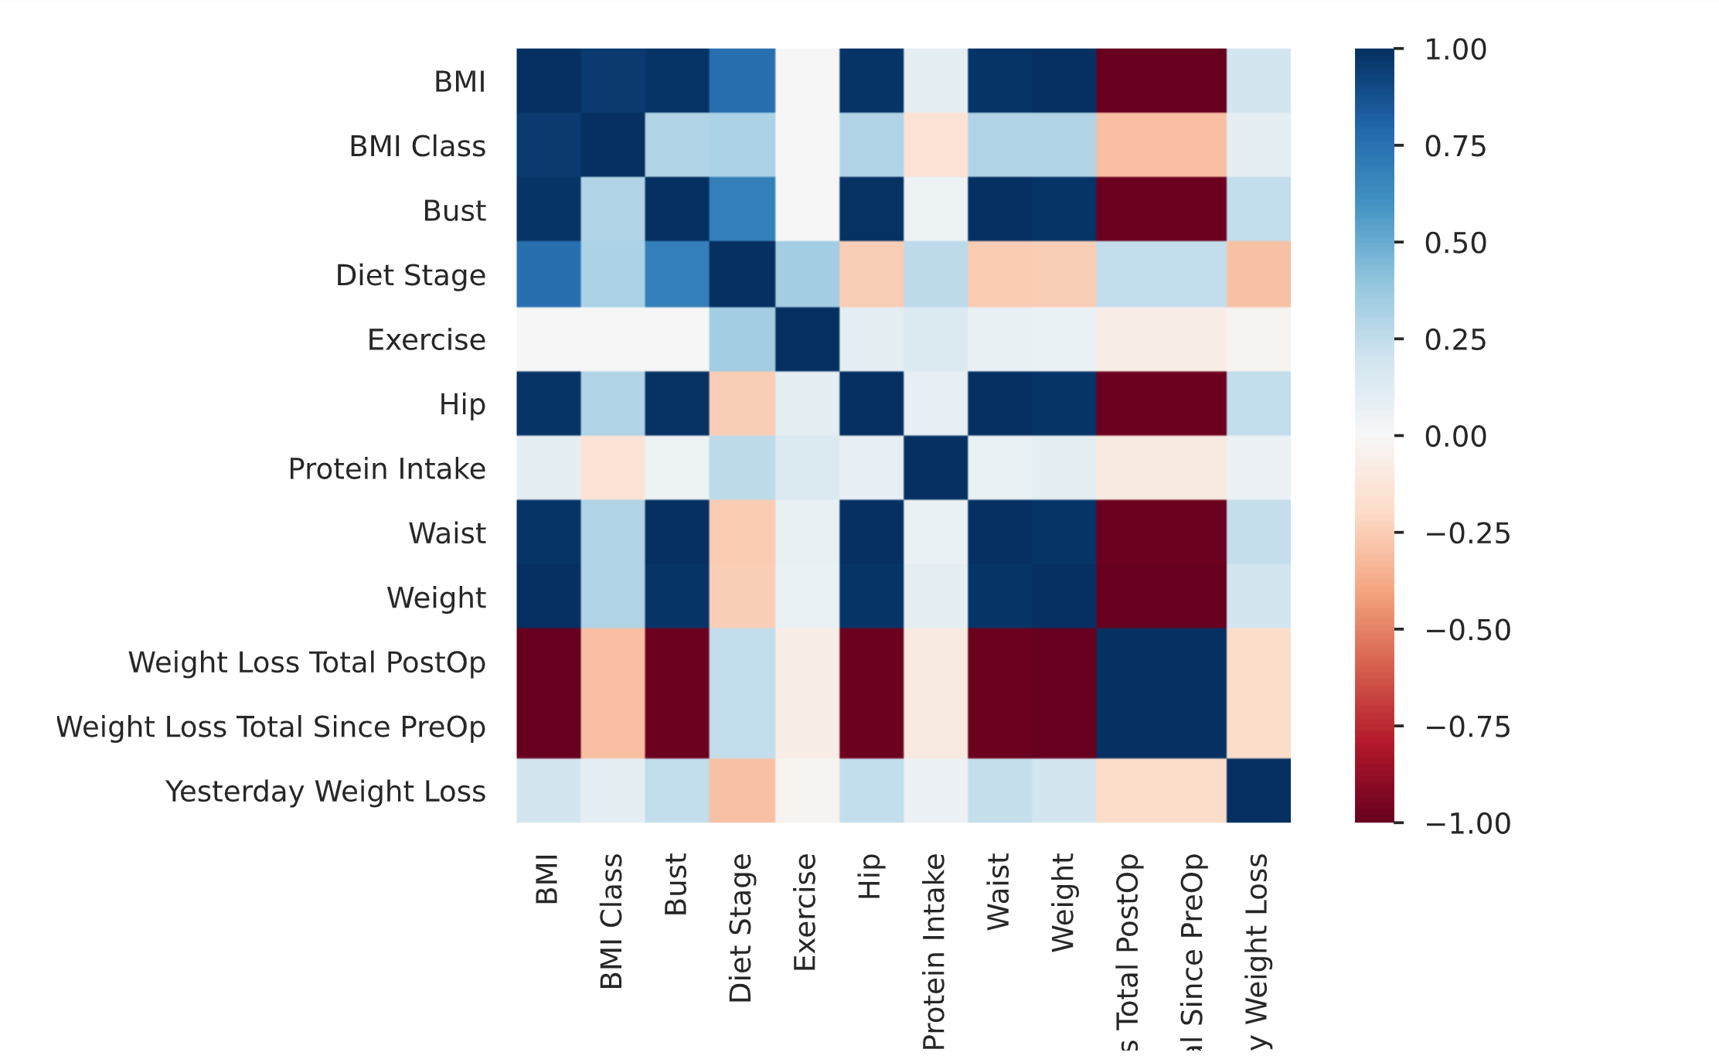
Gastric Sleeve Weight Loss: A Self-Case Study Timeseries Analysis
Kelsey Woods
Pace University Seidenberg School of Computer Science and Information Systems
https://github.com/woodskd24
ABSTRACT & BACKGROUND
METHODOLOGY
CONCLUSION & FUTURE WORK
Gastric sleeve surgery, (sleeve gastrectomy), is a bariatric surgery procedure. It removes a large portion of your stomach, leaving behind a narrow “sleeve.” (Cleveland Clinic).
Reducing your stomach helps restrict calories and reduce hunger signals. This surgery is offered to help people with clinically severe obesity achieve effective weight loss (Cleveland Clinic).
Many individuals going into bariatric surgery have an abundance of questions about their future. There is plenty of research that has been done to understand the complications and side effects of the surgery options, but basically no research into the weight loss expected on a daily, or monthly basis. Using novel time series analytics to analyze my weight loss since the day of surgery is beneficial to someone considering the surgery but who wants to know exactly what they are getting into and see the benefits it can have to their wellbeing and overall health. I felt this was missing from my preoperative education.
No cleaning was necessary because the data was self-collected and standardized within Excel prior to collection. The cleaning parameters were checked in Python
PandasProfiling (PP) was used to perform the EDA (exploratory data analysis)
PP provided a well-rounded picture of the data that was self-collected daily
The data was converted to a datetime format for analysis within the Prophet package
The data was looked at initially in two formats: up to November and up to December
Both formats were looked at before predictions were applied
Decomposition, seasonality, and trend were accounted for
ARIMA (AutoRegressive Integrated Moving Average) modeling was used
The multiplicative approach was used because the weight data exhibited a nonlinear growth pattern and based on the data’s characteristics
Using stasmodel an order of (1,1,1) was used because the analysis indicated that the data has an autoregressive term (p), stationary to seasonality (d), and has one moving average term (q).
The data was split for both datasets with a 80/20 split and evaluated using root mean squared error (rmse), which is common for ARIMA models
It was decided to only forecast 30 steps because of the lack of robust data due to time constraints
Cross validation was performed using the same pdq ARIMA order and evaluated with average mean squared error (amse), which is again common for cross validation evaluation and recommended
Model accuracy was measured using MSE (mean square error) between the two models and shown in a barplot for visualization
More data is absolutely necessary to provide a more accurate insight into weight loss predictions, especially since I am only five months postoperative.
I will continue to collect this data until the two-year mark post surgery to improve the accuracy of the model.
However, this is not to say that the model was not accurate for the amount of data available.
Drastic improvements in accuracy were shown from month to month, indicating that the model will likely only improve as data is added.
With the continuation of adding data the model will likely only improve in accuracy up to a certain point.
Future work should be highly considered on a larger scale, with more individuals, and guided by professionals
This would be a great study in a bariatric clinic for the knowledge-base of others considering surgery
LITERATURE REVIEW
The literature did not indicate much as for how to handle bariatric weight data, but information was found for how to handle “simple” weight loss data
The ARIMA model, Prophet, and Sktime were recommended
All three were used in the analytic process to determine the best model/packages to use
Background information on bariatric surgery was useful to determine which factors to use when constructing the model.
An example includes using a multiplicative model rather than the common additive model for weight loss without surgery.
Overall, the literature review provided some insight but there was no intersection for this exact purpose which led to some innovative approaches
It is important to note that this is a self-case study so there is absolutely a possibility of unknown bias, measurement errors, and variability
The measurement devices were the same throughout the study but there is always room for human error
It is also important to discuss the ethical impact of this data
Individuals should take into consideration guilt if they lose weight at a different pace, this research is meant to be a guide for those considering this surgery
It was also recommended by multiple providers to not weigh myself daily as this could affect weight loss, this is an important factor to note
It was, however, deemed important to add this analysis to the field for others considering surgery since this data is severely lacking in the field and for those considering bariatric surgery
I would also like to note the bias that has and will likely to be faced due to this research on a personal level
Displaying my daily weight for months along with that I received weight loss surgery has led to bias from others that should be noted if anyone would like to repeat this research
RESEARCH QUESTION
RESULTS
Since almost no research has been done in this area, it is prudent to think of advancements that could be made in the field’s research using data science
The goal is to determine if data science can accurately predict weight loss trends in a gastric sleeve patient (myself) using self-collected data since the day of surgery
A timeseries analysis will be used to predict weight trends and see if forecasting weight over time is possible and accurate
Research in this field will help others who receive the surgery to learn what to expect down to the daily level of weight loss and measurement changes, improving pre and post-surgery understanding
Weight loss was significant since date of surgery in August.
Model accuracy improved by about 16% just by the addition of a month of data.
Most variables measured were highly correlated, as expected.
DISCUSSION
RELATED WORK
There is currently no related work in the field of bariatric surgery.
There has been plenty of analysis around the two-year post-operative mark but a severe lack of information for anything prior to this, especially day to day or month to month
Absolutely no research has been done using data science, including time-series analytics
For the reasons above, further research was done into the surgery itself to help determine how to adjust the variables of the time-series analysis
Research was also done into different techniques to perform the analysis itself
The dataset was self-created using my own daily weight loss data from 8-25-2023 (date of surgery) to 12-1-2023 due to project due date restrictions.
Variables include weight, BMI, protein intake, BMI class, total weight lost, exercise, diet stage, as well as hip, waist, and bust measurements.
https://my.clevelandclinic.org/health/treatments/22931-gastric-sleeve-surgery
Benaiges D, Más-Lorenzo A, Goday A, Ramon JM, Chillarón JJ, Pedro-Botet J, Flores-Le Roux JA. Laparoscopic sleeve gastrectomy: More than a restrictive bariatric surgery procedure? World J Gastroenterol. 2015 Nov 7;21(41):11804-14. doi: 10.3748/wjg.v21.i41.11804. PMID: 26557004; PMCID: PMC4631978.
Carvalho Silveira F, Maranga G, Mitchell F, Nowak BA, Ren-Fielding CJ, Fielding GA. First-year weight loss following gastric band surgery predicts long-term outcomes. ANZ J Surg. 2021 Nov;91(11):2443-2446. doi: 10.1111/ans.17233. Epub 2021 Sep 28. PMID: 34582100.
Karpińska IA, Kulawik J, Pisarska-Adamczyk M, Wysocki M, Pędziwiatr M, Major P. Is It Possible to Predict Weight Loss After Bariatric Surgery?-External Validation of Predictive Models. Obes Surg. 2021 Jul;31(7):2994-3004. doi: 10.1007/s11695-021-05341-w. Epub 2021 Mar 13. PMID: 33712937; PMCID: PMC8175311.
Kassir R, Debs T, Blanc P, Gugenheim J, Ben Amor I, Boutet C, Tiffet O. Complications of bariatric surgery: Presentation and emergency management. Int J Surg. 2016 Mar;27:77-81. doi: 10.1016/j.ijsu.2016.01.067. Epub 2016 Jan 22. PMID: 26808323.
O'Brien PE, Hindle A, Brennan L, Skinner S, Burton P, Smith A, Crosthwaite G, Brown W. Long-Term Outcomes After Bariatric Surgery: a Systematic Review and Meta-analysis of Weight Loss at 10 or More Years for All Bariatric Procedures and a Single-Centre Review of 20-Year Outcomes After Adjustable Gastric Banding. Obes Surg. 2019 Jan;29(1):3-14. doi: 10.1007/s11695-018-3525-0. PMID: 30293134; PMCID: PMC6320354.
Pekkarinen T, Mustonen H, Sane T, Jaser N, Juuti A, Leivonen M. Long-Term Effect of Gastric Bypass and Sleeve Gastrectomy on Severe Obesity: Do Preoperative Weight Loss and Binge Eating Behavior Predict the Outcome of Bariatric Surgery? Obes Surg. 2016 Sep;26(9):2161-2167. doi: 10.1007/s11695-016-2090-7. PMID: 26843084
Schrader G, Stefanovic S, Gibbs A, Elmslie R, Higgins B, Slavotinek A. Do psychosocial factors predict weight loss following gastric surgery for obesity? Aust N Z J Psychiatry. 1990 Dec;24(4):496-9. doi: 10.3109/00048679009062905. PMID: 2073225
Vitiello A, Abu-Abeid A, Dayan D, Berardi G, Musella M. Long-Term Results of Laparoscopic Sleeve Gastrectomy: a Review of Studies Reporting 10+ Years Outcomes. Obes Surg. 2023 Sep 25. doi: 10.1007/s11695-023-06824-8. Epub ahead of print. PMID: 37743393
REFERENCES
Dataset

