Slide 1


TEAM TWO
Mentors: Chantapon, James, Sudhir Team Members Jamie, Jason, Jessica, Michael, Suling, Alice

Slide 2
OVERVIEW
Introduction: Team 2 Project Mission
Proposed Product and Value Proposition
Product Development Approach
Prototype Demonstration
Development Challenges and Risk Mitigation
UI/UX Development of Future Product Release

Slide 3
Our Task
Web browser automation using Selenium.
TEAM 2
MISSION
PROJECT
What is Selenium?
Selenium is a portable software-testing framework for web applications. Selenium provides a playback tool for authoring tests without the need to learn a scripting language.

Slide 4
Why did we pursue this job to be done?
Across the goods industries, efficiency is accomplished by optimizing supply chain processes.
“Technological development through improved supply chain logistics… has boosted operational efficiency”
– IBISWorld Industry report on Mobile Phone Retailing
“Systems have also enabled operators to computerise their inventory, which has led to better stock control and cost efficiencies.”
– IBISWorld Industry report on Construction Material Wholesaling
“Large retailers can better control inventory via the use of electronic systems that link retailers to manufacturers, bypassing wholesalers.”
– IBISWorld industry report on Shoe Retailing
INDUSTRY
NEEDS

Slide 5
The Job to be Done – The Problem to be Solved
Businesses need to replenish stock.
Our Solution: Automatic Stock Replenishment (ASR)
PROPOSED
PRODUCT
System that recognises when stock is at a critical level, then automatically liaises with supplier to replenish stock.
Value Proposition
Automating a simple process can take enormous pressure off an organization by streamlining the process.

Slide 6
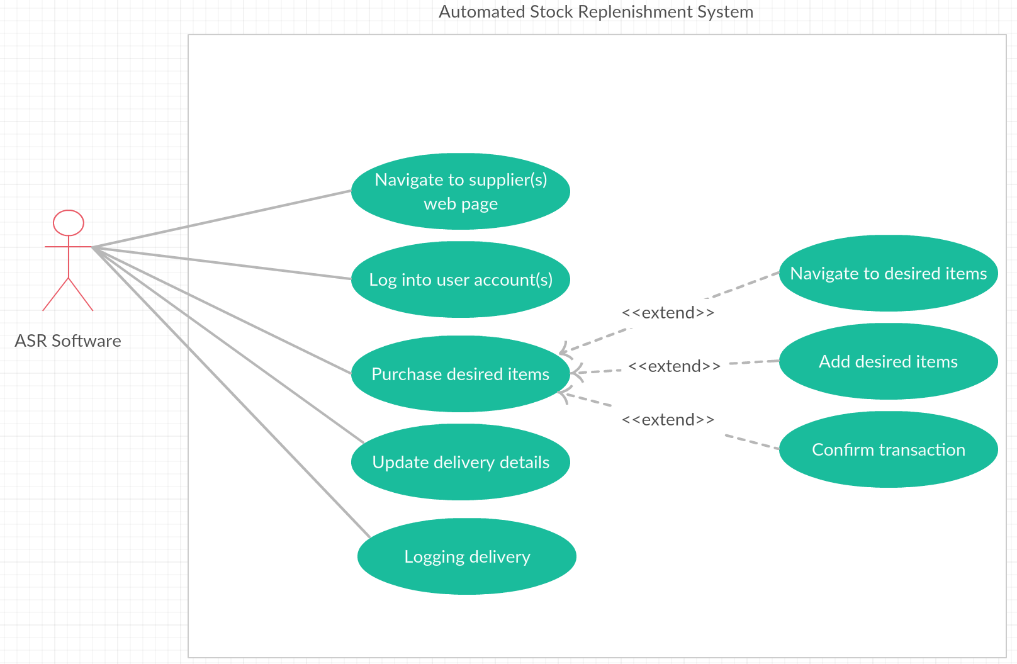
PROJECT APPROACH
Waterfall Structure incorporated with Design Thinking and Agile techniques
Stage 1: Ideate – Design Thinking
+ Emphasise – industry research
+ Solution generation & Scope definition
+ Diverge -> exhaustive list of possible solution
+ Converge-> best solution
+ Use case finalisation

Slide 7
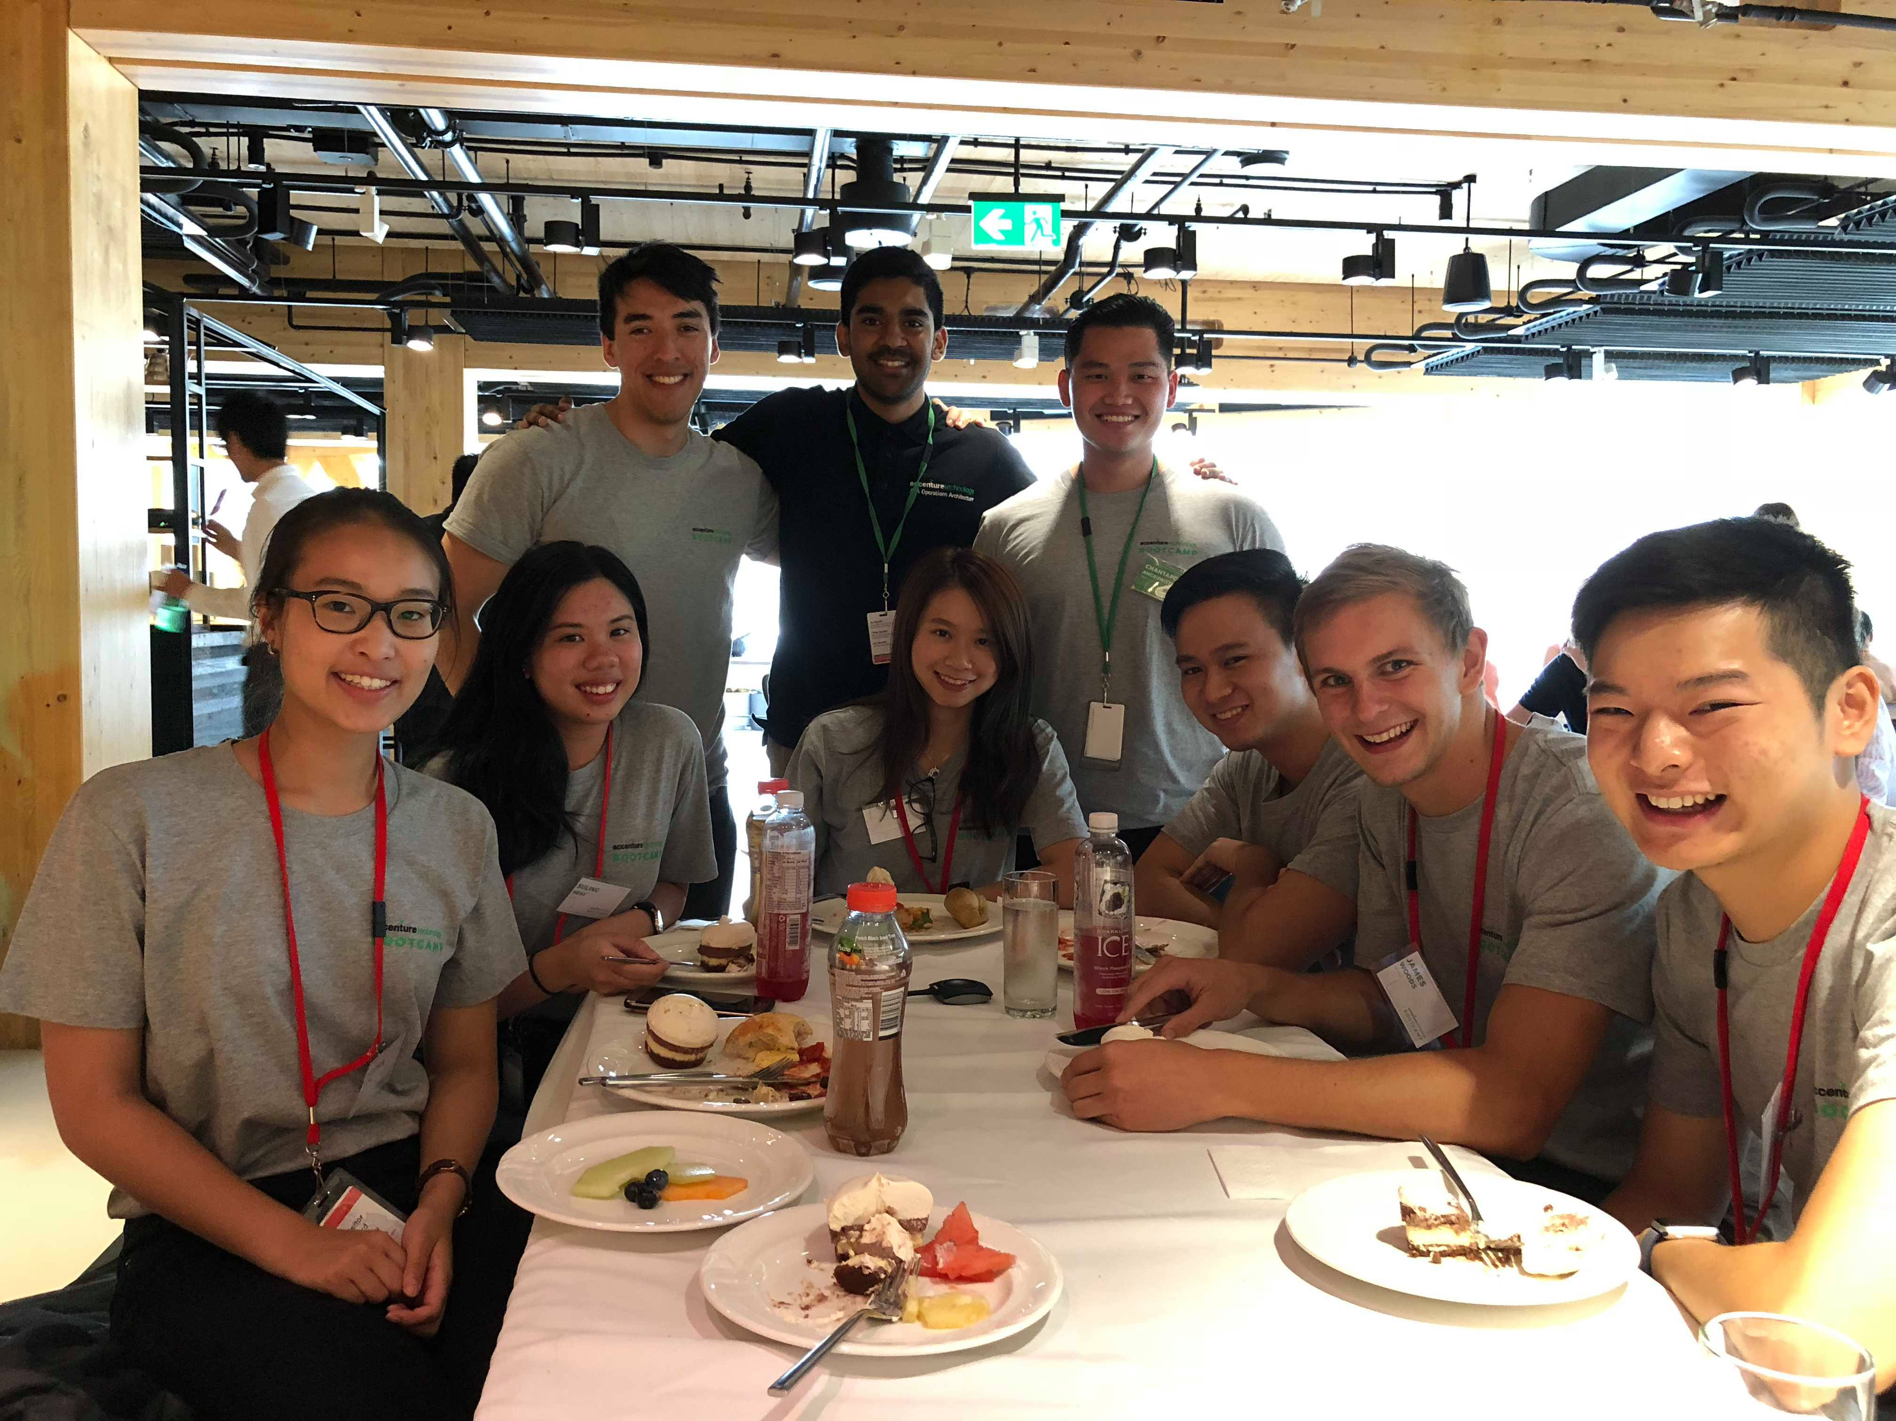
Waterfall Structure incorporated with Design Thinking and Agile techniques
Stage 2: Build & Test (Agile & Scrum)
+ Developed through three iterations
+ Core function
+ Scalability with user friendly configuration
+ Expansion with extra functions
+ Modified scrum meeting – frequent progress check
PROJECT
APPROACH

Slide 8
PROTOTYPE

Slide 9
The scopes of the project extends far beyond this.
Other potentials:
Market research via photographic recognition
Price comparison apps for consumers
Recording Sales Data
Real-time analytics of stock trading (in conjunction with other applications i.e. Splunk)
PROTOTYPE
SCOPE

Slide 10
TECHNICAL CHALLENGES
+ Using Java
+ Discrepancy between Java skillsets
+ Compatibility across devices and time constraints
+ Issues involving Eclipse and Selenium IDE with real-time collaboration
+ Having to reinstall JARs in Eclipse every time we pushed/pulled from GitHub
+ Lack of standard for HTML/CSS website code
+ Difficult to generalise our code to work across a range of websites in the given timeframe
+ Challenging to configure for multiple user credentials, or entering data in multiple fields

Slide 11
1. Alternate Method of Collaboration
Developed locally and then merged at end
PROTOTYPE
KEY ACHIEVEMENTS
2. Generic Search Functions
We developed a generic search function across multiple sites.
3. Easy Configuration
Businesses can easily customise ASR for their chosen supplier and product offering without the need to code.

Slide 12
Risks
+ Security concerns with loading payment information & Lack of CPI qualification
+ Software incompatibility issues with clients’ ERP system.
RISK
MITIGATION
Solutions
+ Partnership with specialised third party with CPI qualification
+ Seek further development support to test prototype compatibility with mainstream ERP systems.

Slide 13
UI/UX DEMONSTRATION
Click here

Slide 14
APPENDIX

Slide 15
IBISWorld (2018). Footwear Retailing in Australia. [online] Available at: http://clients1.ibisworld.com.au.ezproxy1.library.usyd.edu.au/reports/au/industry/default.aspx?entid=408 [Accessed 20 Feb. 2018]. IBISWorld (2018). Hardware and Building Supplies Retailing in Australia. [online] Available at: http://clients1.ibisworld.com.au.ezproxy1.library.usyd.edu.au/reports/au/industry/default.aspx?entid=1877 [Accessed 20 Feb. 2018]. IBISWorld (2018). Mobile Phone and Tablet Wholesaling in Australia. [online] Available at: http://clients1.ibisworld.com.au.ezproxy1.library.usyd.edu.au/reports/au/industry/operatingconditions.aspx?entid=5470#IR [Accessed 20 Feb. 2018].
REFERENCES

Slide 16
+ Updating payment details will be outsourced to third-party to ensure security
+ Delivery time between auto-purchase and when it arrives at destination
+ User has account with their distributor
+ User knows what item they want
+ User is purchasing first available item
+ User can only purchase one item
DEVELOPER
ASSUMPTIONS

Slide 17
Navigation to Distribution Webpage
Description: Actor can navigate to supplier’s webpage
Primary Actor: Company
Preconditions:
+ Company requires a designated supplier’s website.
+ Company requires Web Browsers.
+ Stock is purchased from existing supplier.
Trigger: Stock falls below threshold.
Basic Flow:
Stock falls below a threshold, actor recognises this
Actor navigates to supplier
Alternate flow: Website to offline
Supplier Website Login
Description: Actor can log into supplier website with user credentials
Primary Actor: Selenium
Preconditions:
+ Actor requires credentials for a pre-existing account on the supplier website
+ Selenium successfully execute UC -1.
Trigger: Use Case 1 or on demand
Basic Flow:
Actor navigates to supplier website
Actor navigates to login page.
Actor enters account credentials
Actor logs into page
Alternate flow:
+ Actor logs error
+ Already logged in
+ Input is incorrect
+ Try again/reload page
UC -1
UC -2

Slide 18
Navigate to Item
Description: Actor can navigate to desired item.
Primary Actor: Selenium
Preconditions:
+ Requires connectivity to distribution website
+ Actor is logged in to the distribution website
+ Actor requires web browser
Trigger: Use Case 2 or on demand
Basic Flow:
Actor logs into distribution website
Actor navigates to item in demand
Alternate flow:
+ Actor Logs error
+ Server fails
Purchase Item
Description: Actor can purchase item.
Primary Actor: Selenium
Preconditions:
+ Ensure stock is available.
Trigger: Use Case 3 or on demand
Basic Flow:
Choose quantity
Add to card
Check out
Alternate flow:
+ Time out
+ Low stock/ none available
UC -3
UC -4

Slide 19
Dispatch Site
Description: Actor inputs buyer’s billing and delivery address and sends information to sender.
Primary Actor: Selenium
Preconditions:
+ Actor requires buyer’s billing and delivery address
+ Actor requires dispatch company details
Trigger: Use Case 4
Basic Flow:
Actor grabs buyer’s billing and delivery address to database
Actor enters delivery address into dispatcher’s website
Alternate flow:
+ Actor logs error into delivery address
+ Actor updates delivery address
Logging Delivery
Description: Actor inputs buyer’s billing and delivery address and sends information to sender.
Primary Actor: Selenium
Preconditions:
+ Actor requires buyer’s billing and delivery address
+ Actor requires dispatch company details
Trigger: Use Case 5
Basic Flow:
Call “Logging” function
Function writes stored selenium data as image.
Alternate flow:
+ Delivery data differs from arrived product
+ Alter the data and log actual data and “error” status
+ Send email to dispatch company
UC -5
UC -6

