Slide 1
Beta Presentation ClassView
Team TechSmith
Eric Austin
Rebecca Collins
Kyle Woodward
Department of Computer Science and Engineering
Michigan State University
Spring 2014

Slide 2
Project Overview
Google Chrome applications
Teacher Dashboard - Create classes - Assign homework
Student Dashboard - View assignments - Interact with teacher

Slide 3
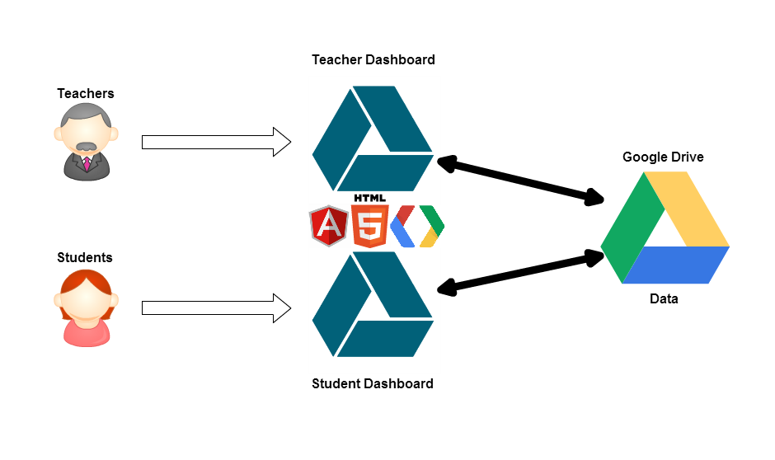
System Architecture

Slide 4
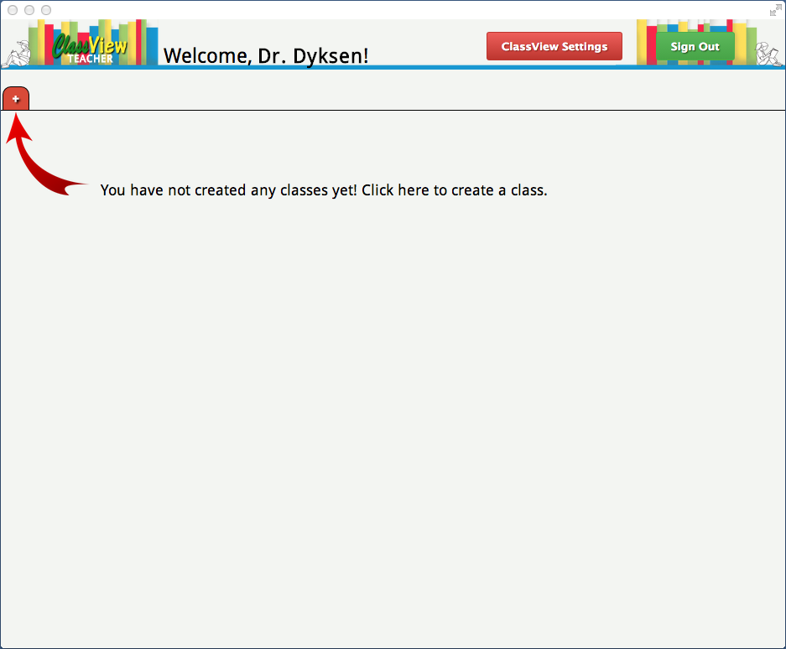
Teacher – No Classes

Slide 5
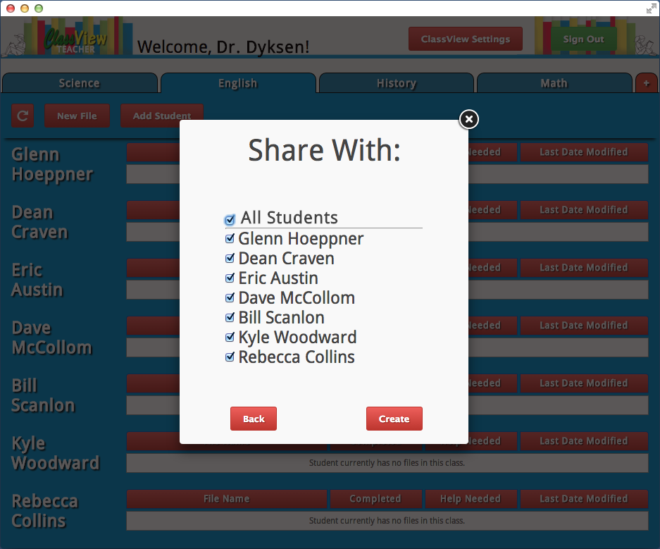
Teacher – Share with Class

Slide 6
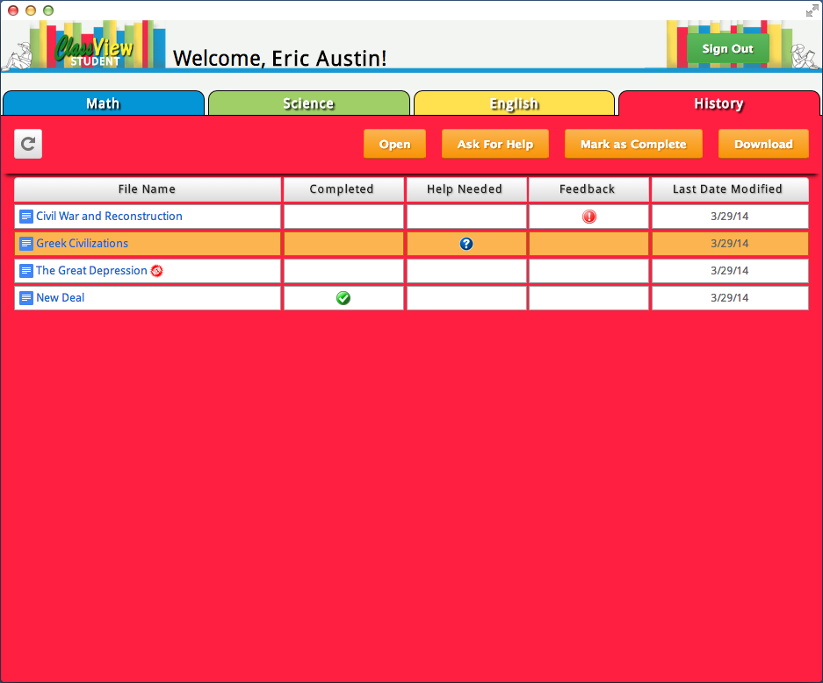
Student – Asking for Help

Slide 7
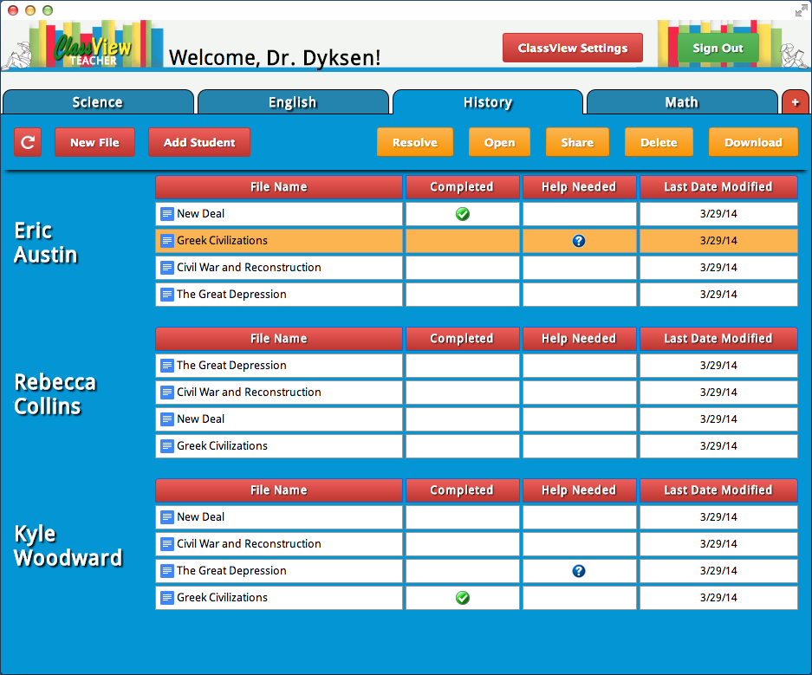
Teacher – Resolving Help

Slide 8
What’s left to do?
Clean up the user interface
Bug fixes
Small tweaks

