Slide 1
Project Plan ClassView
Team TechSmith
Eric Austin
Rebecca Collins
Kyle Woodward
Department of Computer Science and Engineering
Michigan State University
Spring 2014

Slide 2
Project Overview
Functionalities
Dashboard View of Google Drive
For Teachers and Students
Via Chrome App
Features
Models the Classroom
Helps with Content Management
Facilitates Assignments and Collaboration
Teacher Dashboard and Student Dashboard
Notifications for Key Events
Assignment Posted
Assignment Due
Assignment “Progress” Mechanism
Provide Usage Statistics

Slide 3
Functional Specifications
Teacher Dashboard
Create, manage, and modify classes
Send assignments and assign projects
Track student progress on assignments
Monitor student file permissions
Student Dashboard
Create files for classes and view progress
Collaborate with fellow students
Receive homework reminders

Slide 4
Design Specifications
Single page with dynamic content
Custom GUI built off Google Drive for student dashboard
Tabular view for multiple class management in teacher dashboard

Slide 5
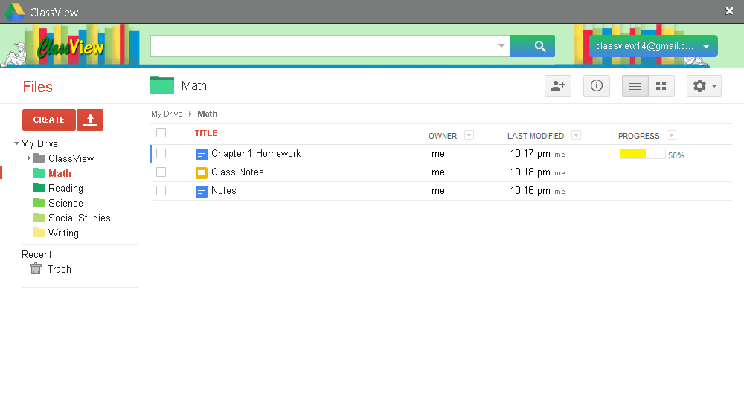
Screen Mockup: Student Dashboard

Slide 6
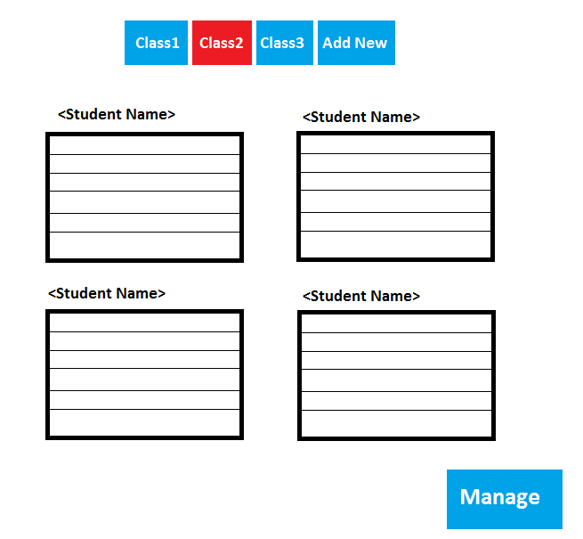
Screen Mockup: Teacher Dashboard

Slide 7
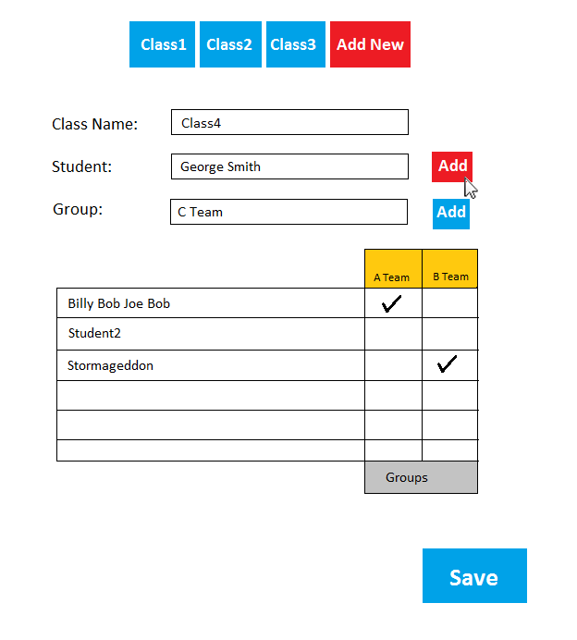
Screen Mockup: Teacher - Add New Class

Slide 8
Technical Specifications
Chrome App
Login with OAuth 2.0 through Google account
Google Drive

Slide 9
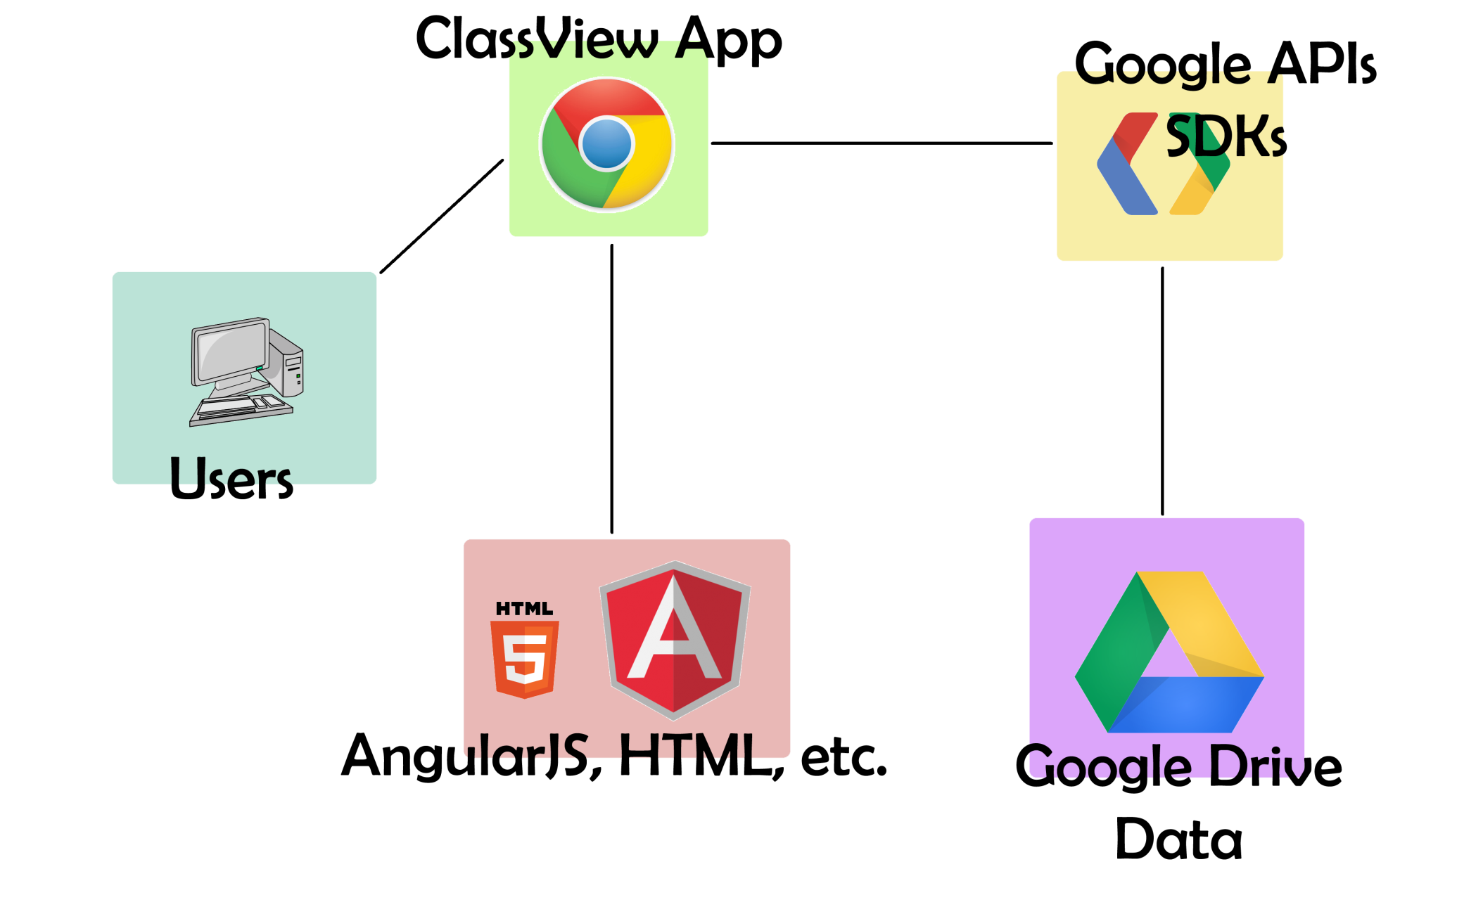
System Architecture

Slide 10
System Components
Hardware Platforms
None
Software Platforms / Technologies
AngularJS, Javascript, HTML, CSS
Google APIs, Google Drive SDK
Development Environment
Dreamweaver, Sublime Text

Slide 11
Testing
Begin with local, offline testing
Improve UI design with further research
Receive client input
Get educator feedback
Developing two separate apps
Eventually combined

Slide 12
Risks
Chrome App APIs, HTML, CSS, Javascript, AngularJS
Minimal previous experience in the group
Working through various tutorials, code samples, examples, etc.
Extent of API capabilities
Not sure if all the requested features are capable with the APIs
Figure out alternative methods
Client are unfamiliar with technologies
Neither of our contacts have worked with Google App APIs, Google Drive SDK
Technical Resource at TechSmith – Randy Schott

