Slide 1
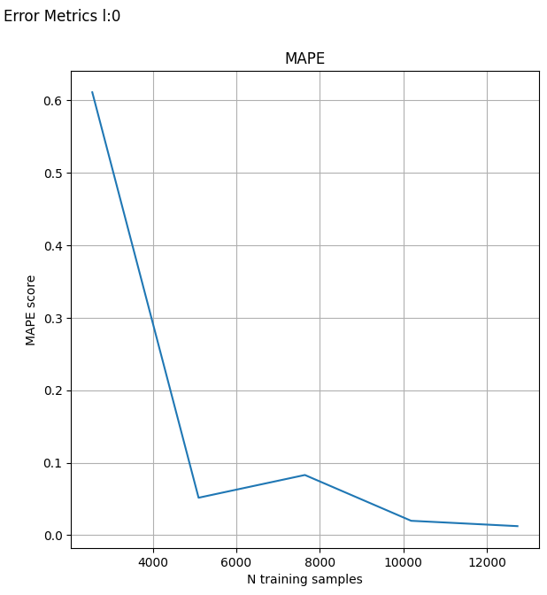
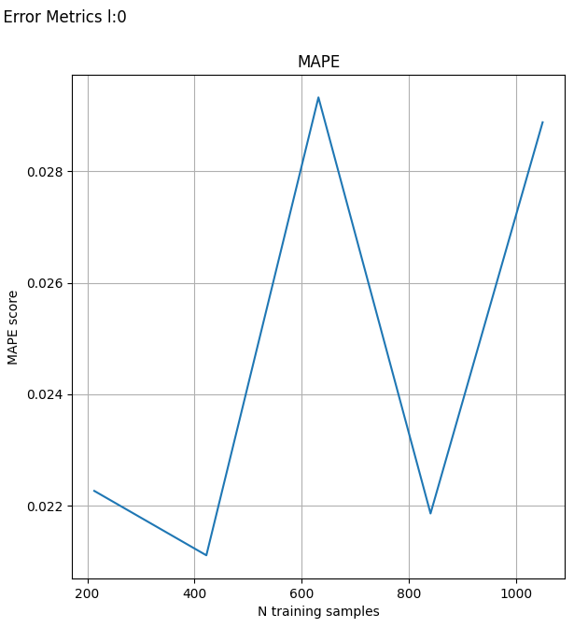
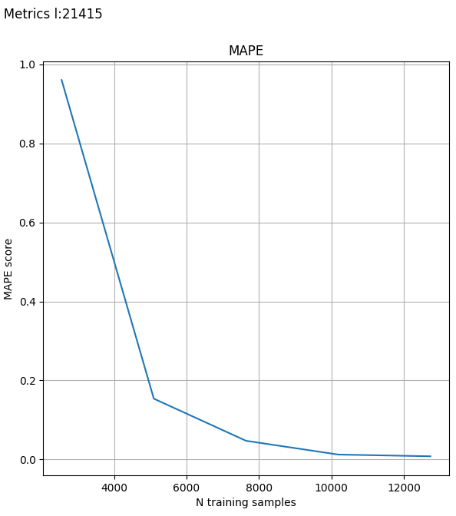
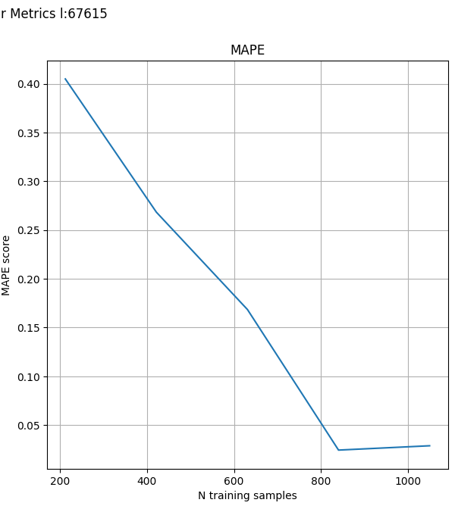
Linear Regression model to predict closing prices from opening.
BP TSLA
Stocks – BP TSLA ; BP more linear than TSLA
1st Model Penrose Inv – Training weights mapping directly X -> Y st. XW =Y
RMSE + MAPE + Autocorrelation for TSLA shows Training Sample Size co-relates with error.
Unreliable on volatile stocks
2nd Model – L2 Regularization – hyperparams (period, λ) now also minimizing the complexity of the model as well as loss – use simpler weights
Timeseries k-Fold – test always follows training in time, increasing N train samples per fold
Grid Search – take hyperparams that minimize avg MAPE score from folds
MAPE errors BP: <1% TSLA: ~<2%

