Slide 1

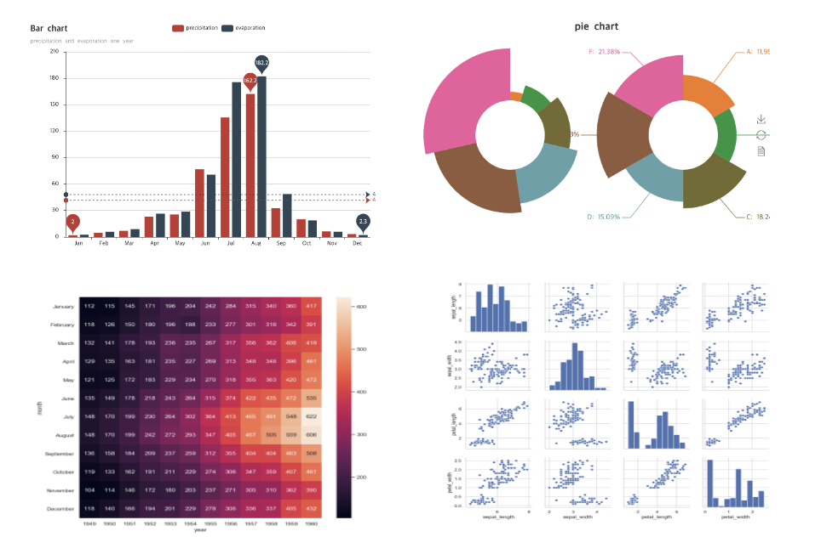

Data Visualization for Python

Slide 2
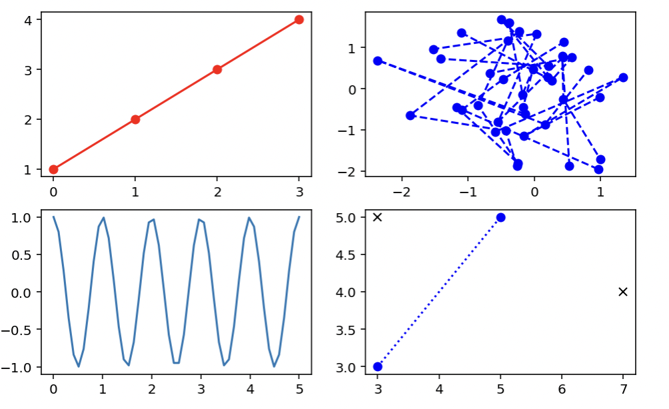
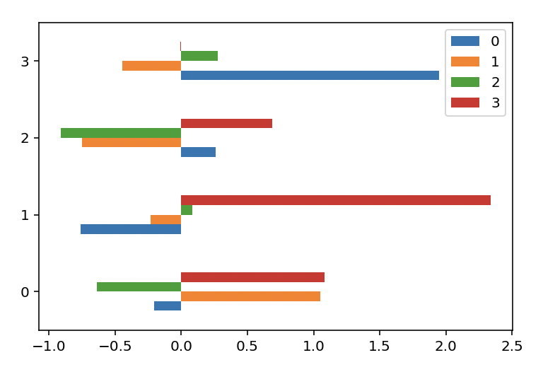
Well-Known Libraries
Matplotlib

Slide 3
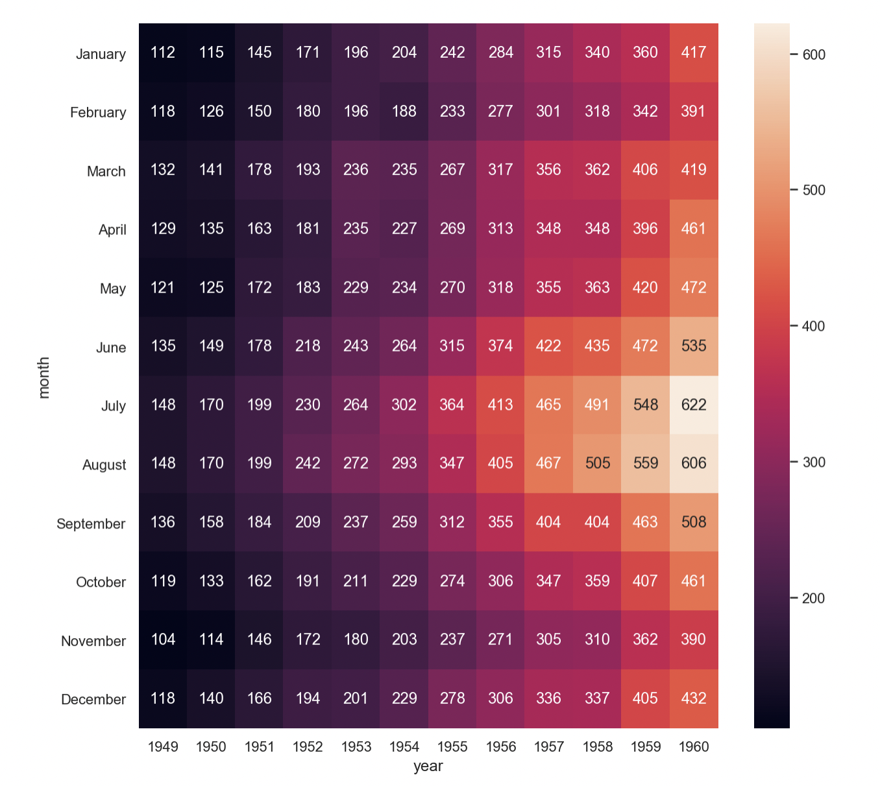
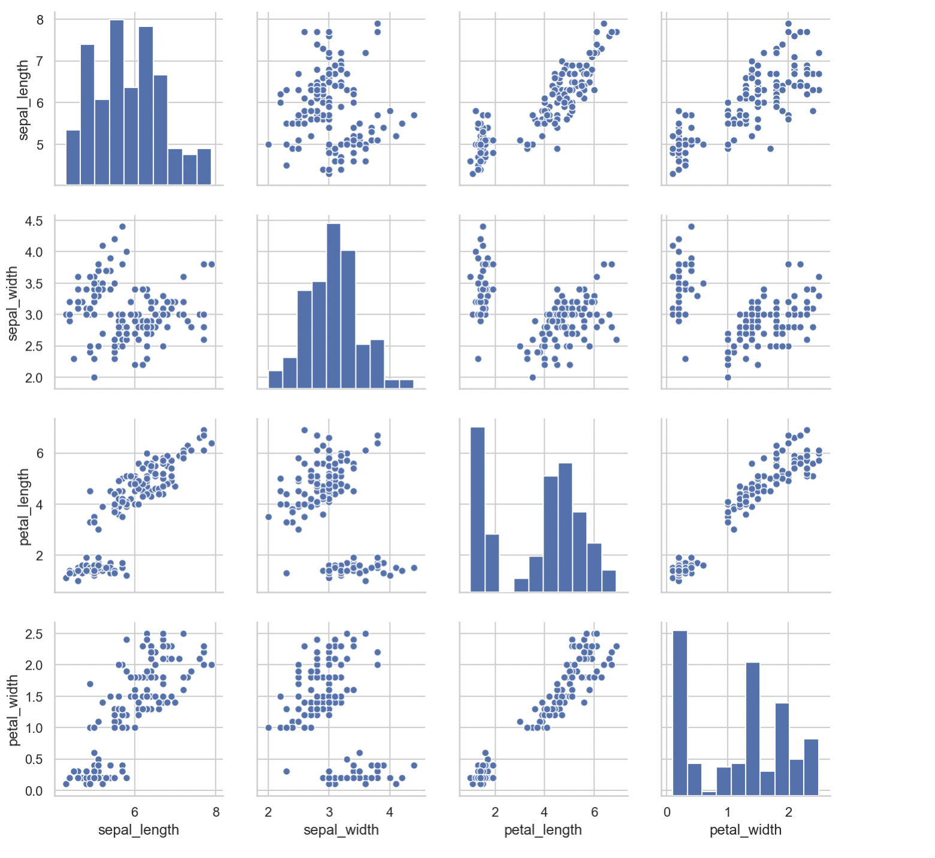
Well-Known Libraries
Seaborn

Slide 4
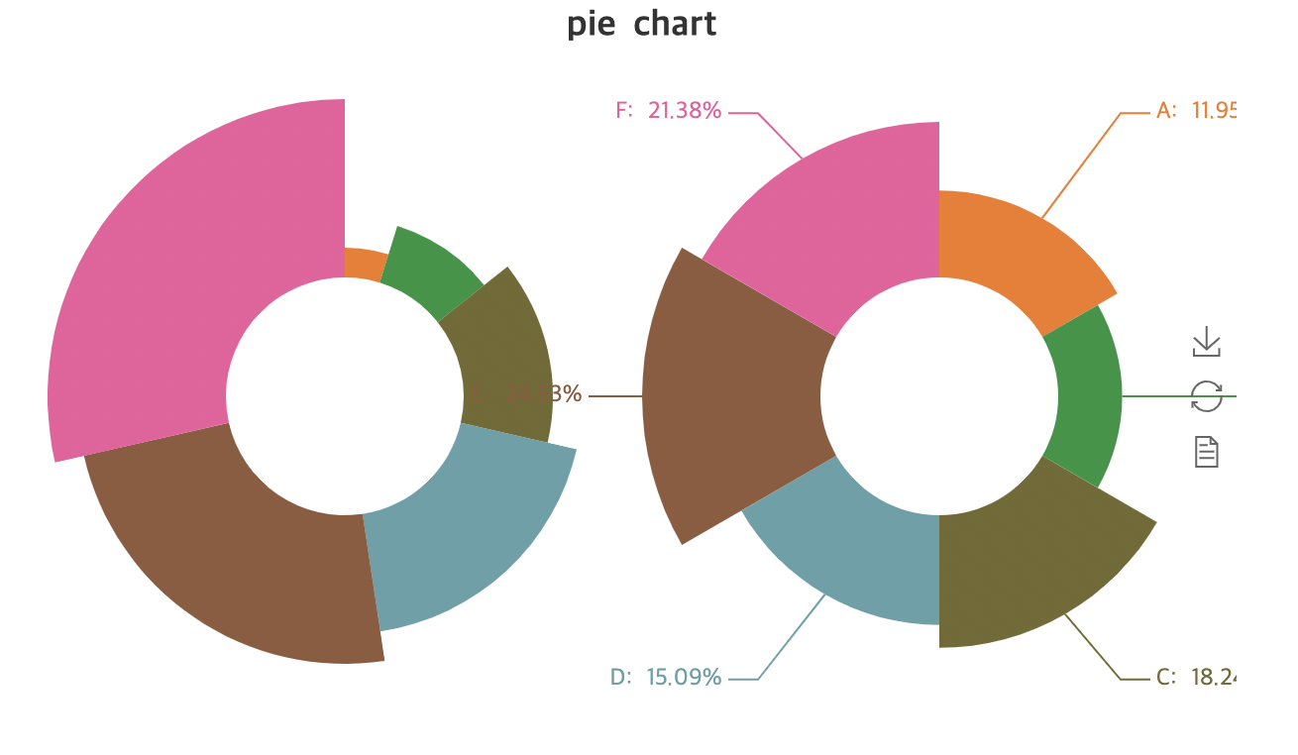
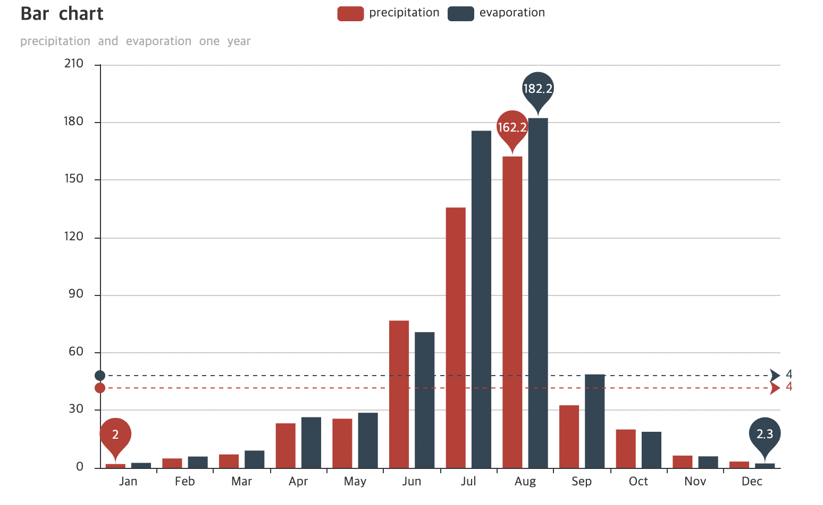
Well-Known Libraries
PyeChart

Slide 5
Main Title

Slide 6
Title
SubTitle

Slide 7
Title
SubTitle

Slide 8
Title
SubTitle
SubTitle
SubTitle
SubTitle

Slide 9



Title Bars
Title
Title
PNG(Image)
Boxes(Vector)
Woody K
Contact: woody35545@gmail.com
Github: https://github.com/woody35545
CNU, Computer Science and Engineering

