Slide 1
M(L)ove
Ho Ko, Rabab Azeem, Nishtha Sharma
Analyze your dance skills

Slide 2
The Problem
Dancing classes before the pandemic were expensive and tedious since the person would have to drive to a place and learn for a particular period of time.
Now, that possibility is completely gone. However, the dance industry is adapting and creating online studios which are hefty on cash, emphasizing the economic disparity for people who want to pursue their passion.
So, to avoid that, learners are learning choreographies for dance via other platforms such as youtube.
However, analyzing your own dance moves is a rather challenging task since people can not always see the tiniest things and are biased towards their work

Slide 3
The Solution
We want to help people who have the passion to learn how to dance and increase their methods.
By inputting two recordings/videos: one of you [the user] dancing and the other of the actual official choreography, M(L)ove compares both of the videos to show you the similarity percentage for both the dances to let you see what and where you, as the dancer could improve on.

Slide 4
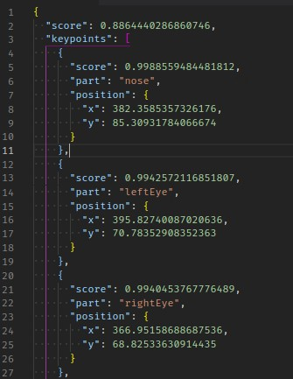
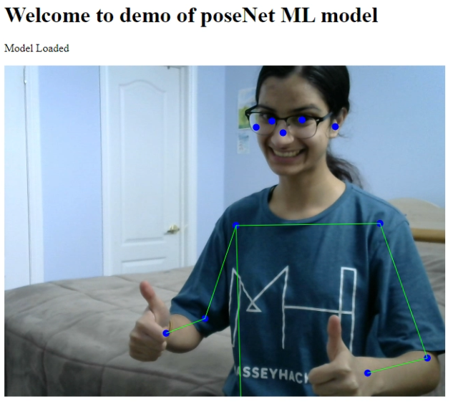
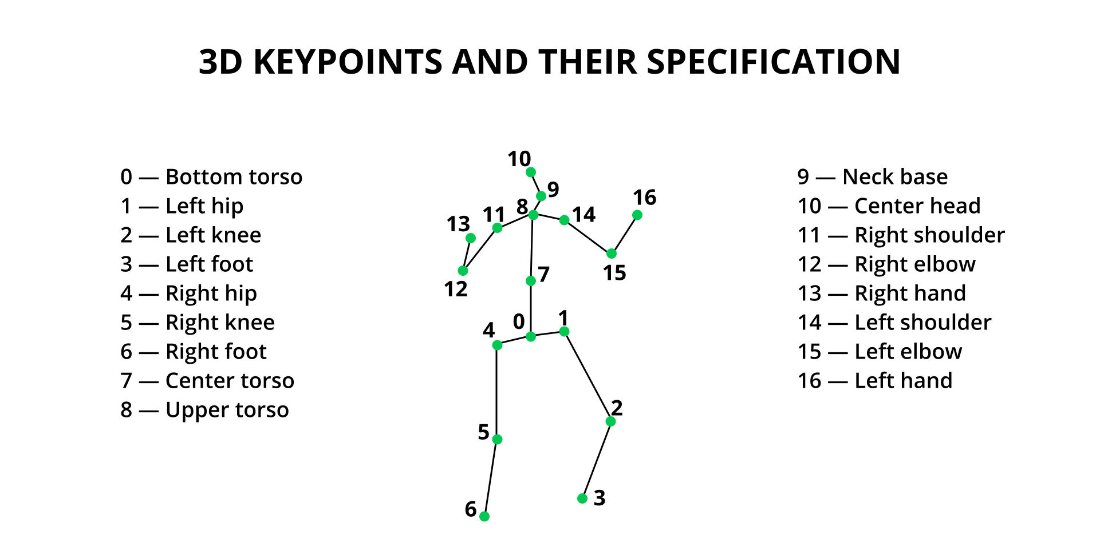
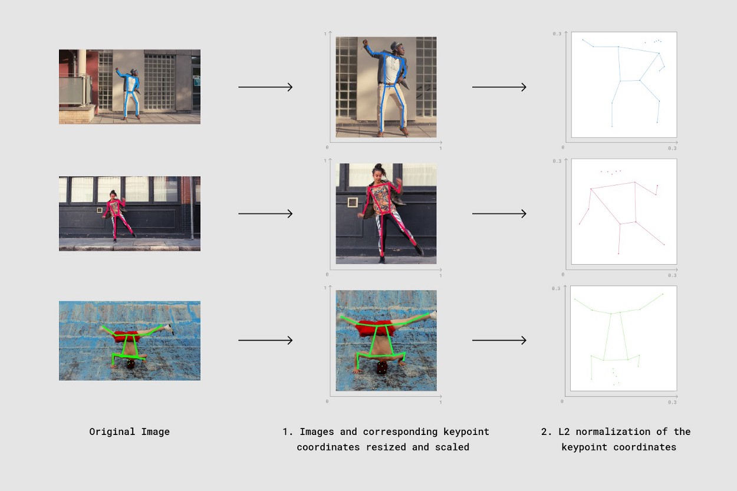
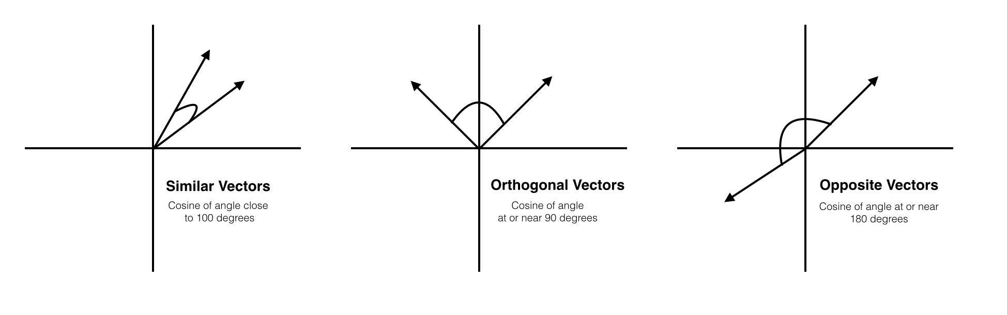
How it works

Slide 5
The final product

Slide 6
