Slide 1

Pocket Site
A temporary catalog for physical garage sales
Scan the sign. Browse the sale. Stop when it matters.
Voiceover-ready demo deck · ~2:30
Notes:
Timing: 0:00–0:08 Pocket Site is a temporary, local-first catalog for a physical garage sale. The viewer should immediately understand the curbside use case: a sign, a QR code, and a quick decision about whether to stop.

Slide 2
0:00–0:20
The problem: signs reveal location, not inventory
A typical garage-sale sign answers only one question:
Where?
It does not answer the question passersby actually have:
Is there anything here worth stopping for?
Marketplace sites solve discovery. Pocket Site helps people browse a temporary physical place.
Pocket Site
scan the sign · browse the sale · stop when it matters
Notes:
Timing: 0:08–0:20 A garage-sale sign tells you where a sale is, but not what is actually there. Marketplace sites solve discovery; Pocket Site helps people browse a temporary physical place.

Slide 3
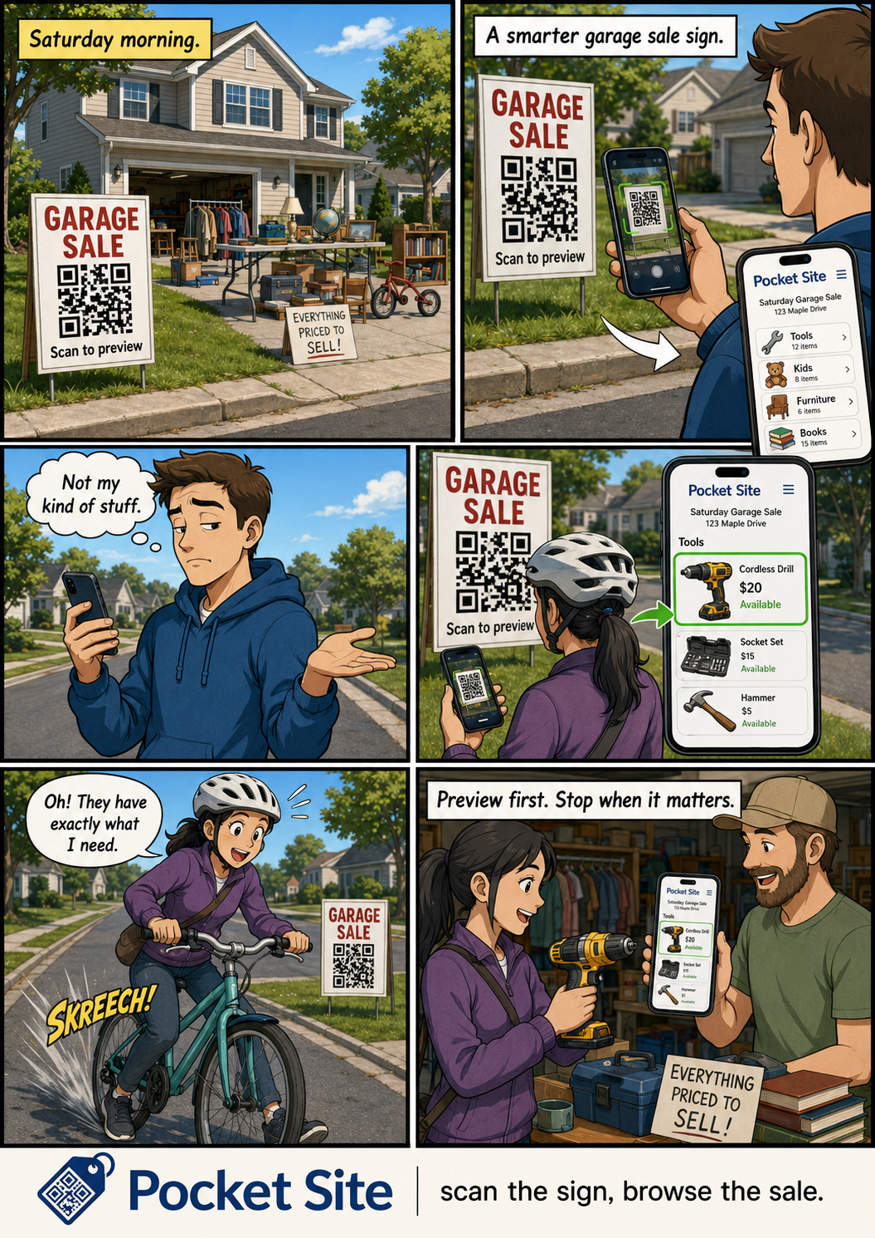
CORE USE CASE
The idea: drive-by triage
Scan once. Decide in seconds.
Passerby previews the sale before stopping
The right buyer stops hard
The wrong buyer moves on without awkward wandering
The host controls when the catalog exists
Not a marketplace. A temporary catalog for a temporary place.
Pocket Site
scan the sign · browse the sale · stop when it matters
Notes:
Timing: 0:20–0:28 The sharper product image is drive-by triage. Someone passes a suburban garage sale, scans the sign, and decides in seconds whether it is worth stopping.

Slide 4
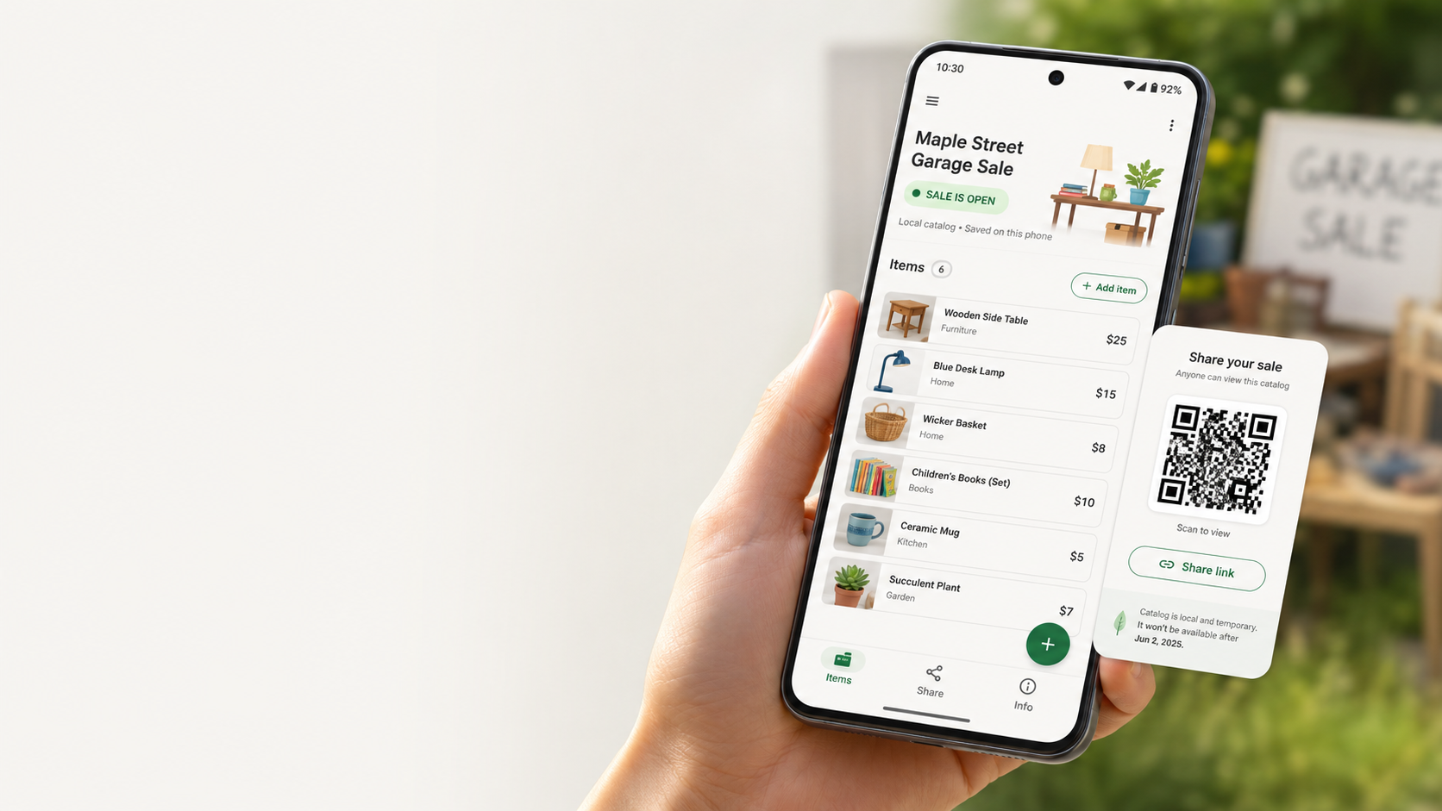
0:20–0:45
Prepare the sale
1
Load demo sale
Populate believable garage-sale items.
2
Review catalog
Show items, prices, categories, and sold/available status.
3
Add context
Sale notes, contact handoff, and Looking For list.
Demo line
“Here is a complete sale catalog—not just a list of listings.”
Pocket Site
scan the sign · browse the sale · stop when it matters
Notes:
Timing: 0:20–0:45 Tap Load Demo Sale and confirm. Briefly show the 10 believable items, categories, prices, and mixed availability. Point out sale notes, optional contact handoff, and the Looking For list.

Slide 5
0:45–1:15
Open and share locally
PocketWiFiSale mode
Open sale starts the live local catalog
Foreground notification keeps the host aware
Share screen shows Wi-Fi join QR + catalog QR/link
Physical-sign instructions are copyable
No app. No account. No public marketplace.
Pocket Site
scan the sign · browse the sale · stop when it matters
Notes:
Timing: 0:45–1:15 Tap Open Sale. Allow notifications if prompted. Show the prominent Open state and persistent “Pocket Site sale is live” notification. Show the PocketWiFiSale join QR, catalog QR/link, and copyable physical-sign instructions. Explain that visitors join the designated sale Wi-Fi, then open the local catalog. No app or internet account is needed.

Slide 6
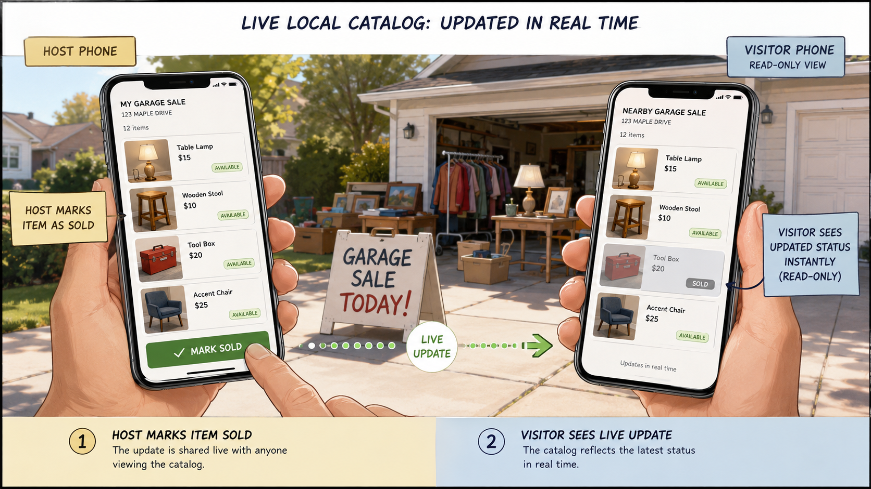
1:15–1:50
Visitor experience: read-only and live
The visitor sees only what they need:
Read-only catalog label
Available items first
Sold items visually distinct
Notes, categories, contact handoff, Looking For section
Sold status updates within seconds
Key demo moment: mark one item sold on the host phone; show the visitor page update.
Pocket Site
scan the sign · browse the sale · stop when it matters
Notes:
Timing: 1:15–1:50 On a second phone already connected to PocketWiFiSale, scan or open the catalog. Show the Read-only visitor catalog label. Browse items and point out that available items appear before visually distinct sold items. Show notes, contact handoff, categories, and Looking For content. On the host phone, mark one available item sold. Let the visitor page auto-refresh within eight seconds and show the updated sold state.

Slide 7
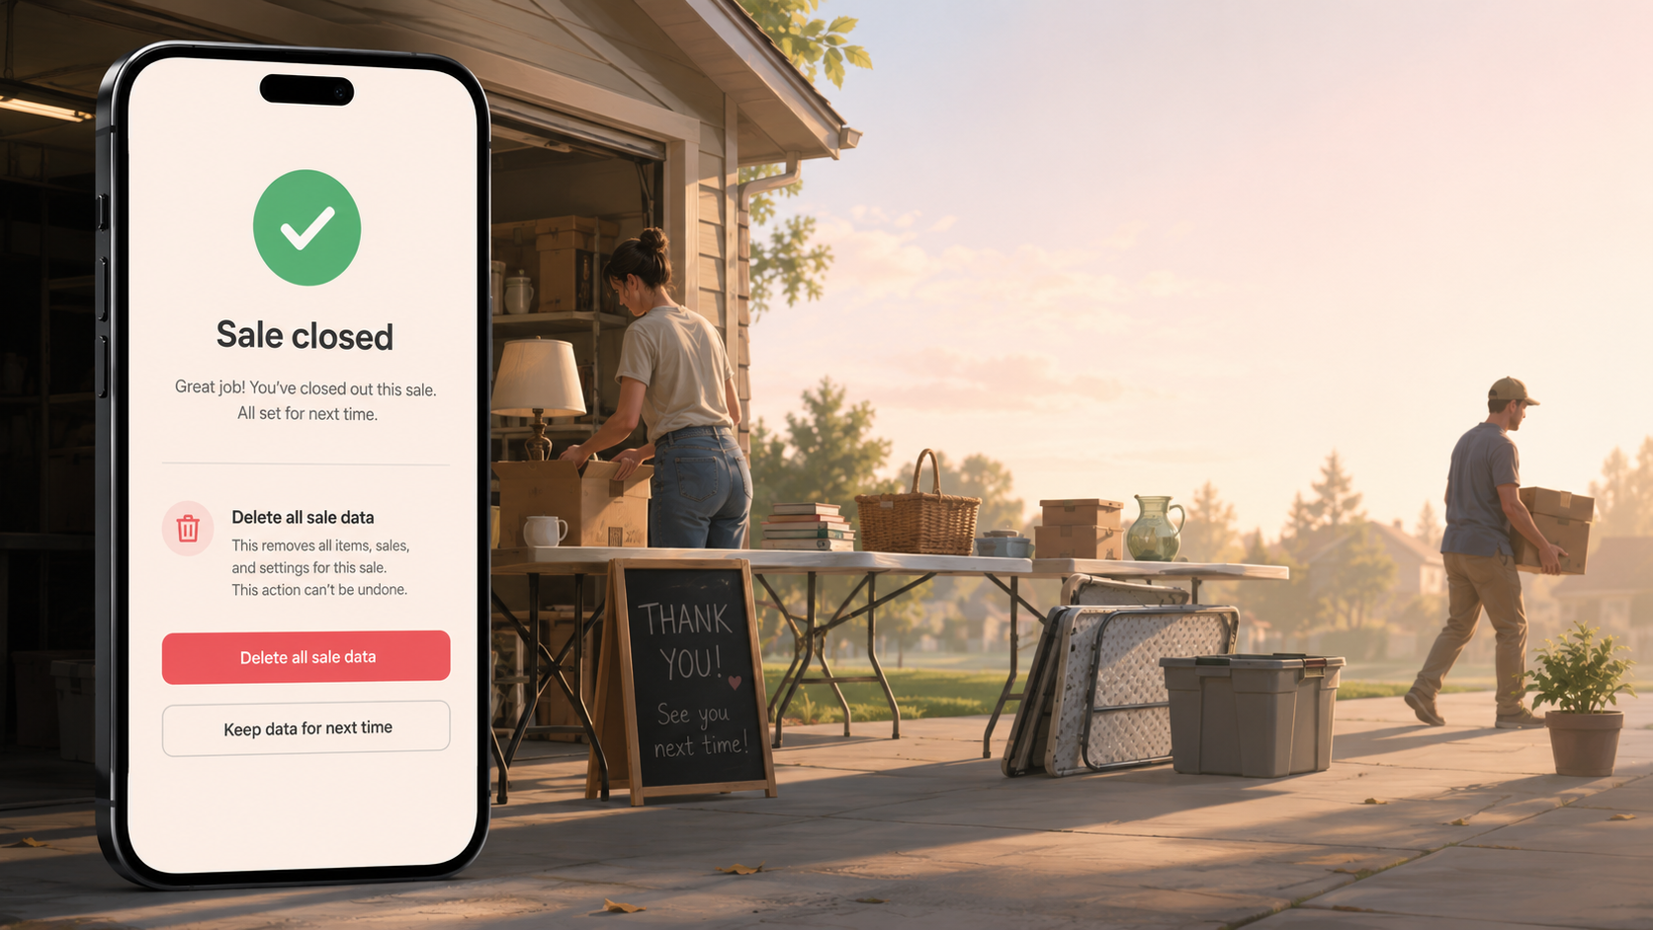
1:50–2:15
Background stability and closure
1
Switch apps
The persistent notification explains the sale is live.
2
Visitor stays connected
The local catalog remains available during the sale.
3
Close sale
Serving stops and the visitor sees a clear closed state.
This is the difference between a demo screen and a temporary place hosted by the phone.
Pocket Site
scan the sign · browse the sale · stop when it matters
Notes:
Timing: 1:50–2:15 Briefly switch the host to another app and point out the ongoing notification. Confirm the visitor catalog remains available. Return to Pocket Site and tap Close Sale. Refresh the visitor phone and explain that local serving and its notification stop when the sale closes.

Slide 8
2:15–2:30
Temporary by design
When the sale ends, the site ends.
Close sale stops the local catalog
Delete All Sale Data clears the app-owned data
The app returns to an empty Draft state
No account, analytics, ads, payments, or marketplace residue
Closing line
“Pocket Site is local-first, private, and temporary by design—not another marketplace.”
Pocket Site
scan the sign · browse the sale · stop when it matters
Notes:
Timing: 2:15–2:30 Tap Delete All Sale Data and confirm. Show the empty Draft state. Close with: “Pocket Site is local-first, private, and temporary by design—not another marketplace.”

Slide 9
RECORDING PLAN
Voiceover cue sheet
Time
Beat
Voiceover focus
0:00–0:20
Problem
Garage-sale signs show where, not what.
0:20–0:45
Prepare
Load demo sale, show items, notes, contact, Looking For.
0:45–1:15
Share
Open sale, notification, PocketWiFiSale QR/link/sign copy.
1:15–1:50
Visitor
Read-only catalog, browse, mark sold, auto-refresh.
1:50–2:15
Stability
Switch apps; catalog remains live; close sale.
2:15–2:30
Nuke
Delete all data; empty state; final thesis.
Recording setup
Configure hotspot/guest network · connect both phones · grant notification permission · test QR/link once · say “browse,” not “filter”
Pocket Site
scan the sign · browse the sale · stop when it matters
Notes:
Timing: reference Use this slide as a recording checklist. The video should feel like a direct product demo, not a slide presentation. Keep the camera on the working app as much as possible.

Slide 10
BUILD WEEK FRAMING
Submission story
What the judges should remember
A green Android builder shipped a working real-world app with Codex
The app solves a concrete physical-life problem
It is intentionally temporary, local-first, and non-marketplace
The demo is understandable in one sentence
One-sentence pitch
“A QR preview catalog for garage-sale signs, so passersby can decide whether to stop.”
Pocket Site
scan the sign · browse the sale · stop when it matters
Notes:
Timing: final framing This project demonstrates the power of Codex as a builder’s multiplier: a bounded real-world Android app created by someone who is not an Android specialist, with human product judgment preserving the boundary.

