Slide 1
站长站素材 SC.chinaz.COM
车牌识别(LPR)中的车牌字符识别

Slide 2
Contents
Class Diagram
UserCase Diagram
Sequence Diagram
Activity Diagram
Statechart Diagram

Slide 3

Class Diagram

Slide 4
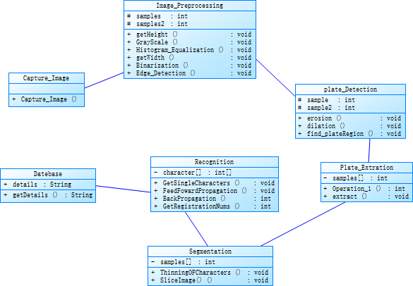
Class Diagram

Slide 5
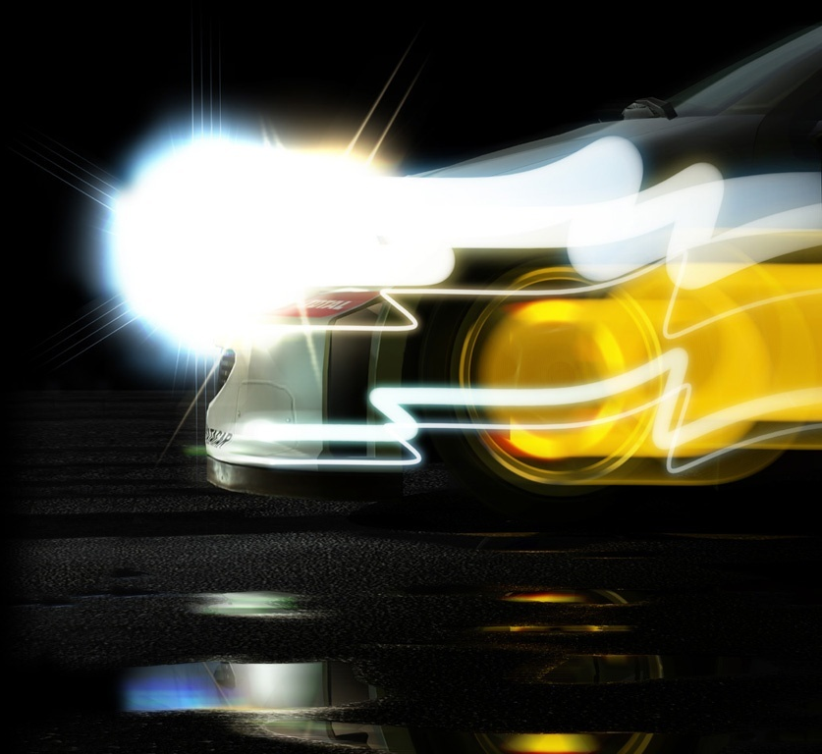
UserCase Diagram

Slide 6
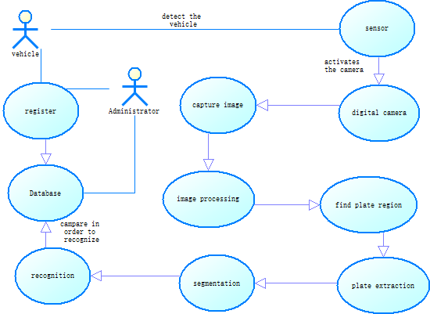
UserCase Diagram

Slide 7
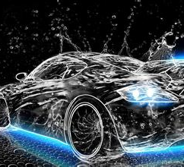
Sequence Diagram

Slide 8
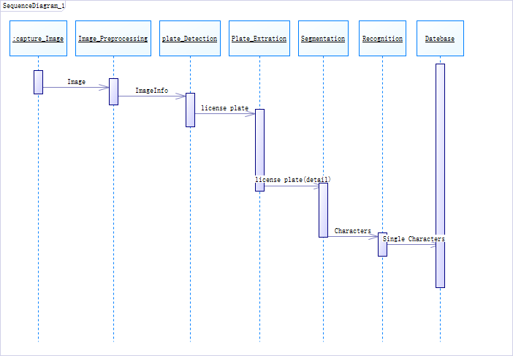
Sequence Diagram

Slide 9
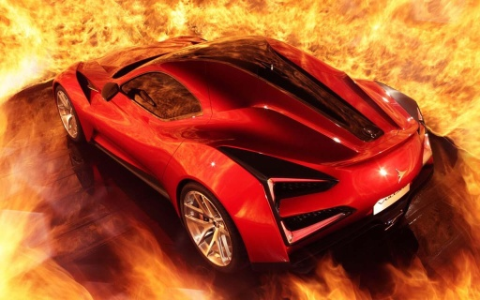
Activity Diagram

Slide 10
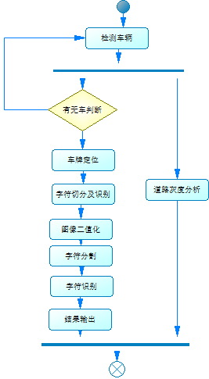
Activity Diagram

Slide 11
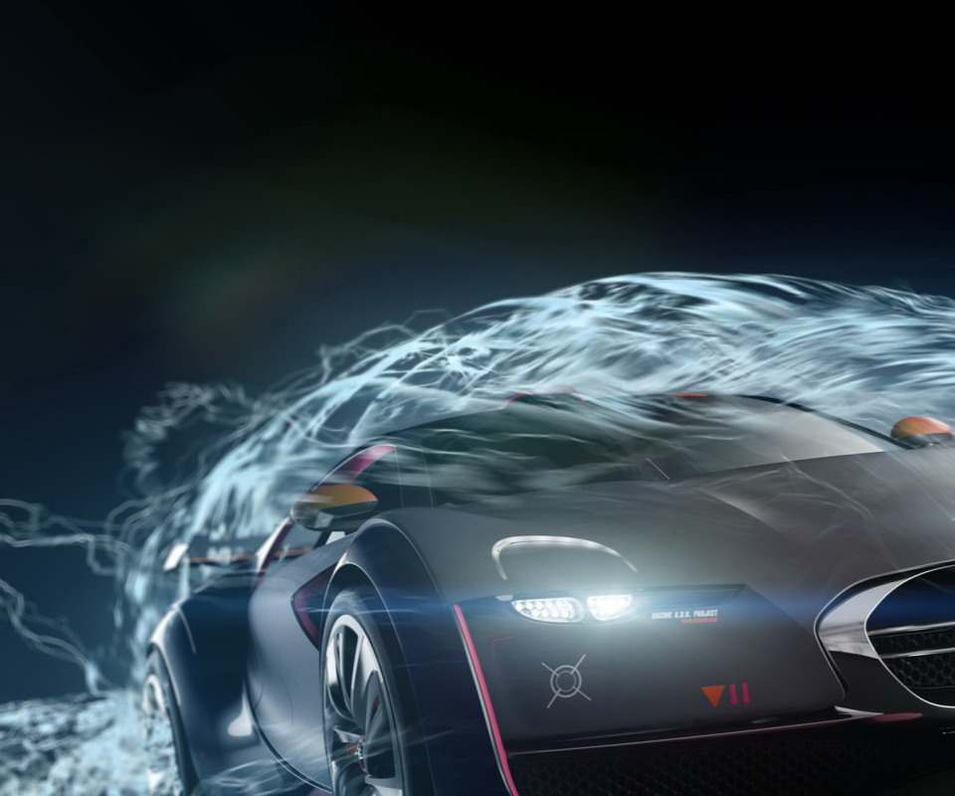
Statechart Diagram

Slide 12
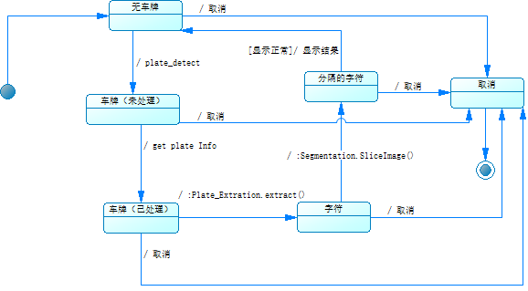
Statechart Diagram

Slide 13

Thank You For Your Listening！

