Slide 1
KotlinToDo
Woo Jia Hao

Slide 2
About Me
Experience: Programming for 4 years
Languages: Java, Kotlin, Python, SQL
Discord: @Chill#4048
GitHub: https://github.com/woojiahao

Slide 3
Materials
All talk materials can be found here
https://woojiahao.github.io/KotlinToDo/#/

Slide 4
Agenda
What is Kotlin?
Why use Kotlin?
Basic of Kotlin
Building an application
Improving the application

Slide 5
What is Kotlin?
Released in 2011 by JetBrains
Made an officially supported for Android development in 2017 by Google
Statically typed language built upon the Java Virtual Machine (JVM)

Slide 6
Why use Kotlin?
Null safety
Compatibility with existing libraries written in Java
Type inference
Open source
Libraries tailored to work with Kotlin’s syntax and features

Slide 7
Basics of Kotlin

Slide 8
Following Along
If you wish to follow along with the basics, you can use the web editor Kotlin has provided
https://try.kotlinlang.org/

Slide 9
Variables
https://kotlinlang.org/docs/reference/basic-syntax.html

Slide 10
Flow Control
https://kotlinlang.org/docs/reference/control-flow.html

Slide 11
Functions
https://kotlinlang.org/docs/reference/functions.html

Slide 12
Lambdas
https://kotlinlang.org/docs/reference/lambdas.html#higher-order-functions-and-lambdas

Slide 13
Classes
https://kotlinlang.org/docs/reference/classes.html

Slide 14
Null Safety
https://kotlinlang.org/docs/reference/null-safety.html

Slide 15
Building KotlinToDo

Slide 16
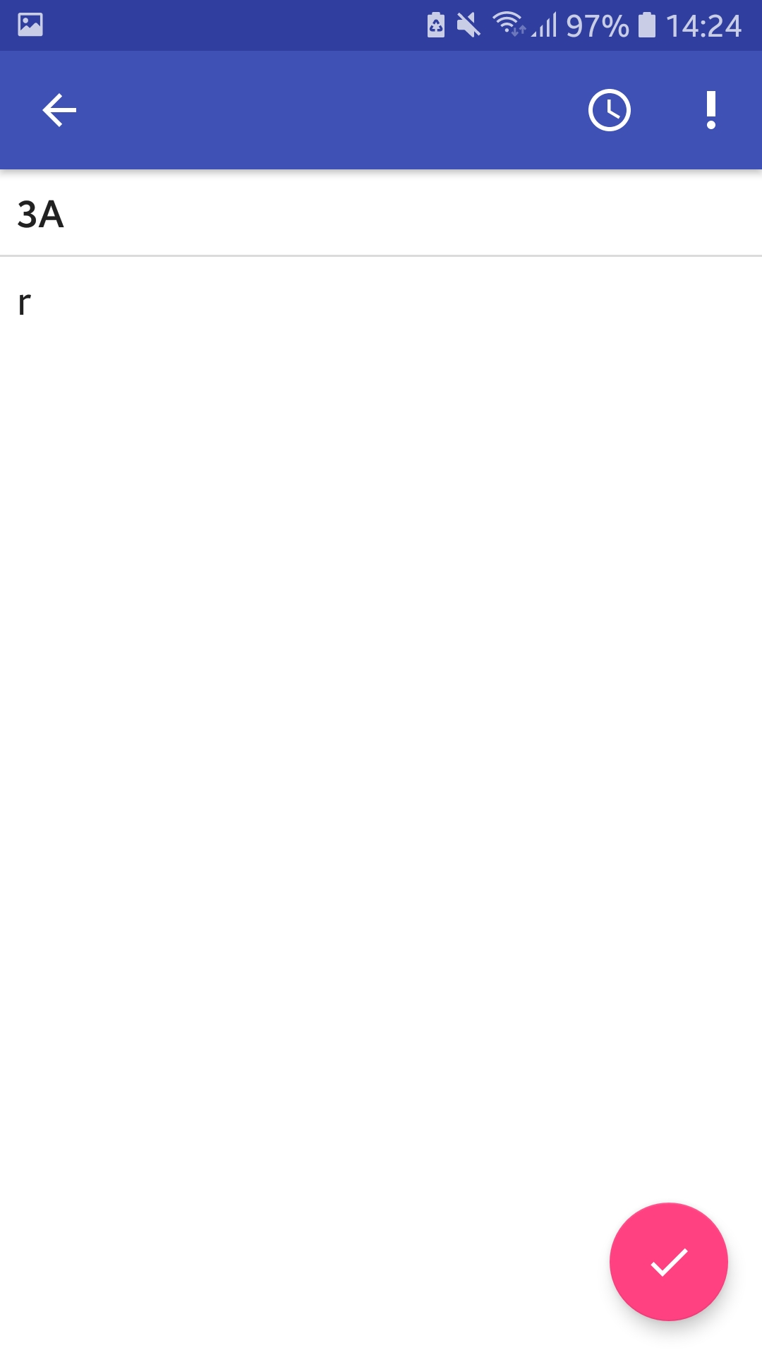
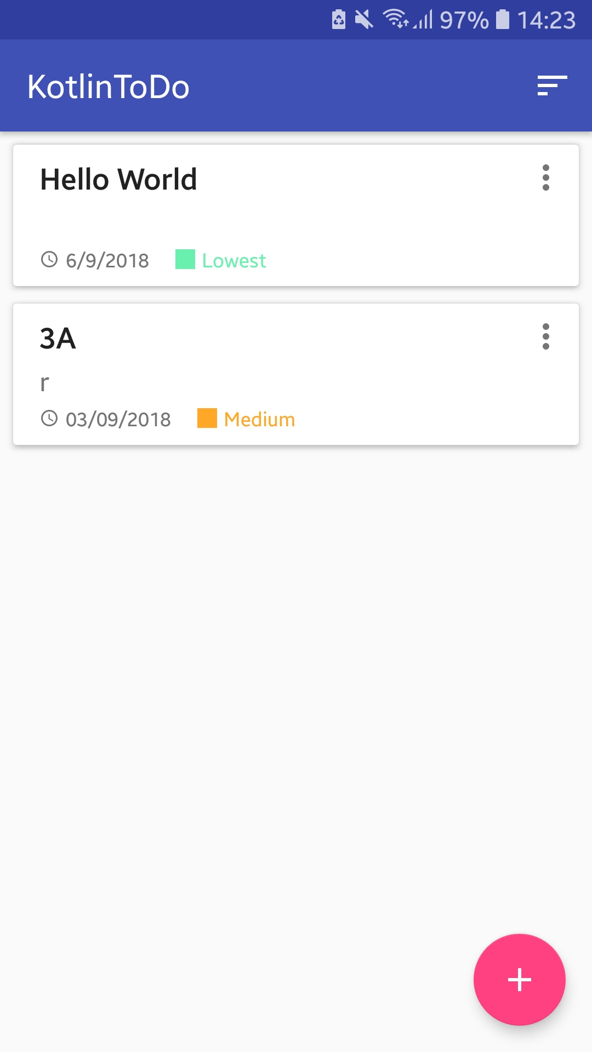
End Product

Slide 17
Pre-Planning
Features:
Display notes
Add/store notes
Add-ons to a note such as priorities
Technologies To Consider:
Data storage – MySQL? Firebase?
Listing information – RecyclerView? ListView?

Slide 18
How the application will be constructed?
We will be using a RecyclerView to display a list of data
The data for each note will be saved to Firebase

Slide 19
Project Files
Set of pre-packaged files are given with things like the layouts already built for you
https://github.com/woojiahao/KotlinToDoBare

Slide 20
Listing Information
https://woojiahao.github.io/KotlinToDo/#/listing_information

Slide 21
What is a RecyclerView?
Method of listing data
Data can be placed in a grid layout or list (horizontally/vertically) layout
Data to be displayed is placed in a list and the RecyclerView goes through each item in the list and creates a list item for them

Slide 22
Adapter
Any custom RecyclerView uses a custom adapter, which is a method of informing the RecyclerView on how to manipulate the data given

Slide 23
ViewHolder
Holds the view that dictates the layout each item in the data will be displayed into

Slide 24
Data Classes
Class that contains fields (instance variables) and means to access them such as getters/setters
Very bloated in Java

Slide 25
Storing And Retrieving Data
https://woojiahao.github.io/KotlinToDo/#/firebase

Slide 26
What is Firebase?
Firebase is a set of tools provided by Google that aims to reduce the burden of mobile developers by handling a lot of the grunt work
Contains many tools to assist developers
Ideal for storing our data as the library written for Android is easy to use
Focus of today is the real-time database

Slide 27
Real-time Database
Uses NoSQL, a non-relational method of storing information
Has a structure similar to JSON

Slide 28
Setting Up Firebase
Setting up Firebase is a straight-forward process, following their built-in tutorial is sufficient
https://console.firebase.google.com/u/0/

Slide 29
Adding Priorities
https://woojiahao.github.io/KotlinToDo/#/priority_system

Slide 30
Enumerations
Enumerations is a collection of constants
Each class is an object of the enumeration

Slide 31
Improving KotlinToDo

Slide 32
Further Reading
Kotlin Documentation
HotBot
Taiga
Exposed Framework
https://woojiahao.github.io/KotlinToDo/#/conclusion

Slide 33
Thank You

