Slide 1

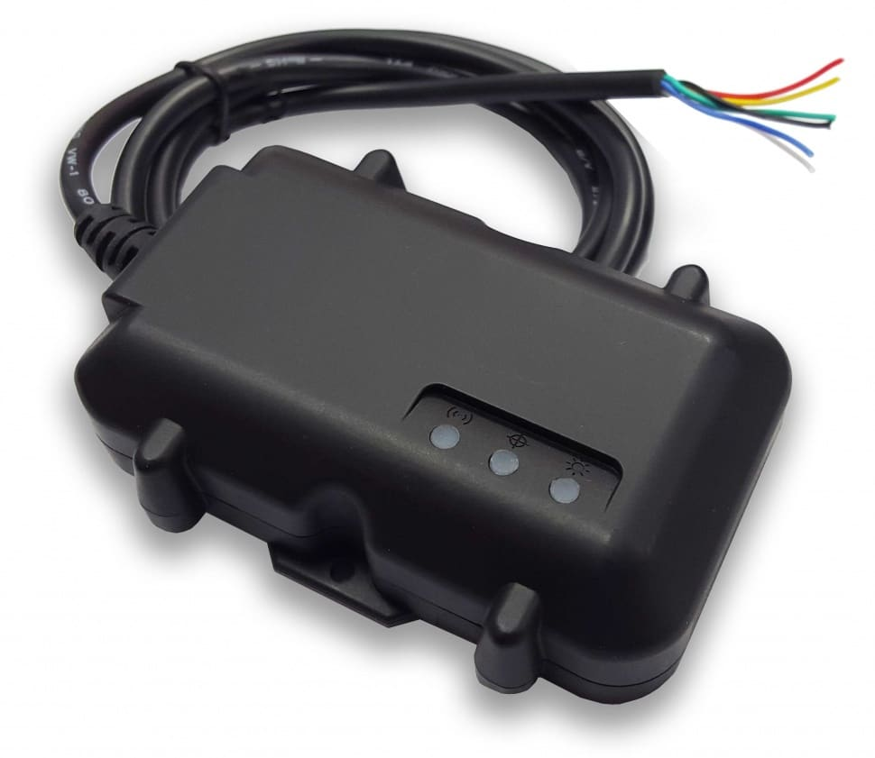
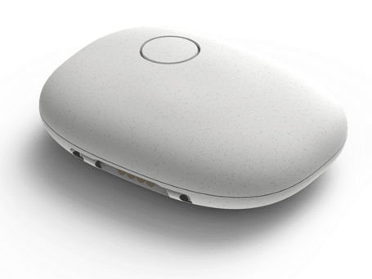

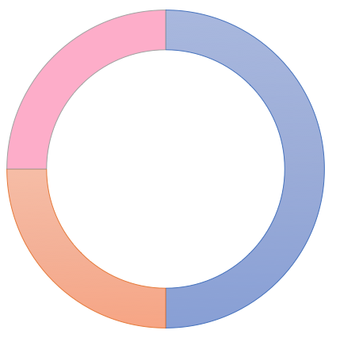
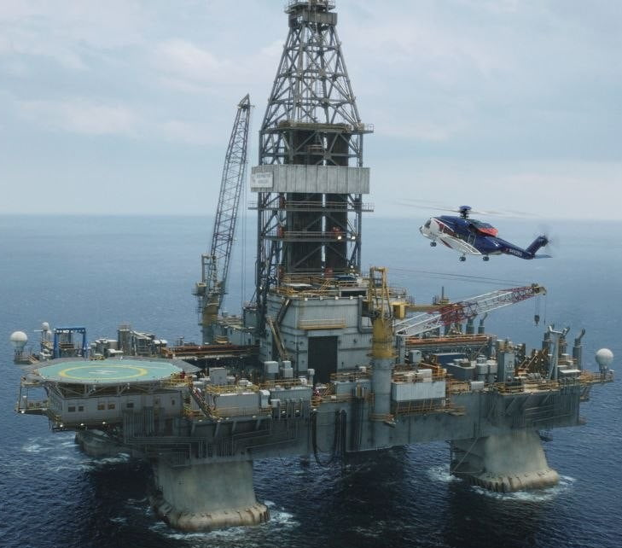
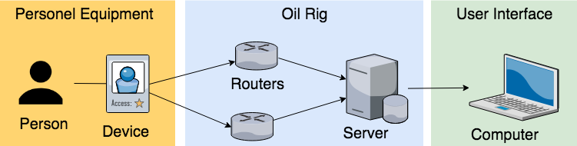

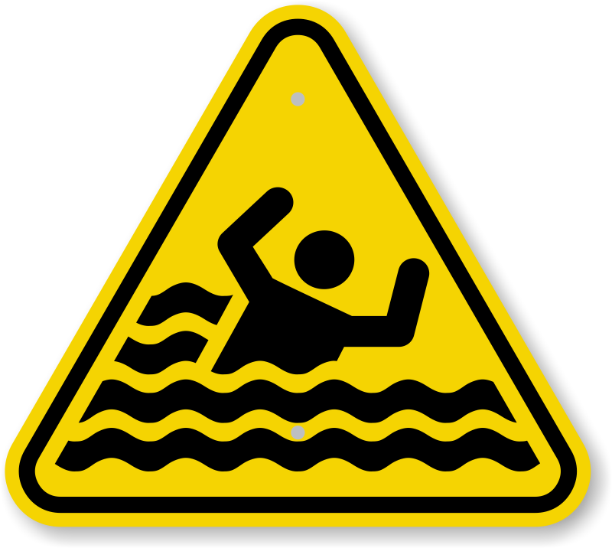
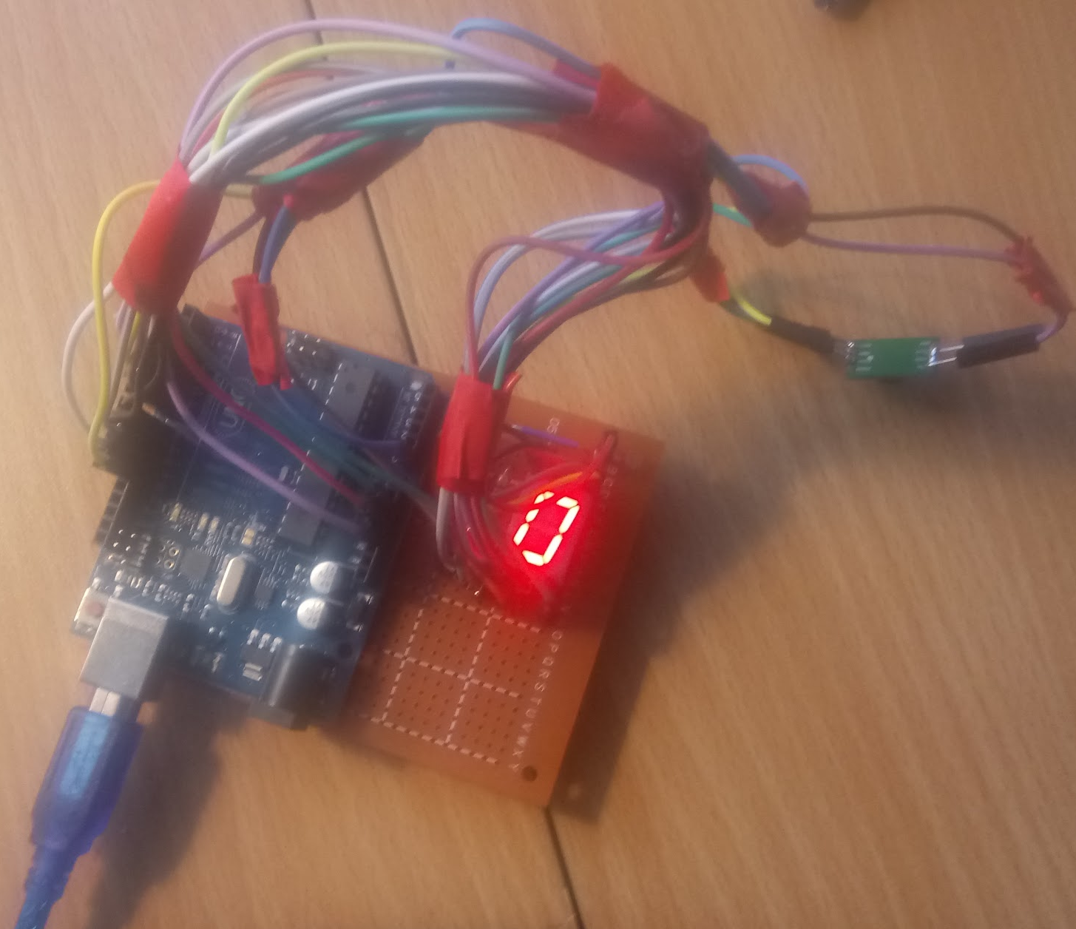


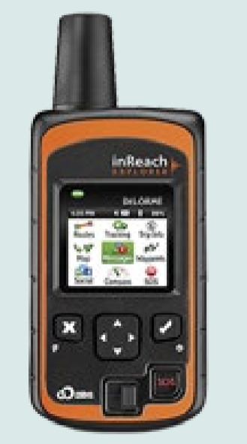
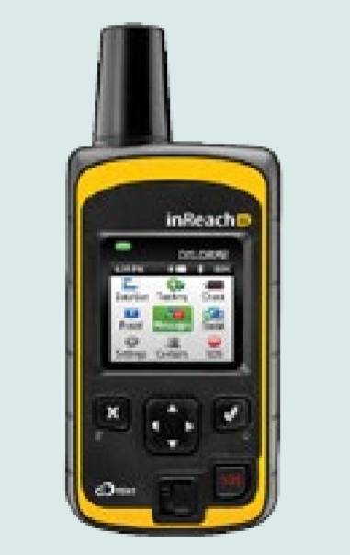
Asset Tracking on an Offshore Oil Rig
During the Deepwater Horizon oil spill disaster, authorities were searching for lost employees for 3 days.
Report
Market Analysis
Current Features
Competitors
We found that the market was oversaturated with competitors
Oil companies need a tracking and monitoring system for its employees while they are onsite to protect them.
Scope and Context
Our project investigates methods and tools that are used to track employees and assets.
System Architecture
Approach
Safety
Prototype
Impact
Transmits a signal to the receiver.
Detects whether device has contact with water.
Detect whether the device has had a sudden acceleration.
Cost
Efficiency
Alisha Boniface, Franklin Wilson, Dillon McGrath, Jordan Schaeffer, Robert Whittaker, Woojin Ra

