Slide 1

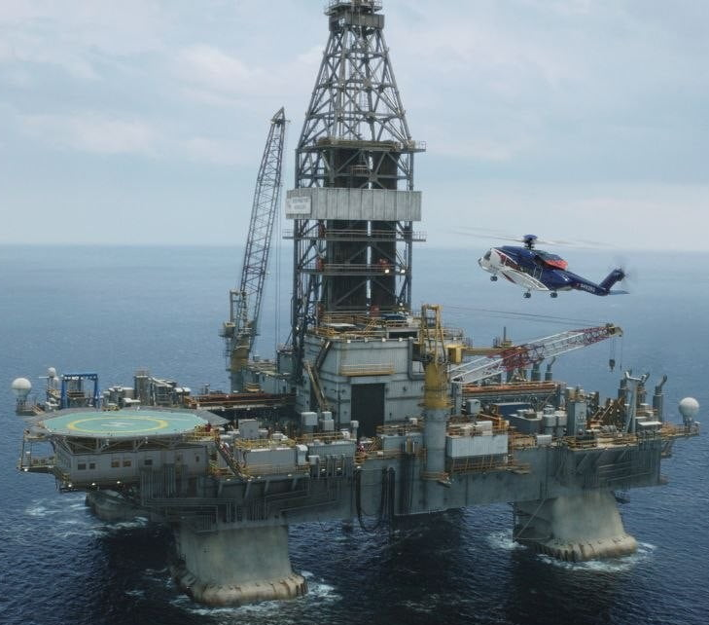
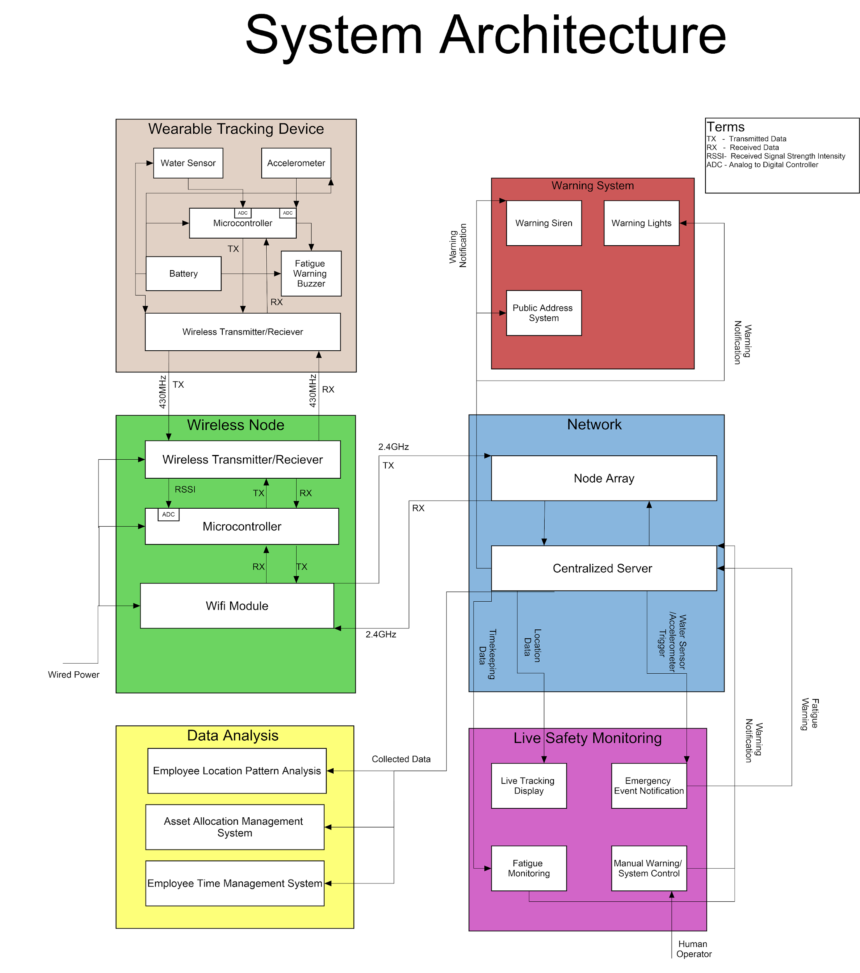
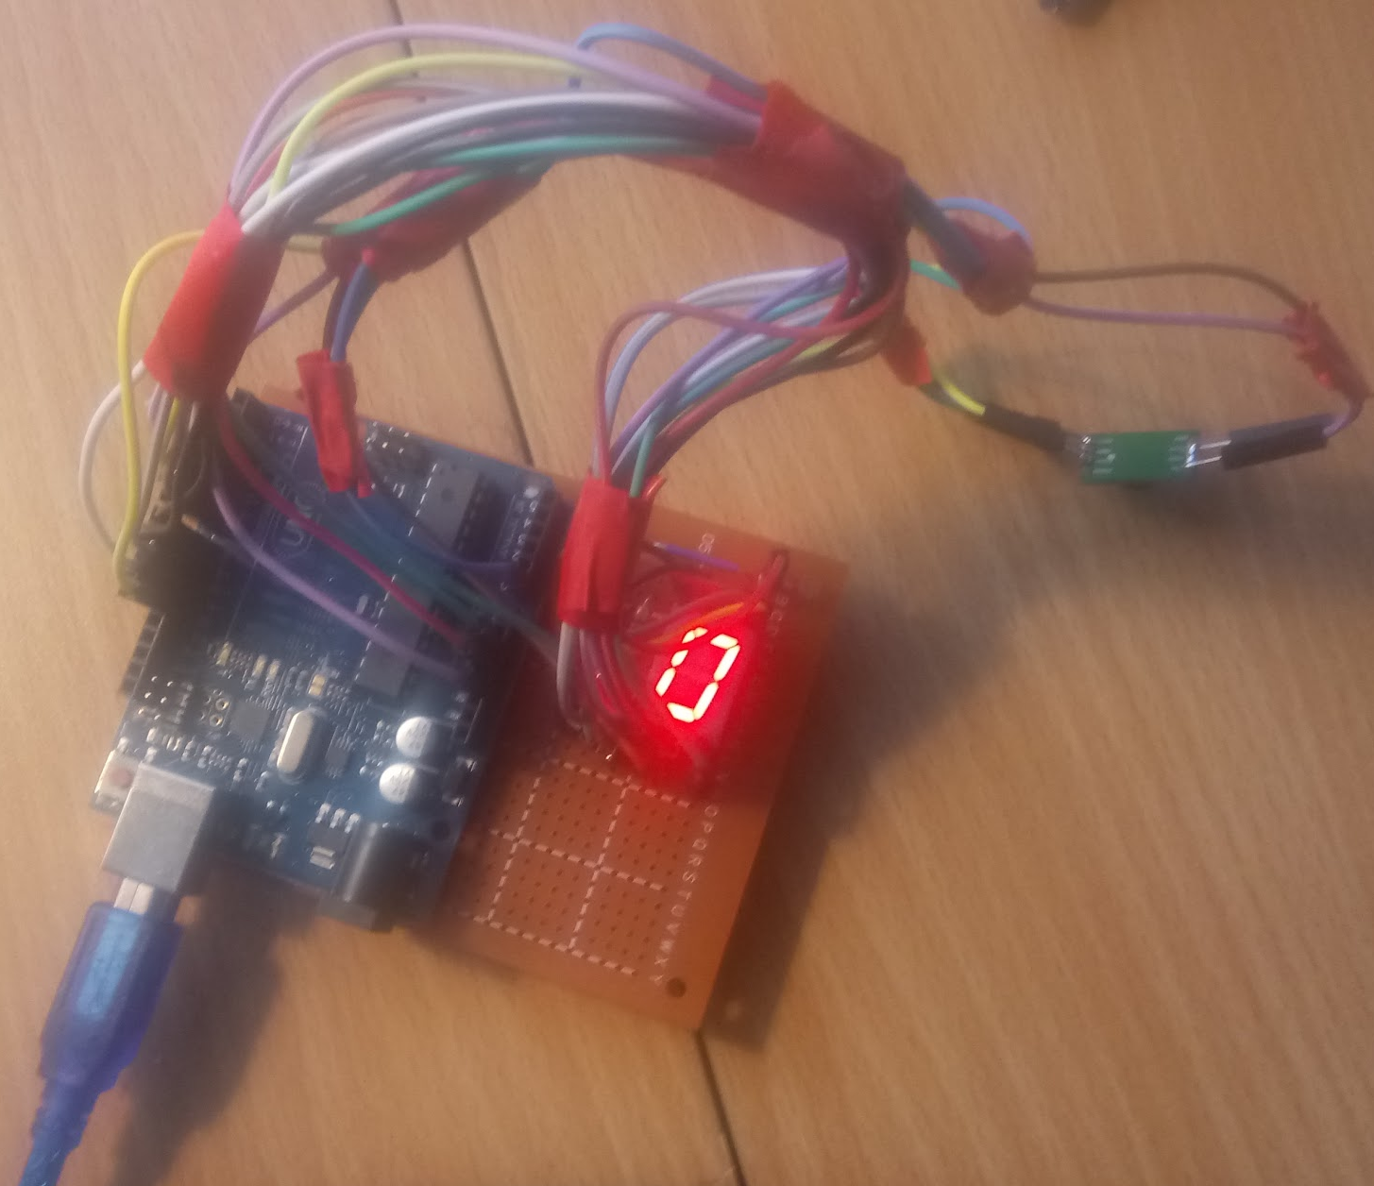
Tracking on an Offshore Oil Rig
During the Deepwater Horizon oil spill disaster, authorities were searching for the lost employees for 3 days.
Our project investigates methods and tools that are used to track employees and assets.
Oil companies need a tracking and monitoring system for its employees while they are onsite to protect them.
Impact
A successful implementation of this project will improve the safety of all those working on an oil rig.
In the case of an emergency the system would notify the employees of the crisis and notify rescuers where the employees are.
Deliverables
Market Analysis Report
System Architecture
Prototype
Alisha Boniface, Franklin Wilson, Dillon McGrath, Jordan Schaeffer, Robert Whittaker, Woojin Ra
Notes:
context of the problem
scope of problem or opportunity
approach or solution
impact of your project
Presentation
production quality
visual engagement

