Slide 1
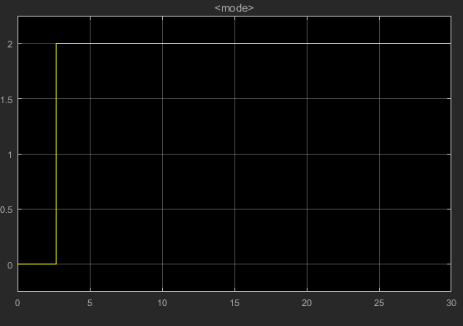
차선변경
In-lane 변경
No Action

Slide 2
 | L_s | K_s
In –lane 변경 | 0.9 | 0.5
차선변경 | 3.6 | 1

Slide 3
k_p k_s | 0.2 | 0.3 | 0.5 | 0.7 | 1 | 1.2
0.2 | 0.4121 | 0.3813 | 0.3434 | 0.329 | 0.3204 | 0.3177
0.3 | 0.4079 | 0.3645 | 0.3229 | 0.3103 | 0.3035 | 0.3015
0.5 | 0.4026 | 0.3285 | 0.2791 | 0.2679 | 0.2622 | 0.2606*
0.6 | 0.4018 | 0.3145 | 0.2681 | 0.2511 | 0.246* | 0.2444*
0.8 | 0.4014 | 0.2942 | 0.235 | 0.2253* | 0.2209 * | 0.2193*
1 | 0.4014 | 0.2817 | 0.2153 * | 0.2064 * | 0.2025 * | 0.2011 *
Max lateral acceleration at mode 1

Slide 4
k_p k_s | 0.2 | 0.3 | 0.5 | 0.7 | 1 | 1.2
0.2 | 0.4389 | 0.4273 | 0.425 | 0.4201 | 0.416 | 0.4145
0.3 | 0.4387 | 0.4273 | 0.4163 | 0.4032 | 0.3943 * | 0.3913 *
0.5 | 0.4387 | 0.4273 | 0.3944 | 0.3581 | 0.3406 * | 0.3357 *
0.6 | 0.4387 | 0.4273 | 0.3858 | 0.3370 * | 0.3172 * | 0.3122 *
0.8 | 0.4387 | 0.4273 | 0.3769 | 0.3030* | 0.2803 * | 0.2751 *
1 | 0.4387 | 0.4273 | 0.3746* | 0.2777 * | 0.2537 8 | 0.2486 *
Max lateral acceleration at mode 2

Slide 5
 | K_s | K_p
In –lane 변경 1 | 0.63 | 0.72
차선변경 2 | 0.83 | 0.56
최적화

