Slide 1
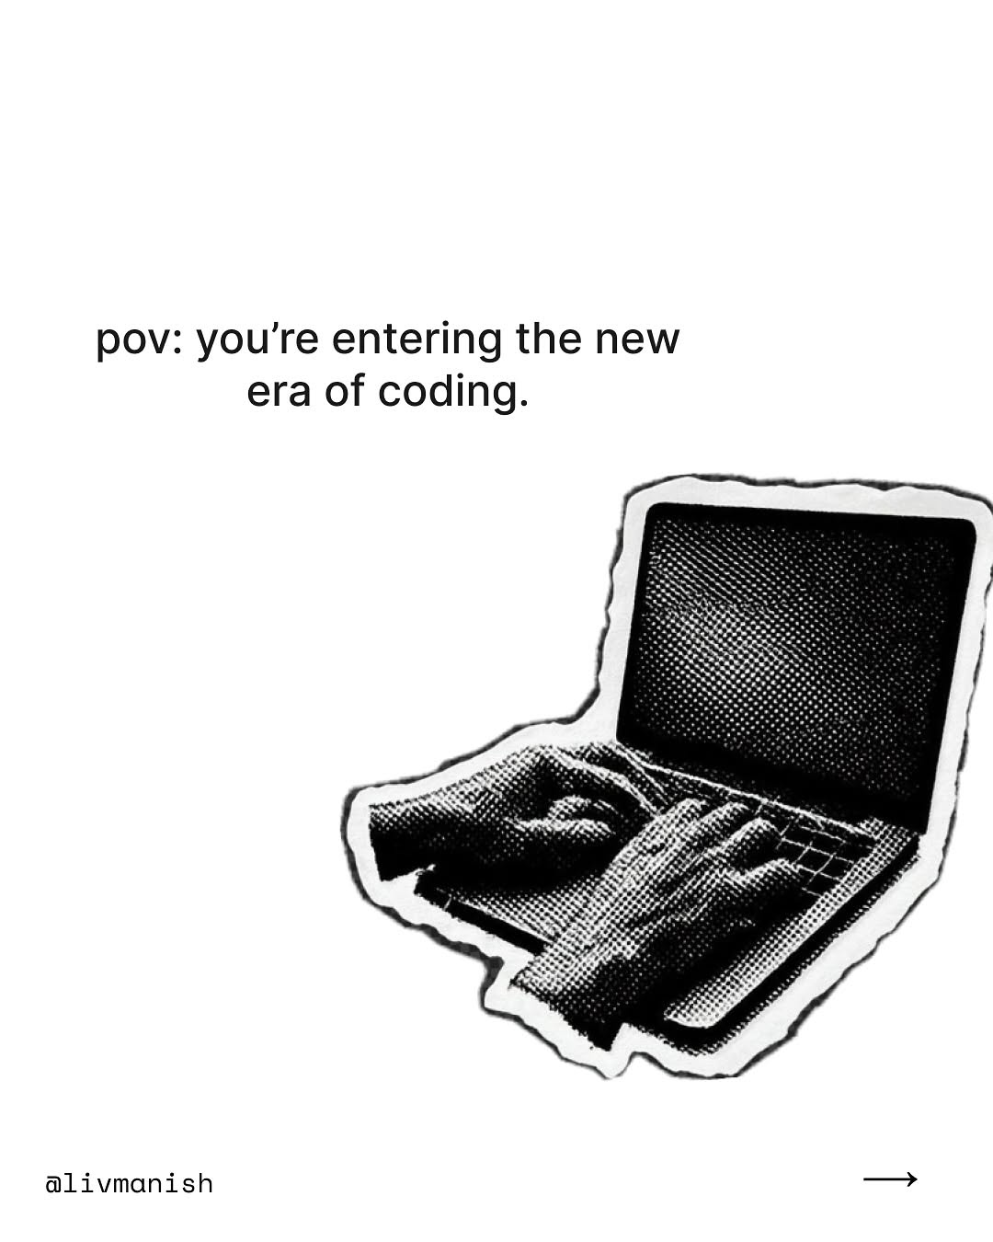
ai-tips / DVXvbomk3OU / slide 01
pov: you're entering the new
era of coding.
a@livmanish —

Slide 2
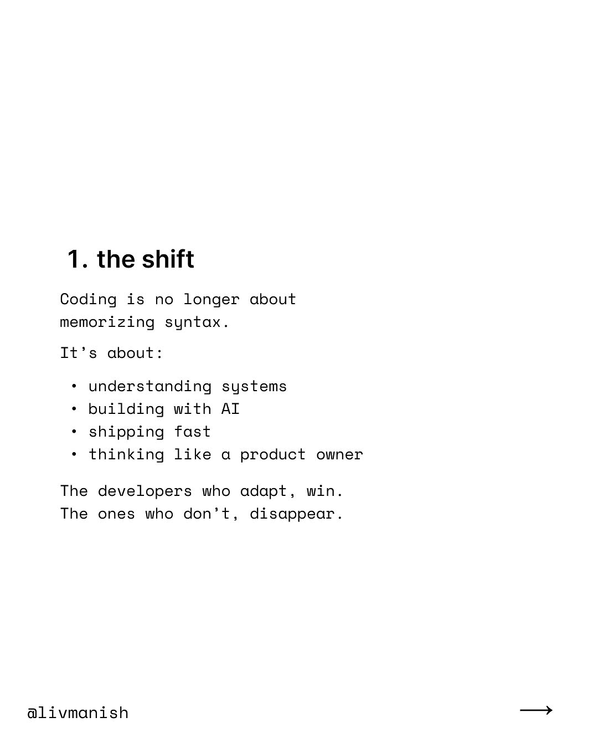
ai-tips / DVXvbomk3OU / slide 02
1. the shift
Coding is longer about
memorizing syntax.
It’s about:
understanding systems
building with ATI
shipping fast
thinking like product
The developers who adapt, win.
The who don’t, disappear.
alivmanish

Slide 3
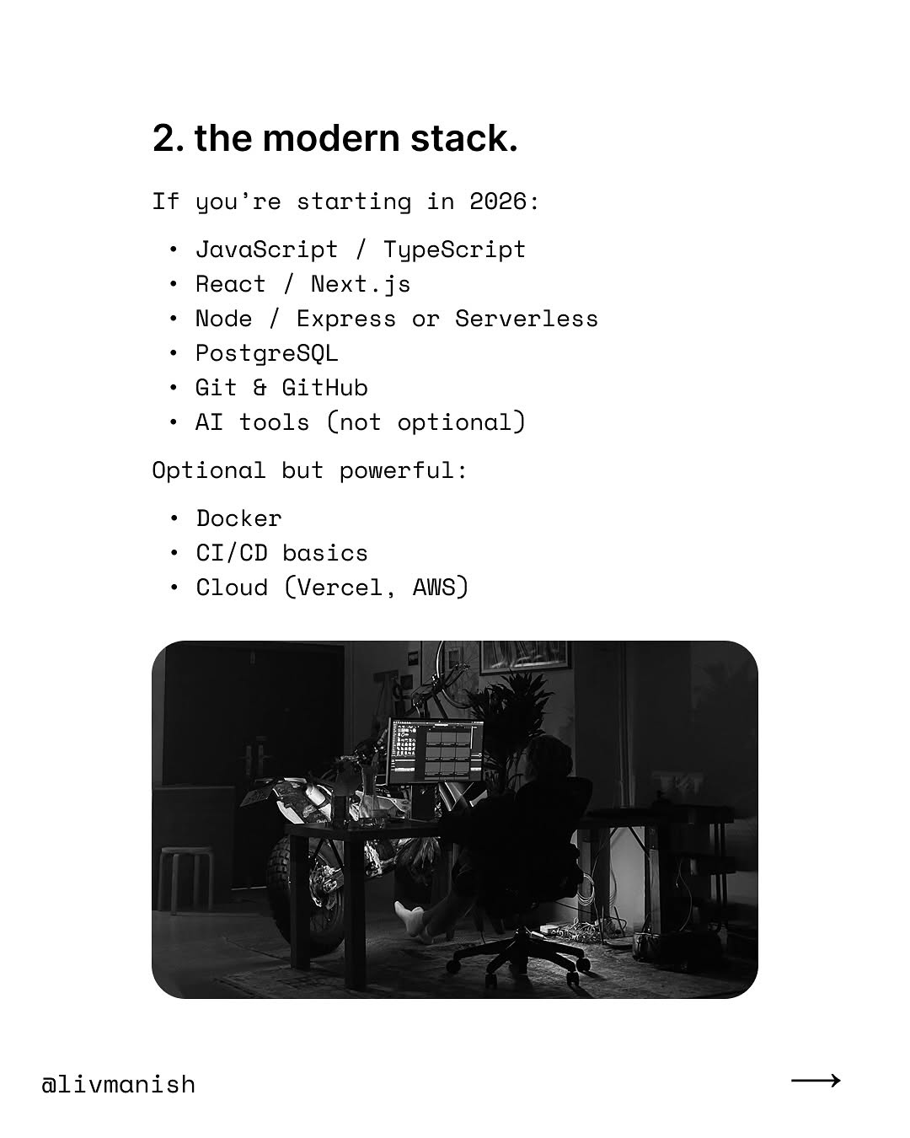
ai-tips / DVXvbomk3OU / slide 03
2. the modern stack.
If you’re starting in 2026:
JavaScript / TypeScript
React / Next.js
Node / Express Serverless
PostgreSQL
Git & GitHub
AI tools (not optional)
Optional but powerful:
Docker
CI/CD basics
Cloud (Vercel, AWS)
Fay
alivmanish

Slide 4
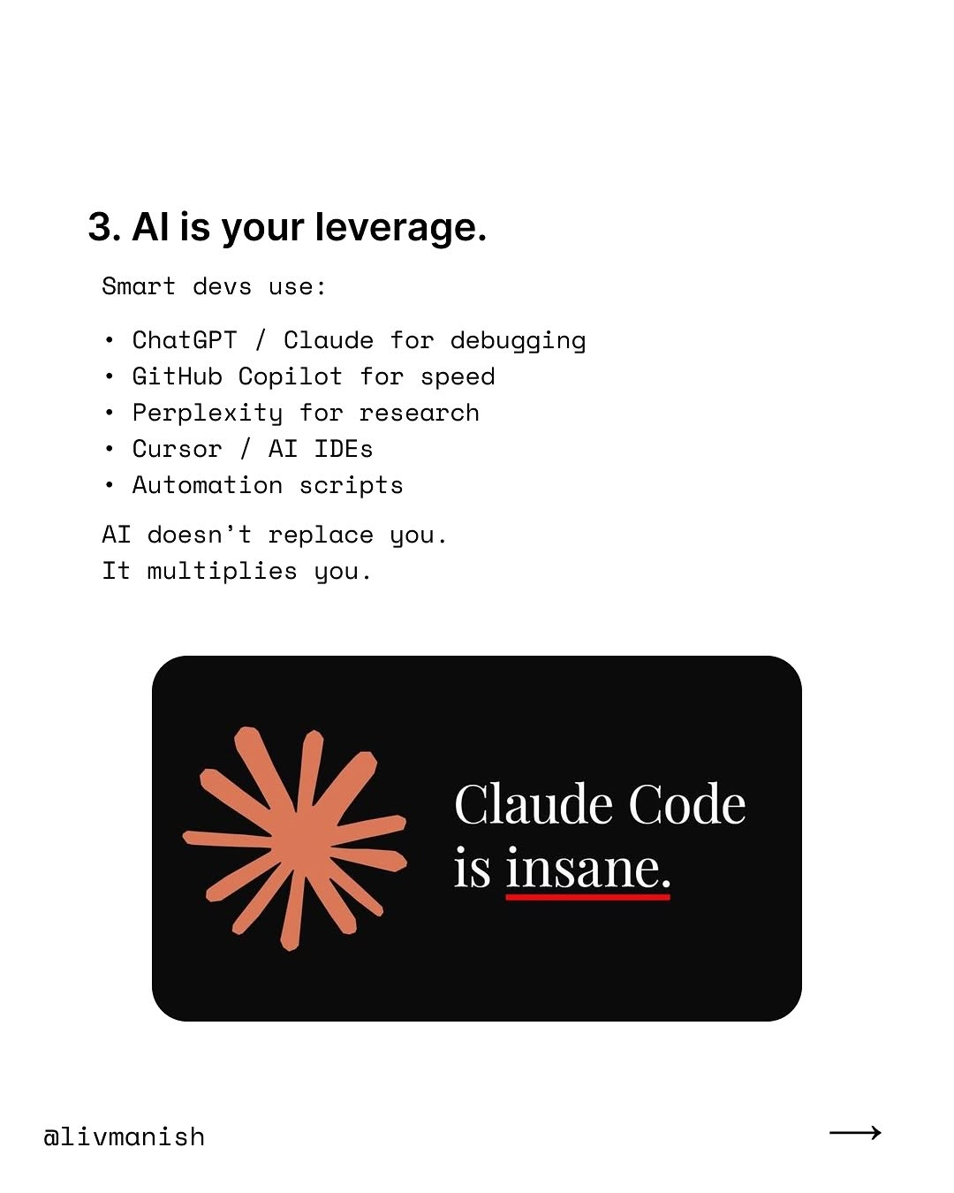
ai-tips / DVXvbomk3OU / slide 04
3. Alis your leverage.
Smart devs
ChatGPT / Claude for debugging
GitHub Copilot for speed
Perplexity for research
Cursor / AI IDEs
Automation scripts
AI doesn’t replace you.
It multiplies you.
Claude Code
1S Insane.
alivmanish

Slide 5
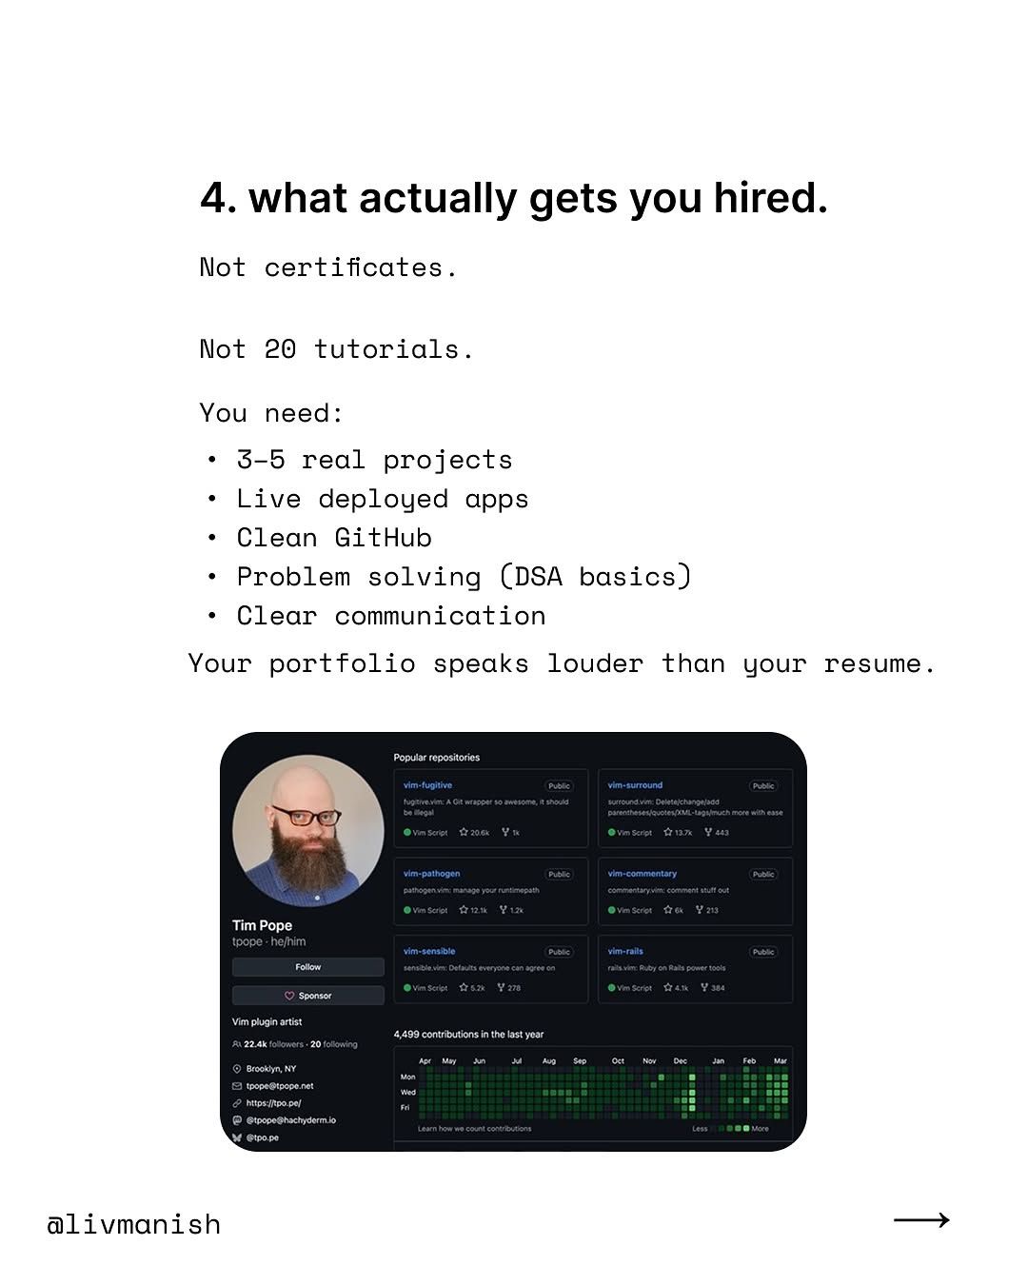
ai-tips / DVXvbomk3OU / slide 05
4. what actually gets you hired.
Not certificates.
Not 20 tutorials.
You need:
$-5 real projects
Live deployed apps
Clean GitHub
Problem solving (DSA basics)
Clear communication
Your portfolio speaks louder than your
alivmanish

Slide 6
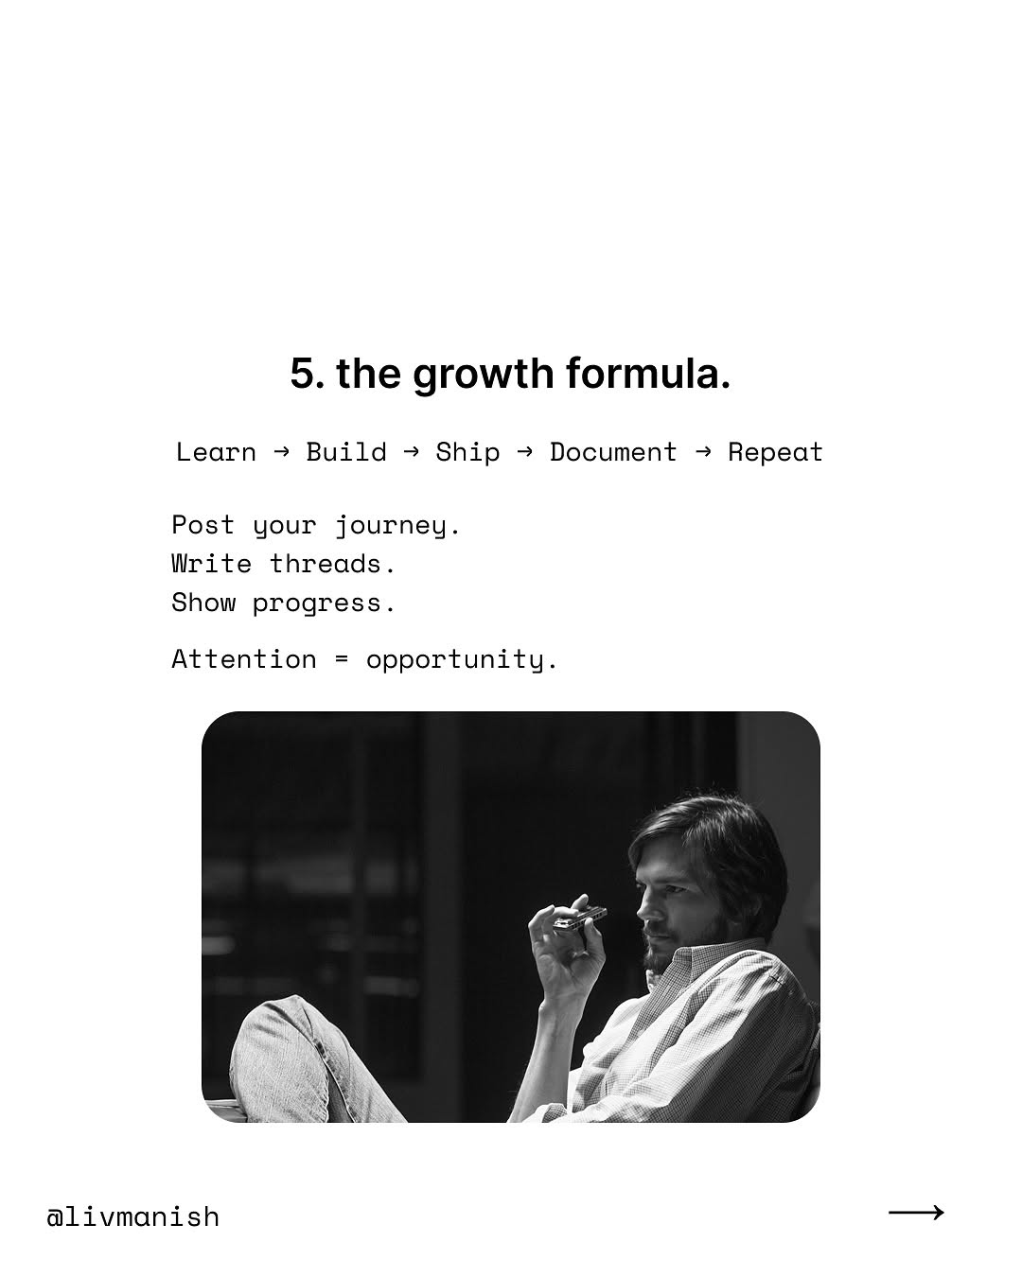
ai-tips / DVXvbomk3OU / slide 06
5. the growth formula.
Learn Build Ship Document Repeat
Post your journey.
Write threads.
Show progress.
Attention opportunity.
Fi
alivmanish

Slide 7
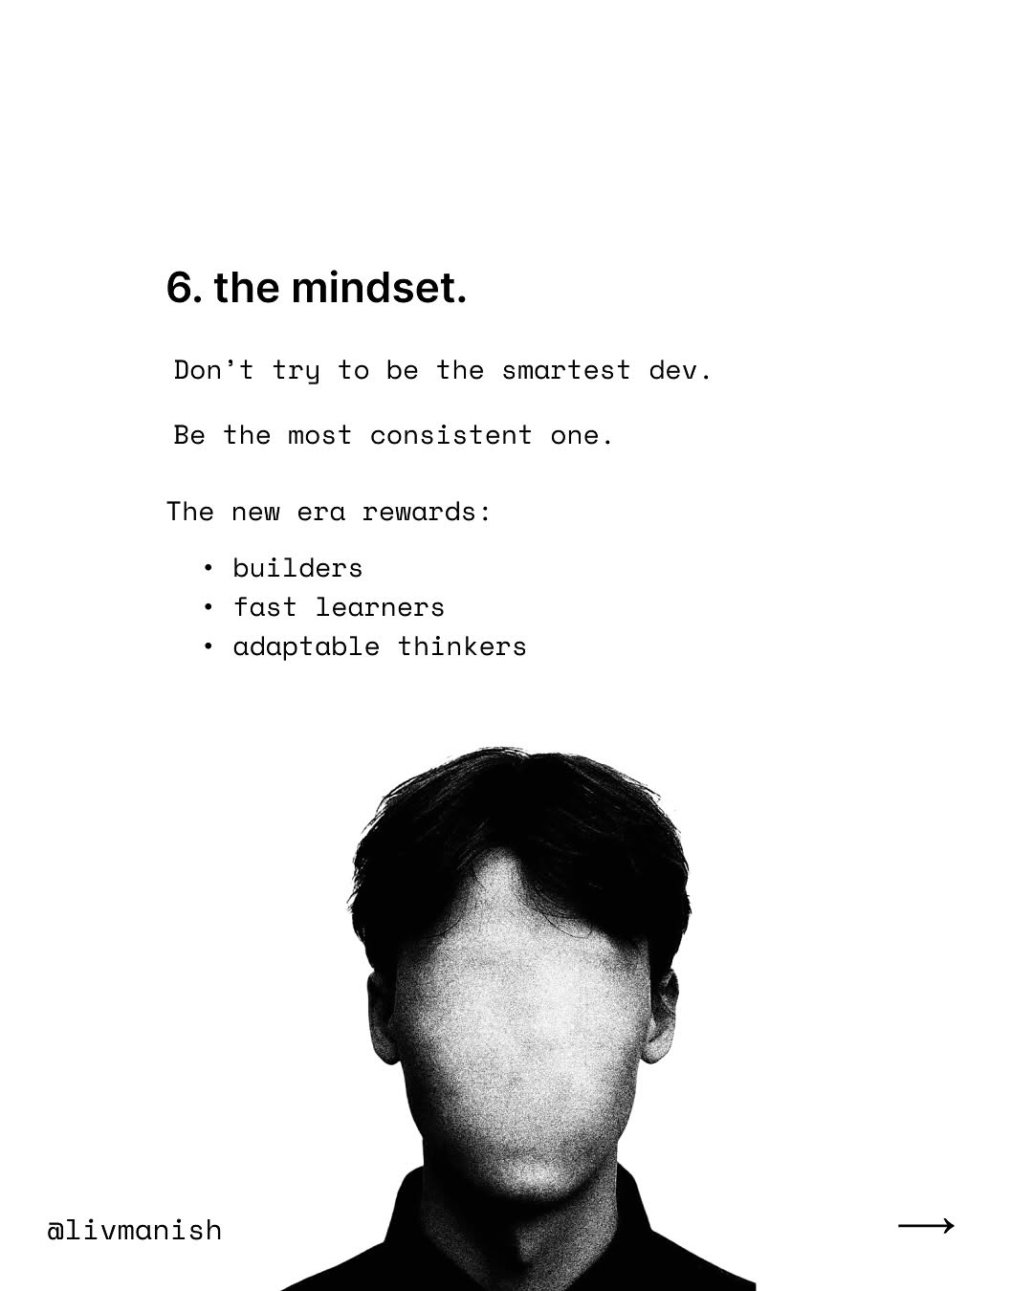
ai-tips / DVXvbomk3OU / slide 07
6. the mindset.
Don’t try to be the smartest dev.
Be the most consistent
The rewards:
builders
fast learners
adaptable thinkers
alivmanish —

Slide 8
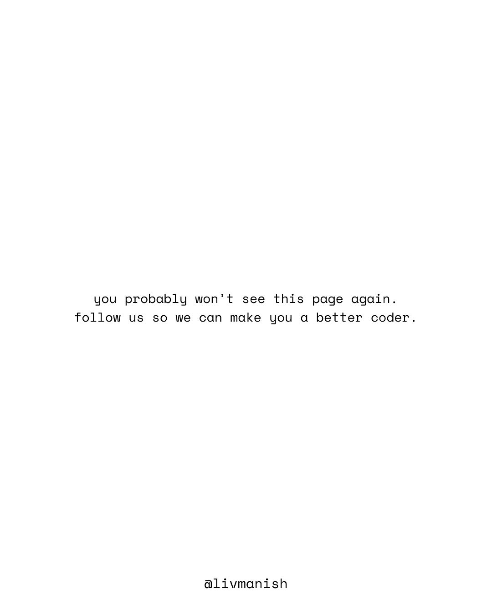
ai-tips / DVXvbomk3OU / slide 08
you probably won’t this page again.
follow make you better coder.
a@livmanish

Slide 9
ai-tips / DVXvbomk3OU
Source URL
https://www.instagram.com/p/DVXvbomk3OU/
Caption
The coding era has changed. It’s no longer about memorizing syntax or finishing courses. It’s about: – building real systems – using AI as leverage – shipping fast – showing proof of work The developers who adapt will dominate the next 5 years. The rest will stay stuck in tutorial hell. If you’re serious about becoming a real builder, stay here. #ai #tech #coding #programming
Componentization note
Images are separate page objects. OCR-detected text has been covered and recreated as editable text boxes.

