Slide 1
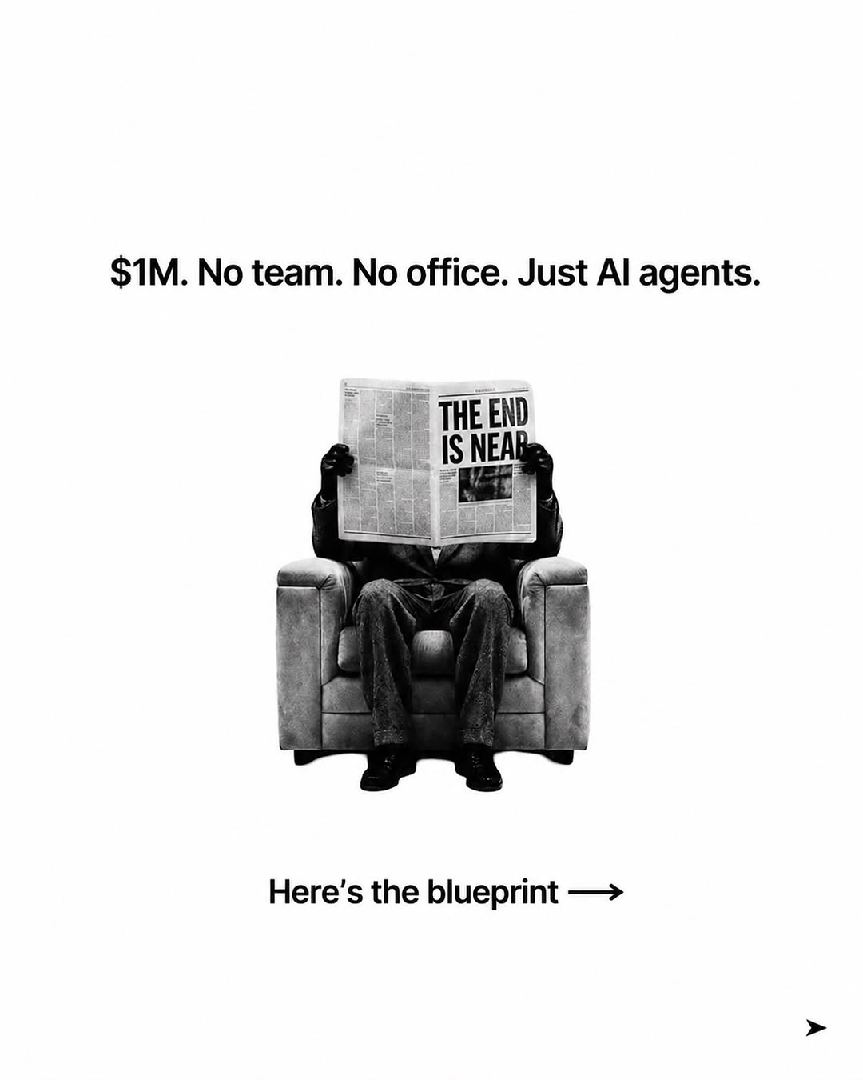
ai-tips / DXlZ0wxE-Rr / slide 01
$1M. No team. No office. Just Al agents.
dow
the blueprint —>

Slide 2
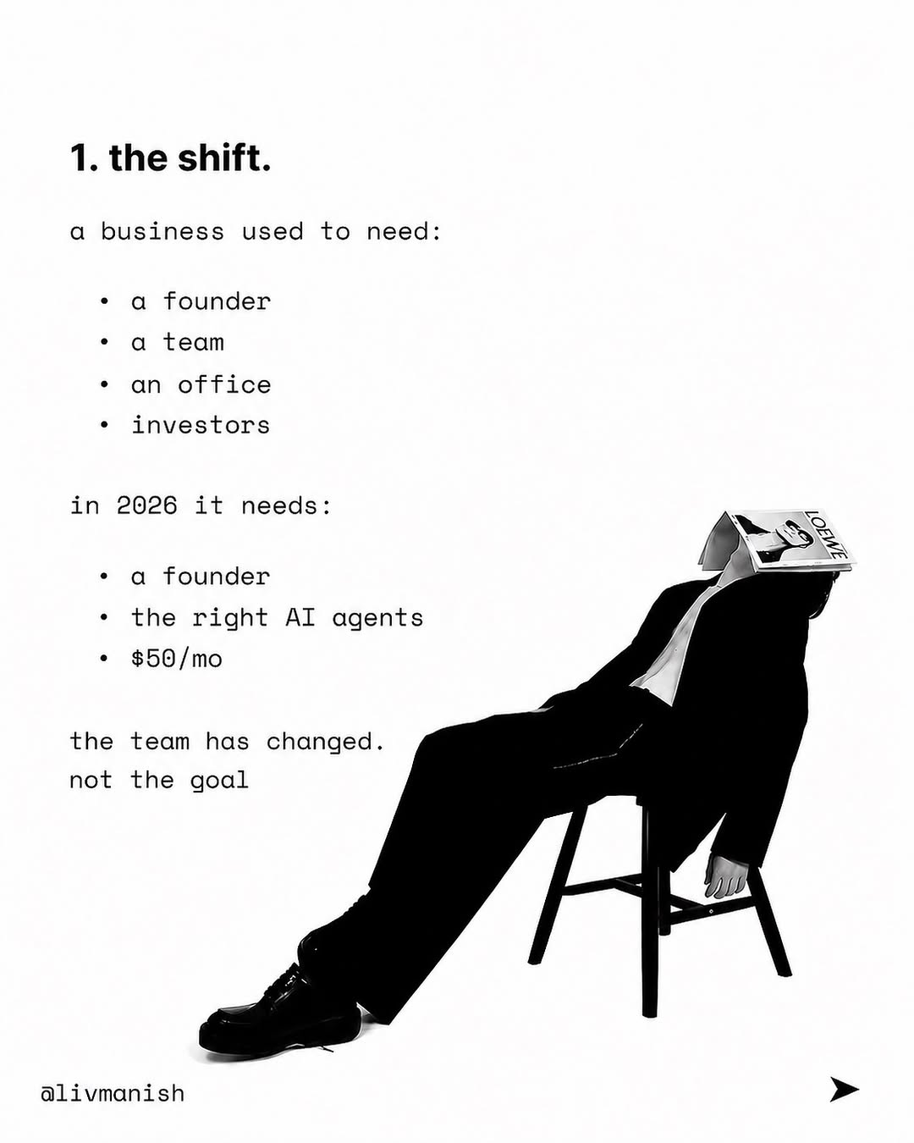
ai-tips / DXlZ0wxE-Rr / slide 02
1. the shift.
business used to need:
a founder
a team
office
investors
in 2026 it needs:
a founder —
the right AI agents
$50/mo y
the team has changed.
not the goal
alivmanish >

Slide 3
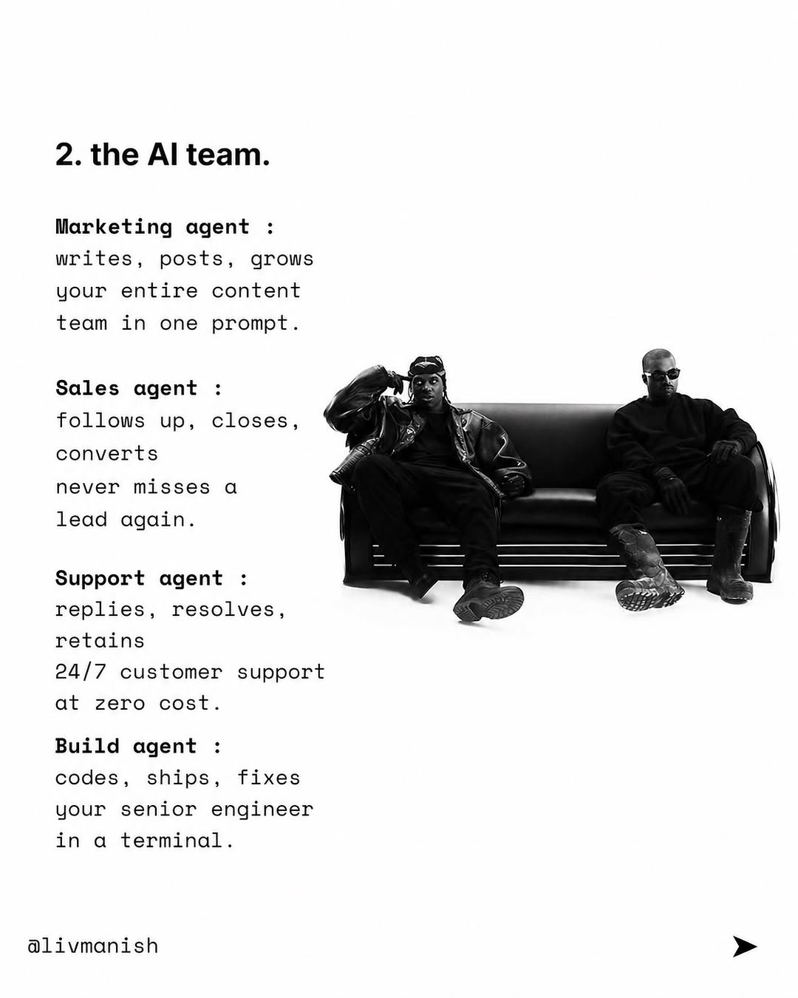
ai-tips / DXlZ0wxE-Rr / slide 03
2. the Al team.
Marketing agent
writes, posts, grows
your entire content
team in prompt.
Sales agent
follows up, closes,
converts
misses
lead again. i
Support agent
replies, resolves,
retains
24/7 customer support
at cost.
Build agent
codes, ships, fixes
your senior engineer
in terminal.
@livmanish >

Slide 4
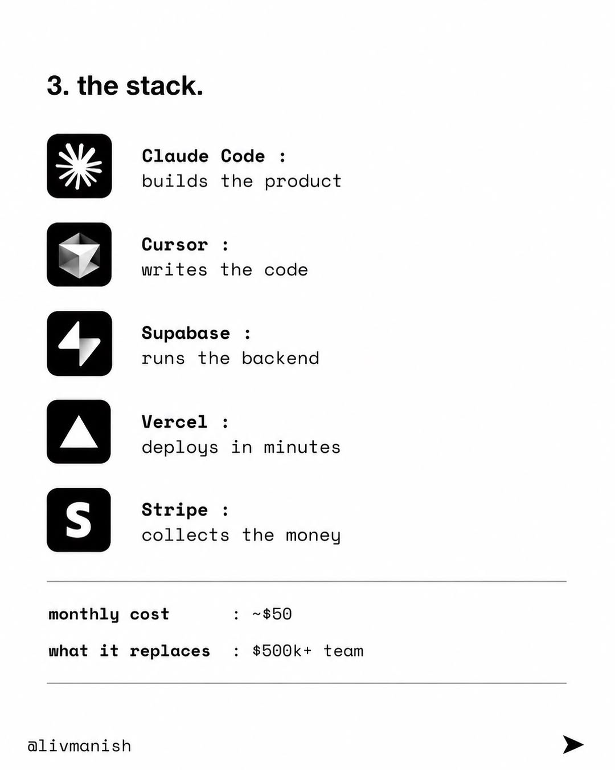
ai-tips / DXlZ0wxE-Rr / slide 04
3. the stack.
> Claude Code
builds the product
Cursor
writes the code
Supabase
runs the backend
Vercel
deploys in minutes
Stripe
collects the money
monthly cost ~$50
what it replaces $500k+ team

Slide 5
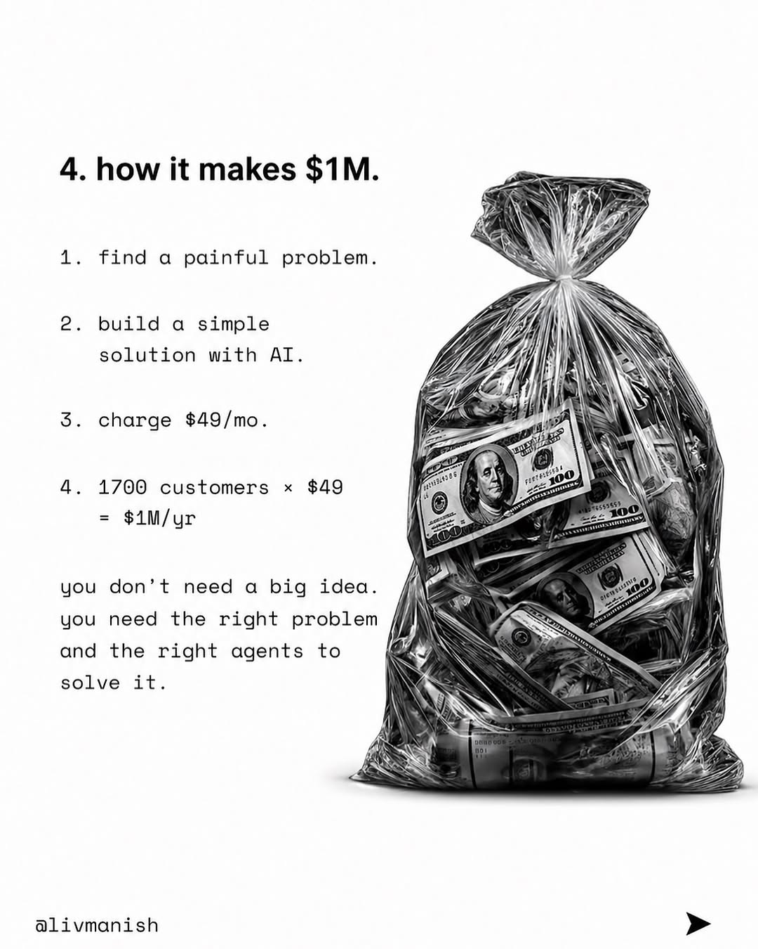
ai-tips / DXlZ0wxE-Rr / slide 05
4. how it makes $1M.
1. find painful problem.
2. build simple
solution with ATI. Wy
3 Is iil EN
charge $49/mo.
4. 1700 customers $49 q j
—ZA |
you don’t need big idea.
LS
you need the right problem FEE N
and the right agents to
solve it NGA SG |
a@livmanish >

Slide 6
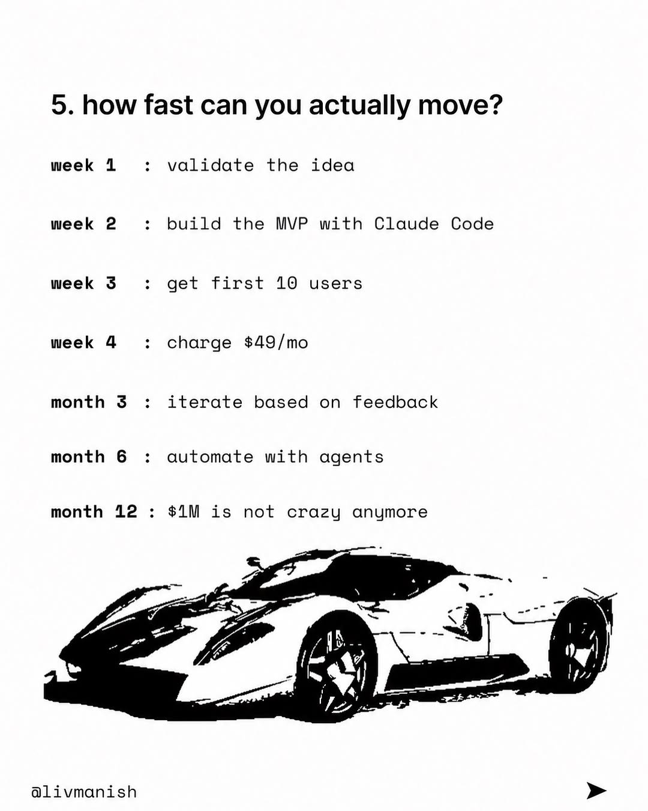
ai-tips / DXlZ0wxE-Rr / slide 06
5. how fast can you actually move?
week 1 validate the idea
week 2 build the MVP with Claude Code
week S$ get first 10
week 4 charge $49/mo
month iterate based feedback
month 6 automate with agents
month 12 $1M is not crazy anymore
eo a TS

Slide 7
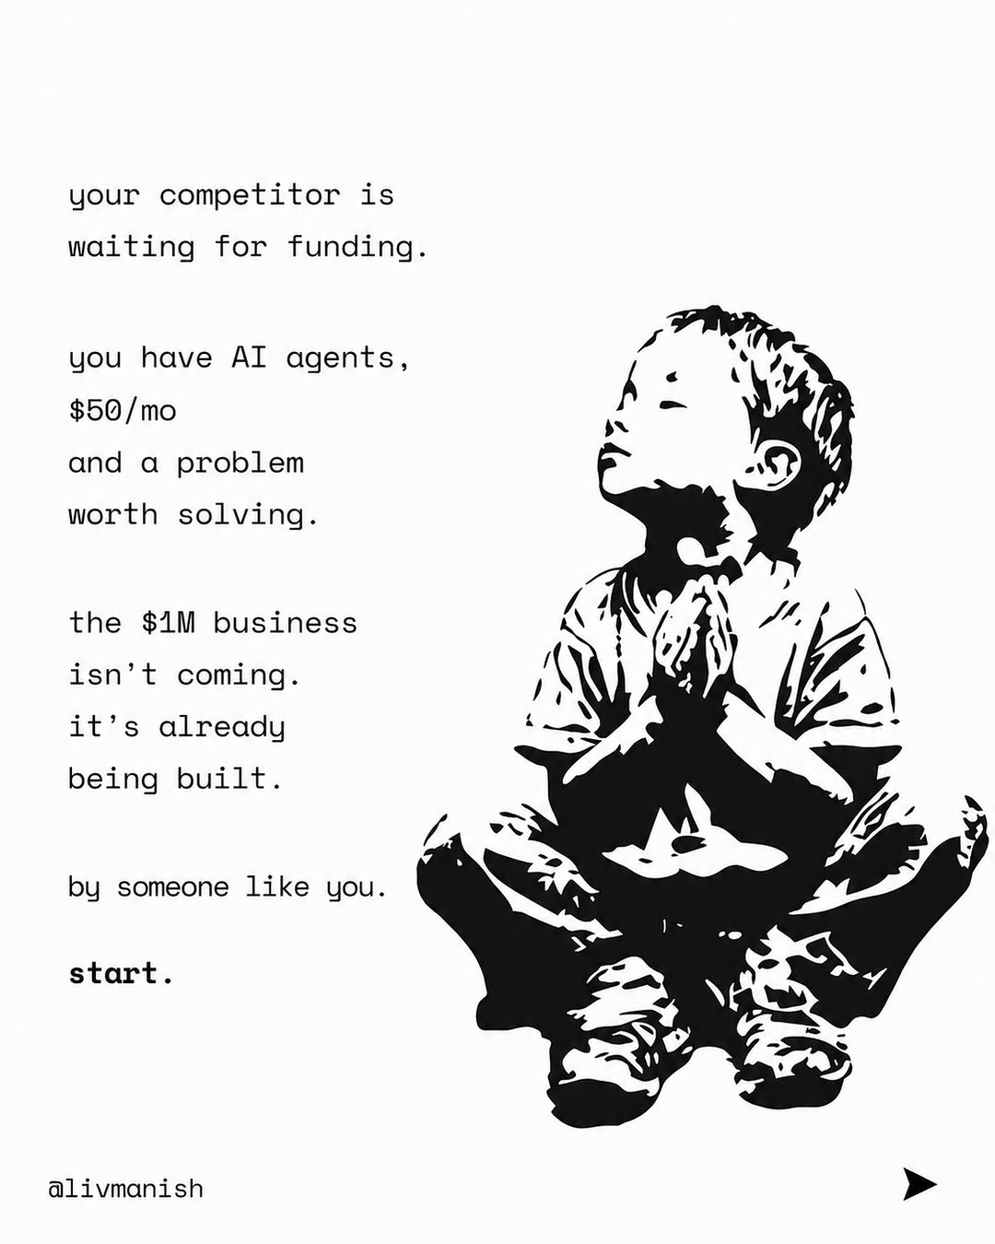
ai-tips / DXlZ0wxE-Rr / slide 07
your competitor is
waiting for funding.
you have AI agents,
$50/mo
and a problem a
worth solving.
the $1M business K \
isn’t coming.
it’s already
being built.

Slide 8
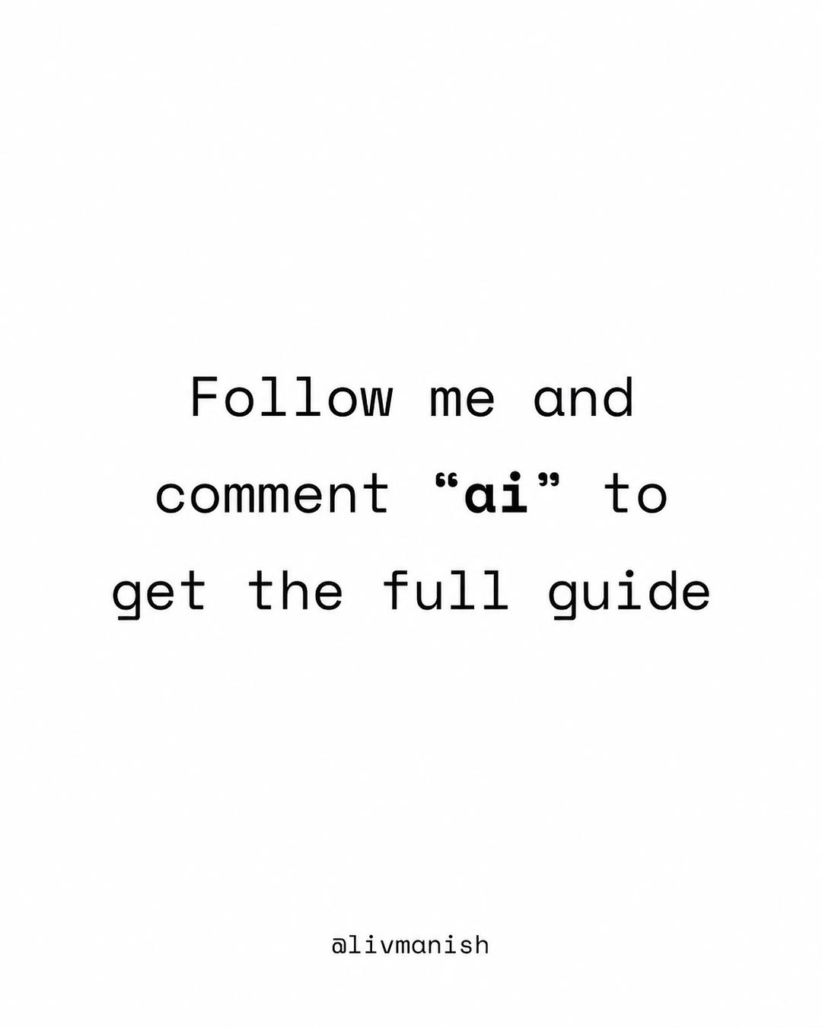
ai-tips / DXlZ0wxE-Rr / slide 08
Follow me and
comment “ai” to
get the full guide

Slide 9
ai-tips / DXlZ0wxE-Rr
Source URL
https://www.instagram.com/p/DXlZ0wxE-Rr/
Caption
The first $1M business run by AI agents is being built right now. Not by a funded startup. Not by a team of 20. By one person with a laptop and $50/mo. Follow me and comment “ai” to get the full guide #ai #tech #app #coding
Componentization note
Images are separate page objects. OCR-detected text has been covered and recreated as editable text boxes.

