Slide 1
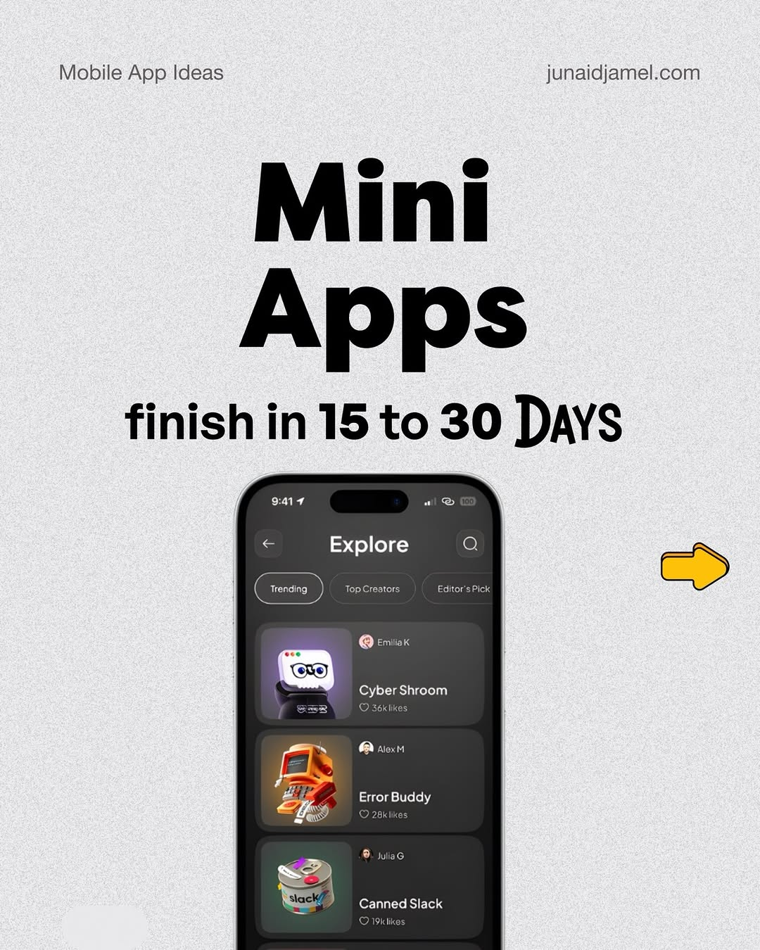
app / DXZb3JaCLnu / slide 01
Mobile App Ideas junaidjamel.com
Mini
finish in 15 to 30 DAYS
Explore Q
Com
‘7
| Canned

Slide 2
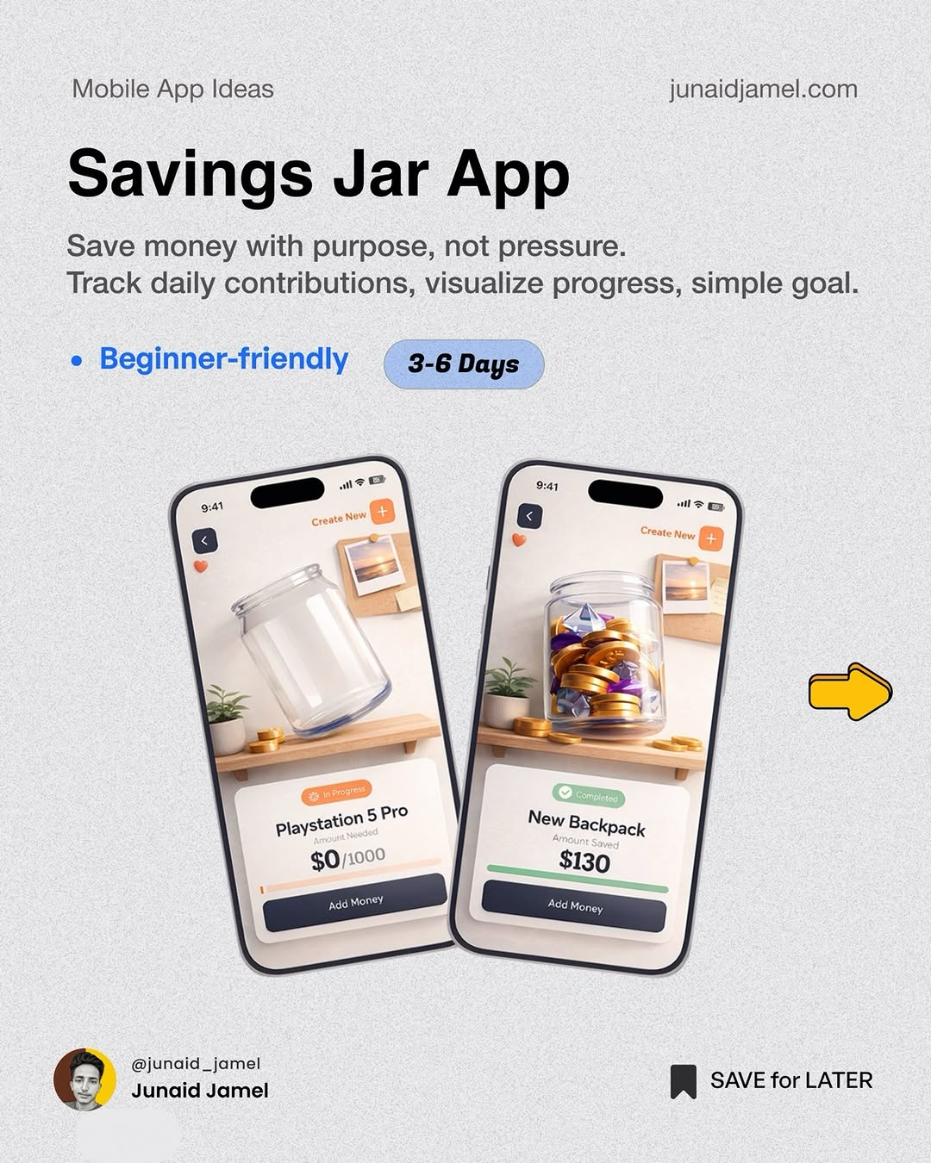
app / DXZb3JaCLnu / slide 02
Mobile App Ideas junaidjamel.com
Save money with purpose, not pressure.
Track daily contributions, visualize progress, simple goal.
Beginner-friendly 3-6 Days
gg

Slide 3
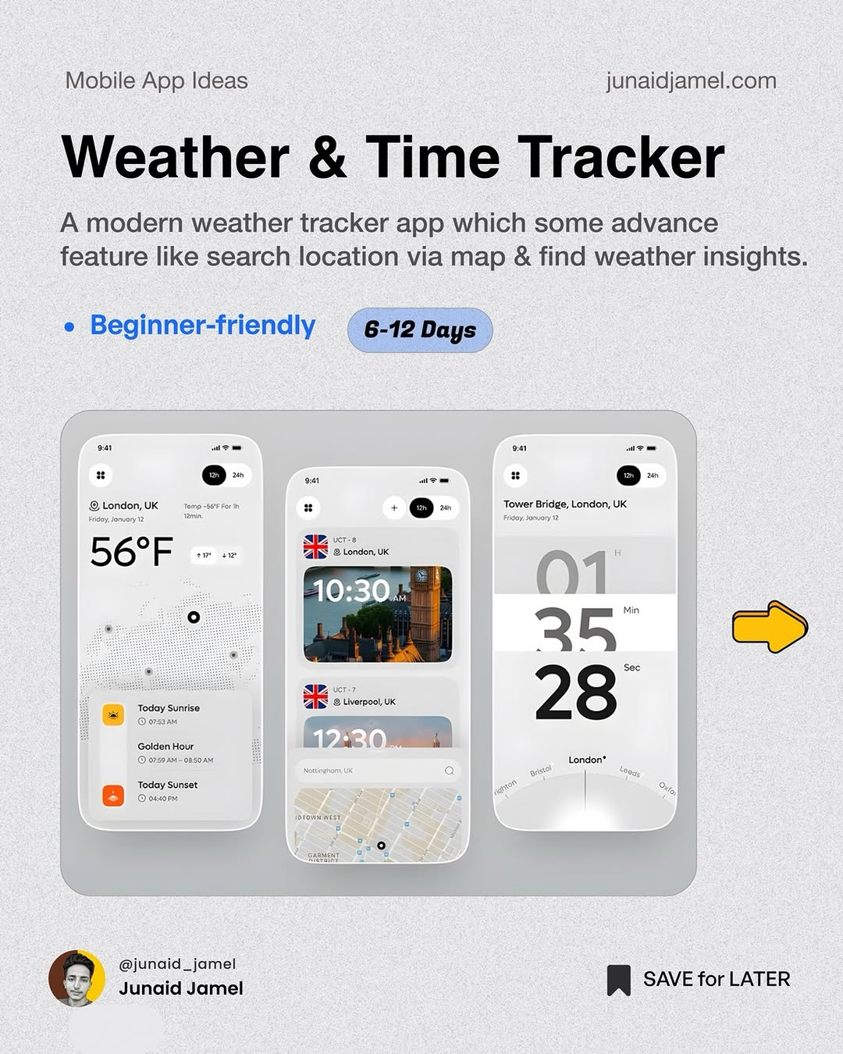
app / DXZb3JaCLnu / slide 03
Mobile App Ideas junaidjamel.com
Weather & Time Tracker
A modern weather tracker app which some advance
feature like search location via map & find weather insights.
Beginner-friendly ( 6-42 Days
(>
eo London,
56° F BAR uc
PR SAVE for LATER

Slide 4
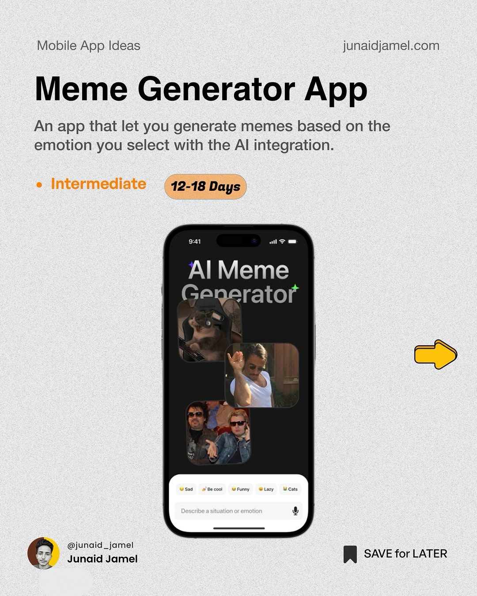
app / DXZb3JaCLnu / slide 04
Mobile App Ideas junaidjamel.com
Meme Generator App
An app that let you generate memes based on the
emotion you select with the Al integration.
Intermediate
Al Meme
Generator
PR SAVE for LATER

Slide 5
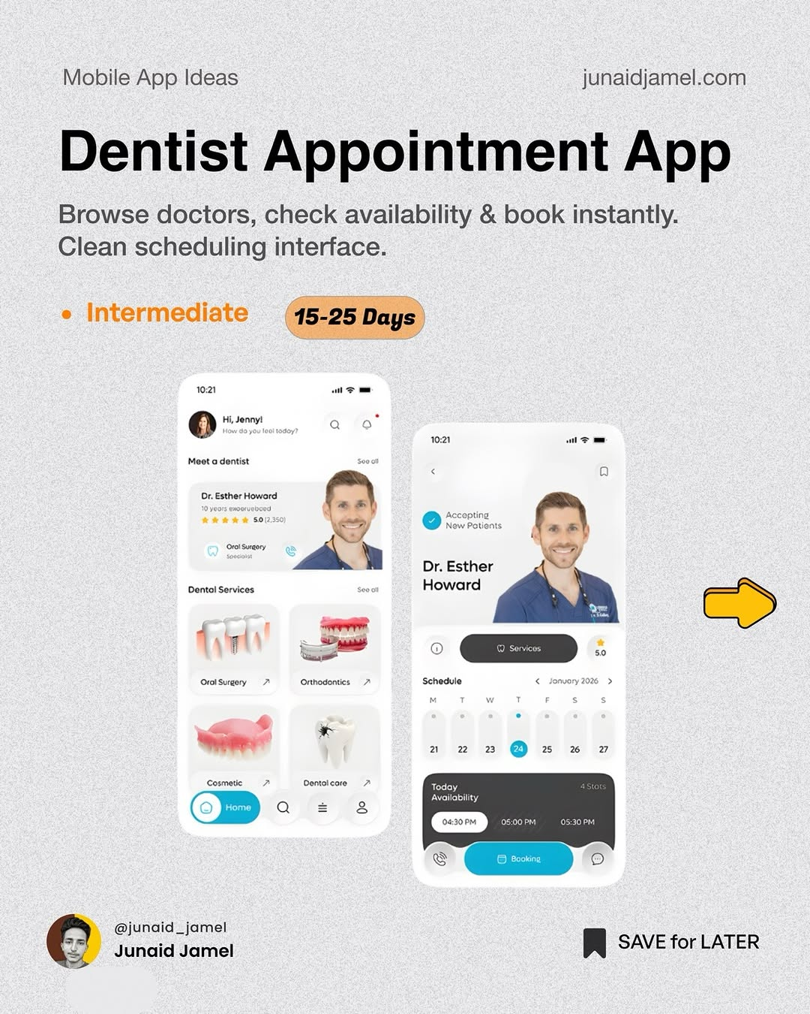
app / DXZb3JaCLnu / slide 05
Mobile App Ideas junaidjamel.com
Dentist Appointment App
Browse doctors, check availability & book instantly.
Clean scheduling interface.
Intermediate
20
Services Howard aa» cS
4 i!
Availability
Sr
@junaid_jamel
PR SAVE for LATER

Slide 6
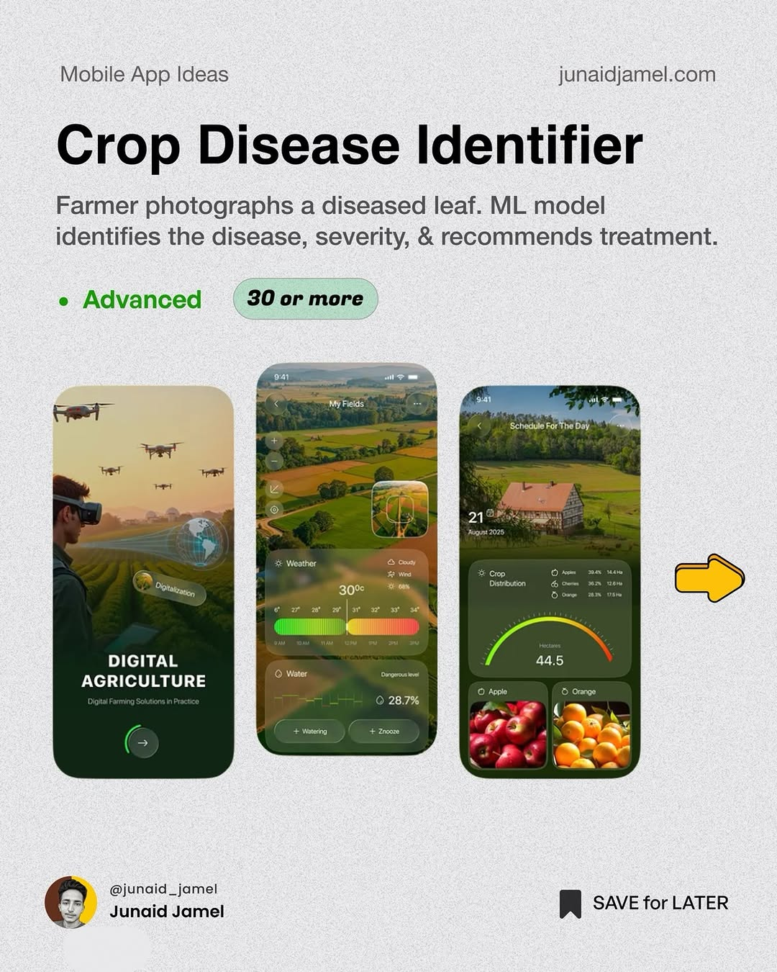
app / DXZb3JaCLnu / slide 06
Mobile App Ideas junaidjamel.com
Crop Disease Identifier
Farmer photographs a diseased leaf. ML model
identifies the disease, severity, & recommends treatment.
Advanced 30 or more
aq E>
i em
DIGITAL vA
AGRICULTURE
28.7%
@junaid_jamel
PR SAVE for LATER

Slide 7
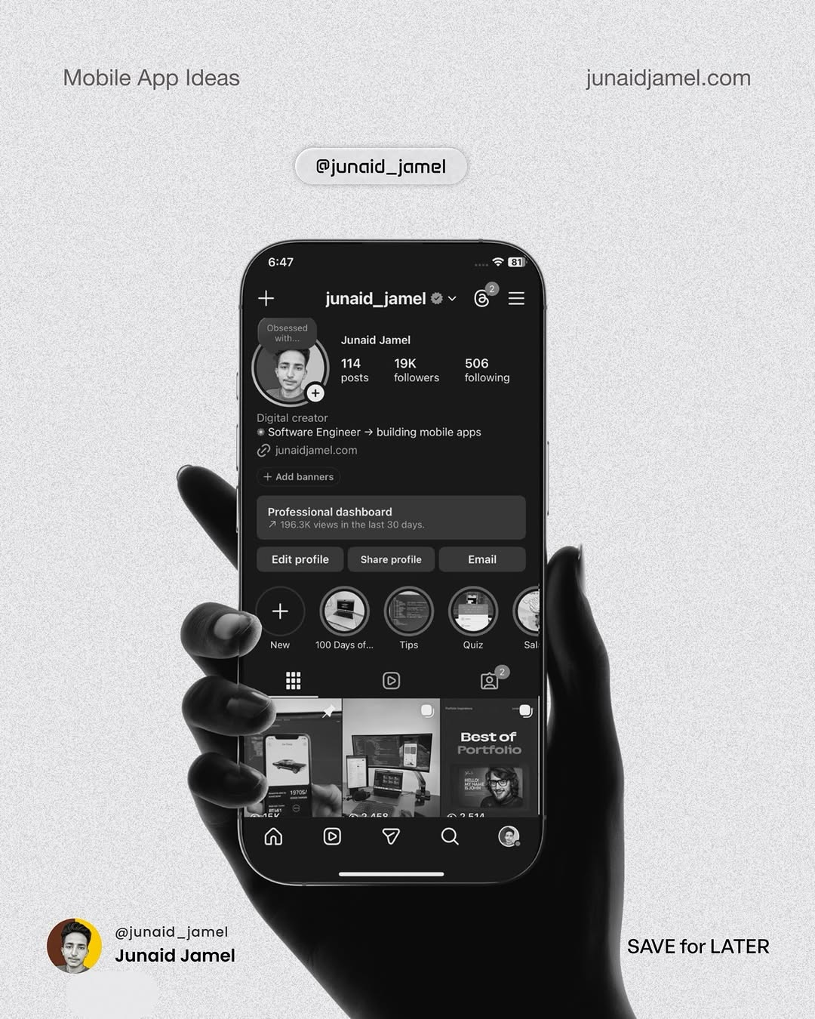
app / DXZb3JaCLnu / slide 07
Mobile App Ideas junaidjamel.com
@junaid_jamel
6:47
f+ junaid_jamel
‘ath
za
<0
a?
Best
© 7 Qa @
@junaid_jamel
Jamel SAVE for LATER

Slide 8
app / DXZb3JaCLnu
Source URL
https://www.instagram.com/p/DXZb3JaCLnu/
Caption
App ideas you can make to capture market 🚀 My Github 🔗 https://github.com/JunaidJamel Follow @junaid_jamel
Componentization note
Images are separate page objects. OCR-detected text has been covered and recreated as editable text boxes.

