Slide 1
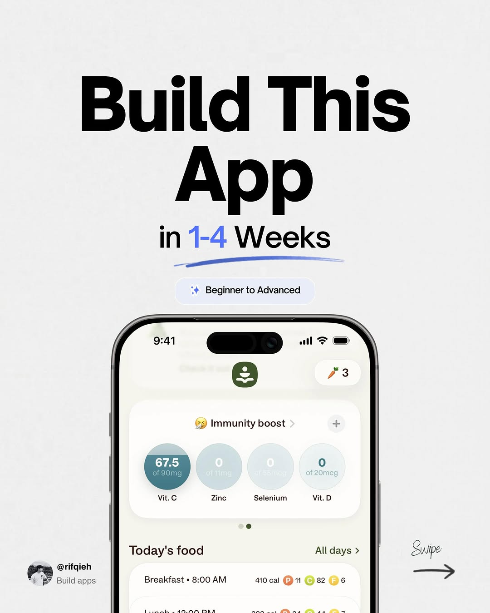
app / DYuD-i5E3Pz / slide 01
in 1-4 Weeks
‘+ Beginner
9:41 al
e 73
69 Immunity boost
Selenium
Today's food All days Swipe
@rifqieh =
Or @s2

Slide 2
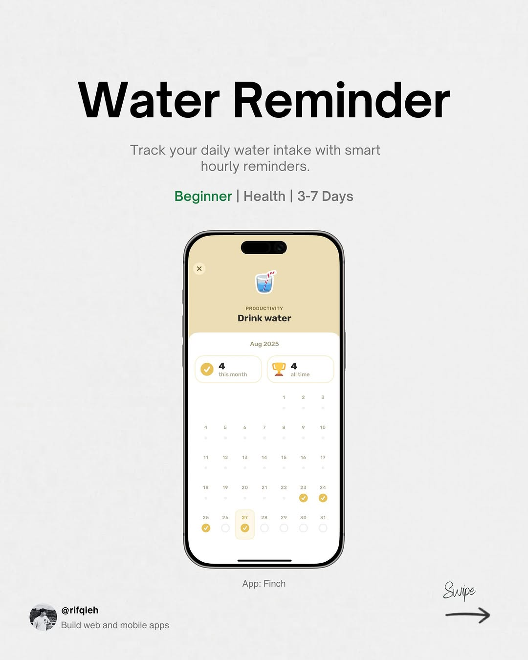
app / DYuD-i5E3Pz / slide 02
Water Reminder
Track your daily water intake with smart
hourly reminders.
Beginner Health 3-7 Days
Ww
ban
°° 0
App: Supe
GB =

Slide 3
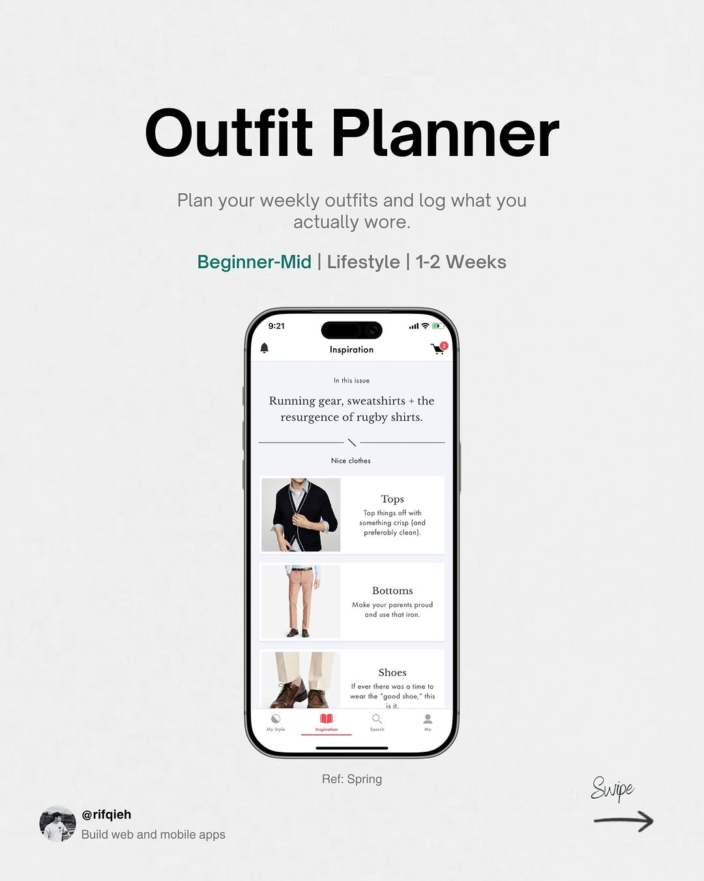
app / DYuD-i5E3Pz / slide 03
Plan your weekly outfits and log what you
actually
Beginner-Mid Lifestyle 1-2 Weeks
aa)
Running
rugby
Spring Qu
@rifqieh =

Slide 4
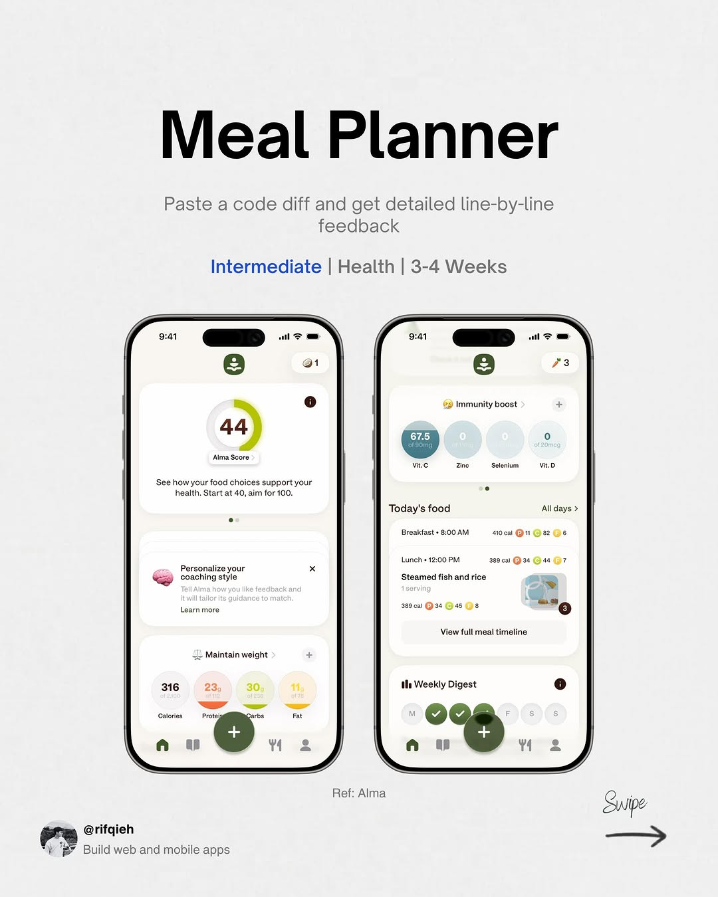
app / DYuD-i5E3Pz / slide 04
Paste code diff and get detailed line-by-line
feedback
Intermediate Health 3-4 Weeks
support
coaching

Slide 5
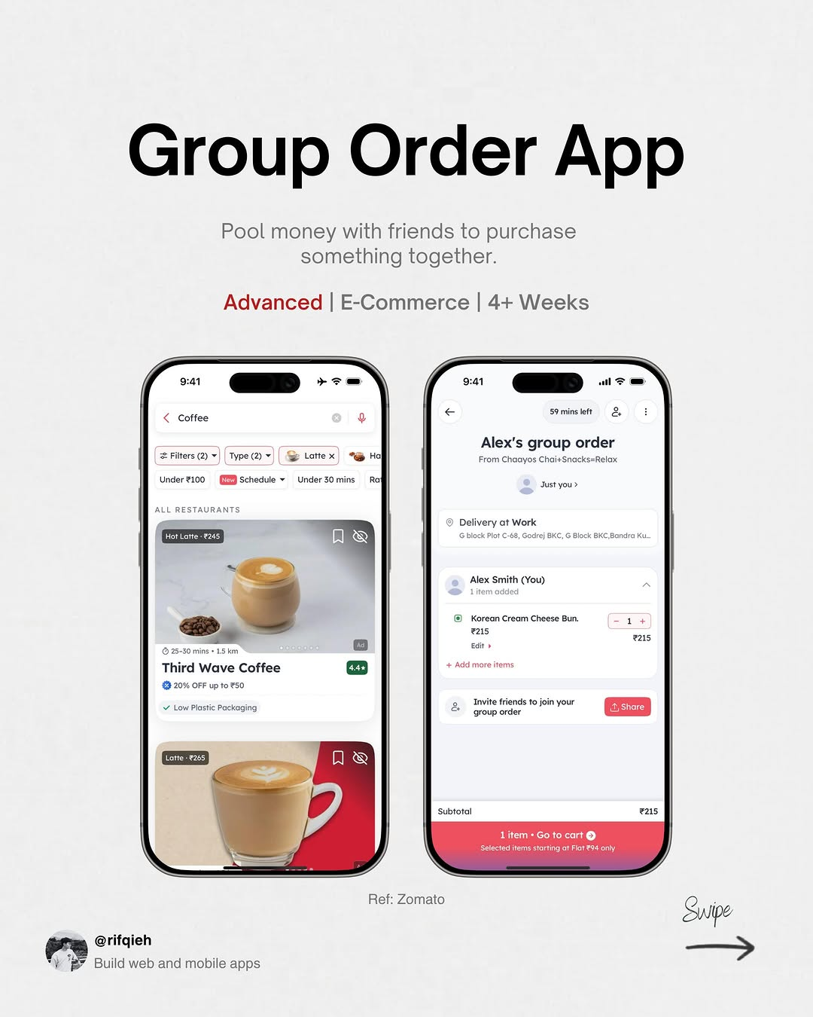
app / DYuD-i5E3Pz / slide 05
Pool money with friends to purchase
something together.
Advanced E-Commerce 4+ Weeks
agp
(2) ~|
HB
at
Korean reamCheese Bun.
~~
Supe
a] @rifqieh =

Slide 6
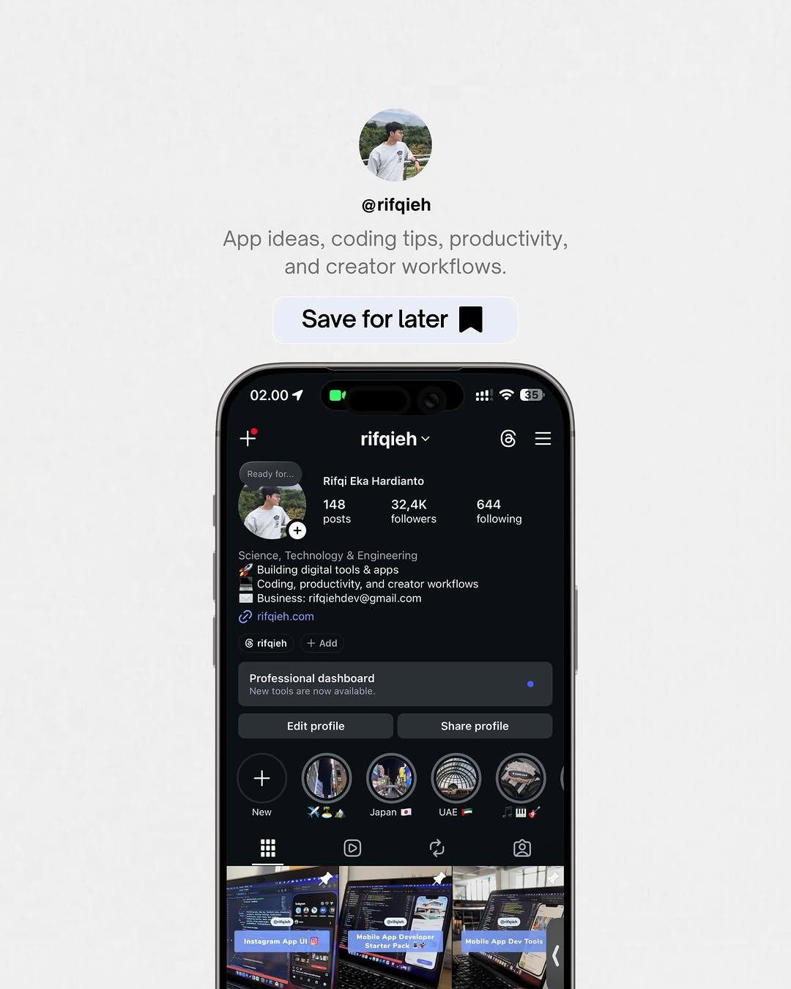
app / DYuD-i5E3Pz / slide 06
App ideas, coding tips, productivity,
and creator workflows.
Save for later Jj
+ rifqieh
Bo
posts
32,4K
HH ©
2,

Slide 7
app / DYuD-i5E3Pz
Source URL
https://www.instagram.com/p/DYuD-i5E3Pz/
Caption
App ideas to build next 🚀 Free tools: http://rifqieh.com http://github.com/rifqieh
Componentization note
Images are separate page objects. OCR-detected text has been covered and recreated as editable text boxes.

