Slide 1
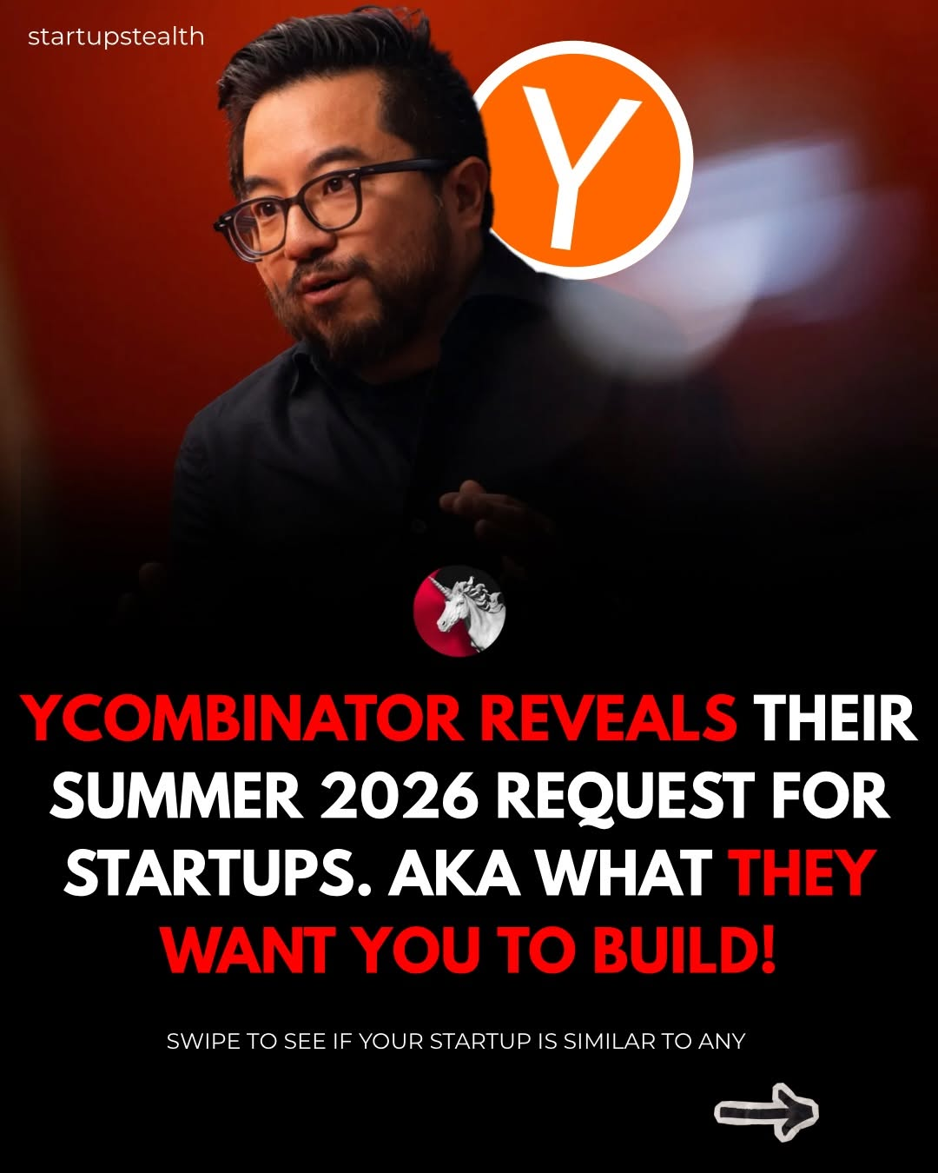
tech-news / DYKyzOMCGal / slide 01
THEIR
SUMMER 2026 REQUEST FOR
STARTUPS. AKA WHAT
=>

Slide 2
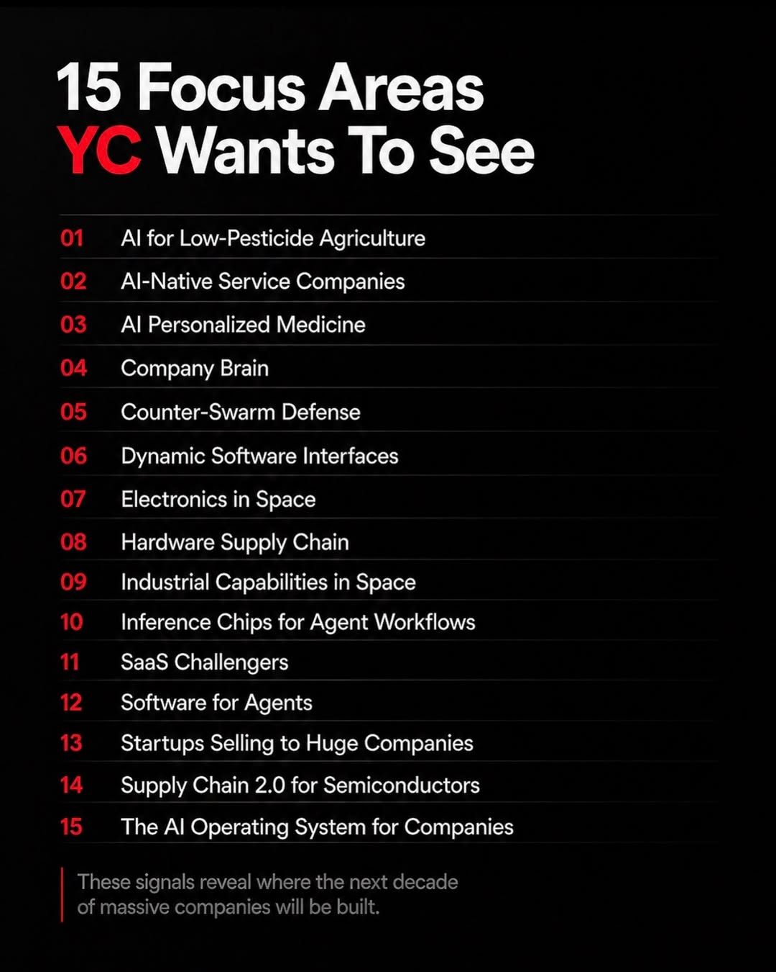
tech-news / DYKyzOMCGal / slide 02
15 Focus Areas
YC Wants To See
01 Al for Low-Pesticide Agriculture
Al-Native Service Companies
Al Personalized Medicine
04 Company Brain
Counter-Swarm Defense
06 Dynamic Software Interfaces
07 Electronics in Space
08 Hardware Supply Chain
09 Capabilities in Space
10 Inference Chips for Agent Workflows
11 SaaS Challengers
12 Software for Agents
18 Startups Selling to Huge Companies
Supply Chain 2.0 for Semiconductors
15 The Al Operating System for Companies
These signals reveal where the next decade
of massive companies will be built.

Slide 3
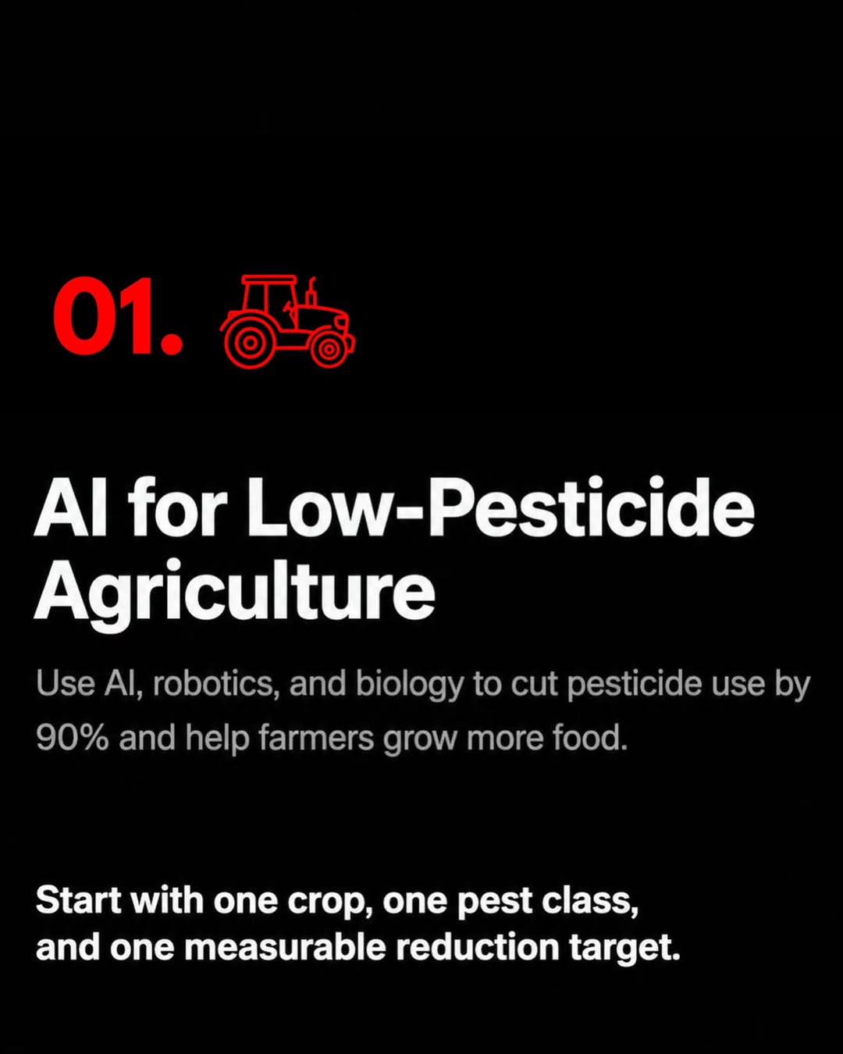
tech-news / DYKyzOMCGal / slide 03
01.
e e
Al for Low-Pesticide
Agriculture
Use Al, robotics, and biology to cut pesticide use by
90% and help farmers grow more food.
Start with one crop, one pest class,
and one measurable reduction target.

Slide 4
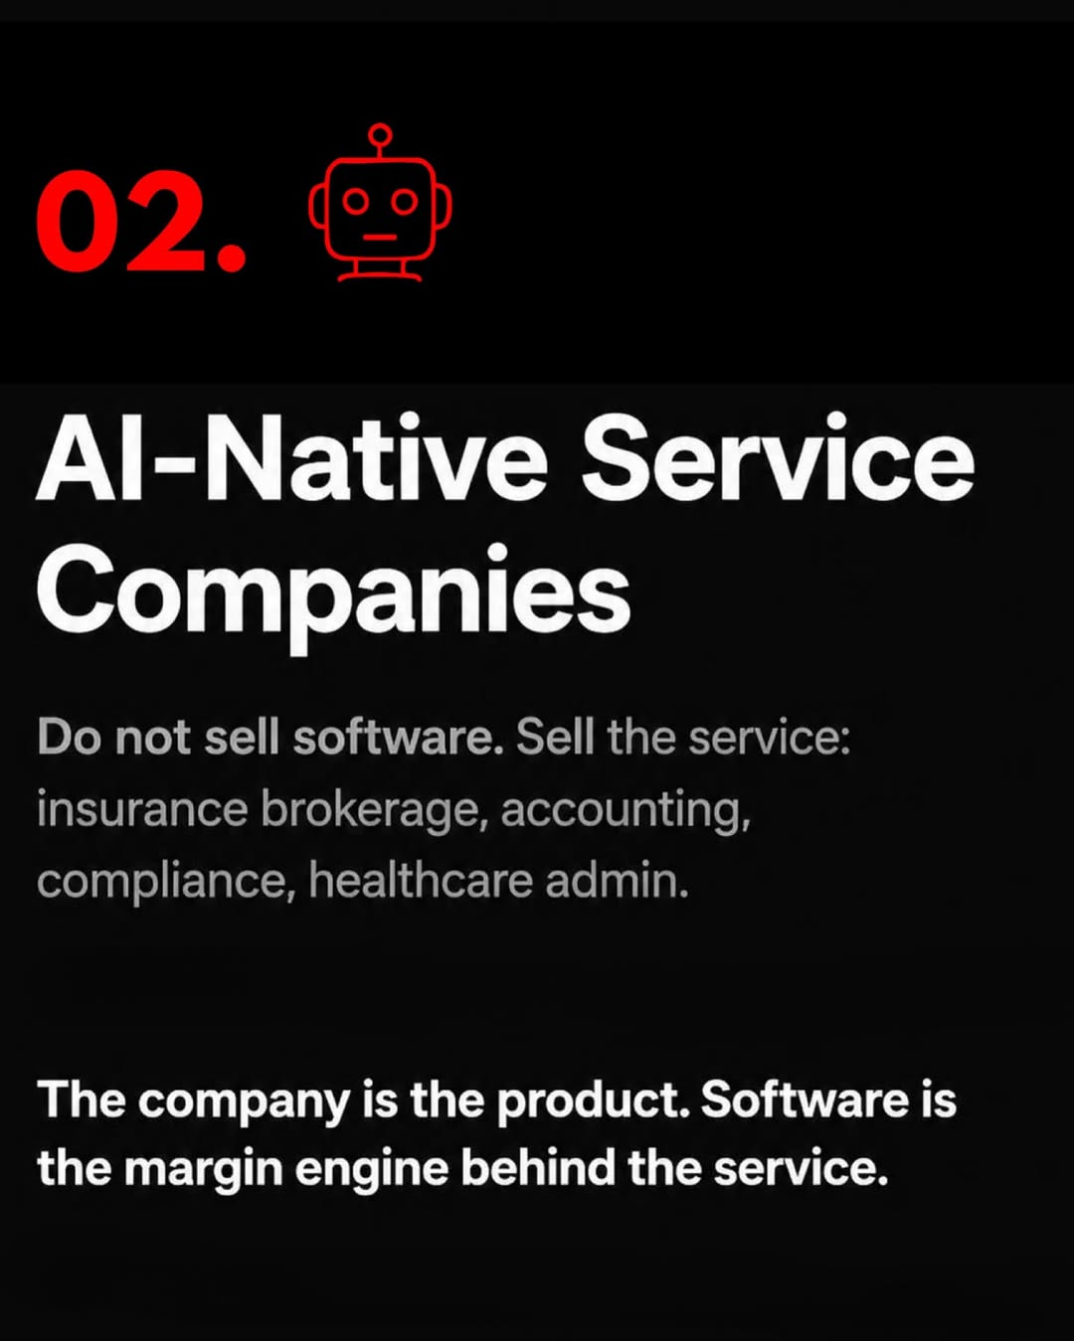
tech-news / DYKyzOMCGal / slide 04
02
e e
Al-Native Service
Companies
Do not sell software. Sell the service:
insurance brokerage, accounting,
compliance, healthcare admin.
The company is the product. Software is
the margin engine behind the service.

Slide 5
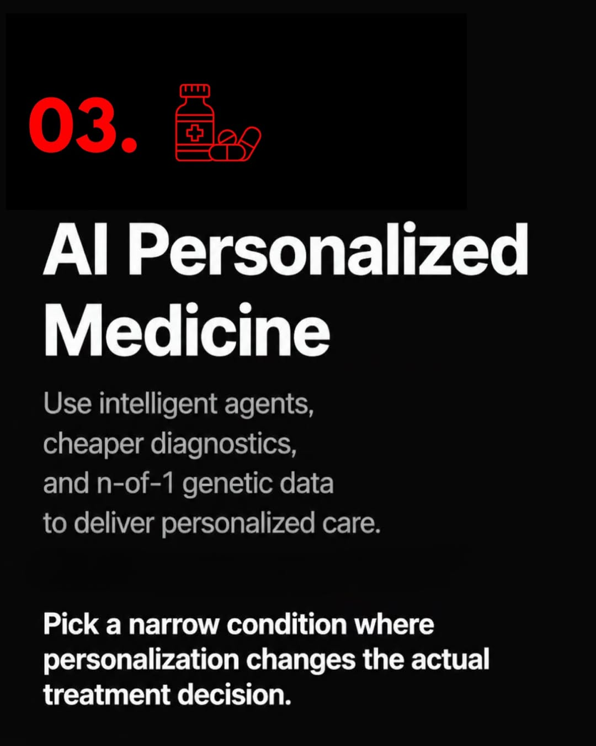
tech-news / DYKyzOMCGal / slide 05
03 e
Al Personalized
Medicine
Use intelligent agents,
cheaper diagnostics,
and n-of-1 genetic data
to deliver personalized care.
Pick a narrow condition where
personalization changes the actual
treatment decision.

Slide 6
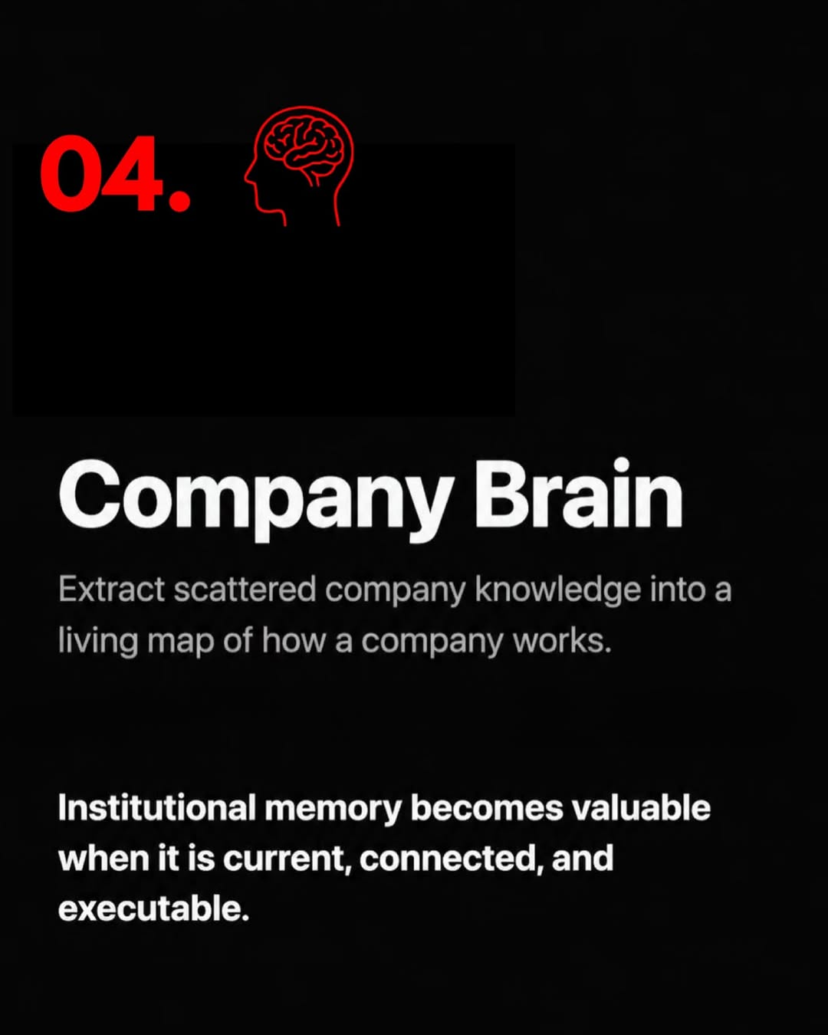
tech-news / DYKyzOMCGal / slide 06
04.
Company Brain
Extract scattered company knowledge into a
living map of how a company works.
Institutional memory becomes valuable
when it is current, connected, and
executable.

Slide 7
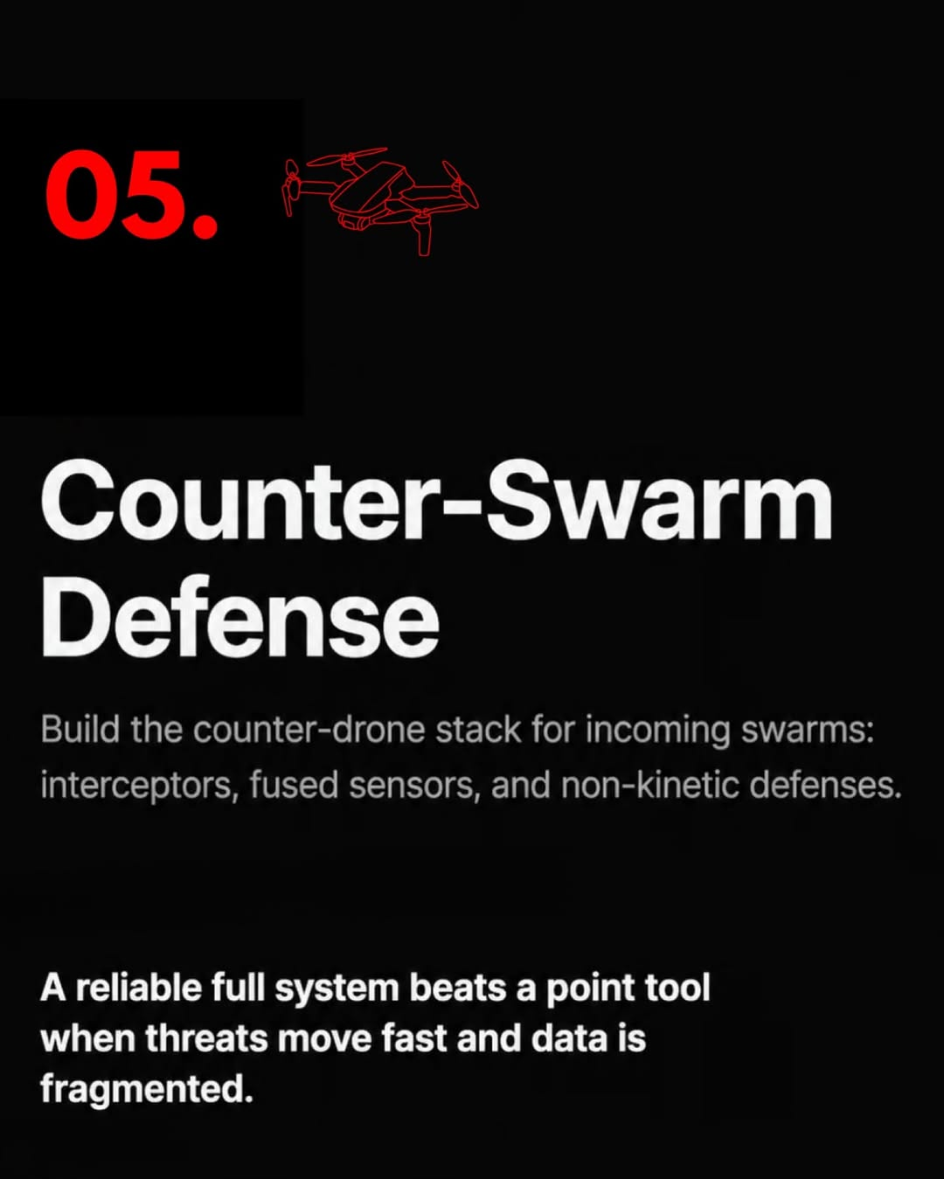
tech-news / DYKyzOMCGal / slide 07
05
Counter-Swarm
Build the counter-drone stack for incoming swarms:
interceptors, fused sensors, and non-kinetic defenses.
A reliable full system beats a point tool
when threats move fast and data is
fragmented.

Slide 8
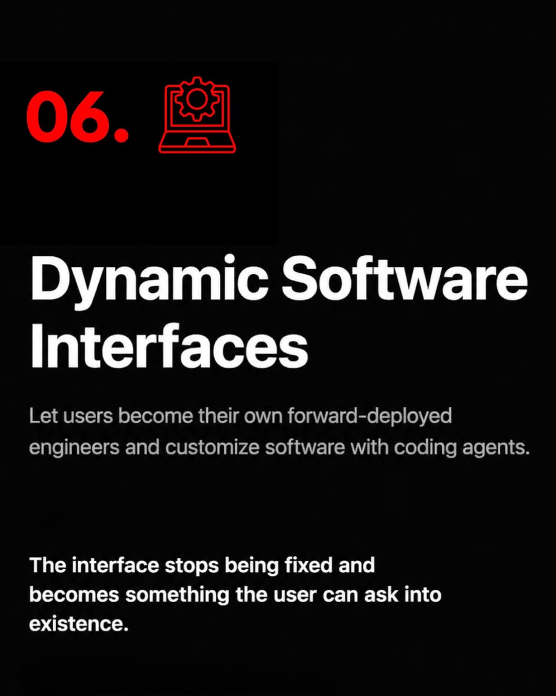
tech-news / DYKyzOMCGal / slide 08
06.
Dynamic Software
Interfaces
Let users become their own forward-deployed
engineers and customize software with coding agents.
The interface stops being fixed and
becomes something the user can ask into
existence.

Slide 9

tech-news / DYKyzOMCGal / slide 09
07. 28
Electronics
in Space
Build inference chips optimized
for mass, thermal constraints,
and radiation.
Performance per watt and
survivability matter more than
benchmark theater.

Slide 10
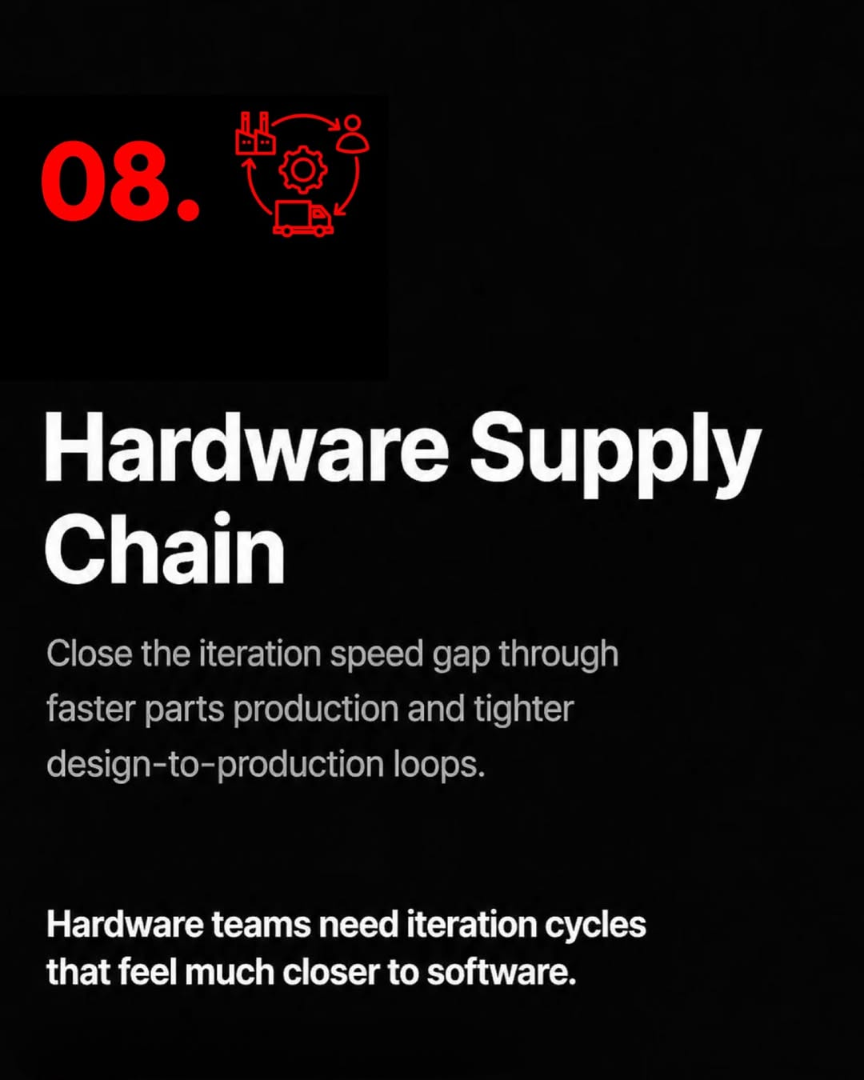
tech-news / DYKyzOMCGal / slide 10
08. \&
Hardware Supply
Chain
Close the iteration speed gap through
faster parts production and tighter
design-to-production loops.
Hardware teams need iteration cycles
that feel much closer to software.

Slide 11

tech-news / DYKyzOMCGal / slide 11
e @
Industrial Capabilities
in Space
Extract raw materials through electrolysis
and 3D print complex structures from
molten regolith on the moon.
The first proof is one useful material
process that works repeatably under
lunar constraints.

Slide 12
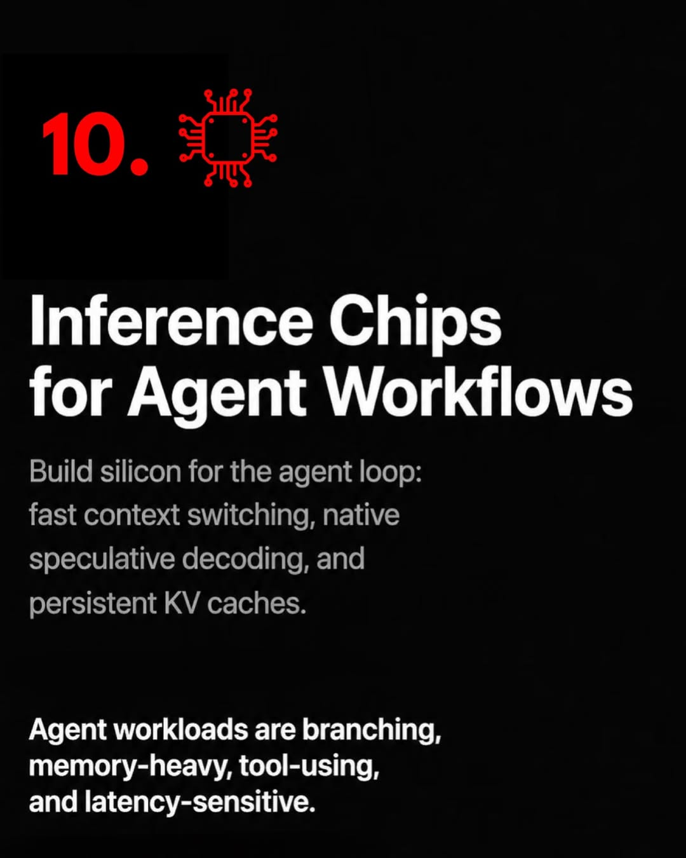
tech-news / DYKyzOMCGal / slide 12
10.
Inference Chips
for Agent Workflows
Build silicon for the agent loop:
fast context switching, native
speculative decoding, and
persistent KV caches.
Agent workloads are branching,
memory-heavy, tool-using,
and latency-sensitive.

Slide 13
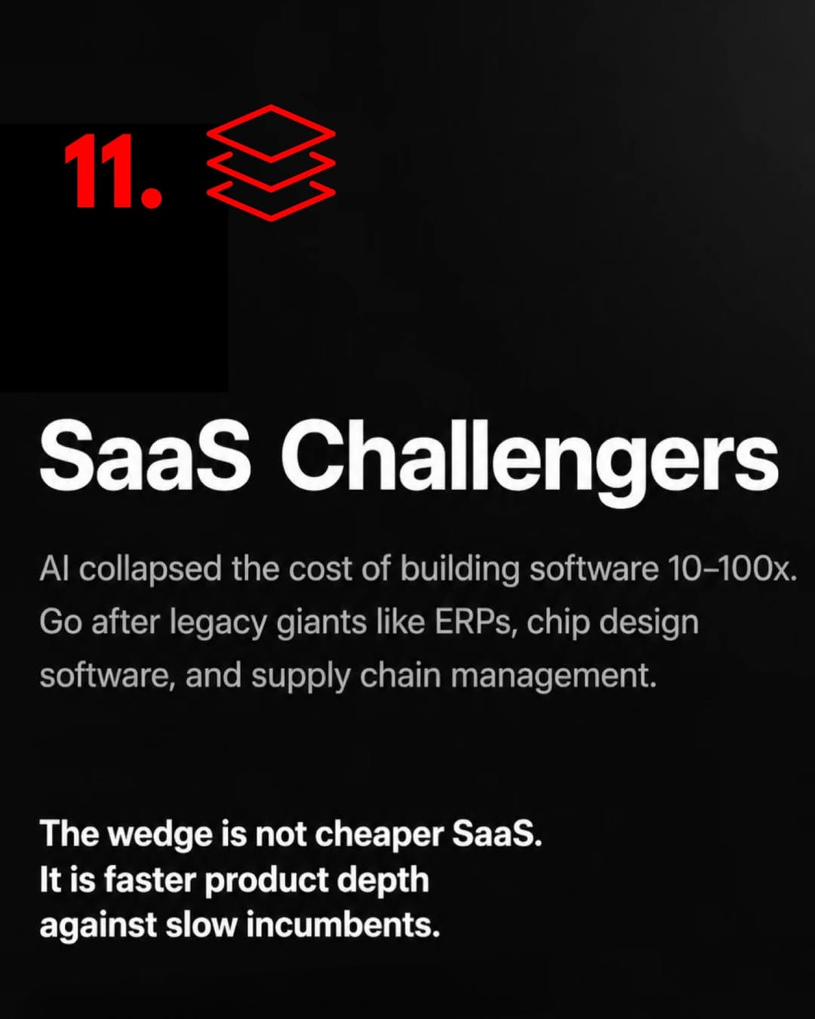
tech-news / DYKyzOMCGal / slide 13
1. =
Al collapsed the cost of building software 10-100x.
Go after legacy giants like ERPs, chip design
software, and supply chain management.
The wedge is not cheaper SaaS.
It is faster product depth
against slow incumbents.

Slide 14
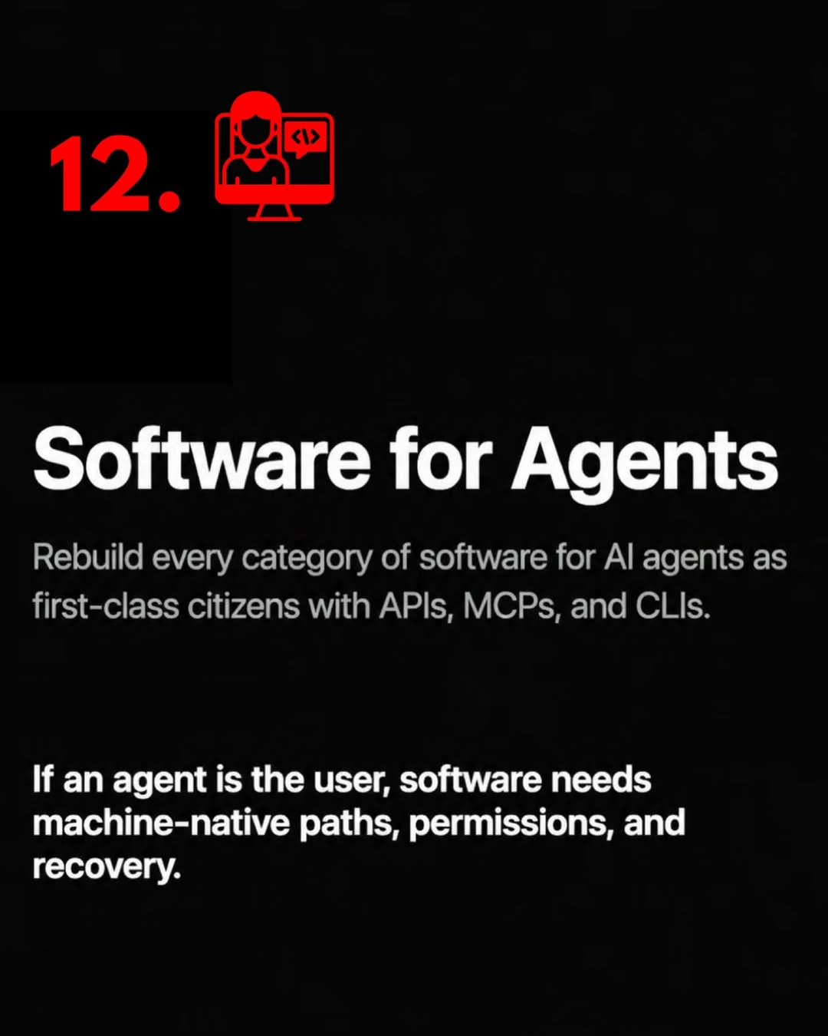
tech-news / DYKyzOMCGal / slide 14
12
bad
Rebuild every category of software for Al agents as
first-class citizens with APIs, MCPs, and CLIs.
If an agent is the user, software needs
machine-native paths, permissions, and
recovery.

Slide 15
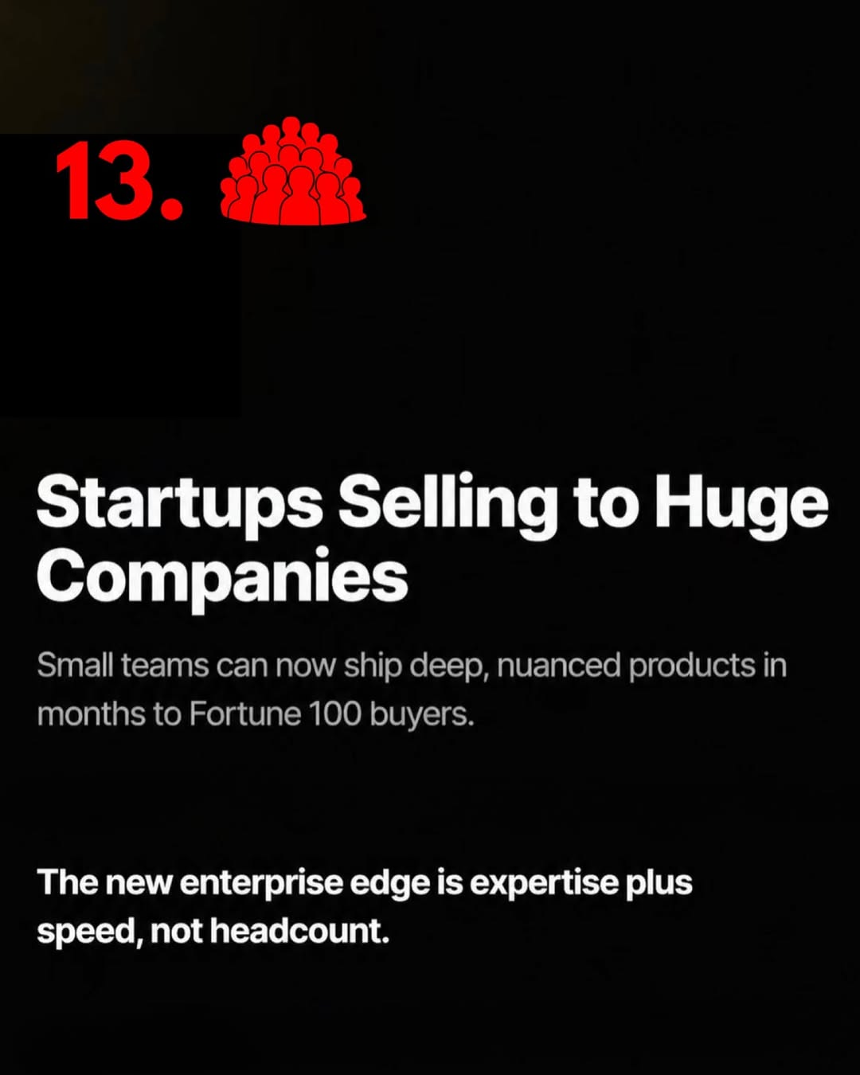
tech-news / DYKyzOMCGal / slide 15
13.
Startups Selling to Huge
Companies
Small teams can now ship deep, nuanced products in
months to Fortune 100 buyers.
The new enterprise edge is expertise plus
speed, not headcount.

Slide 16
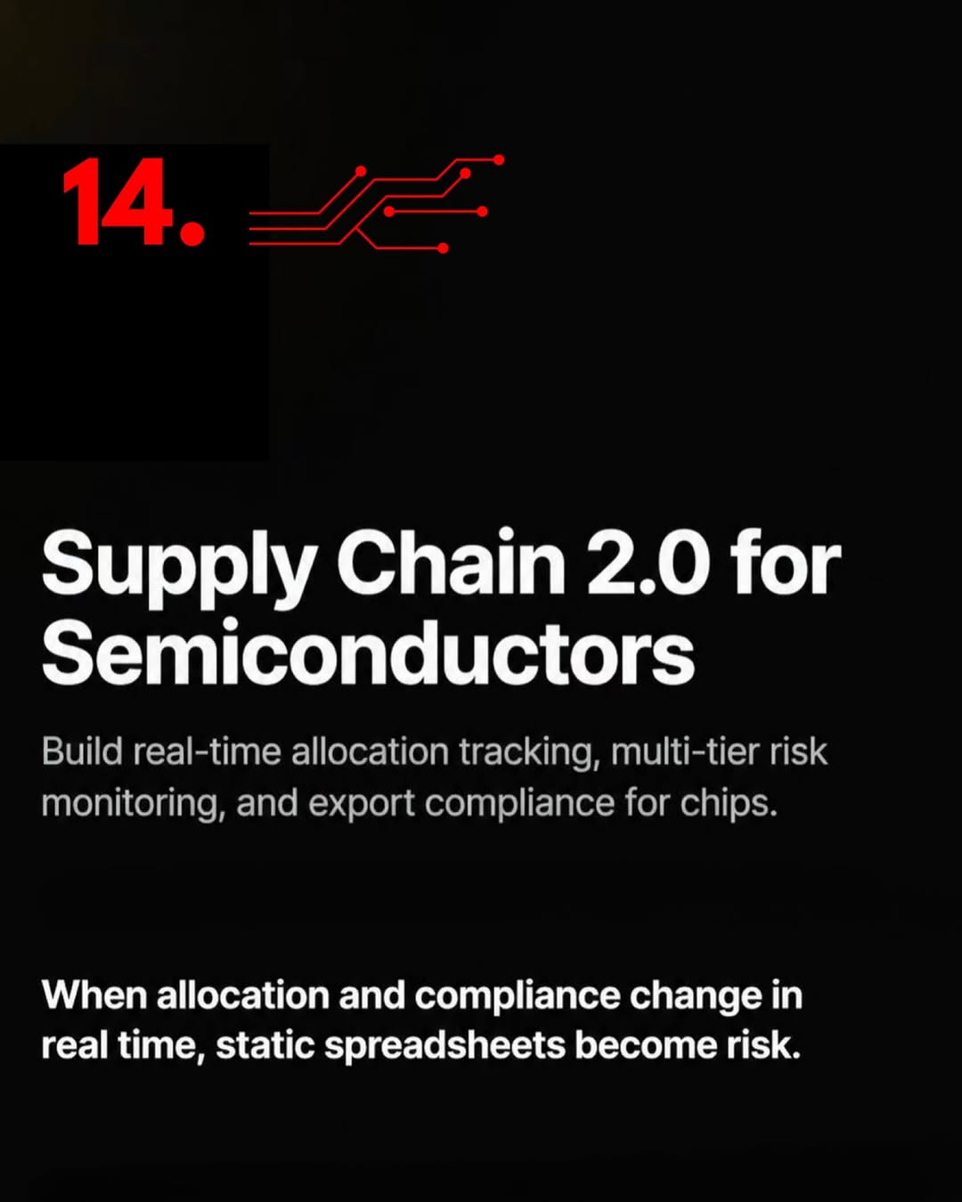
tech-news / DYKyzOMCGal / slide 16
14.
a)
Supply Chain 2.0 for
Semiconductors
Build real-time allocation tracking, multi-tier risk
monitoring, and export compliance for chips.
When allocation and compliance change in
real time, static spreadsheets become risk.

Slide 17
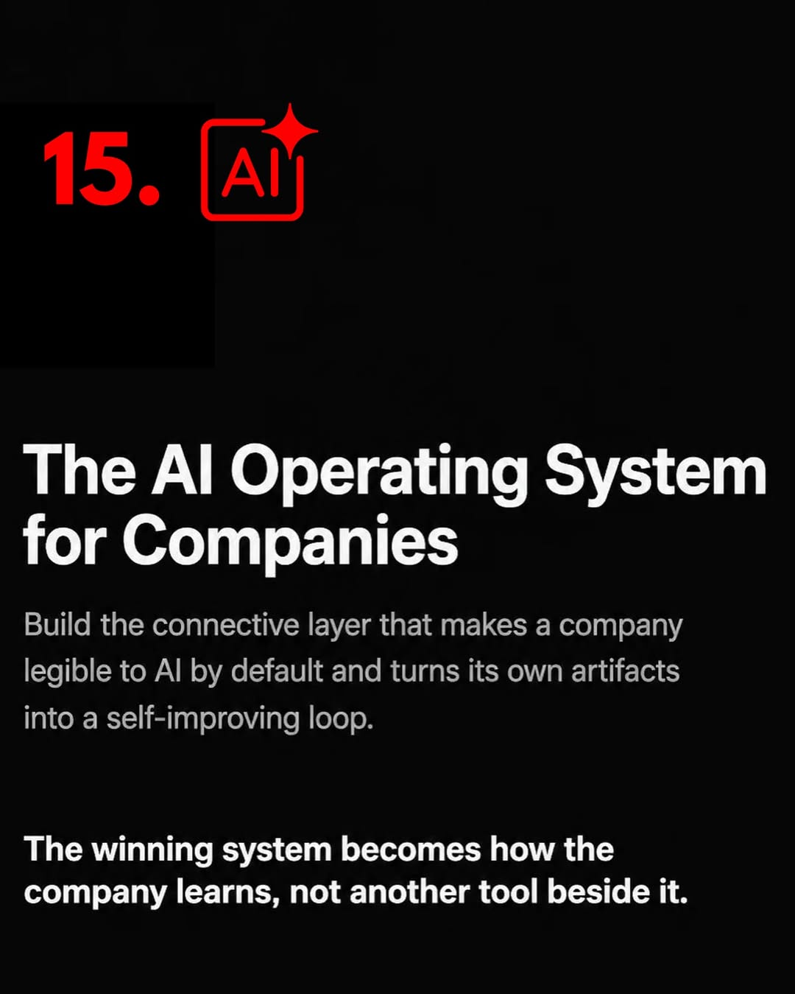
tech-news / DYKyzOMCGal / slide 17
15.
The Al Operating System
for Companies
Build the connective layer that makes a company
legible to Al by default and turns its own artifacts
into a self-improving loop.
The winning system becomes how the
company learns, not another tool beside it.

Slide 18

tech-news / DYKyzOMCGal / slide 18
YOUR FAVOURITE FOUNDER'S
FAVOURITE NEWSLETTER.

Slide 19
tech-news / DYKyzOMCGal
Source URL
https://www.instagram.com/p/DYKyzOMCGal/
Caption
Y Combinator’s Summer 2026 startup request list is one of the most important documents founders, investors, and operators should study right now. It offers a rare glimpse into where one of the world’s most influential accelerators believes the next wave of AI and frontier technology companies will emerge. What makes this valuable is the signal quality. YC reviews thousands of companies before markets fully recognize major shifts, meaning their requests often foreshadow where capital, talent, and innovation are accelerating. For ambitious builders, this is more than content. It is strategic intelligence that can shape timing, positioning, product direction, and long term conviction. Join over 10,000 founders with our newsletter available for free now, to stay ahead of the market. #startup #startups #ycombinator #ycombinatorstartup #startuprequest
Componentization note
Images are separate page objects. OCR-detected text has been covered and recreated as editable text boxes.

