Slide 1
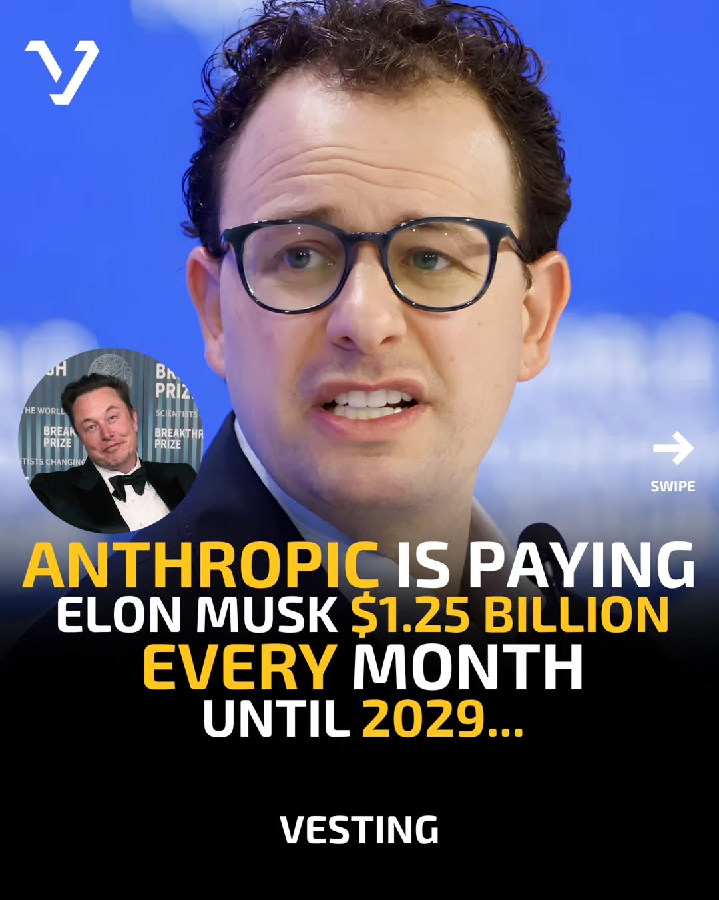
tech-news / DYlD0fiCBJp / slide 01
ot
ELON MUSK S1.25 BILLION
EVERY MONTH
UNTIL 2029...
VESTING

Slide 2
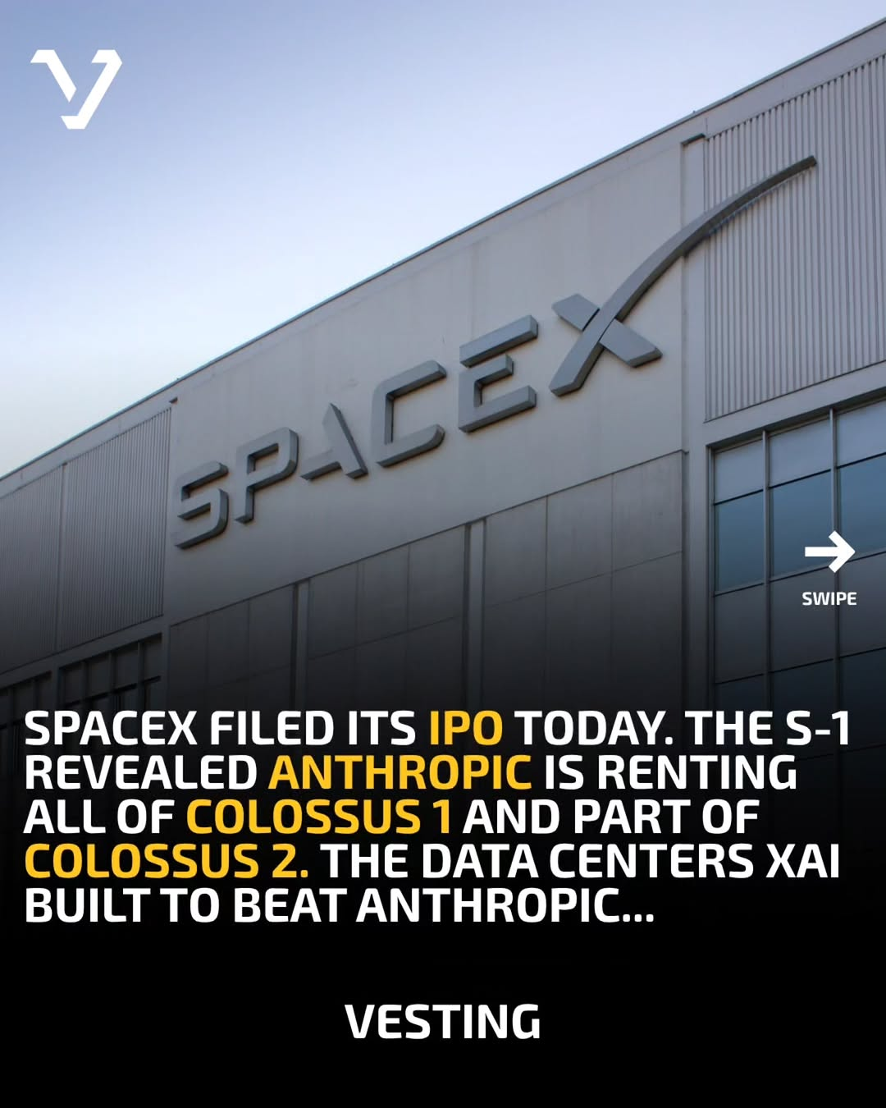
tech-news / DYlD0fiCBJp / slide 02
SPACEX FILED ITS IPO TODAY. THE S-1
REVEALED ANTHROPIC IS RENTING
ALL OF COLOSSUS 1 AND PART OF
COLOSSUS 2. THE DATA CENTERS XAI
BUILT TO BEAT ANTHROPIC...
VESTING

Slide 3
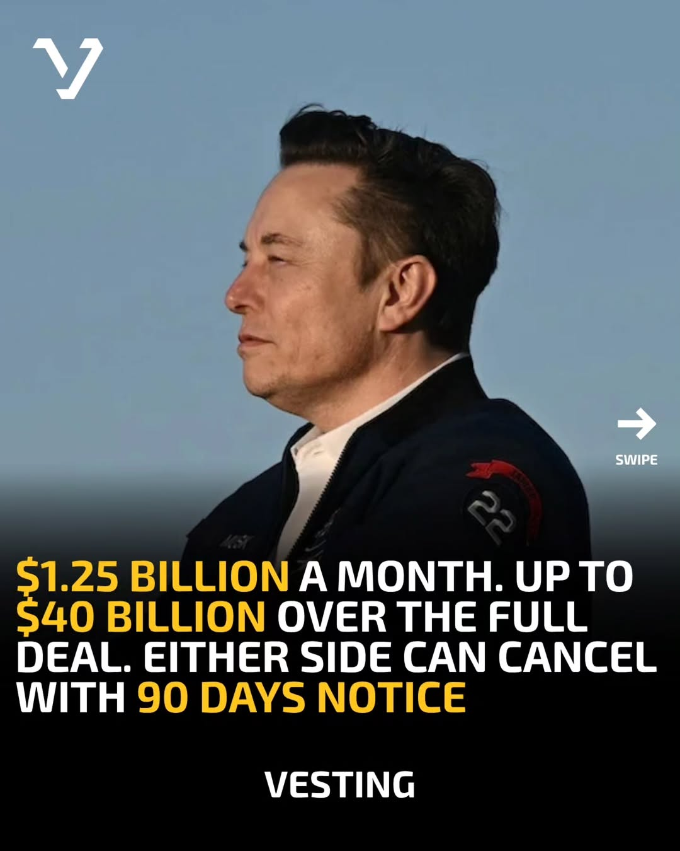
tech-news / DYlD0fiCBJp / slide 03
2 4
BILLION A MONTH. UP TO
40 BILLION OVER THE FULL
DEAL. EITHER SIDE CAN CANCEL
WITH 90 DAYS NOTICE
VESTING

Slide 4

tech-news / DYlD0fiCBJp / slide 04
VESTING NEWSLETTER
VESTING

Slide 5
tech-news / DYlD0fiCBJp
Source URL
https://www.instagram.com/p/DYlD0fiCBJp/
Caption
Anthropic is paying Elon Musk $1.25 billion every month until 2029! SpaceX filed its IPO paperwork today. Buried in the S-1 was the actual price tag of the Anthropic compute deal both sides announced earlier this month. Anthropic is renting all of SpaceX's Colossus 1 data center plus expanding into Colossus 2, the same facilities xAI built to compete in the AI race. The full numbers: $1.25 billion per month through May 2029. May and June 2026 are at a discounted rate during ramp-up. If the deal runs the full term, SpaceX could collect over $40 billion from Anthropic alone. Either side can cancel with 90 days notice. Anthropic also expressed interest in helping SpaceX build orbital data centers, potentially using up to one million satellites for AI compute in space. Elon Musk has spent the past year calling Anthropic "evil" and "hostile to Western civilization." Now they're his single largest customer. Subscribe to the Vesting daily for more stories like this: vesting.beehiiv.com/subscribe #ai #anthropic #spacex
Componentization note
Images are separate page objects. OCR-detected text has been covered and recreated as editable text boxes.

