Slide 1

tech-news / DYwzdqSEm4R / slide 01
Your Startup Idea is
Worthless...Until you
validate it.
Learn the validation process
oo >)

Slide 2
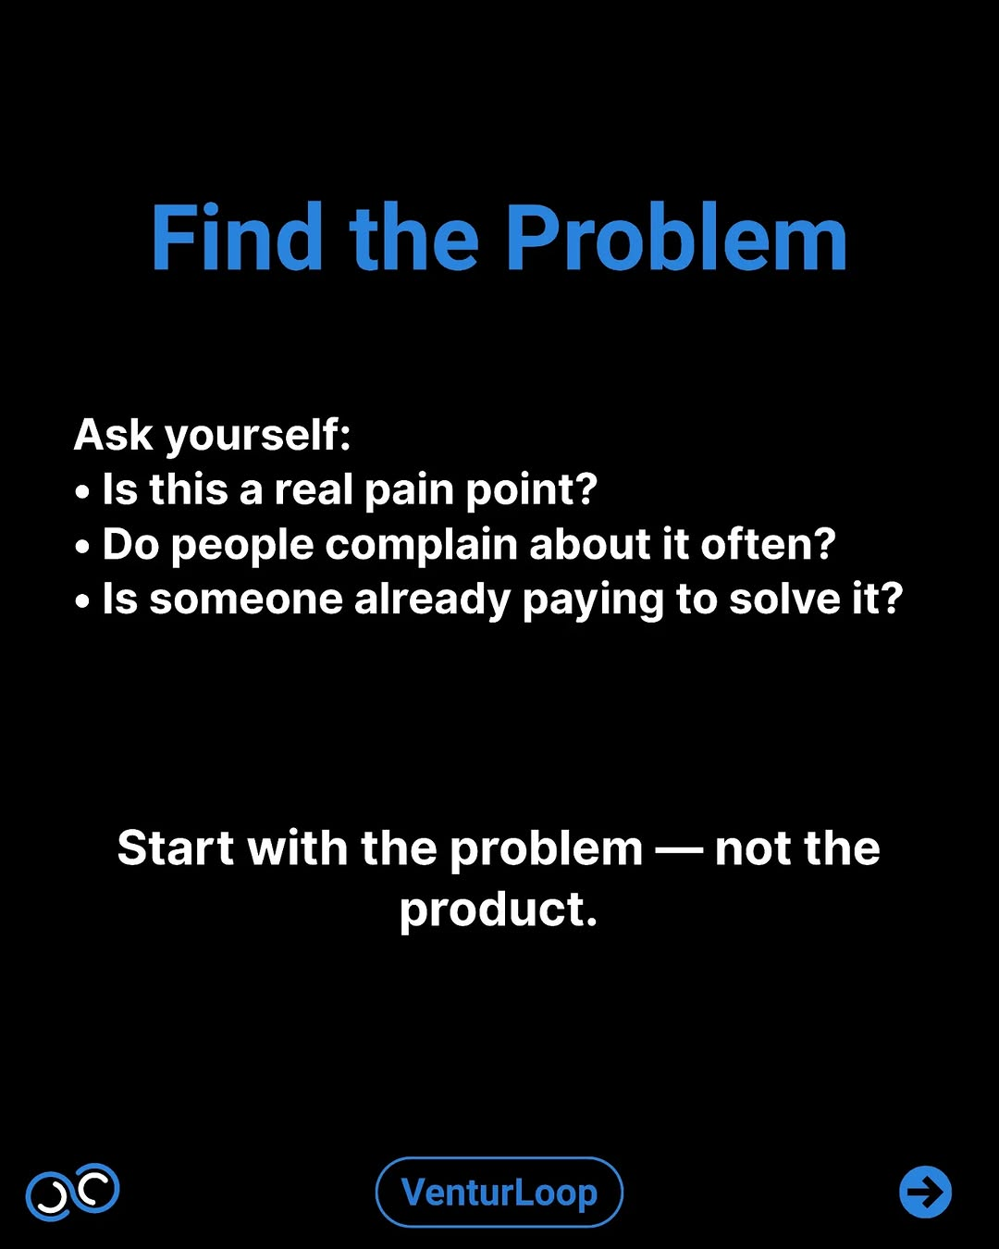
tech-news / DYwzdqSEm4R / slide 02
Find the Problem
Ask yourself:
Is this a real pain point?
Do people complain about it often?
Is someone already paying to solve it?
Start with the problem not the
product.
90 ©

Slide 3
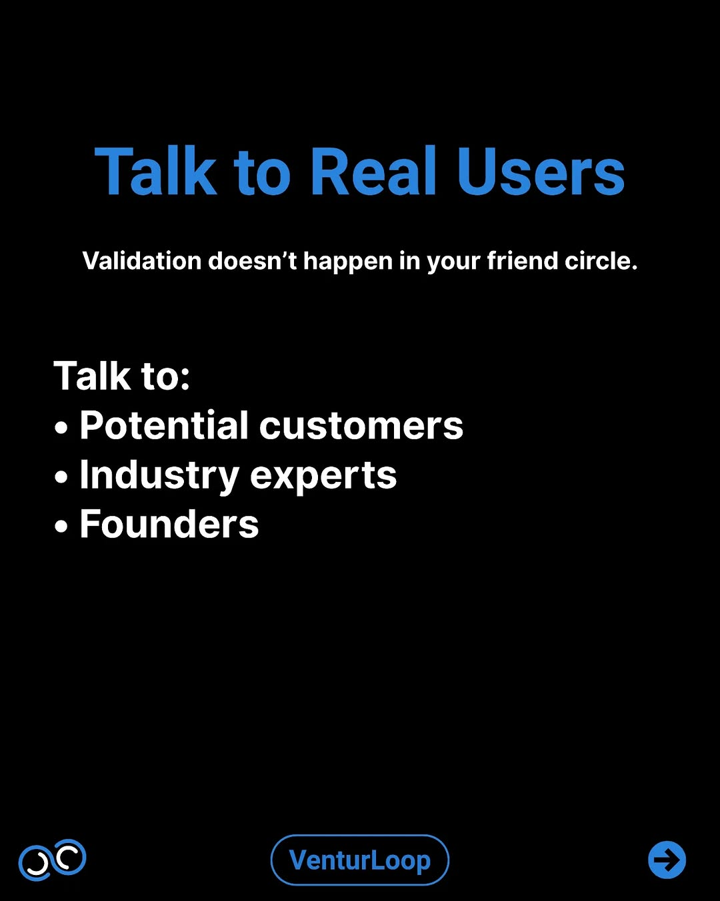
tech-news / DYwzdqSEm4R / slide 03
Talk to Real Users
Validation doesn’t happen in your friend circle.
Talk to:
Potential customers
e Industry experts
e Founders
90

Slide 4
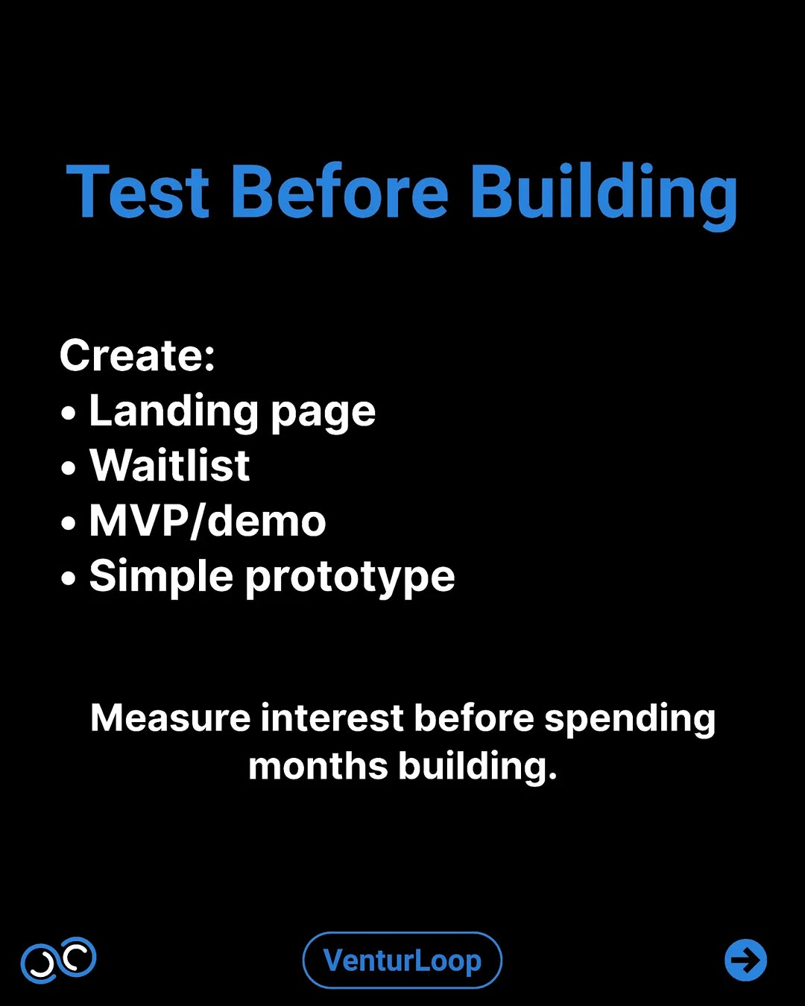
tech-news / DYwzdqSEm4R / slide 04
Test Before Building
Create:
e Landing page
e Waitlist
e MVP/demo
¢ Simple prototype
Measure interest before spending
months building.
90 ©

Slide 5
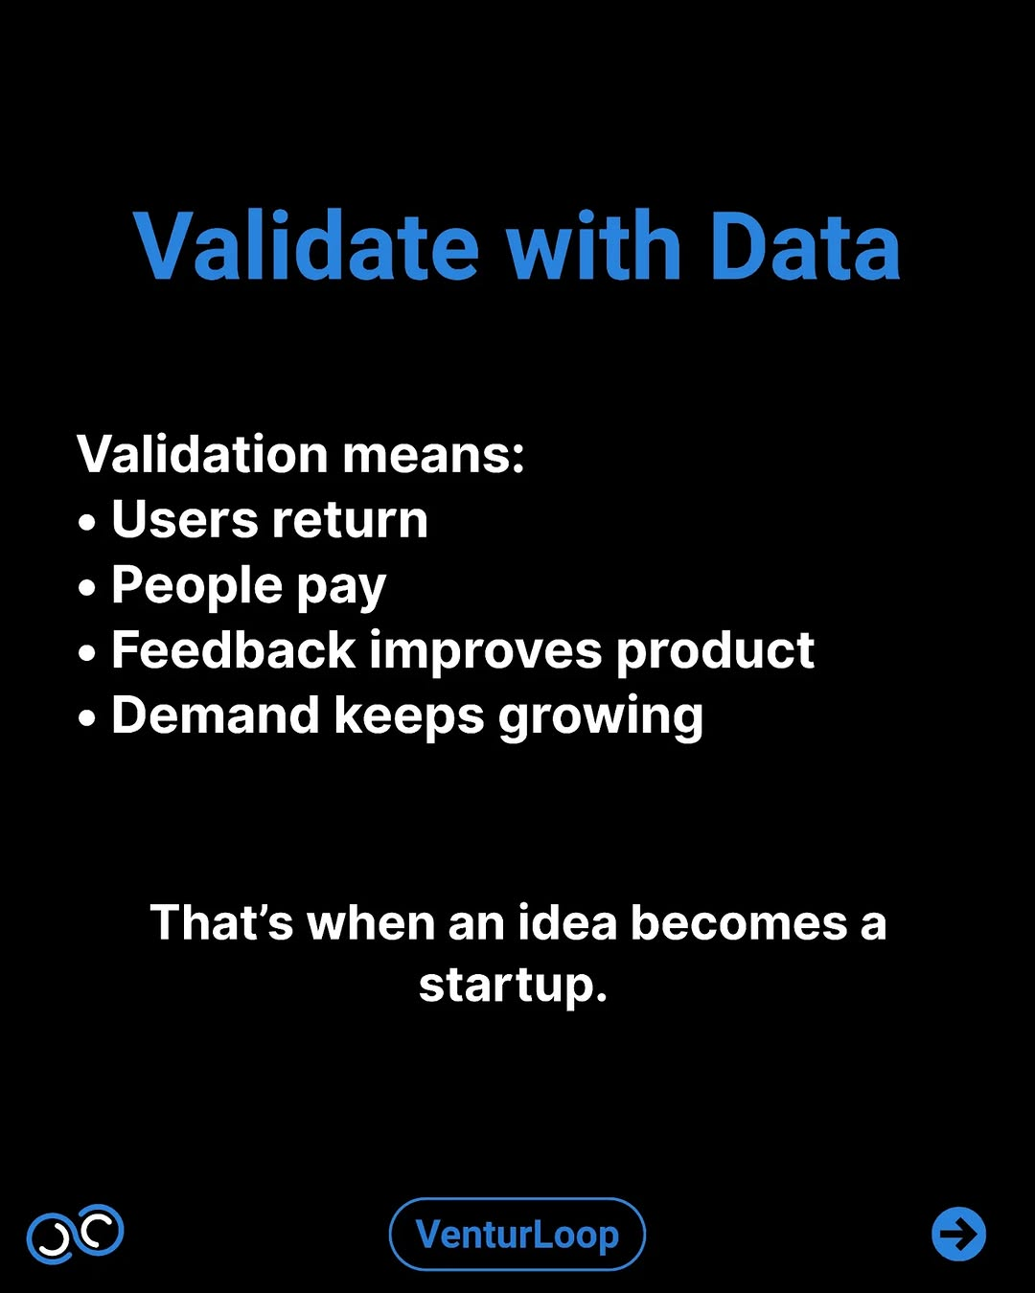
tech-news / DYwzdqSEm4R / slide 05
Validate with Data
Validation means:
e Users return
e People pay
e Feedback improves product
e Demand keeps growing
That’s when an idea becomes a
startup.
go

Slide 6
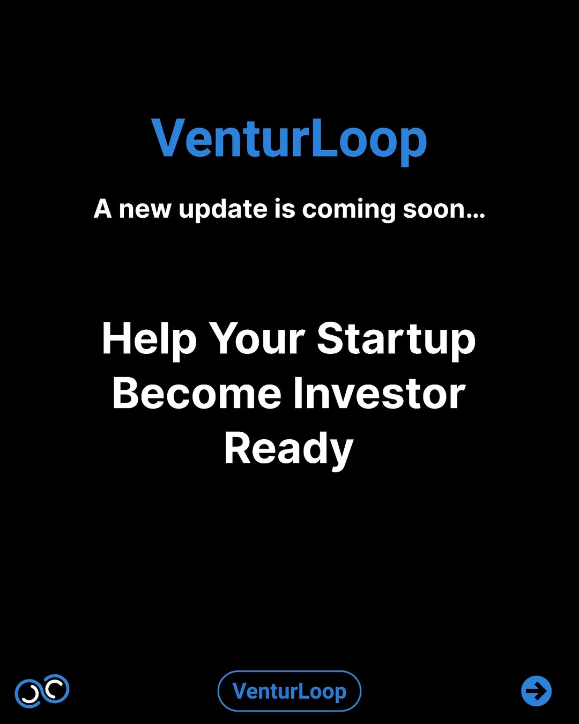
tech-news / DYwzdqSEm4R / slide 06
VenturLoop
A new update is coming soon...
Help Your Startup
Become Investor
Ready

Slide 7
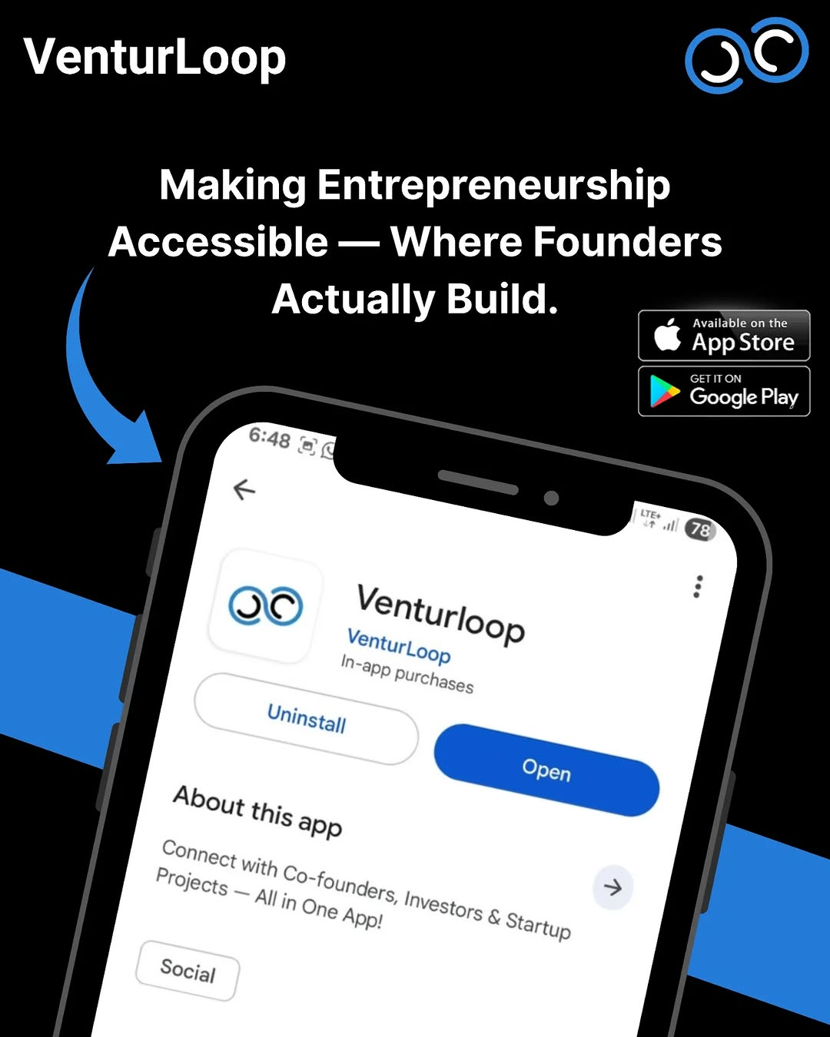
tech-news / DYwzdqSEm4R / slide 07
VenturLoop IE
Making Entrepreneurship
Accessible Where Founders
Actually Build. on the
6:48
<€
GO Venty
Venturto loop4 1 1 1 9 0 445 846 159 51 -1 5 1 1 1 9 1 445 852 15 17 96.849251 In5 1 1 1 9 2 468 856 40 30 86.083649 ‘app5 1 1 1 9 3 514 846 90 51 3.369064 ines4 1 1 1 10 0 349 913 342 127 -1 5 1 1 1 10 1 349 913 101 47 64.258873 Yninstay5 1 1 1 10 2 569 926 122 114 58.443253 iE4 1 1 1 11 0 213 1094 126 28 -1 5 1 1 1 11 1 213 1094 67 28 91.880074 Conne5 1 1 1 11 2 337 1118 2 2 0.000000 ;4 1 1 1 12 0 204 1111 258 52 -1 5 1 1 1 12 1 204 1125 42 34 90.893463 Pro,5 1 1 1 12 2 246 1111 61 50 18.608303 oe5 1 1 1 12 3 316 1120 44 21 0.000000 a5 1 1 1 12 4 370 1127 92 36 58.621513 Co-foun,4 1 1 1 13 0 240 1143 569 67 -1 5 1 1 1 13 1 240 1143 55 22 13.642664 WScts5 1 1 1 13 2 307 1161 9 2 44.071236 ~5 1 1 1 13 3 332 1158 28 20 19.463806 ay5 1 1 1 13 4 394 1171 45 25 96.723152 One5 1 1 1 13 5 446 1148 70 62 47.911400 ‘on5 1 1 1 13 6 527 1161 100 37 88.682831 Investors5 1 1 1 13 7 636 1184 45 26 4.998989 -5 1 1 1 13 8 787 1144 22 22 96.523781 >4 1 1 1 14 0 492 1199 250 27 -1 5 1 1 1 14 1 492 1206 2 2 55.462681 !5 1 1 1 14 2 682 1199 60 27 0.000000 4rtup4 1 1 1 15 0 210 1249 70 31 -1 5 1 1 1 15 1 210 1249 70 31 20.269379 Socia/

Slide 8
tech-news / DYwzdqSEm4R
Source URL
https://www.instagram.com/p/DYwzdqSEm4R/
Caption
New update coming soon on VenturLoop. We’re building something to help founders turn their ideas into investor-ready startups. From startup clarity and mentorship to better guidance and real founder connections — this update is focused on helping you build smarter from day one. No complicated jargon. Just practical help for people who actually want to build. VenturLoop — Making entrepreneurship accessible. Platform -@we.venturloop
Componentization note
Images are separate page objects. OCR-detected text has been covered and recreated as editable text boxes.

