Slide 1

ai-tips / DVXvbomk3OU / slide 01

Slide 2
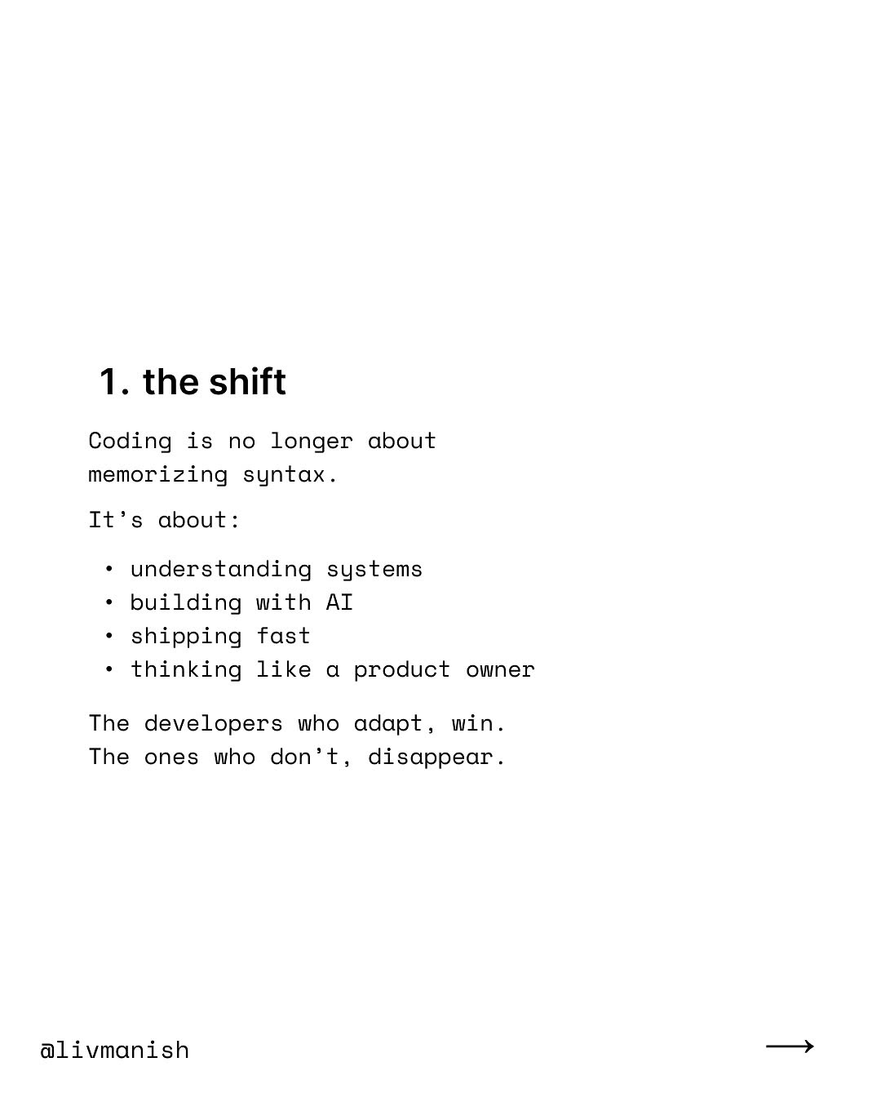
ai-tips / DVXvbomk3OU / slide 02

Slide 3
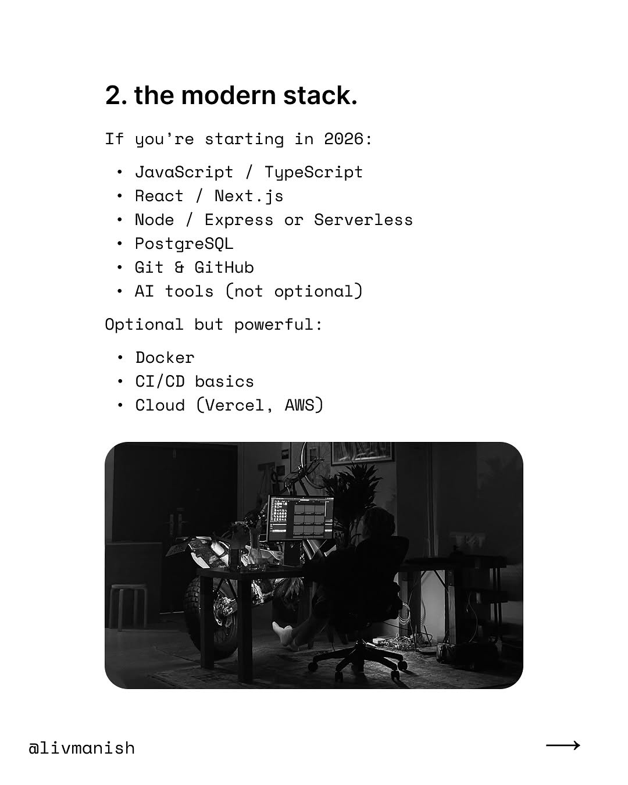
ai-tips / DVXvbomk3OU / slide 03

Slide 4
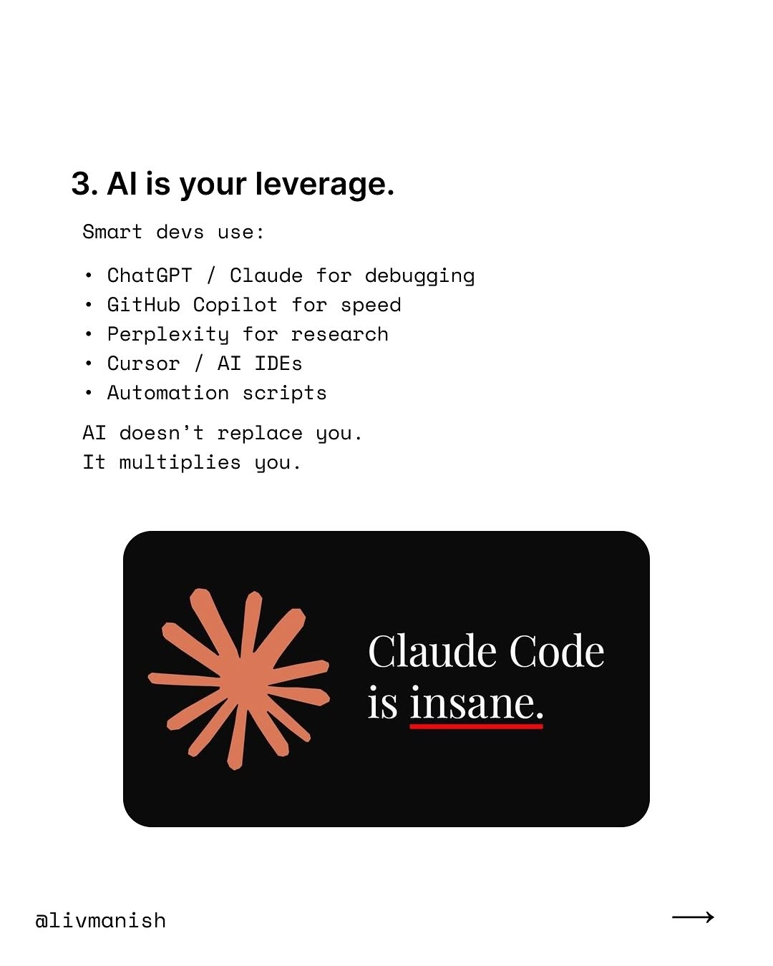
ai-tips / DVXvbomk3OU / slide 04

Slide 5
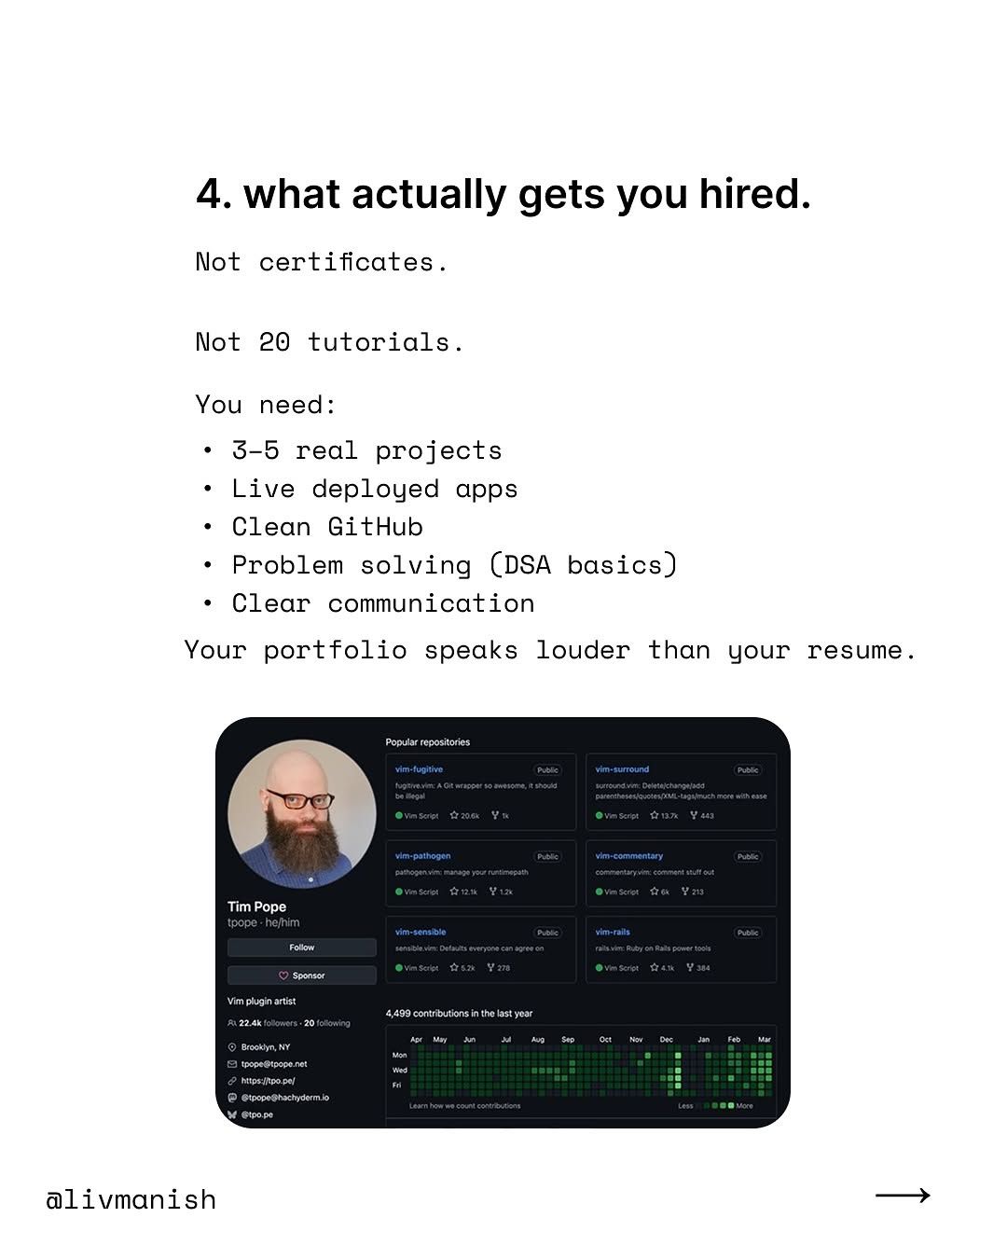
ai-tips / DVXvbomk3OU / slide 05

Slide 6
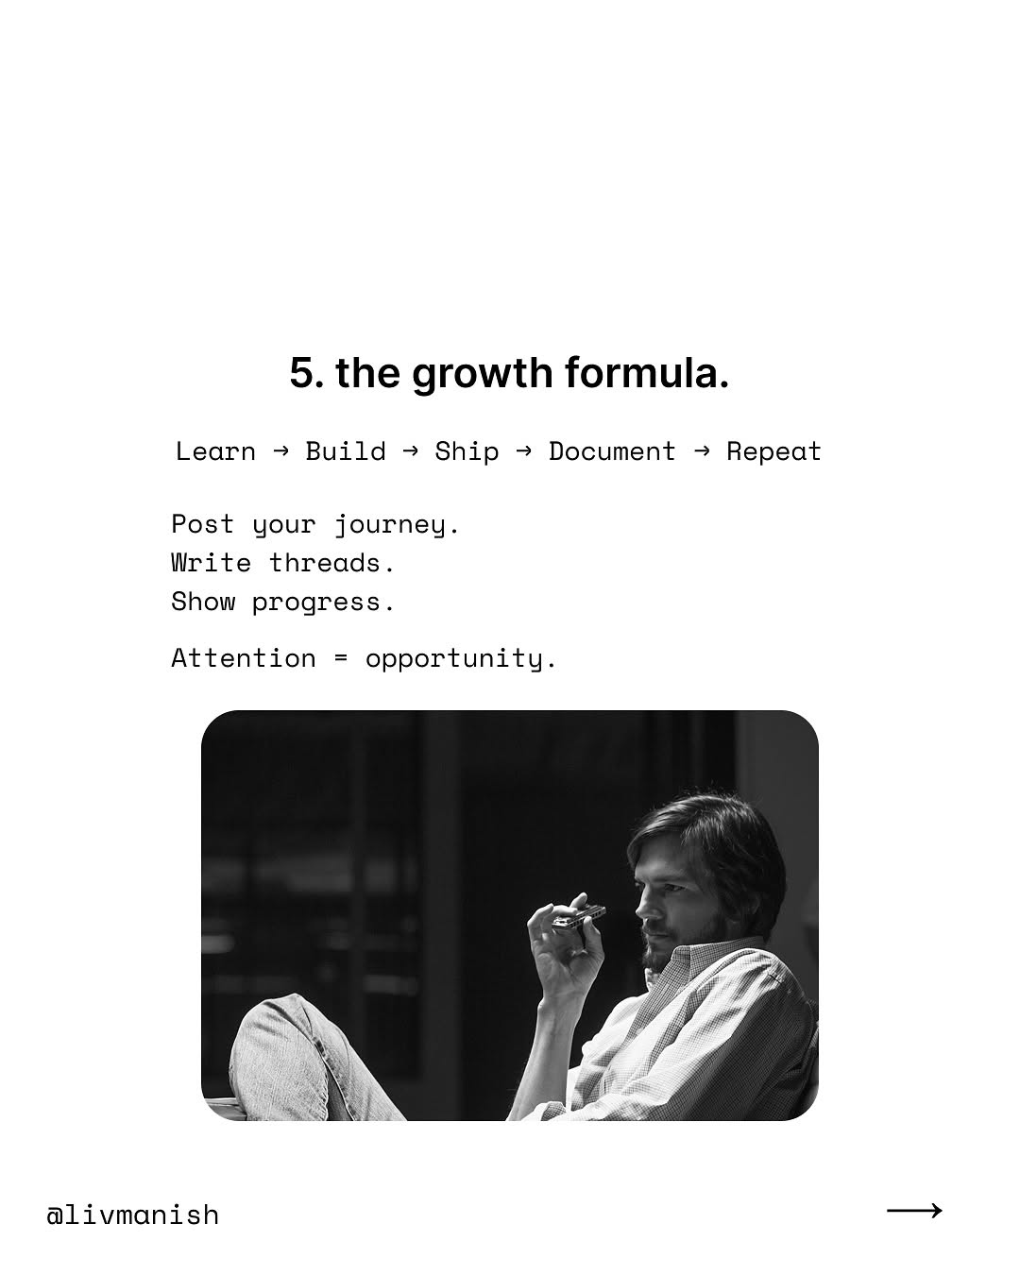
ai-tips / DVXvbomk3OU / slide 06

Slide 7
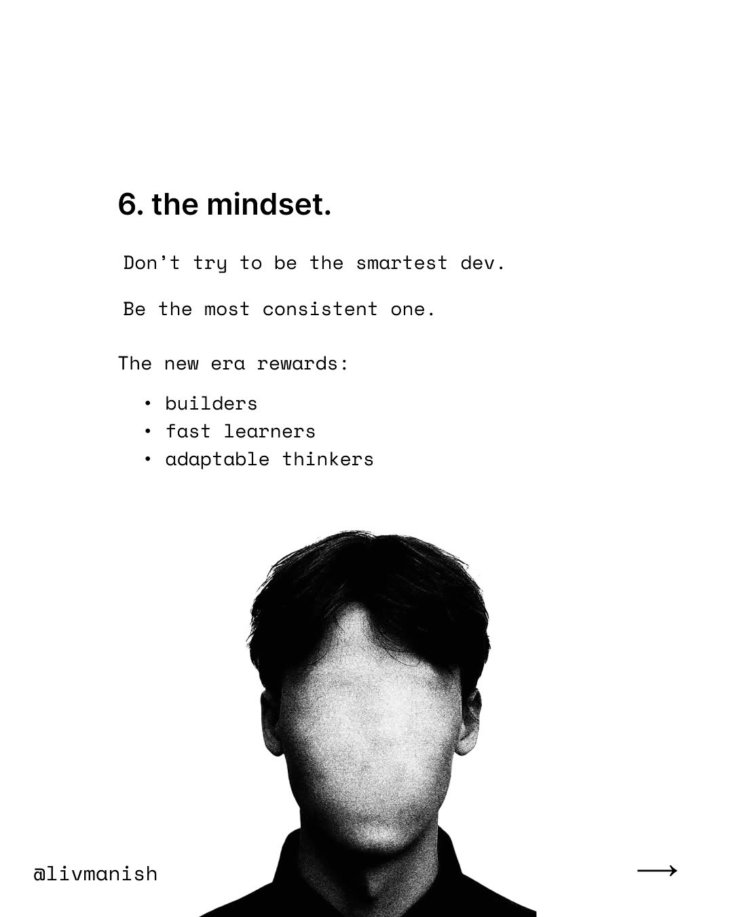
ai-tips / DVXvbomk3OU / slide 07

Slide 8
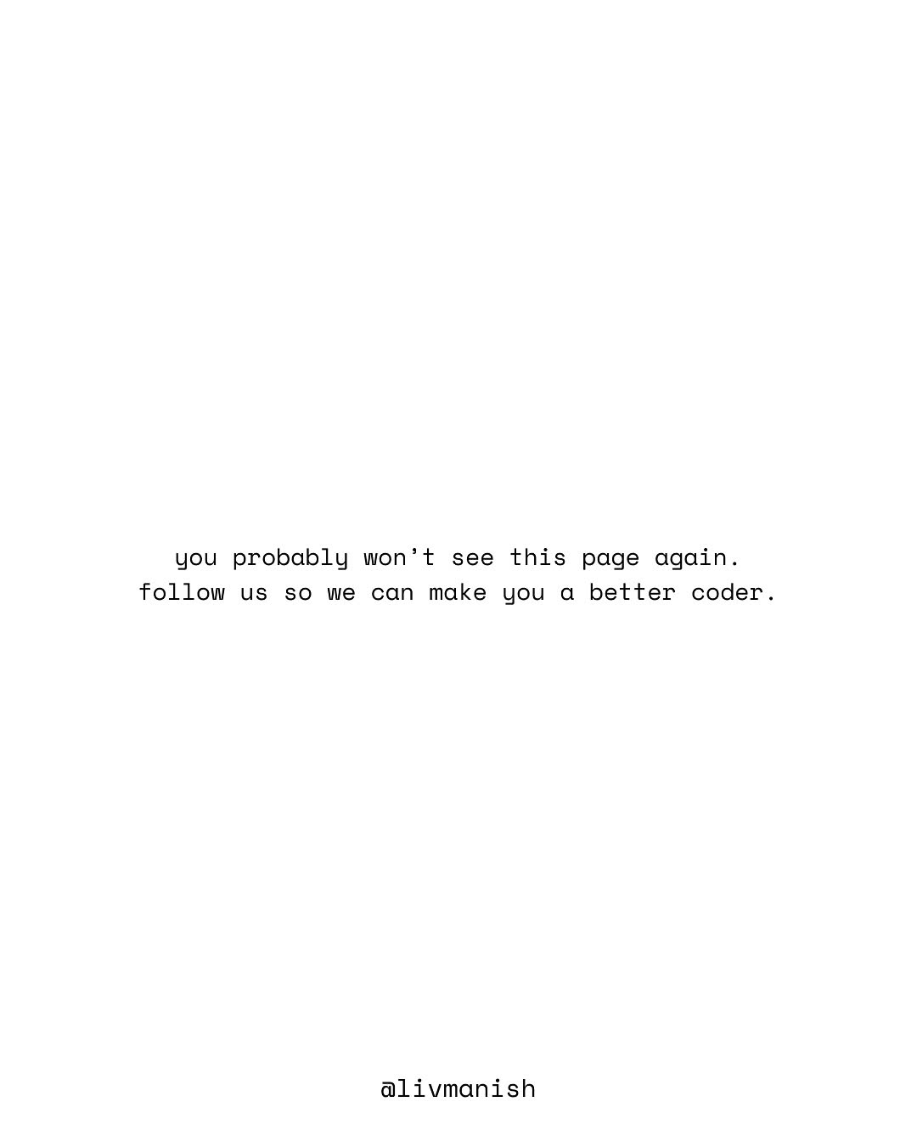
ai-tips / DVXvbomk3OU / slide 08

Slide 9
ai-tips / DVXvbomk3OU
Source URL
https://www.instagram.com/p/DVXvbomk3OU/
Caption
The coding era has changed. It’s no longer about memorizing syntax or finishing courses. It’s about: – building real systems – using AI as leverage – shipping fast – showing proof of work The developers who adapt will dominate the next 5 years. The rest will stay stuck in tutorial hell. If you’re serious about becoming a real builder, stay here. #ai #tech #coding #programming

