Slide 1
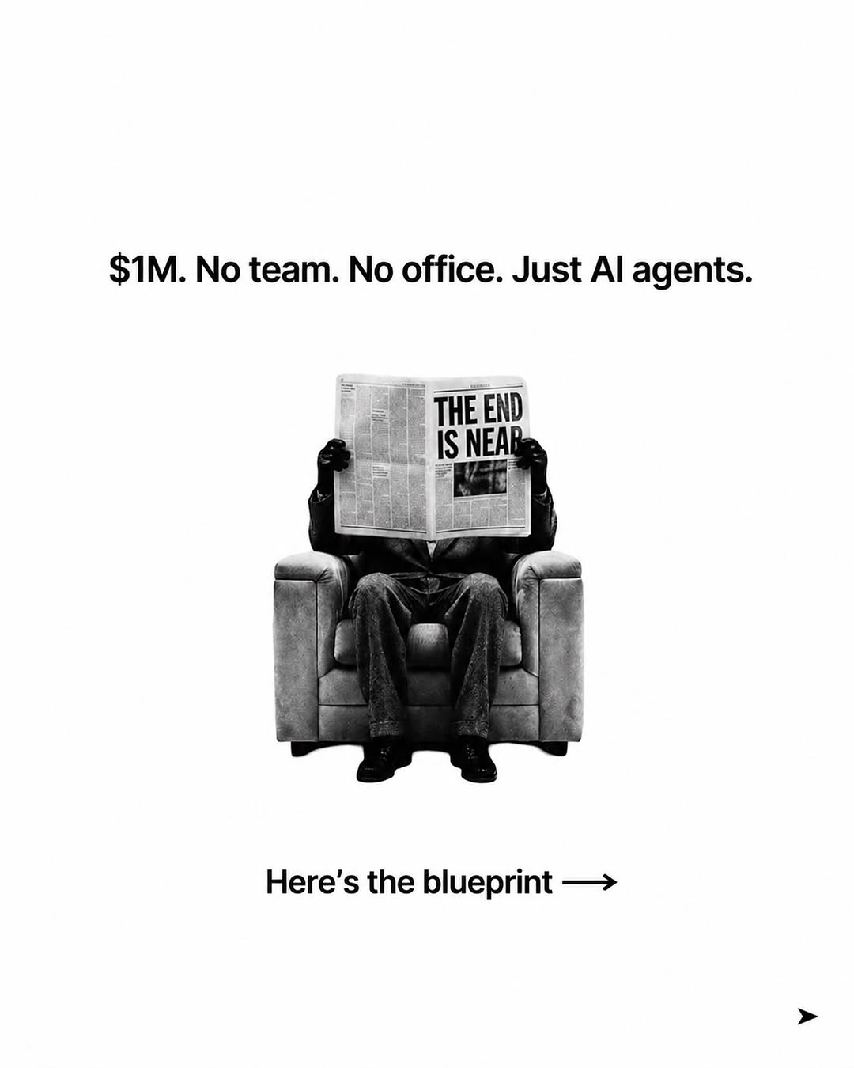
ai-tips / DXlZ0wxE-Rr / slide 01

Slide 2
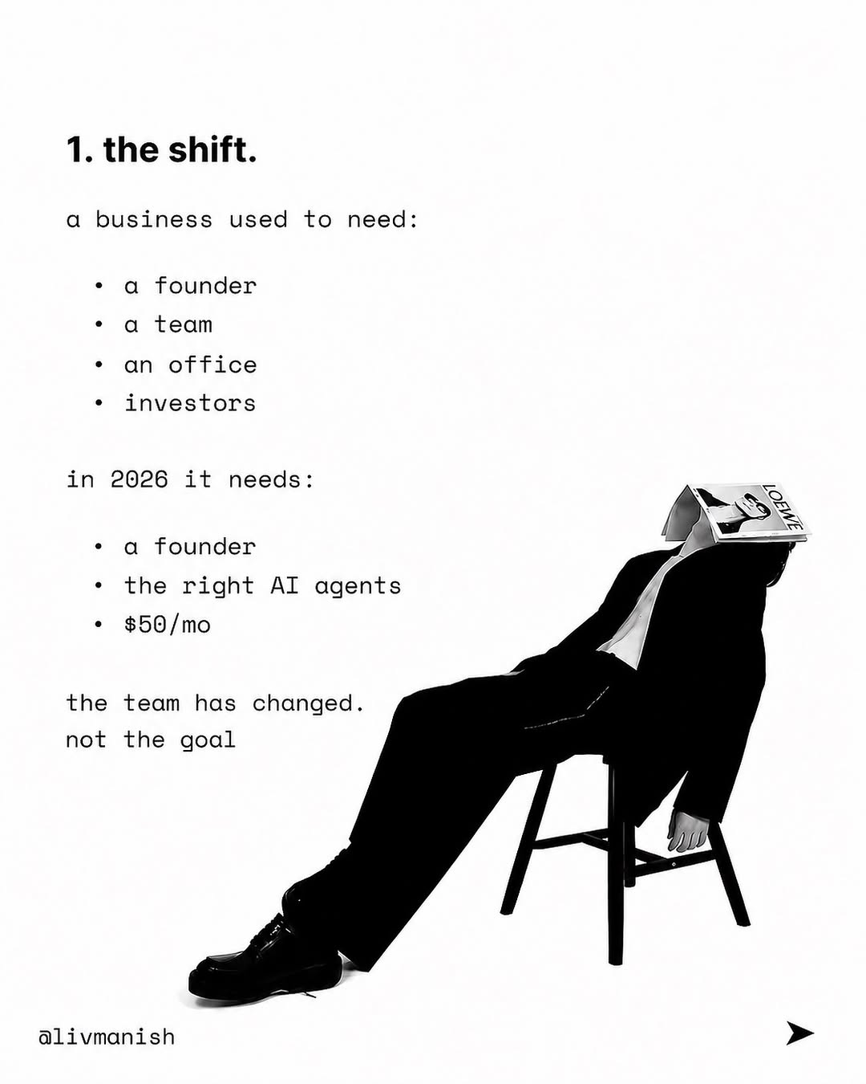
ai-tips / DXlZ0wxE-Rr / slide 02

Slide 3
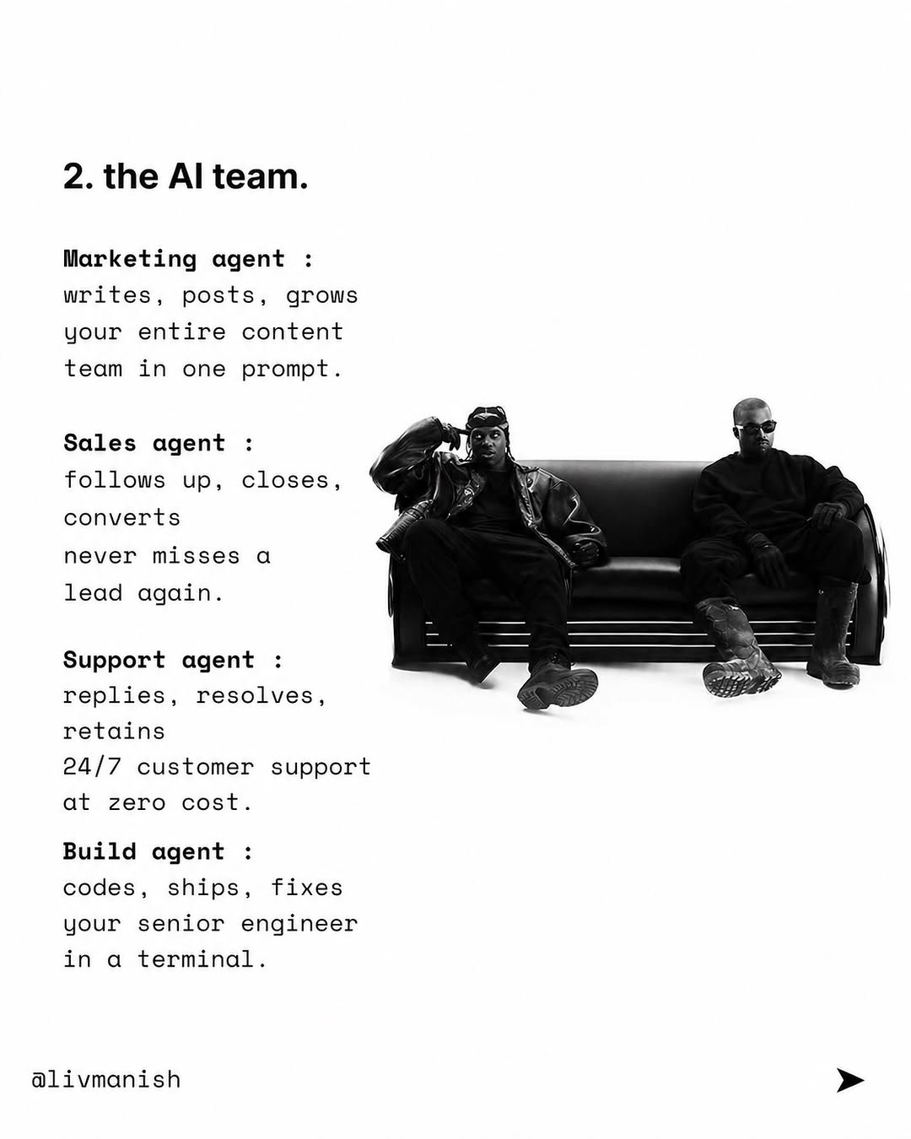
ai-tips / DXlZ0wxE-Rr / slide 03

Slide 4
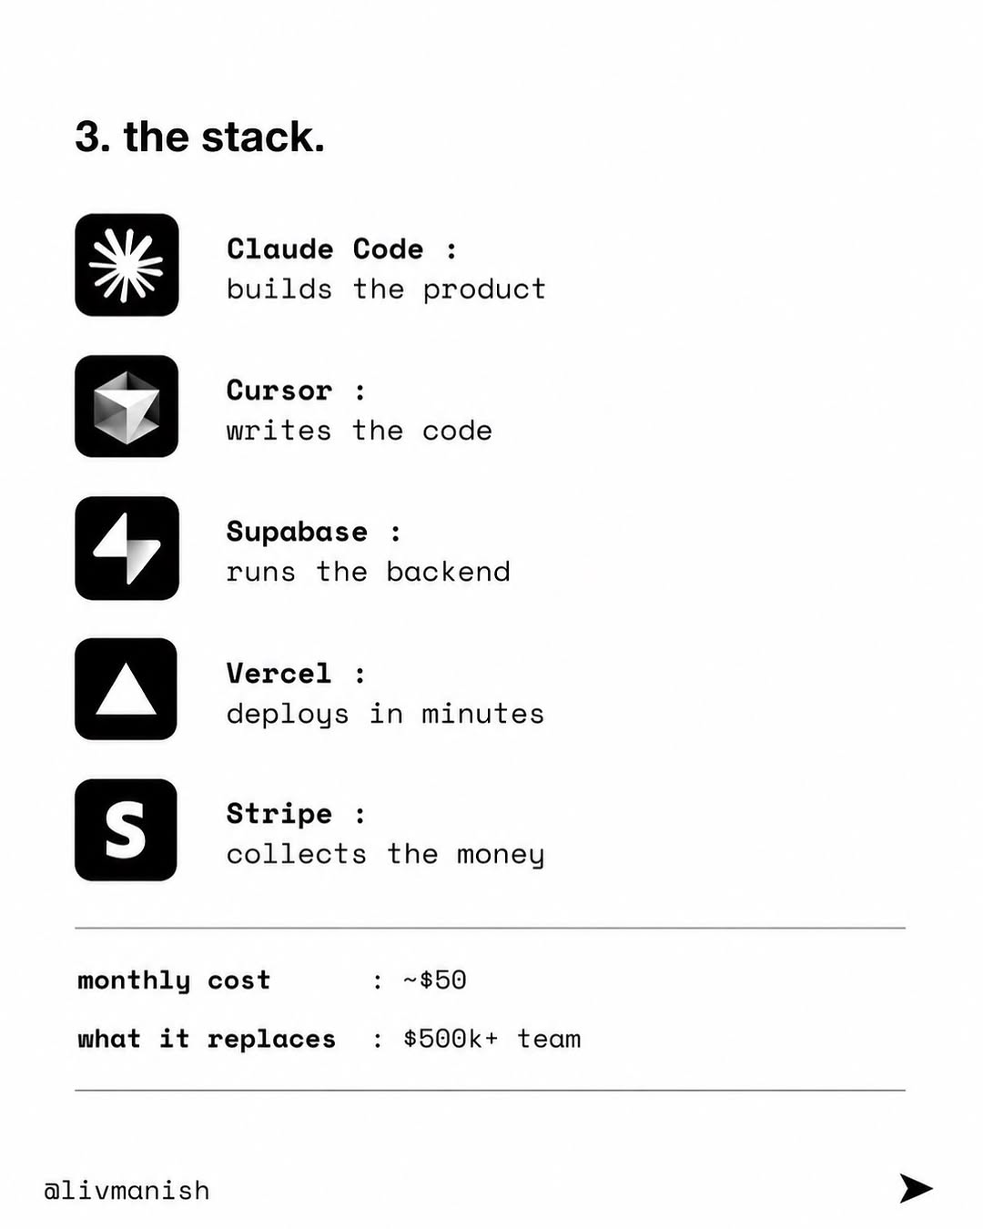
ai-tips / DXlZ0wxE-Rr / slide 04

Slide 5
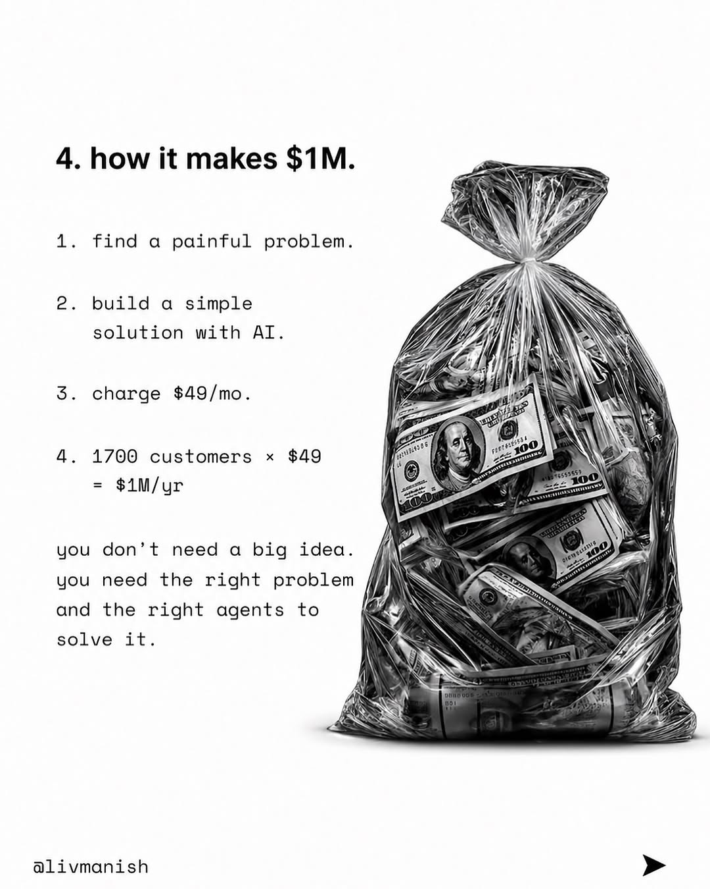
ai-tips / DXlZ0wxE-Rr / slide 05

Slide 6
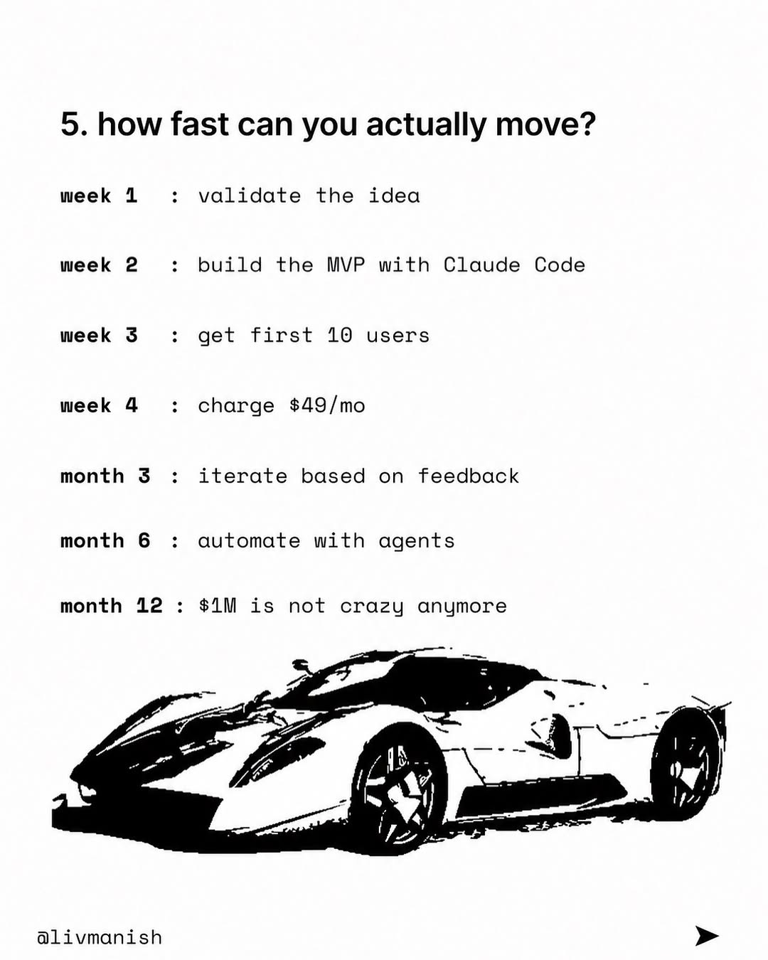
ai-tips / DXlZ0wxE-Rr / slide 06

Slide 7
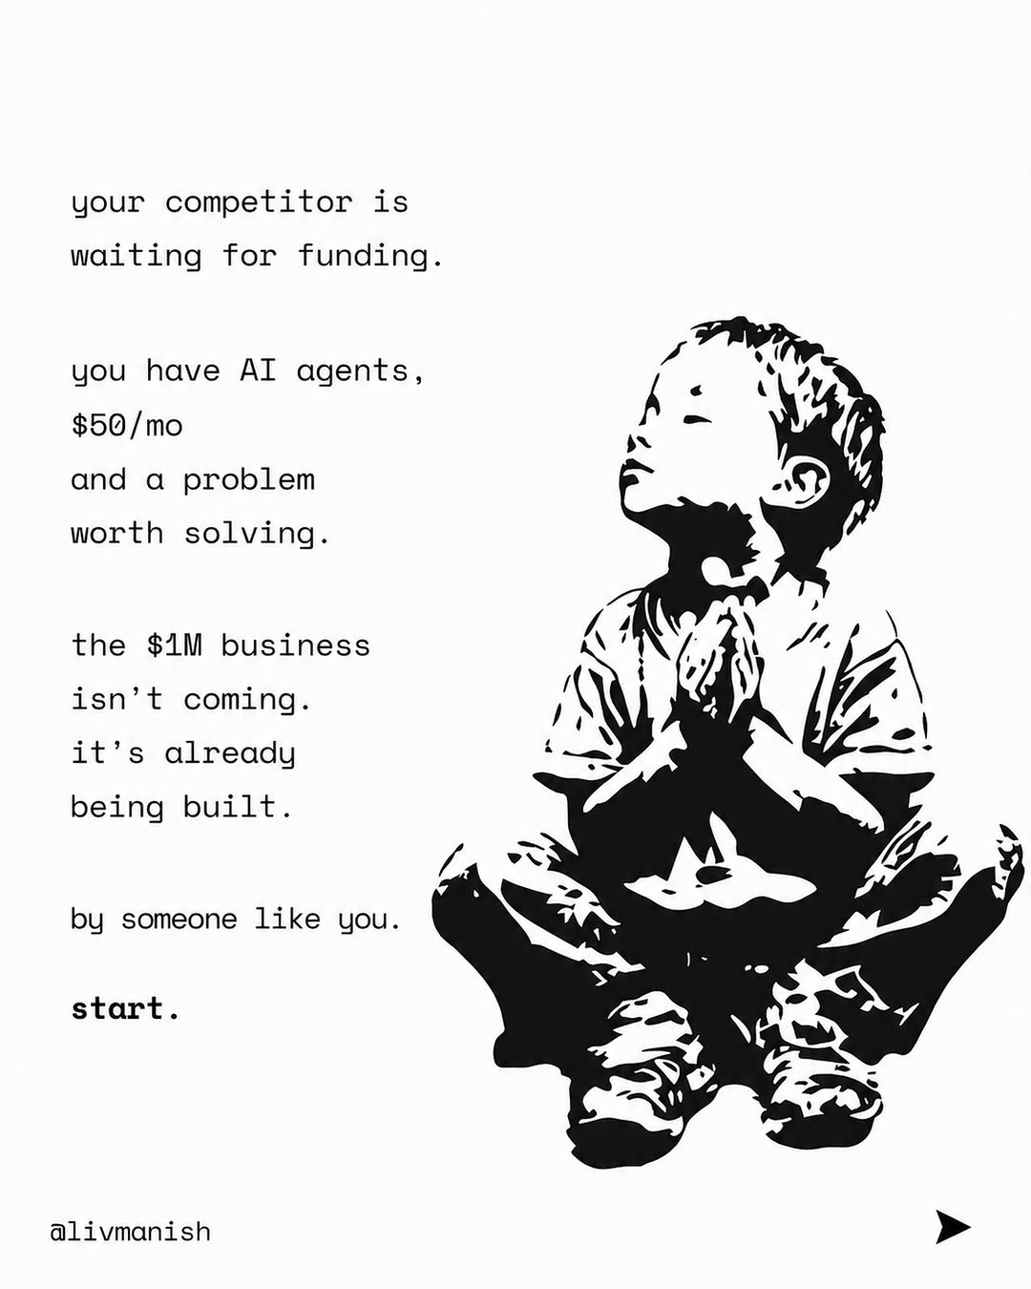
ai-tips / DXlZ0wxE-Rr / slide 07

Slide 8
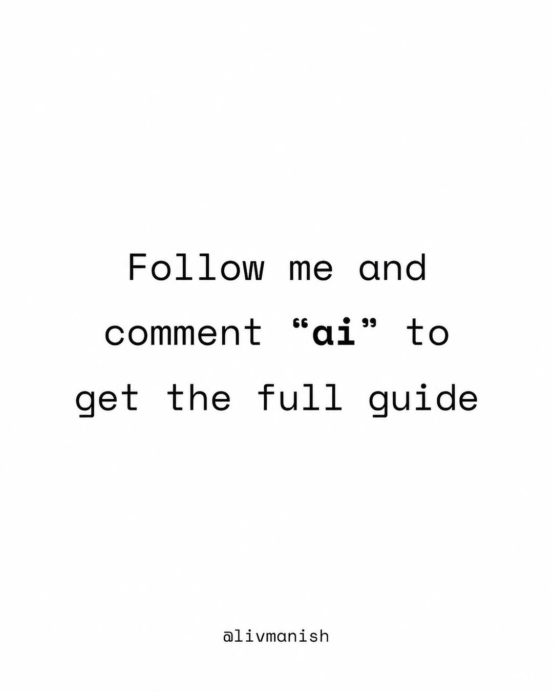
ai-tips / DXlZ0wxE-Rr / slide 08

Slide 9
ai-tips / DXlZ0wxE-Rr
Source URL
https://www.instagram.com/p/DXlZ0wxE-Rr/
Caption
The first $1M business run by AI agents is being built right now. Not by a funded startup. Not by a team of 20. By one person with a laptop and $50/mo. Follow me and comment “ai” to get the full guide #ai #tech #app #coding

