Slide 1
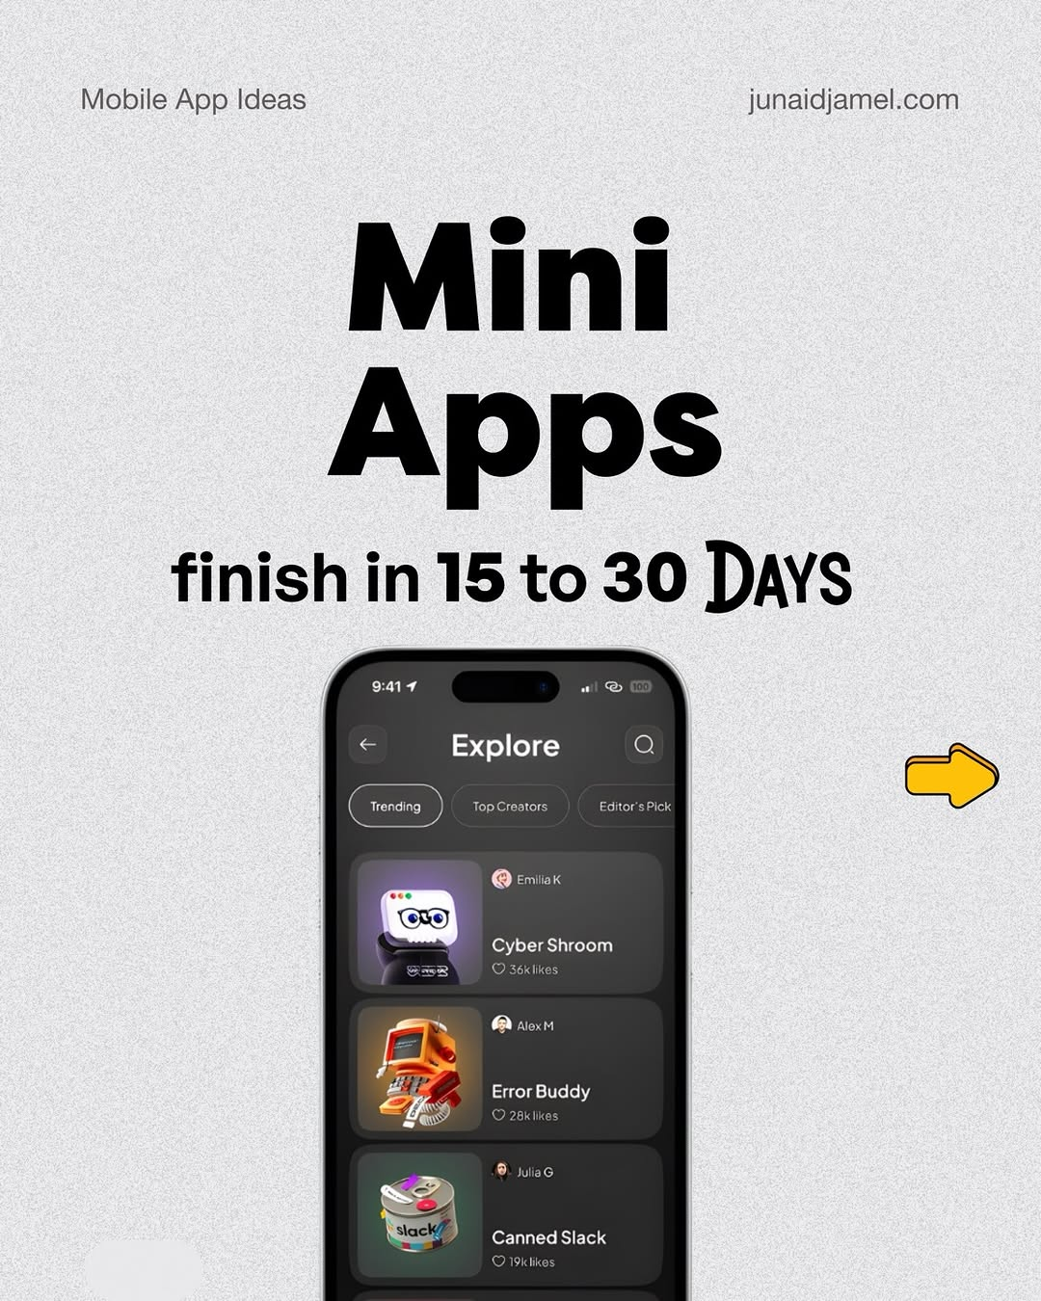
app / DXZb3JaCLnu / slide 01

Slide 2
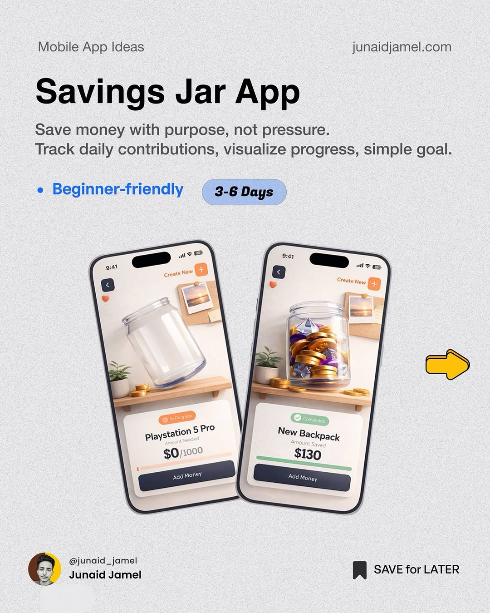
app / DXZb3JaCLnu / slide 02

Slide 3
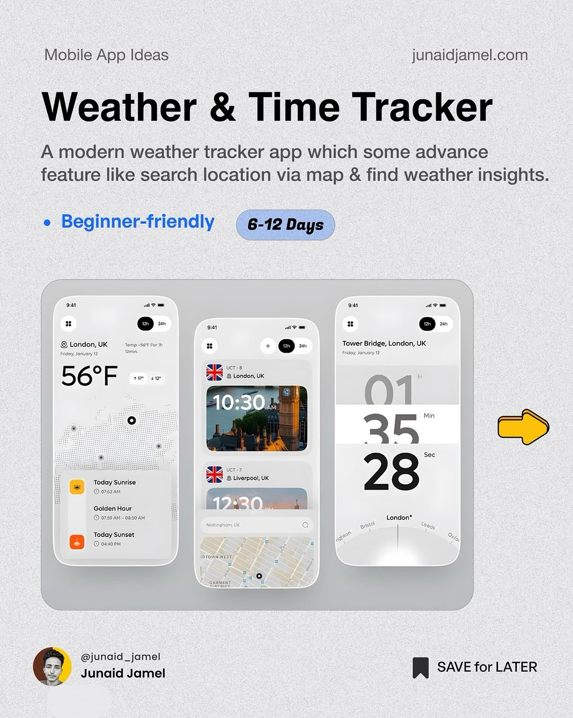
app / DXZb3JaCLnu / slide 03

Slide 4
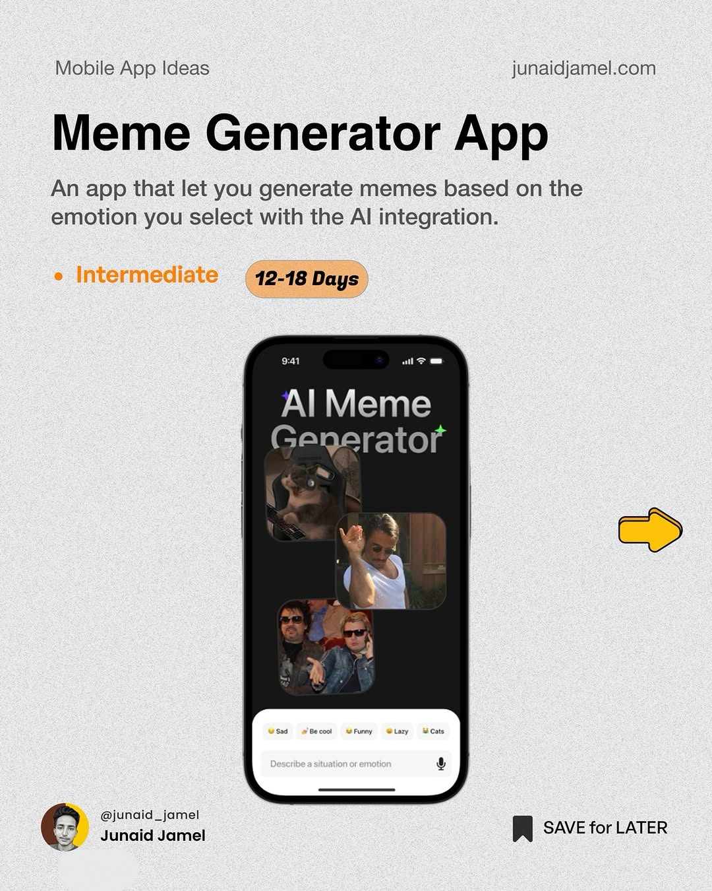
app / DXZb3JaCLnu / slide 04

Slide 5
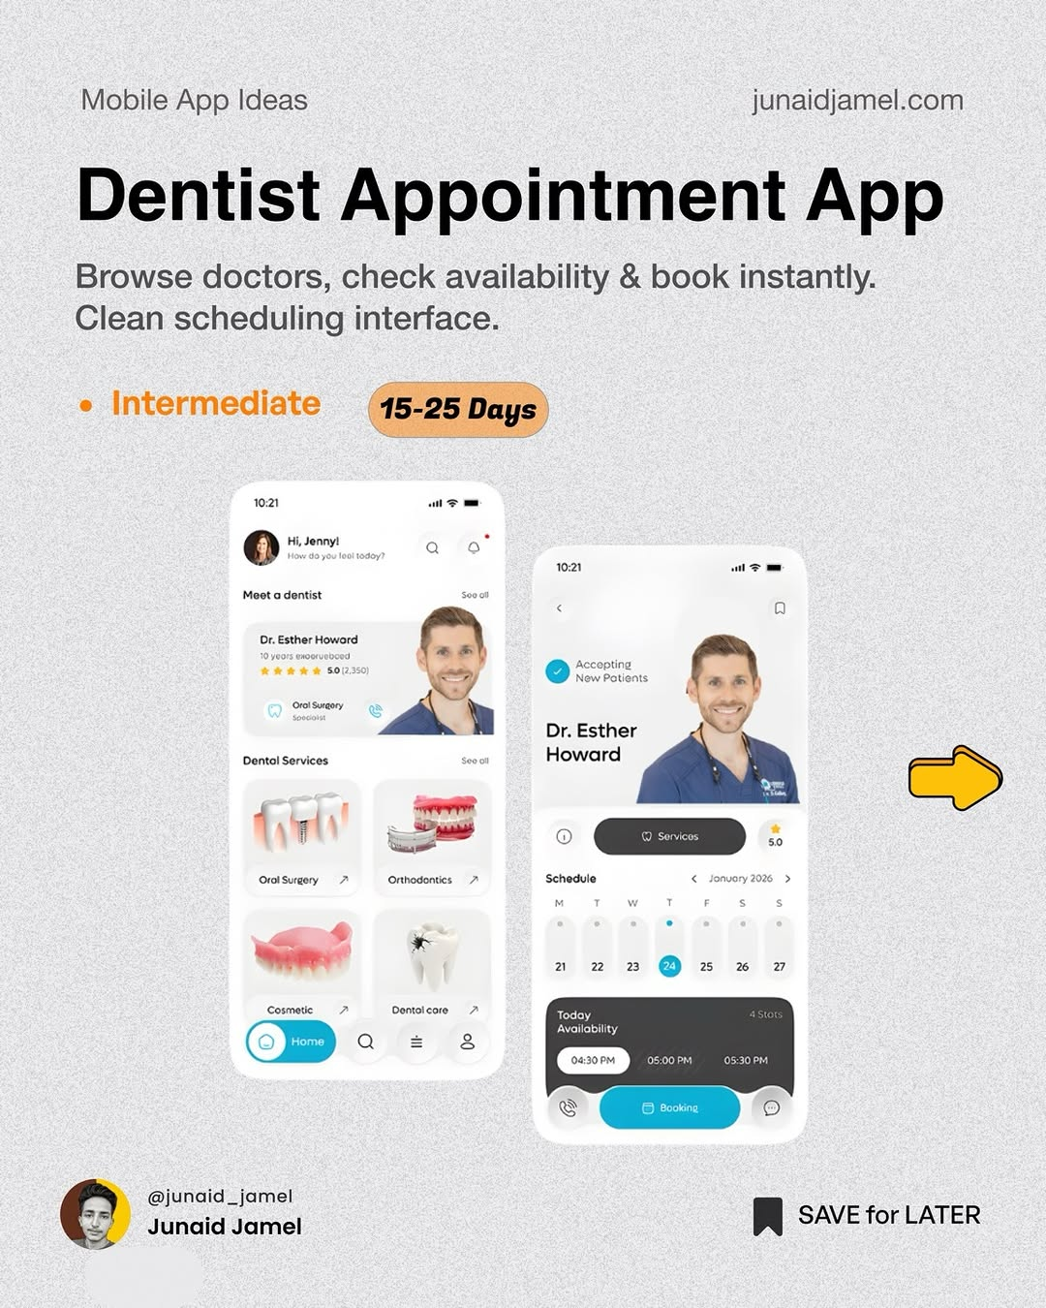
app / DXZb3JaCLnu / slide 05

Slide 6
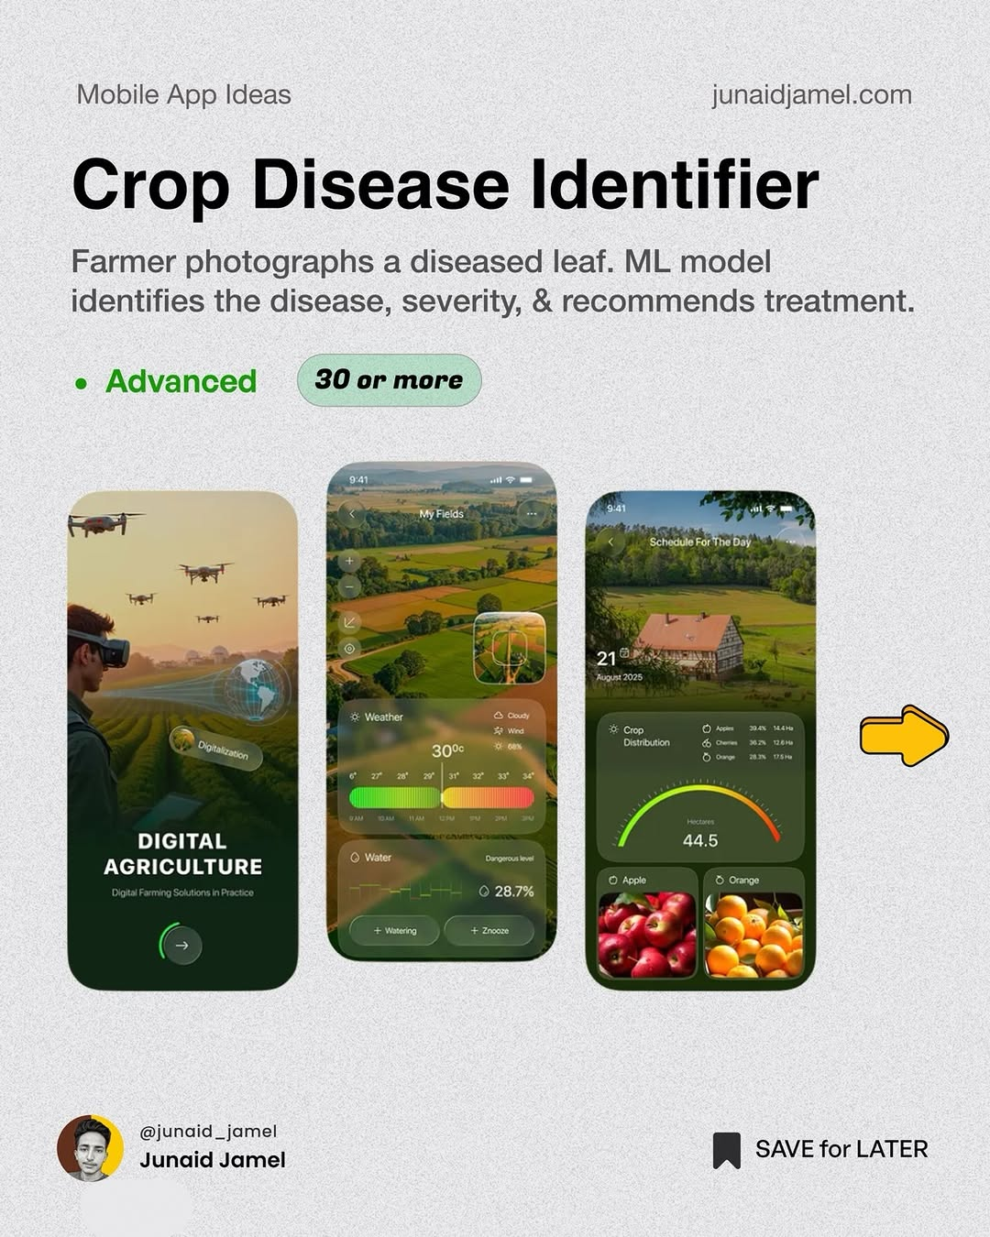
app / DXZb3JaCLnu / slide 06

Slide 7
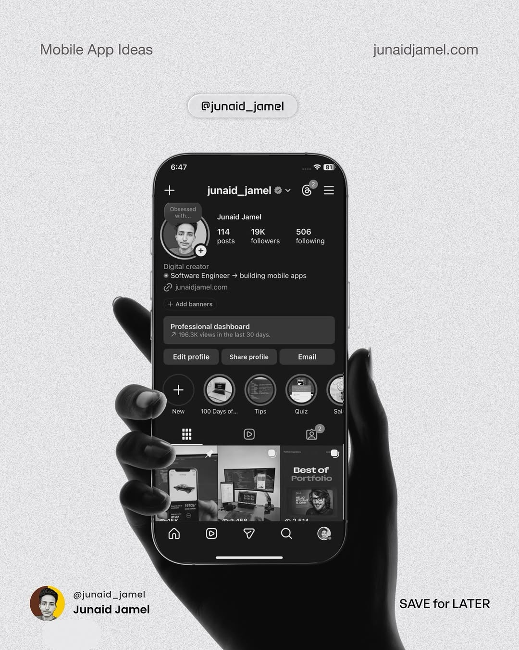
app / DXZb3JaCLnu / slide 07

Slide 8
app / DXZb3JaCLnu
Source URL
https://www.instagram.com/p/DXZb3JaCLnu/
Caption
App ideas you can make to capture market 🚀 My Github 🔗 https://github.com/JunaidJamel Follow @junaid_jamel

