Slide 1
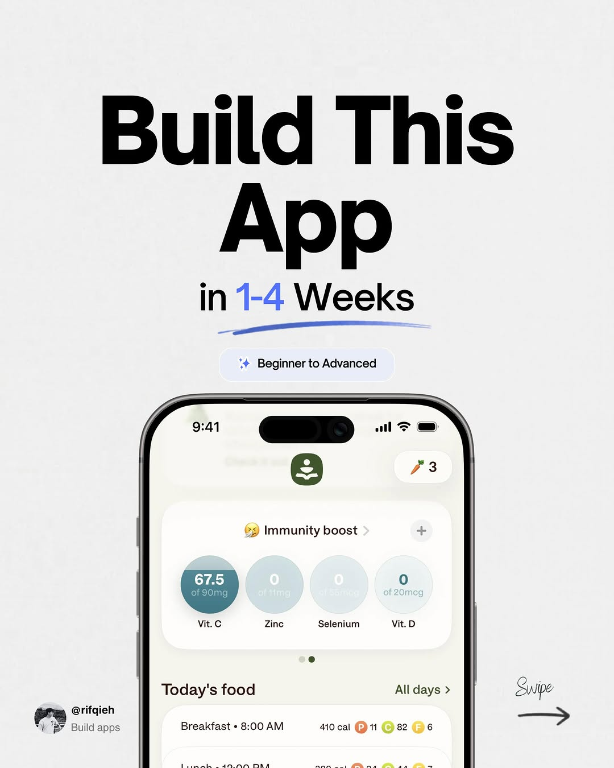
app / DYuD-i5E3Pz / slide 01

Slide 2
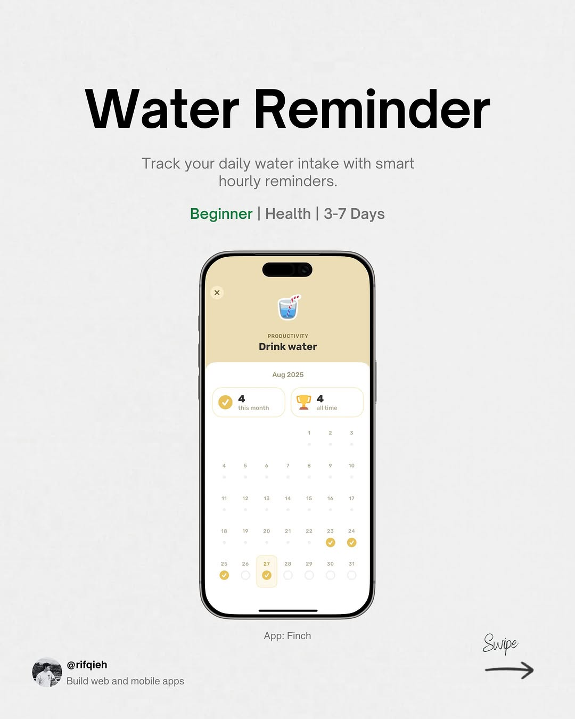
app / DYuD-i5E3Pz / slide 02

Slide 3
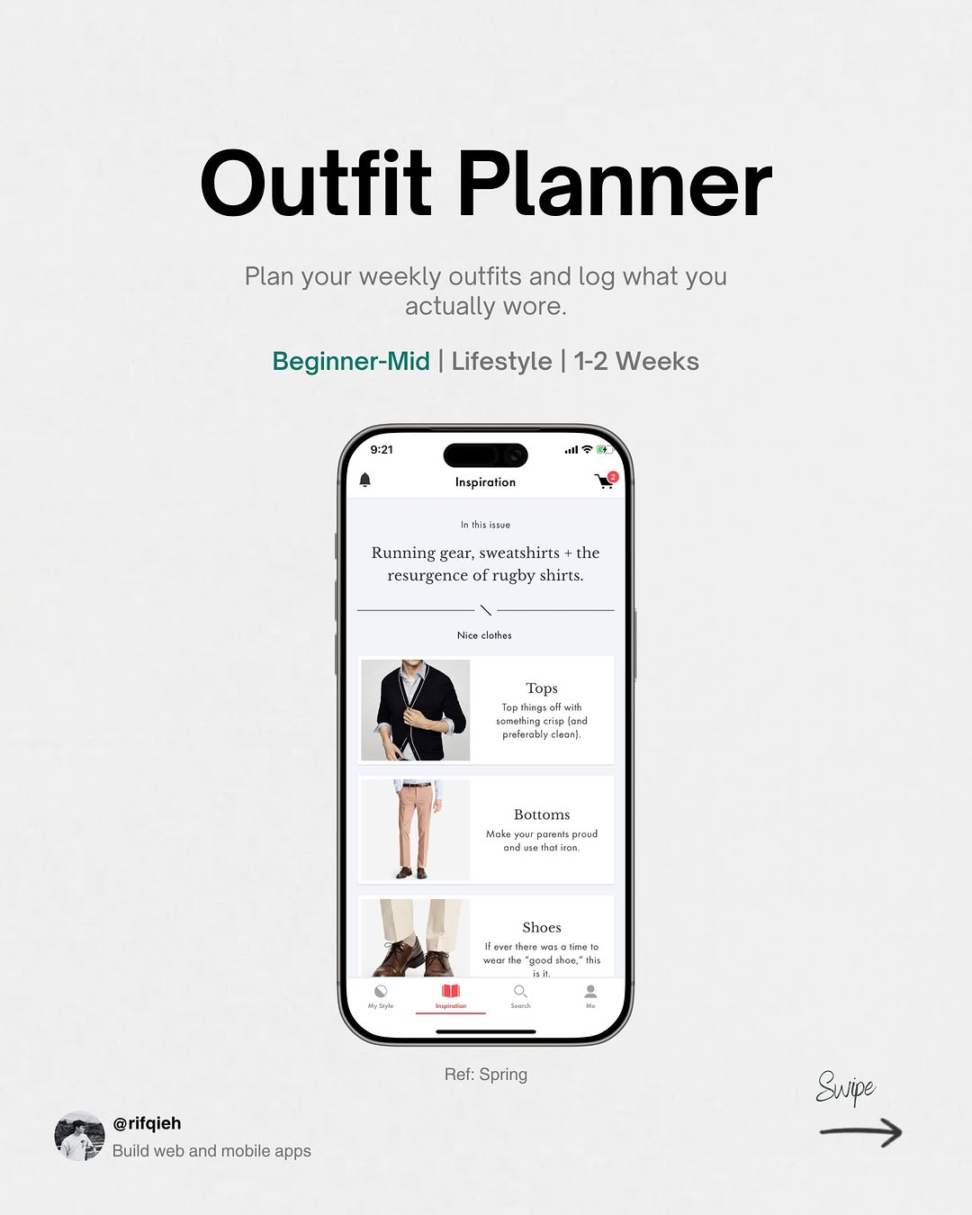
app / DYuD-i5E3Pz / slide 03

Slide 4
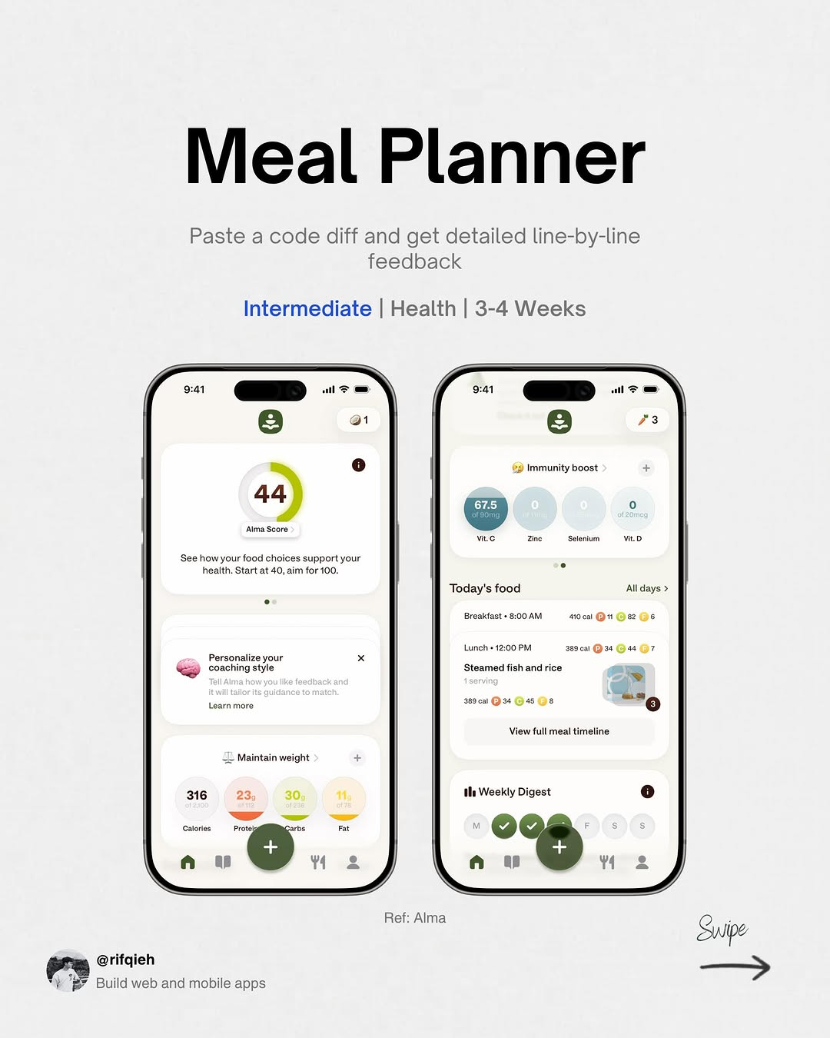
app / DYuD-i5E3Pz / slide 04

Slide 5
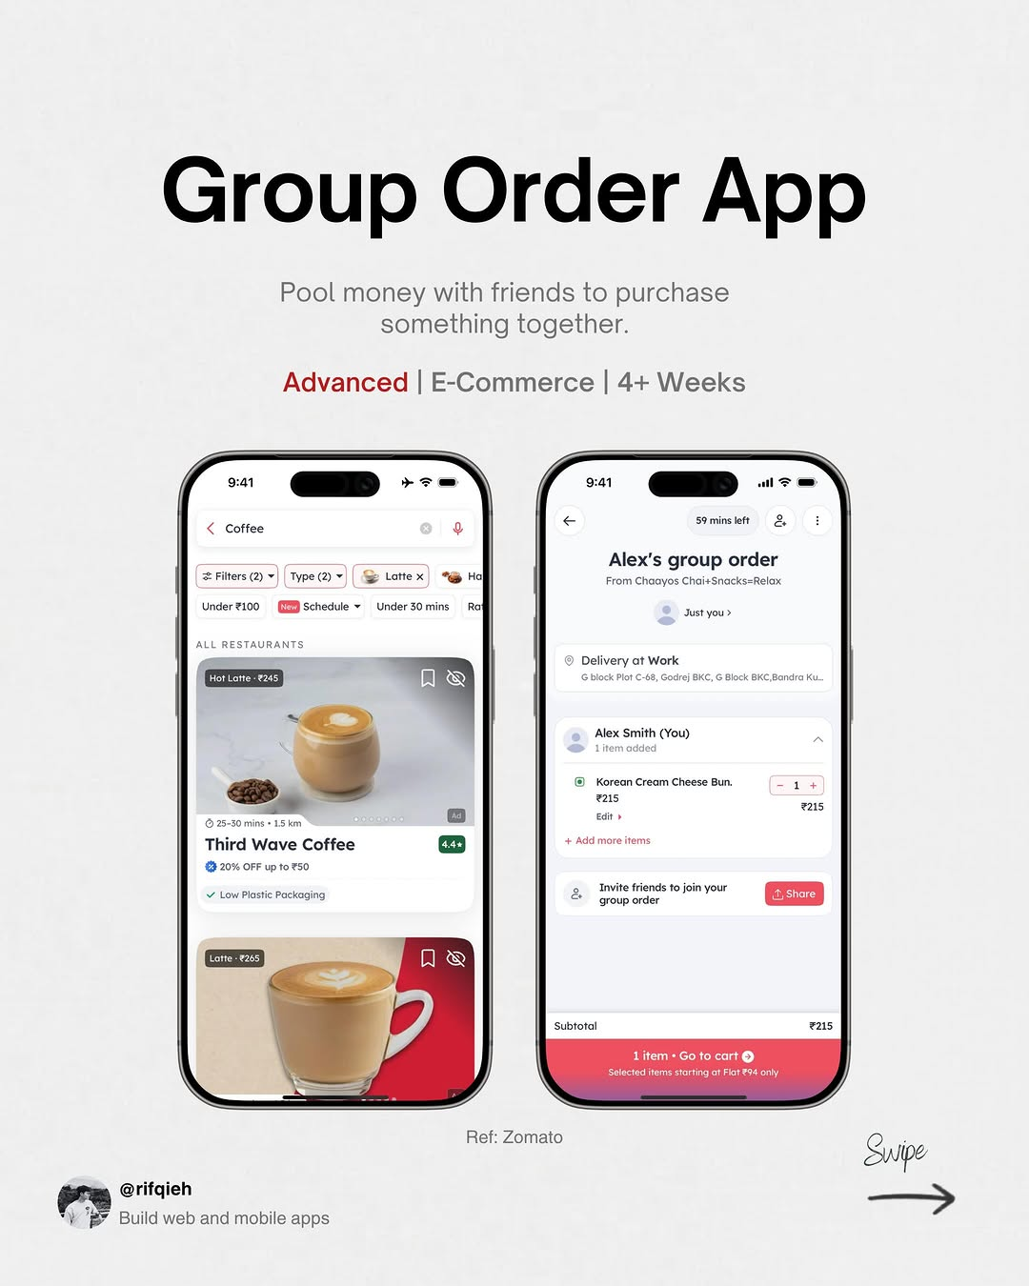
app / DYuD-i5E3Pz / slide 05

Slide 6
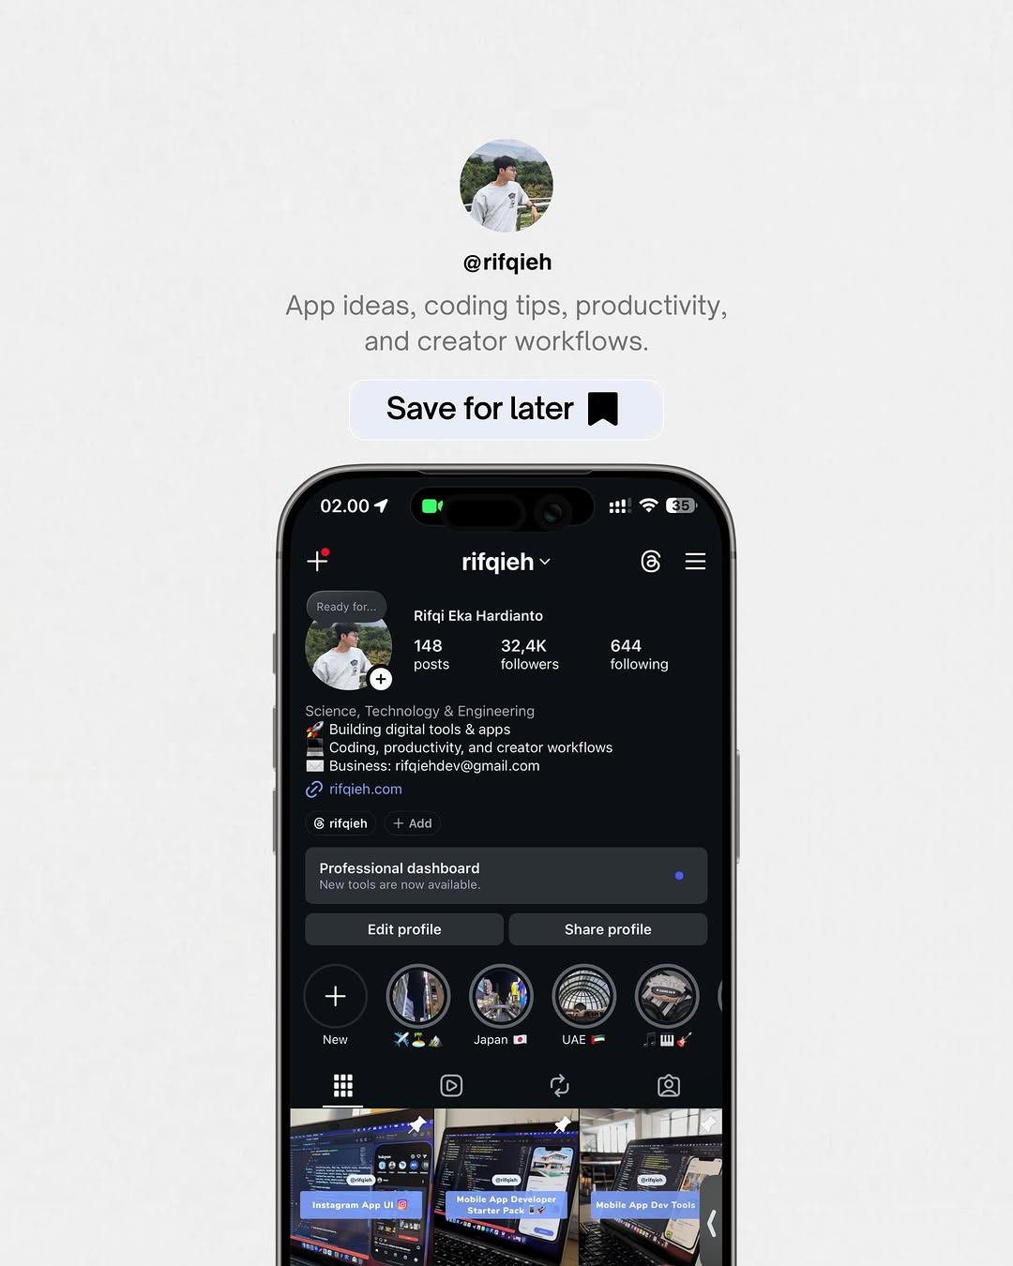
app / DYuD-i5E3Pz / slide 06

Slide 7
app / DYuD-i5E3Pz
Source URL
https://www.instagram.com/p/DYuD-i5E3Pz/
Caption
App ideas to build next 🚀 Free tools: http://rifqieh.com http://github.com/rifqieh

