Slide 1

tech-news / DYKyzOMCGal / slide 01

Slide 2
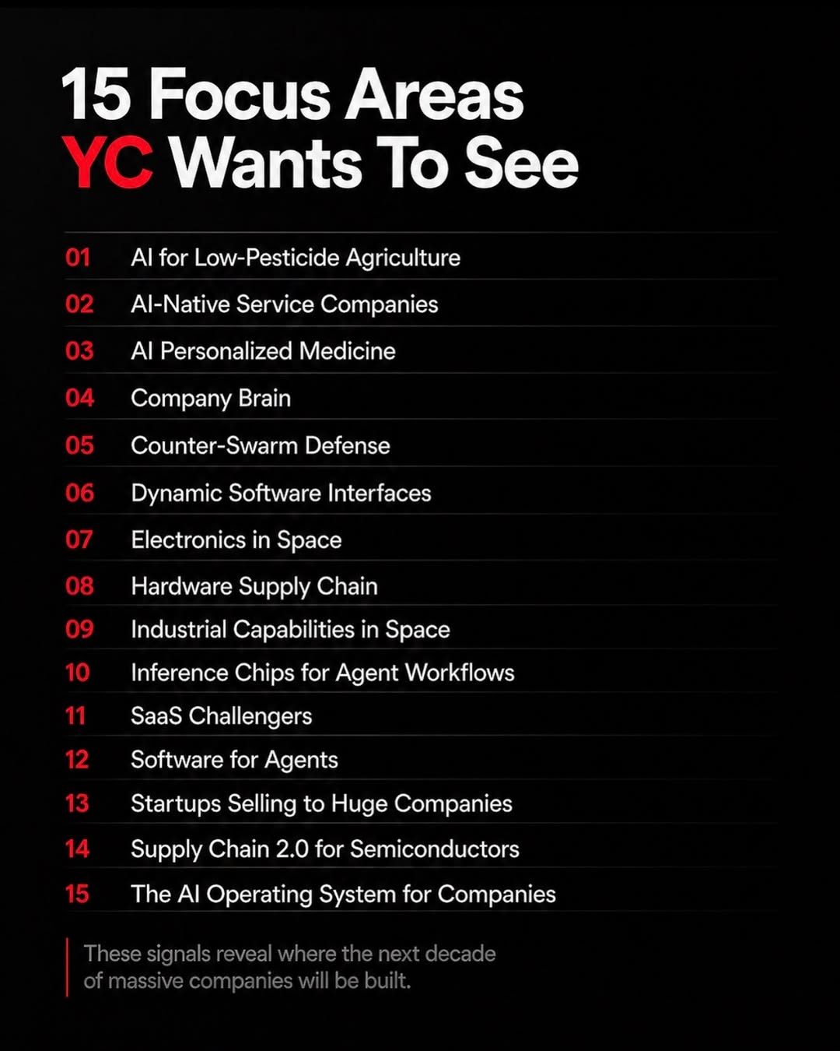
tech-news / DYKyzOMCGal / slide 02

Slide 3

tech-news / DYKyzOMCGal / slide 03

Slide 4

tech-news / DYKyzOMCGal / slide 04

Slide 5

tech-news / DYKyzOMCGal / slide 05

Slide 6

tech-news / DYKyzOMCGal / slide 06

Slide 7

tech-news / DYKyzOMCGal / slide 07

Slide 8

tech-news / DYKyzOMCGal / slide 08

Slide 9

tech-news / DYKyzOMCGal / slide 09

Slide 10

tech-news / DYKyzOMCGal / slide 10

Slide 11

tech-news / DYKyzOMCGal / slide 11

Slide 12

tech-news / DYKyzOMCGal / slide 12

Slide 13

tech-news / DYKyzOMCGal / slide 13

Slide 14
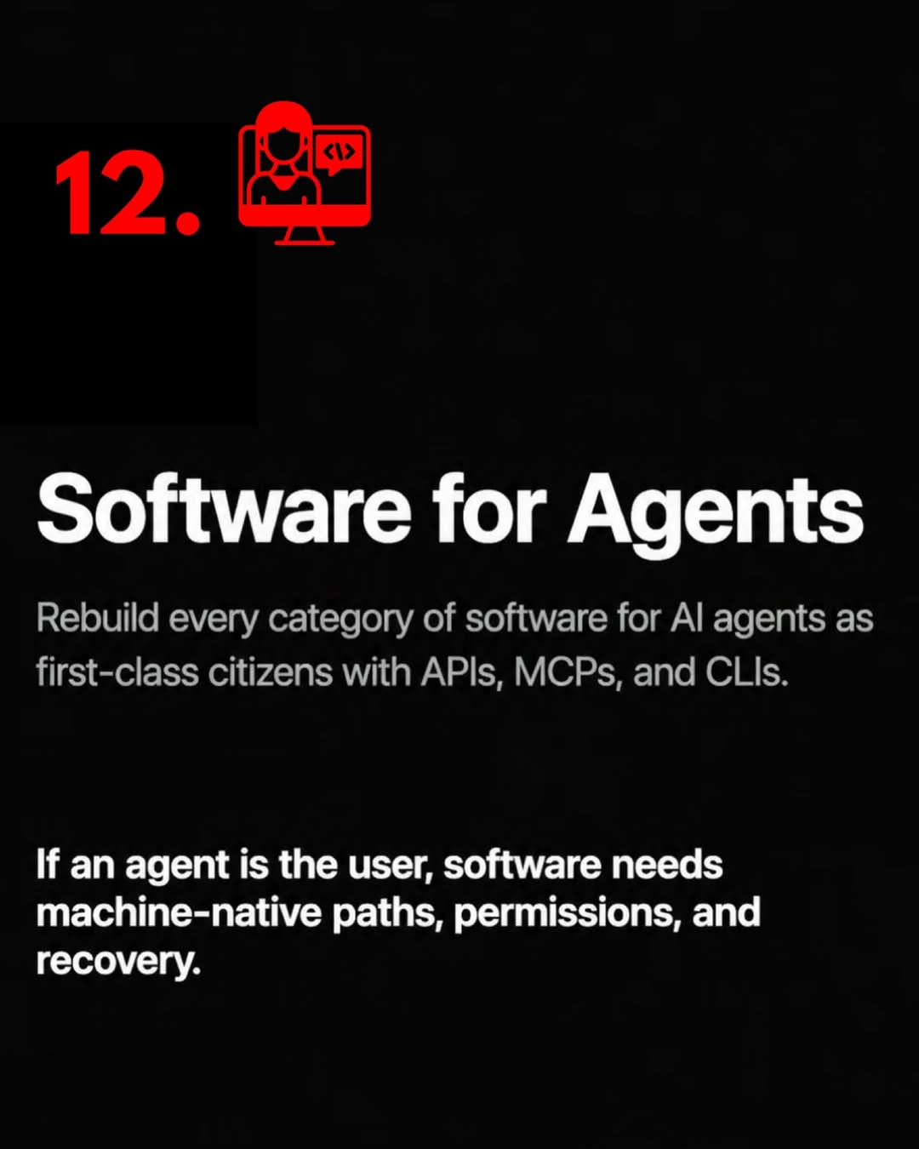
tech-news / DYKyzOMCGal / slide 14

Slide 15

tech-news / DYKyzOMCGal / slide 15

Slide 16

tech-news / DYKyzOMCGal / slide 16

Slide 17
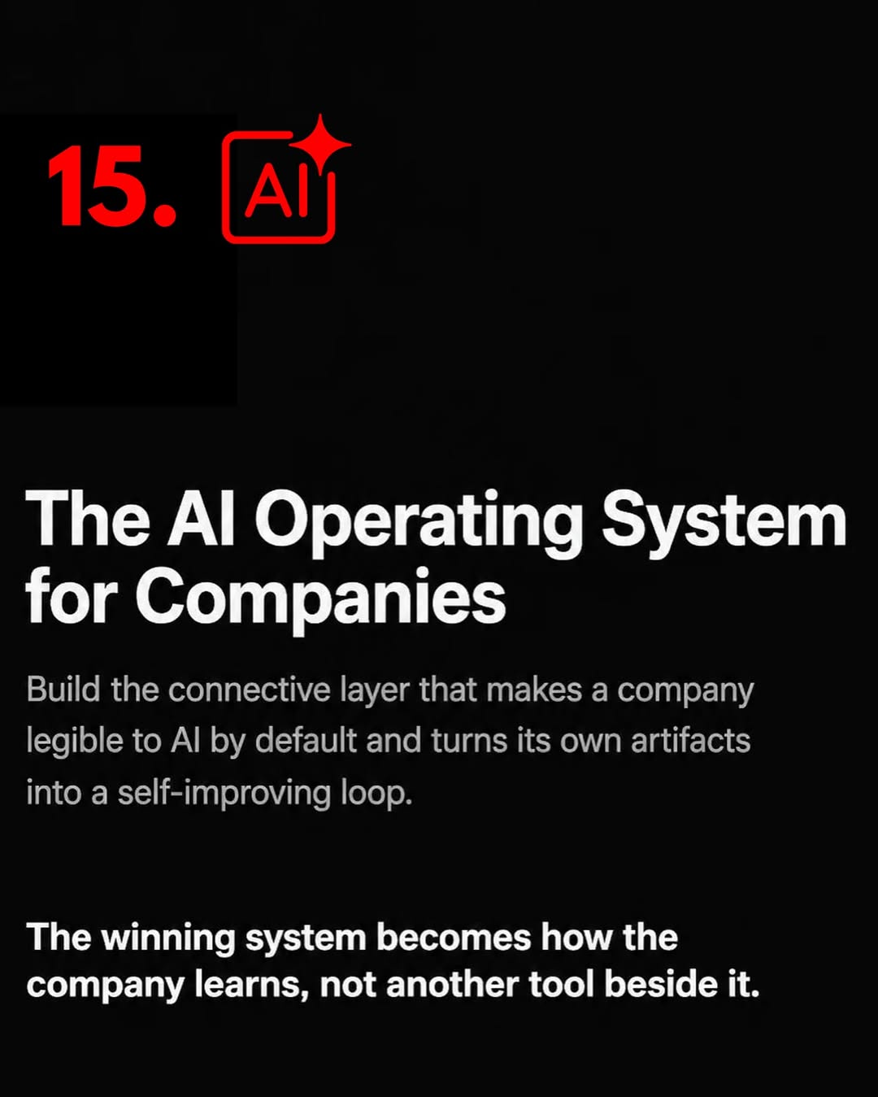
tech-news / DYKyzOMCGal / slide 17

Slide 18

tech-news / DYKyzOMCGal / slide 18

Slide 19
tech-news / DYKyzOMCGal
Source URL
https://www.instagram.com/p/DYKyzOMCGal/
Caption
Y Combinator’s Summer 2026 startup request list is one of the most important documents founders, investors, and operators should study right now. It offers a rare glimpse into where one of the world’s most influential accelerators believes the next wave of AI and frontier technology companies will emerge. What makes this valuable is the signal quality. YC reviews thousands of companies before markets fully recognize major shifts, meaning their requests often foreshadow where capital, talent, and innovation are accelerating. For ambitious builders, this is more than content. It is strategic intelligence that can shape timing, positioning, product direction, and long term conviction. Join over 10,000 founders with our newsletter available for free now, to stay ahead of the market. #startup #startups #ycombinator #ycombinatorstartup #startuprequest

