Slide 1

tech-news / DYwzdqSEm4R / slide 01

Slide 2
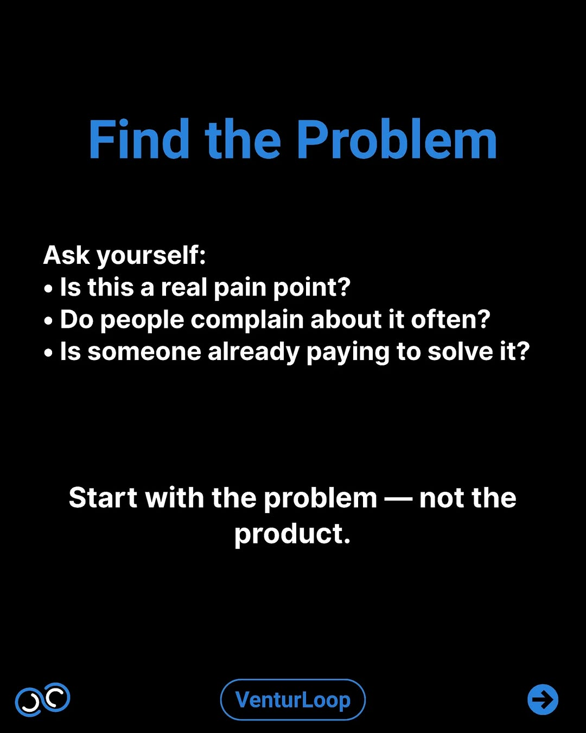
tech-news / DYwzdqSEm4R / slide 02

Slide 3
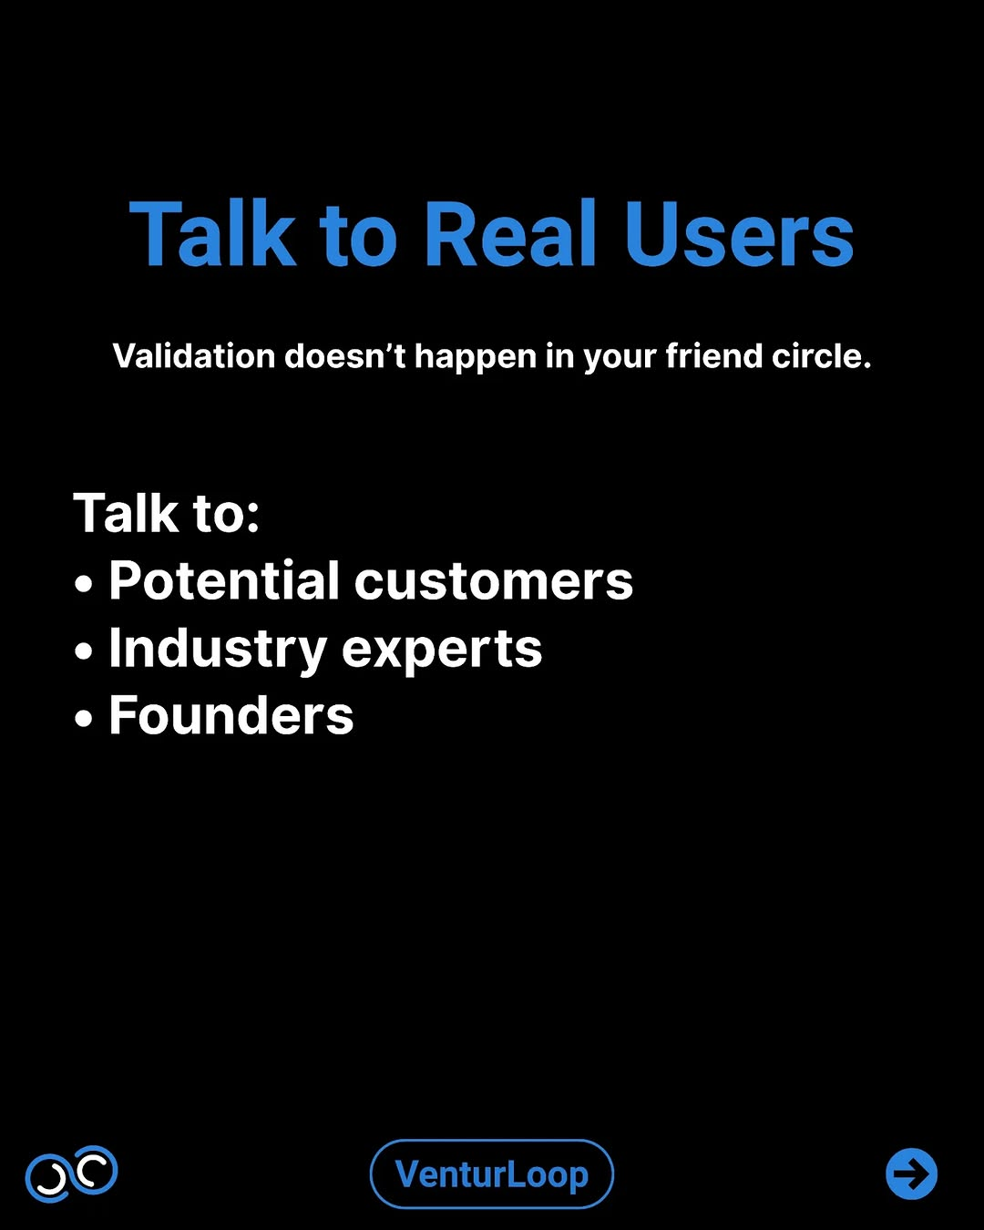
tech-news / DYwzdqSEm4R / slide 03

Slide 4
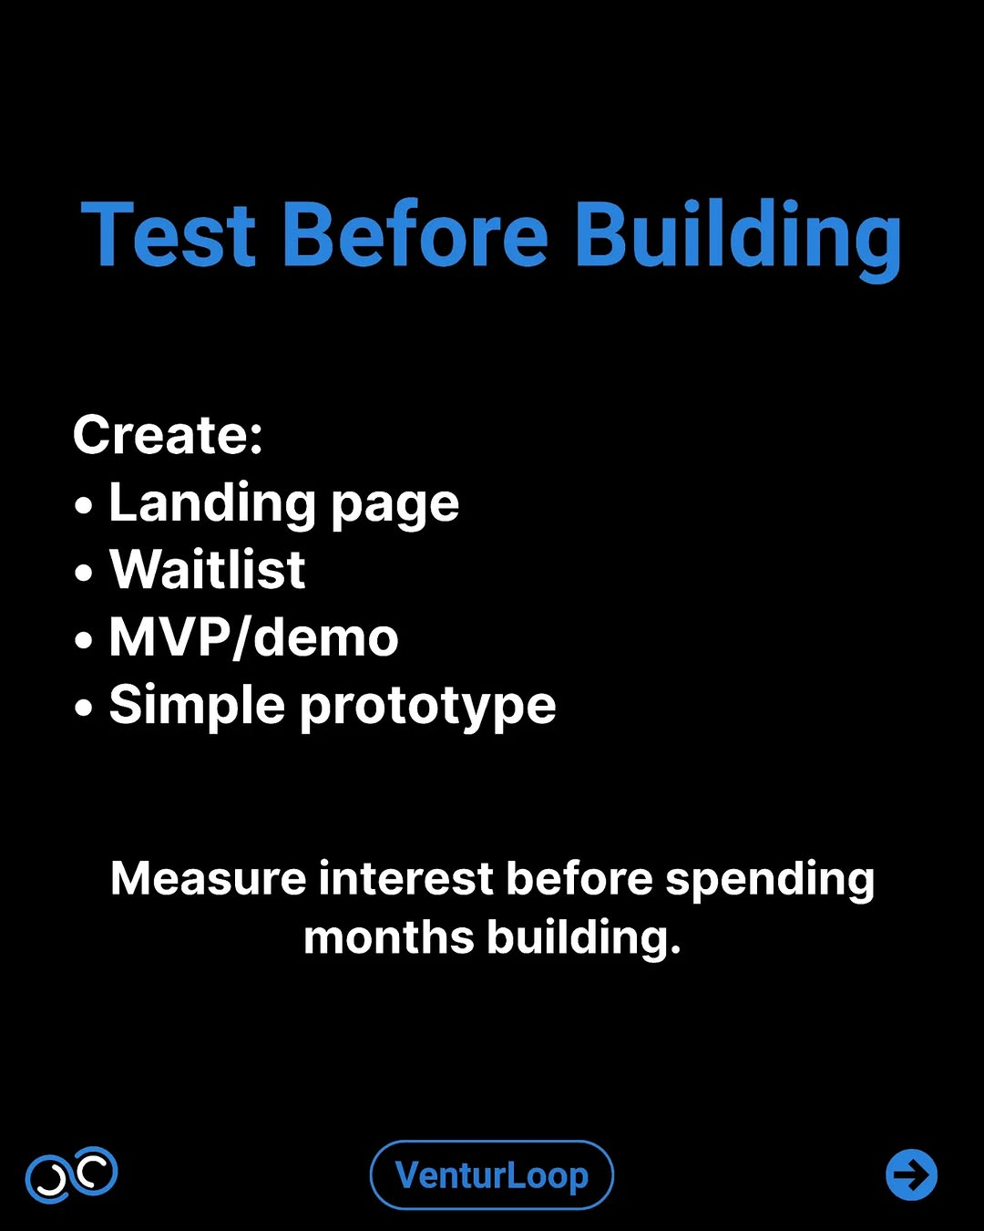
tech-news / DYwzdqSEm4R / slide 04

Slide 5
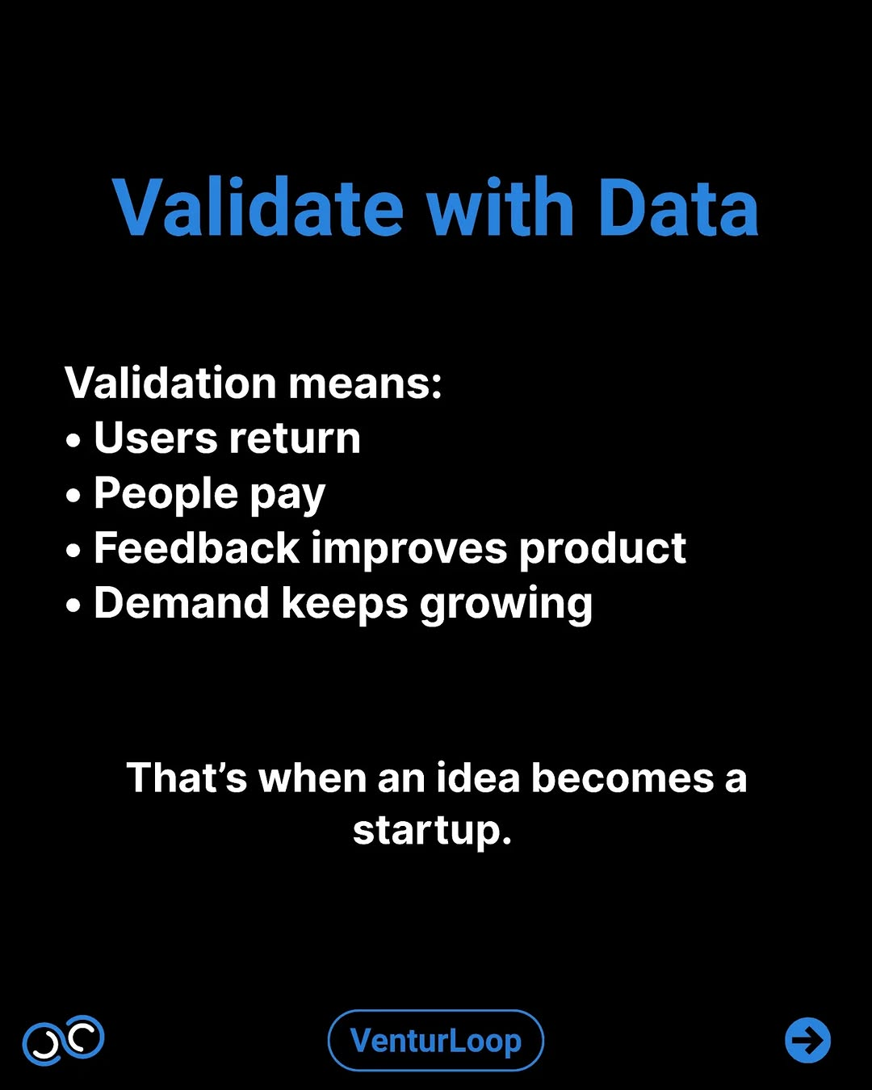
tech-news / DYwzdqSEm4R / slide 05

Slide 6
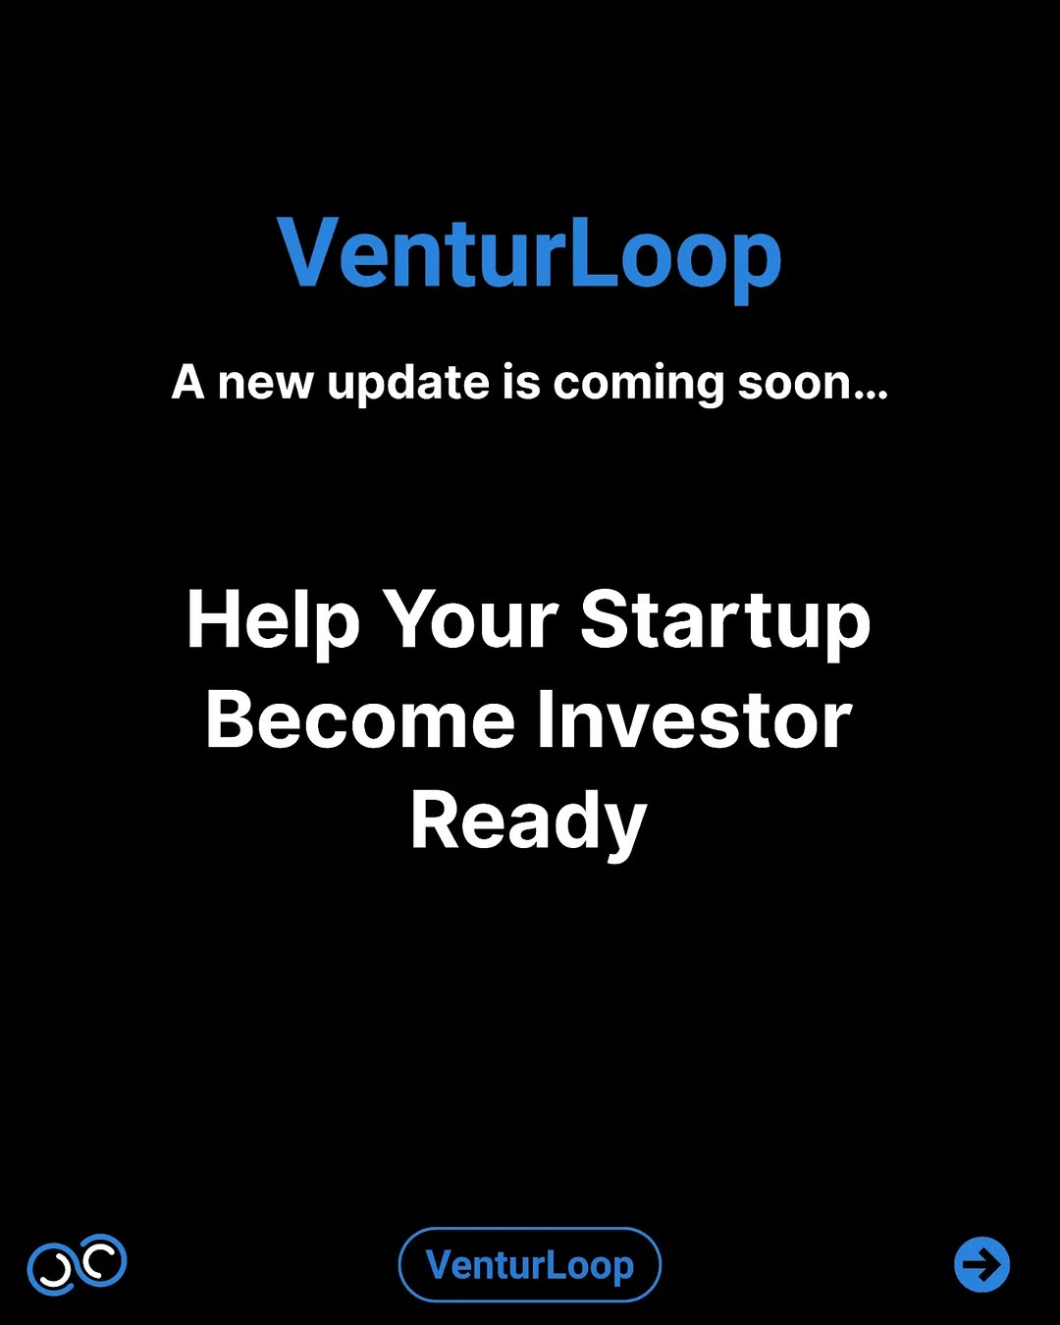
tech-news / DYwzdqSEm4R / slide 06

Slide 7
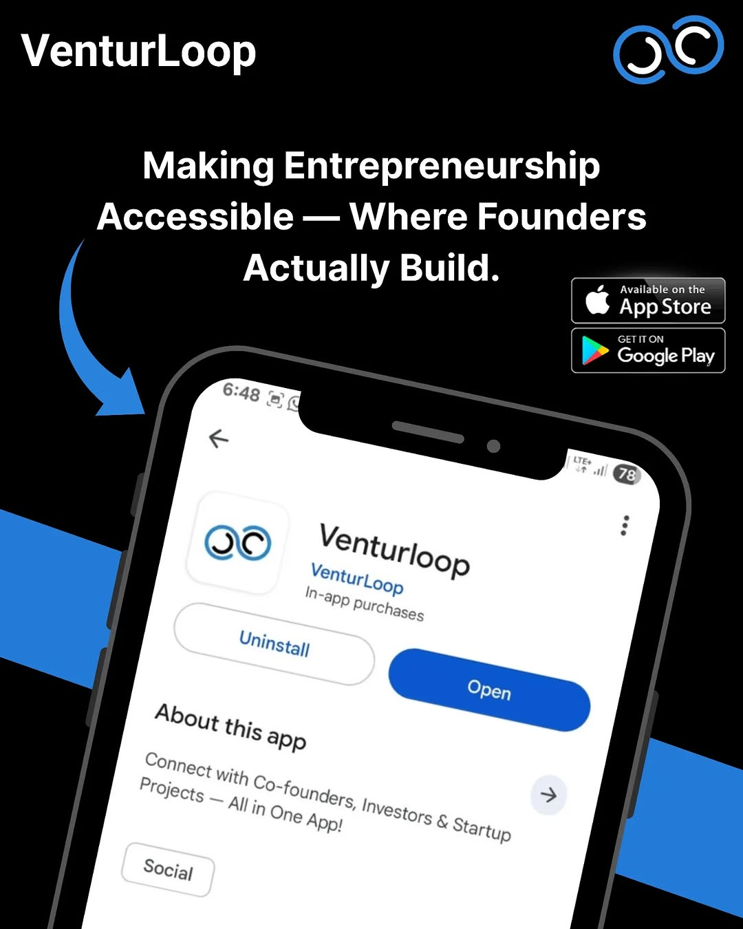
tech-news / DYwzdqSEm4R / slide 07

Slide 8
tech-news / DYwzdqSEm4R
Source URL
https://www.instagram.com/p/DYwzdqSEm4R/
Caption
New update coming soon on VenturLoop. We’re building something to help founders turn their ideas into investor-ready startups. From startup clarity and mentorship to better guidance and real founder connections — this update is focused on helping you build smarter from day one. No complicated jargon. Just practical help for people who actually want to build. VenturLoop — Making entrepreneurship accessible. Platform -@we.venturloop

