Slide 1
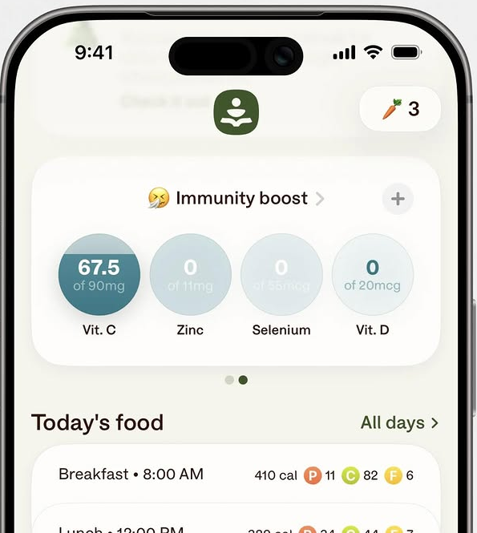
Build This App
in 1-4 Weeks
__________
Beginner to Advanced
Swipe
@rifqieh
->
Build apps

Slide 2
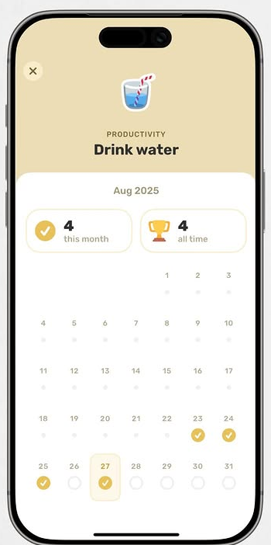
Water Reminder
Track your daily water intake with smart hourly reminders.
Beginner | Health | 3-7 Days
App: Finch
Swipe
@rifqieh
->
Build web and mobile apps

Slide 3
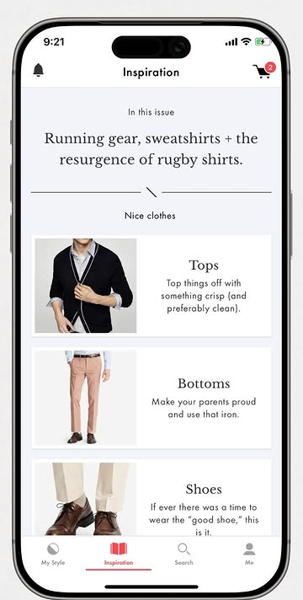
Outfit Planner
Plan your weekly outfits and log what you actually wore.
Beginner-Mid | Lifestyle | 1-2 Weeks
Ref: Spring
Swipe
@rifqieh
->
Build web and mobile apps

Slide 4
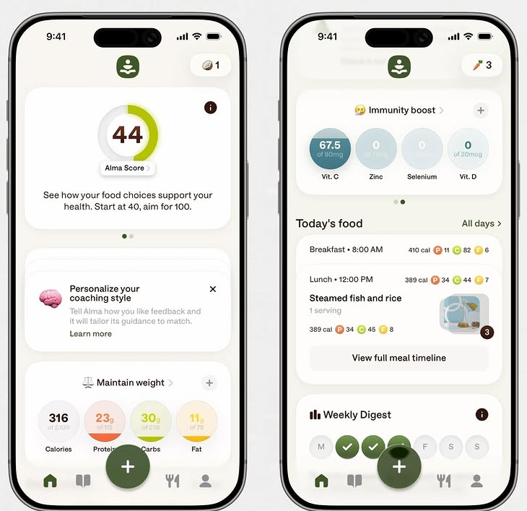
Meal Planner
Paste a code diff and get detailed line-by-line feedback
Intermediate | Health | 3-4 Weeks
Ref: Alma
Swipe
@rifqieh
->
Build web and mobile apps

Slide 5
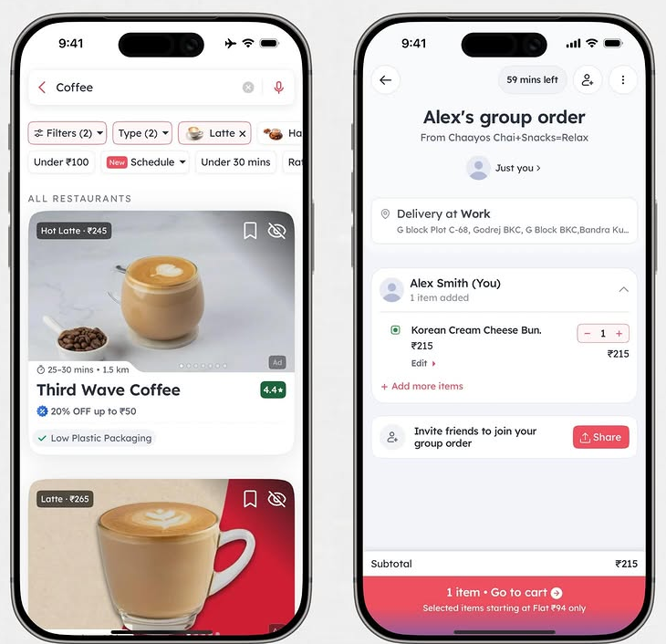
Group Order App
Pool money with friends to purchase something together.
Advanced | E-Commerce | 4+ Weeks
Ref: Zomato
Swipe
@rifqieh
->
Build web and mobile apps

Slide 6

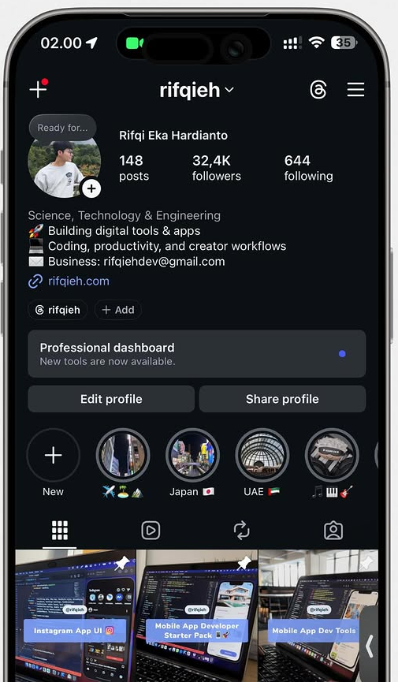
@rifqieh
App ideas, coding tips, productivity, and creator workflows.
Save for later |

Slide 7
Componentized editable trial
app / DYuD-i5E3Pz
Source URL
https://www.instagram.com/p/DYuD-i5E3Pz/
Editable structure
Each page recreates the large title, description, level line, footer, and swipe labels as separate editable text boxes. Phone/app screenshots remain separate image objects so you can replace or move them independently.
Caption
App ideas to build next. Free tools: http://rifqieh.com http://github.com/rifqieh

